Slide 1
Triggering on muon showers
Javier Prado Pico
Notes:
Good morning everyone.
Im Javier Prado from the university of oviedo, currently working in the high energy physics department. And today i want to introduce you to my work “Triggering on shower muons”

Slide 2
Introduction to CMS and the trigger system
Notes:
Although i think we all know, i am going to start with a brief introduction to the CMS experiment and the trigger system.

Slide 3
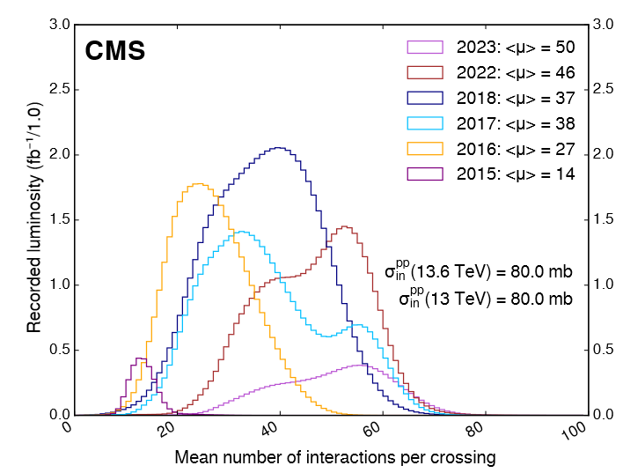
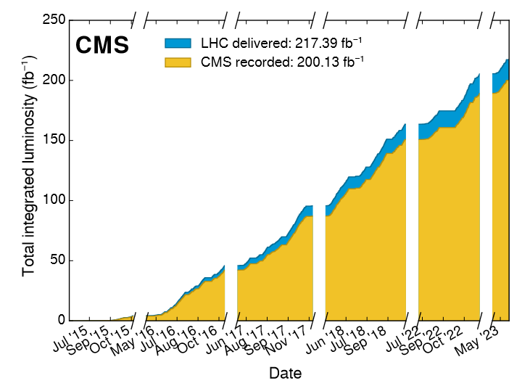
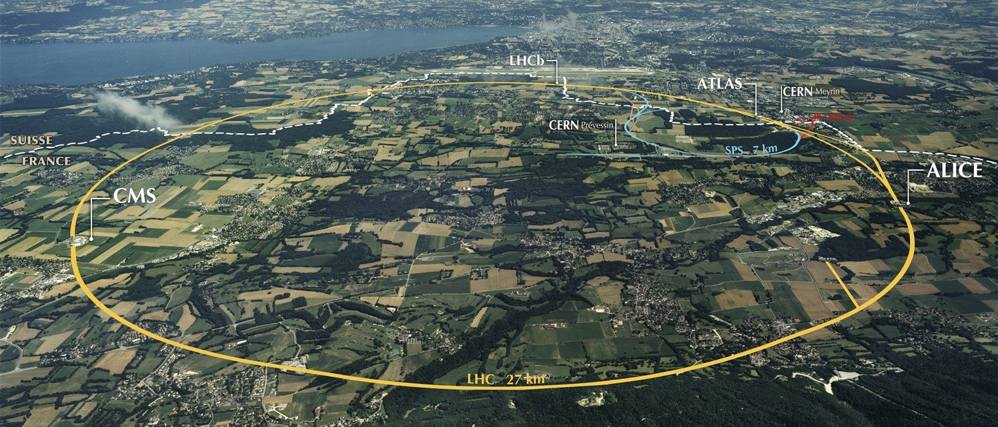
The Large Hadron Collider
Run 2 (2015-2018):
Delivered ~163 fb-1 of pp collisions
s = 13 TeV
17-37 average simulations interactions (PU)
Run 3 (2022-):
pp collisions at s = 13.6 TeV (highest up to date)
46-50 average simulations interactions
CMS
Notes:
The Large Hadron Collider is a particle accelerator, with different detector, as Atlas, CMS and many more.
During run 2 it delivered around 163 inverse fb of proton proton collisions at an energy of 13TeV.
We are currently at Run 3, with an energy of 13.6 TeV and increasing the amount of simulation interactions.

Slide 4
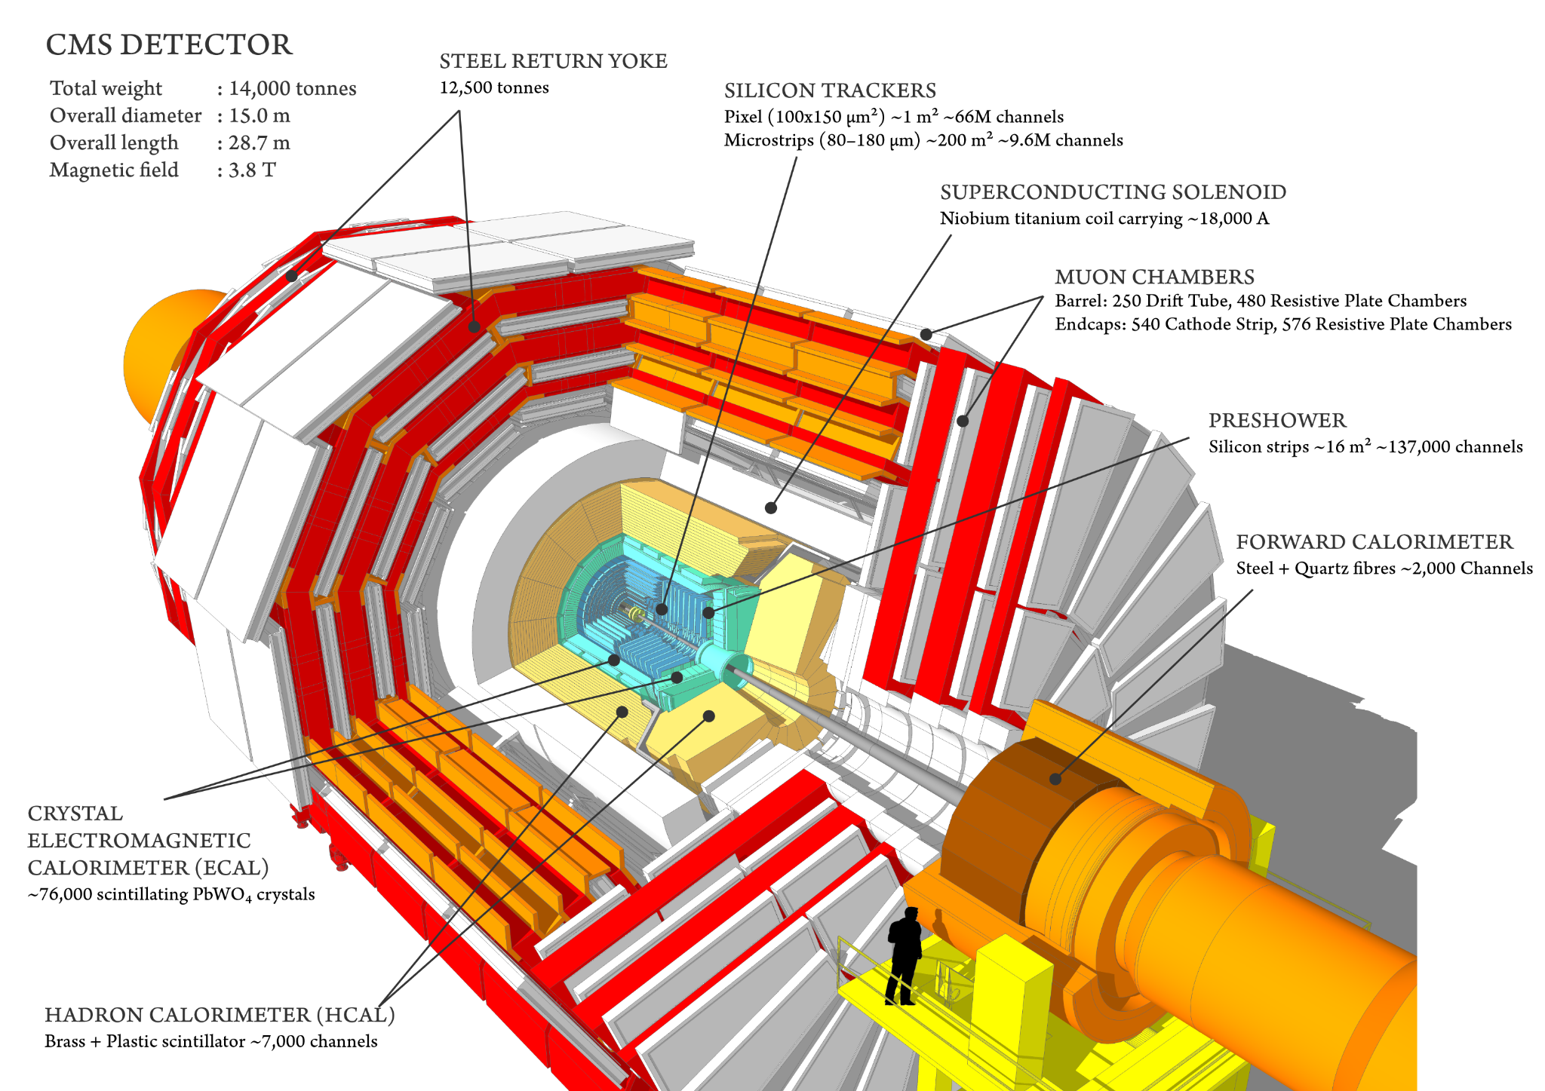
The CMS detector
Efficiency over 90% during the full data-taking period
Multiple layers
Silicon trackers
Electromagnetic calorimeter
Hadron calorimeter
Muon chambers
3.8 T magnetic field generated by the solenoid
Notes:
CMS is one of the detectors at the LHC, comprised of multiple layers, but im going to focus on the outer layer, that is the muon chambers.

Slide 5
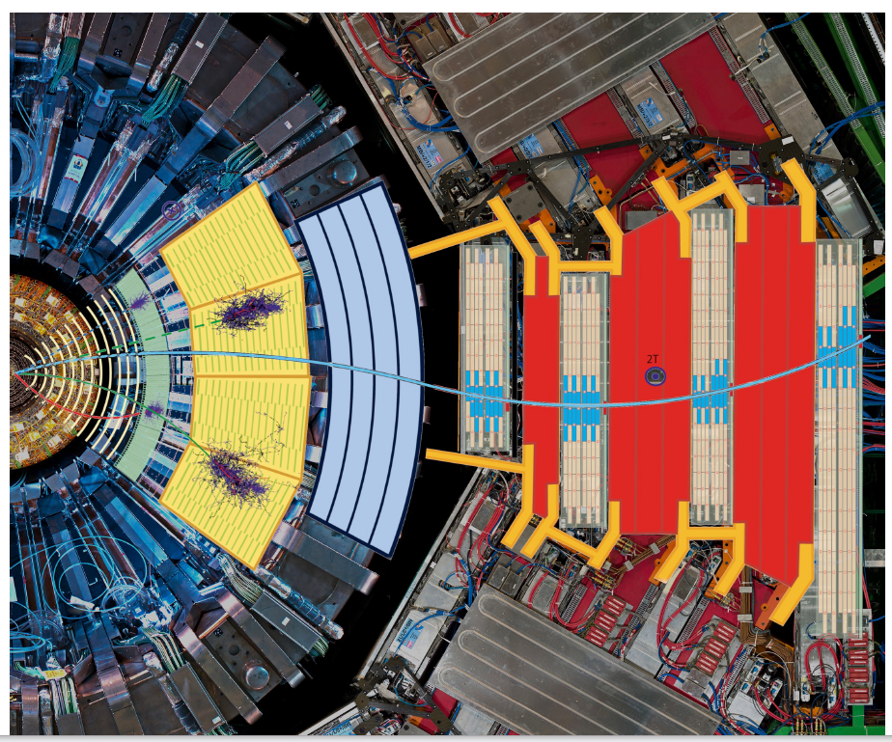
Object reconstruction in CMS
Local reconstruction in each subdetector using dedicated algorithms.
Objects used at analysis level constructed combining information from all sub detectors
Notes:
As I said, the detector has different systems, and each one is running its dedicated reconstruction algorithms, that are then

Slide 6
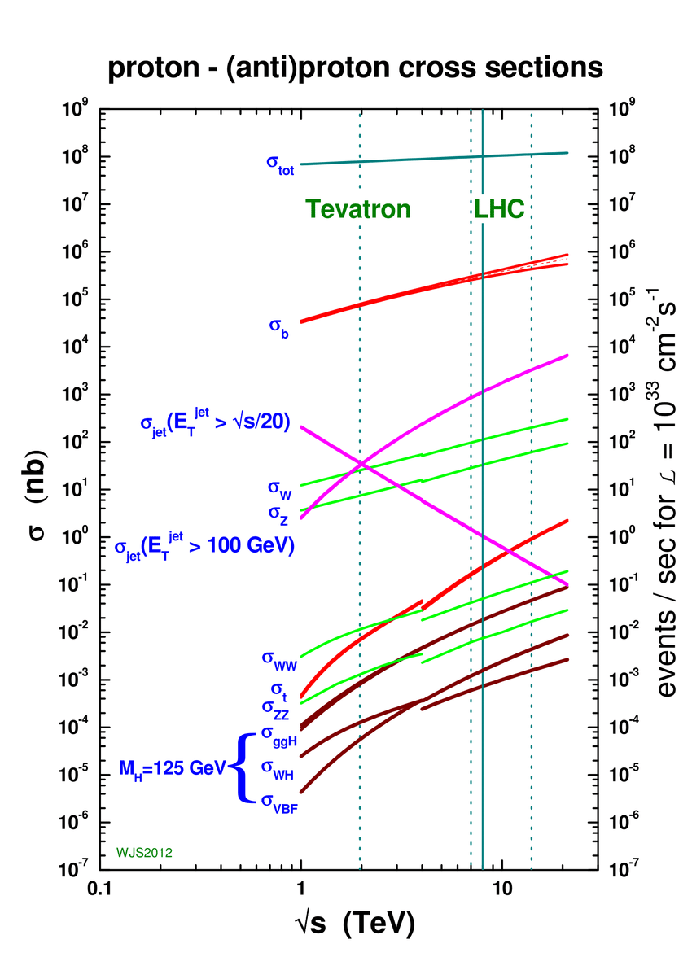
Why do we need a trigger system?
40 million proton-proton collisions per second
50 Terabytes of data per second
Only interested in the rarest ~1000 per second
Must decide if a collision is interesting or not in 25ns
Discarded data is lost forever
Notes:
So, why do we need a trigger system? I think after Zabi presentation we already know that the amount of data generated is enormous, and that we are only interested in the rarest. We have 40 million collisions, generating more than 50TBs per second. However, we are only interested in the rarest, with a desired rate of arround 1000 per second. We must decide if a collision is interesting or not in 25ns, taking into account that the discarded data is lost forever!

Slide 7
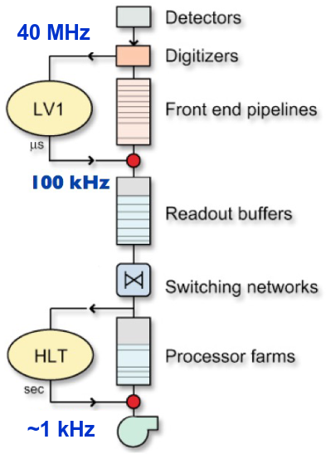
CMS trigger
Level 1 trigger: From 40MHz to 100KHz with the most strict timing latencies 4us. Executed in FPGAs or ASICS
High level trigger: Reduce from 100kHz to 1kHz. Filtering events, executed in CPUs and GPUs, to reduce the rate for storage
It should accept a wide variety of final states, we might not know what we are looking for!
Notes:
So, to do that, the CMS trigger is divided in two levels. The first one, has the most strict timing and reduces the timing from 10MHz to 100KHz, executed in FPGAs or ASICS.
The High level trigger reduces from 100KHz to 1Khz . As the timing requirements are not so demanding, it runs on CPUs and GPUs before storing the data.

Slide 8
Triggering in the drift tubes
Notes:
So, now. How does the triggering in the drift tubes work?
As I said, im going to focus on the drift tubes, but first what are them and how do they work?

Slide 9
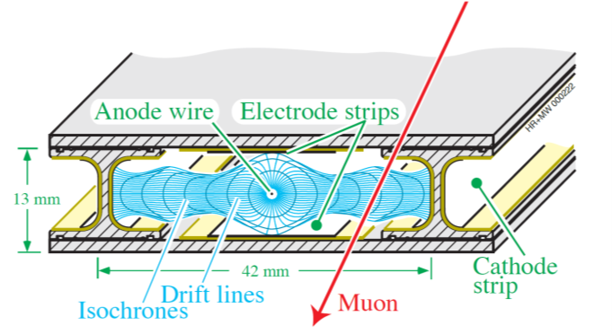
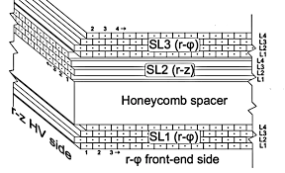
Drift tubes
FPFE-J.Prado
‹#›
Notes:
Here we have a section of CMS, Each of this stations are comprised of multiple SuperLayers like this one, and each of these are made of layers of drift tubes..
Lets focus on a single drift tube.

Slide 10
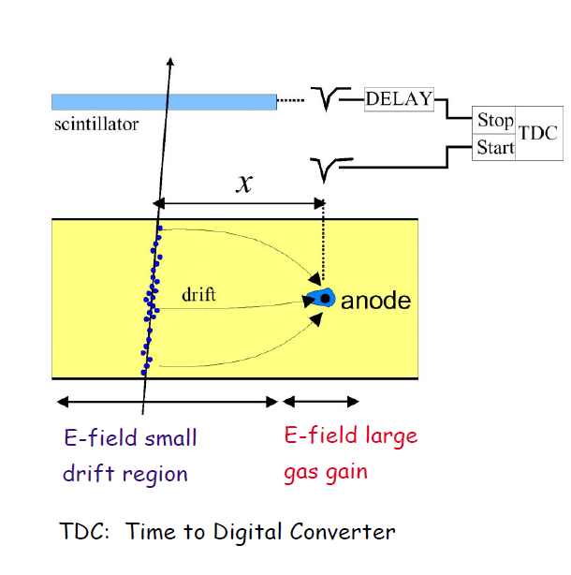
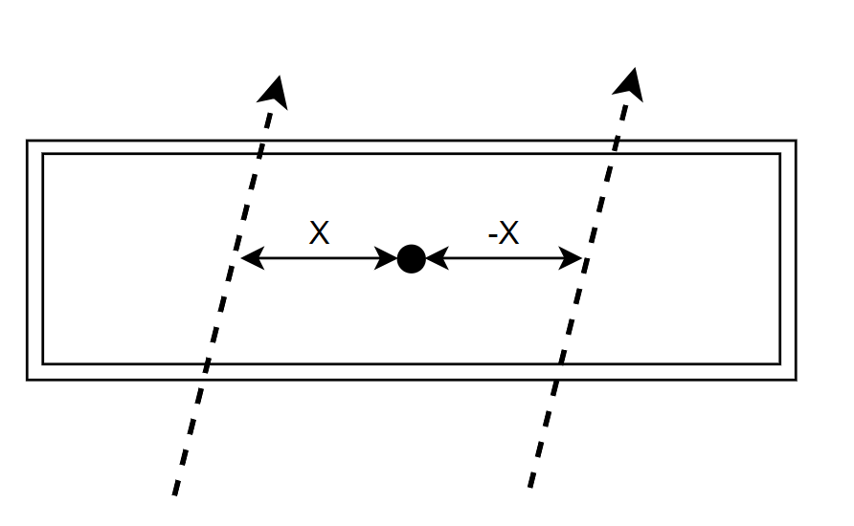
Drift tubes
Notes:
Drift tube applying an electric field in a known gaseous medium. When a muon crosses the gas it will ionize it and the electrons will drift towards the anode. Knowing the drift time, we can get the distance to the anode. But here we have a problem. We dont know from which side of the anode it crossed. We could have the distance X or the distance -X.

Slide 11
Local DT reconstruction
Using the Analytical Method (AM) we can accurately reconstruct tracks
3 or 4 active cells give an unequivocal track of the particle.
Notes:
To solve that, the current algorithm used is the Analythical method. It takes groups of 3 or 4 active cells solving the the laterality problem and reconstructing the tracks with higher resolution than just using the active cells.

Slide 12
Local DT reconstruction
What happens if a muon radiates?
Waste of time and spurious data
Many possible tracks to calculate!
Many active cells
Notes:
But what happens if a muon radiates and activates a bunch of cells in an small space?
In that case we have many groups of 3 or 4 cells that are compatible with a straight line, so the algorithm tries to calculate all the posible tracks.
(tik tik tik)
This is a waste of time and produces spurious data.

Slide 13
How can we solve it?
Notes:
So, how can we solve it?

Slide 14
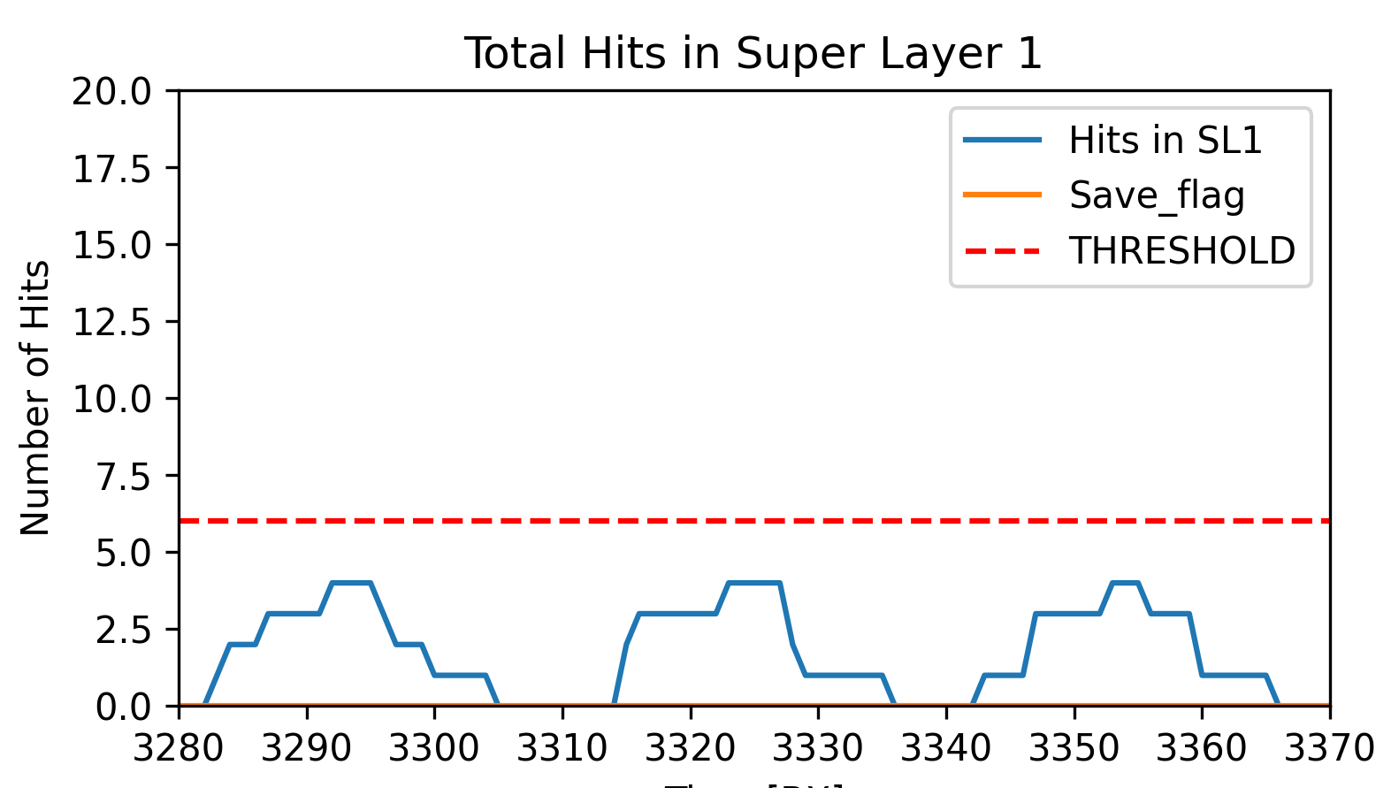
Shower identification algorithm
Each hit is stored for 16BXs (400ns) to account for their drift times
We can represent the total amount of hits in a given superlayer over time
Time (BXs)
Notes:
We know that the problem comes if we have a lot of hits in a single super layer.
In this case we have 3 events that did not radiate. When they cross through the super layer they activated 4 cells.
Each hit is stored during 16BXs, 400ns to account for the maximum drift time, so some time after the activation, they are deleted.

Slide 15
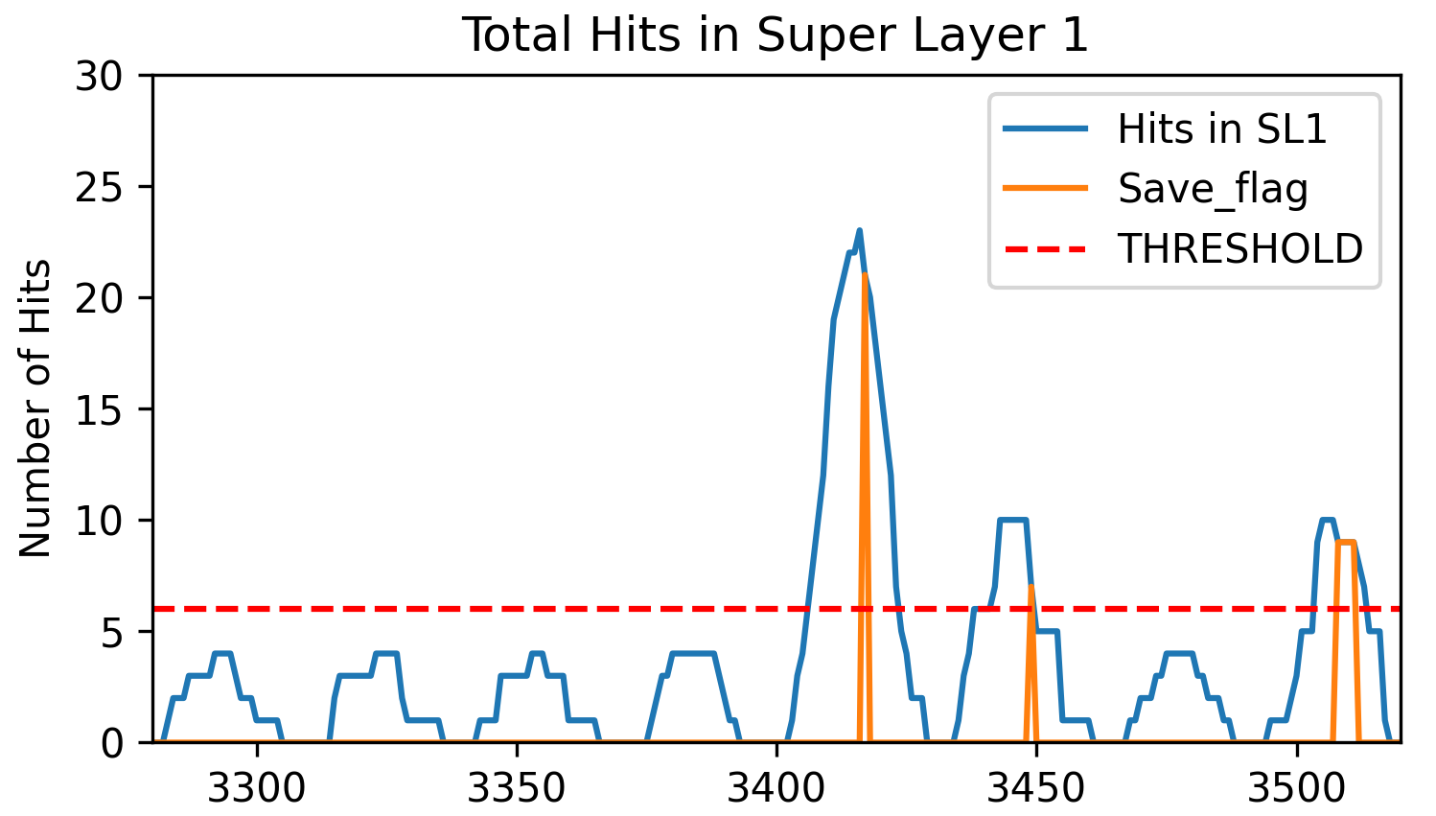
Shower identification algorithm
Above a threshold we mark the event as a shower.
With a peak detector, we wait until we receive all the data from the event.
Time (BXs)
Notes:
But showers are characterized by a large amount of hits in a short amount of time, as in this case. So what we do is define a threshold.
If the total amount of hits in a SL is above the threshold, the first thing that we do is flagging that the AM operations might not be correct.
After that, we use a peak detector so we can recover the maximum amount of hits before performing the calculations.

Slide 16
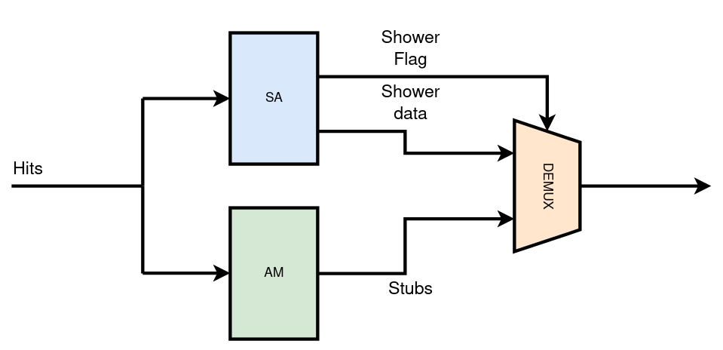
Shower detection algorithm
Notes:
At the end the Shower algorithm will work in parallel with the current algorithm and will have the veto power

Slide 17
How well does it work?

Slide 18
Results
 | SL1 |  | SL2 |  | SL3
True positives | 602 |  | 609 |  | 620
False positives | 0 |  | 0 |  | 0
True negatives | 390 |  | 383 |  | 376
False negatives | 8 |  | 8 |  | 4
Accuracy(%) | 99,2 |  | 99,2 |  | 99,6
Precision(%) | 100 |  | 100 |  | 100
Recall(%) | 98,7 |  | 98,7 |  | 99,3
F1(%) | 99,3 |  | 99,3 |  | 99,6
Notes:
And how well does it work? So for now we have tested it with 1000 events with good results, the accuracy is above 99%, and the precision is 100% meaning that we should not interfere with the analytical method, while still being able to detect most of the showers.

Slide 19
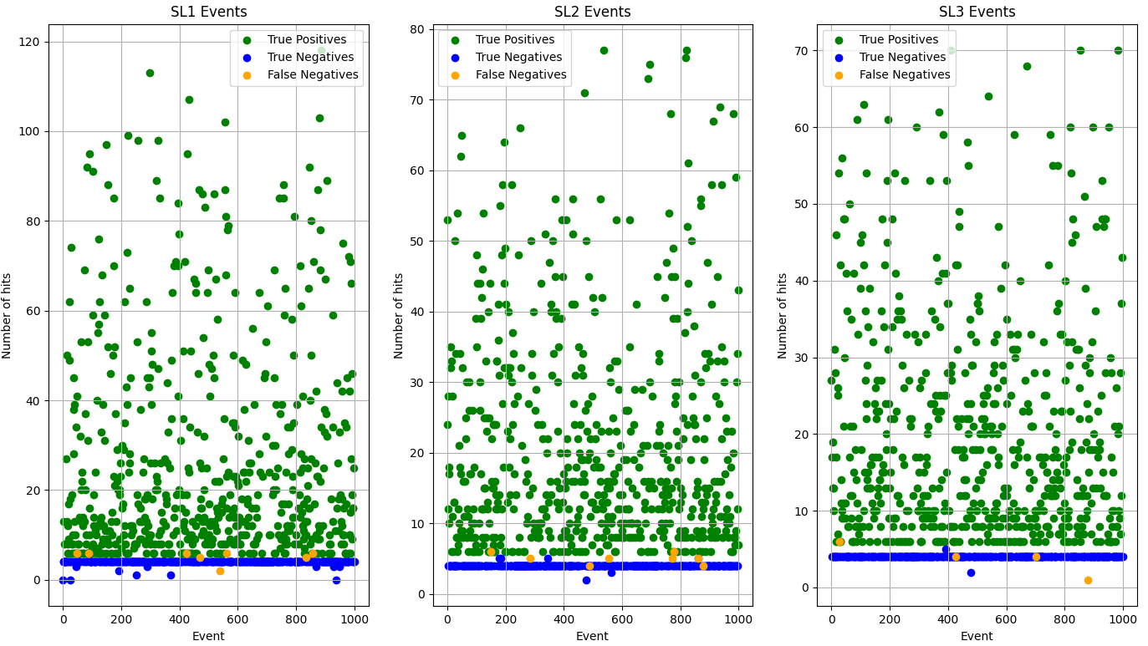
Shower detection algorithm
Notes:
And in the case of the false negatives, the amount of hits is really low, meaning that the AM will not lose a lot of time trying to reconstruct the tracks, and this tracks will be rejected in the high level trigger

Slide 20
Conclusions and future works
The shower algorithm works well for the identification of showers
Improved AM robustness against this events.
More studies should be done in different conditions to test for different thresholds
Converting the algorithm to VHDL for FPGA implementation
Notes:
So to summarize, we have presented a shower identification algorithm that works correctly to identify showers, and could be used not only for identification, but also for reconstruction.
It will also help the AM to be more robust against this events, improving its efficiency.
Future work goes along the lines of studying different conditions, in the different stations of the barrel to test different thresholds.
And porting the algorithm fo FPGA implementation.

Slide 21
Triggering on muon showers
Javier Prado Pico
Notes:
Good morning everyone. Im Javier Prado from the high energy physics department. And today i want to introduce you to my work “Triggering on shower muons”

