Slide 1
One-dimensional Convolutional Neural Networks (1D-CNN) for characterizing transiting exoplanets
Santiago Iglesias Álvarez

Slide 2
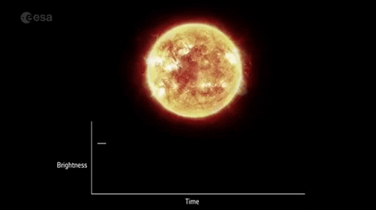
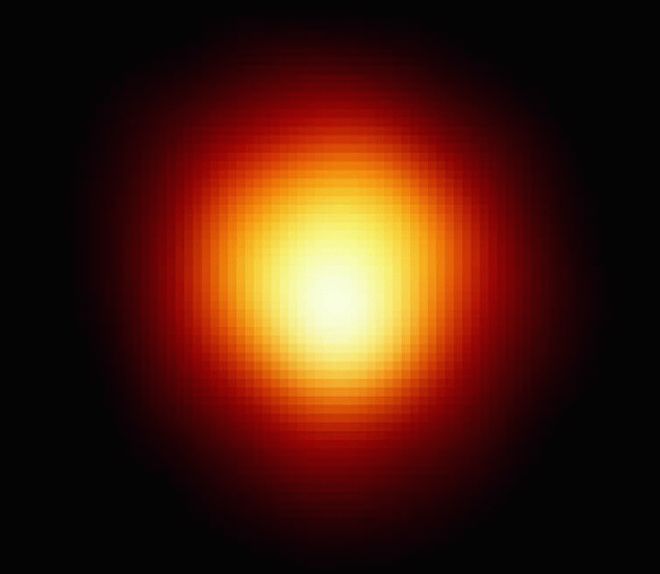
Exoplanet detection: the transit method
Consists of detecting periodic dimmings in light curves (lc).
The signals are separated by the value of the orbital period.
r
Observer
Exoplanet movement
ESA: detecting exoplanets with the transits method.

Slide 3
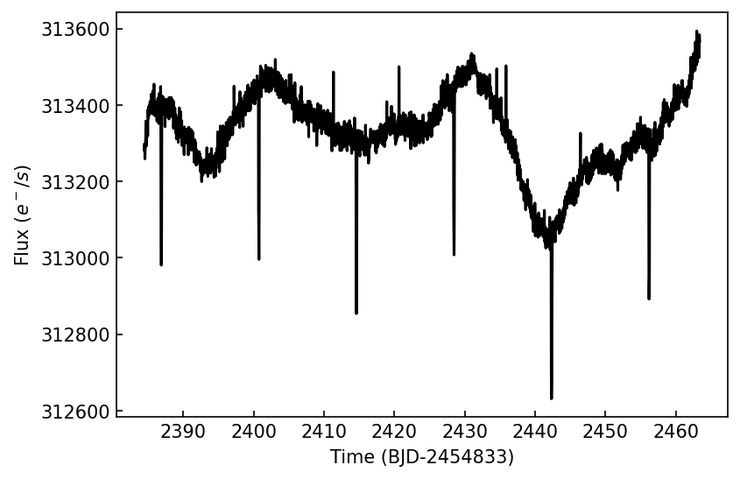
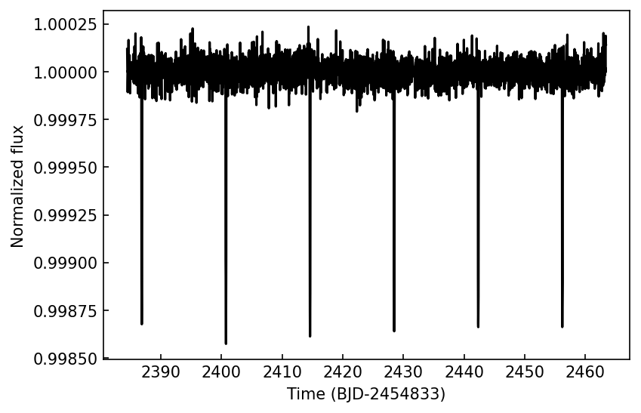
Exoplanet detection: detrended light curves
Long-term trends are induced by stellar variability phenomena.
This trends have to be removed before analyzing light curves.

Slide 4
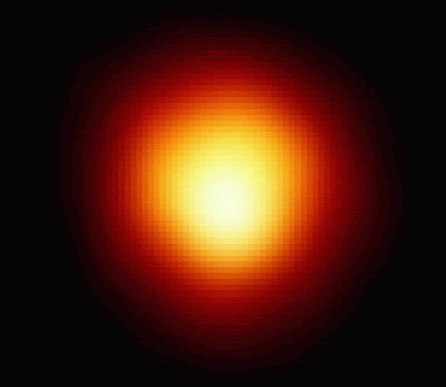
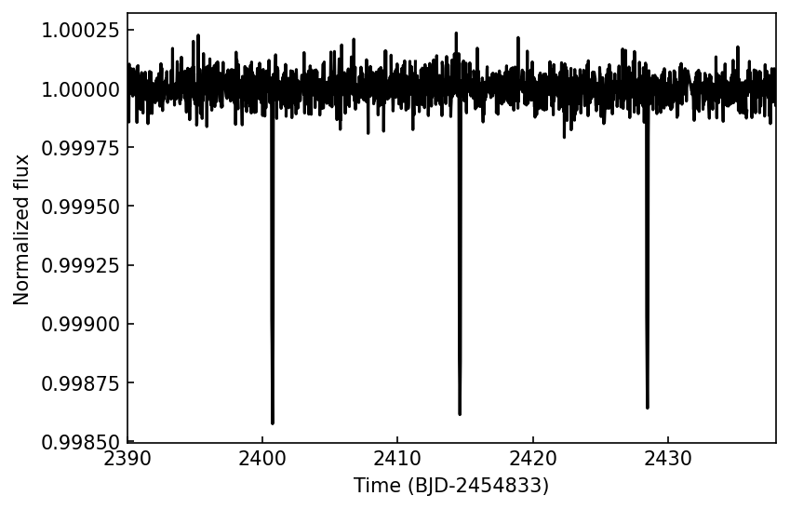
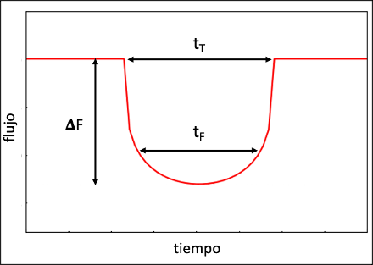
Shape dependency of transit-like signals
Limb darkening effect makes the transits getting rounded.
From a transit, different parameters can be inferred.
P(d)
P(d)
Flux
Time

Slide 5
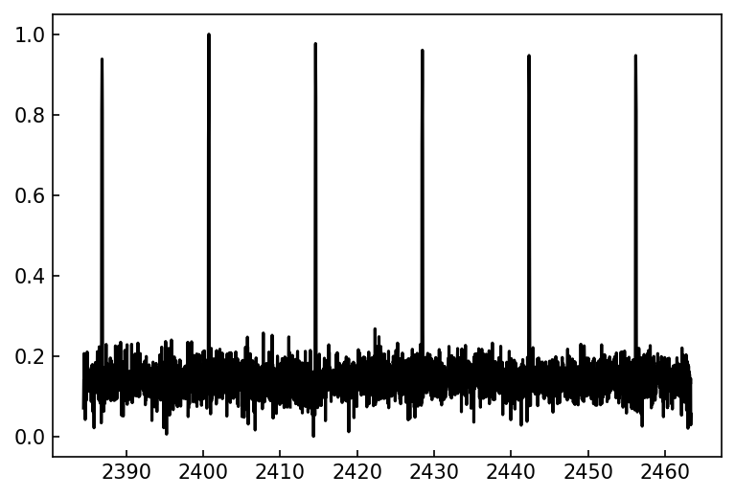
Convolutional Neural Networks (CNN)
CNN are a type of Artificial Intelligence (AI) ideal for detecting shape-dependency features.
CNN filters extract the main characteristics.
Output

Slide 6
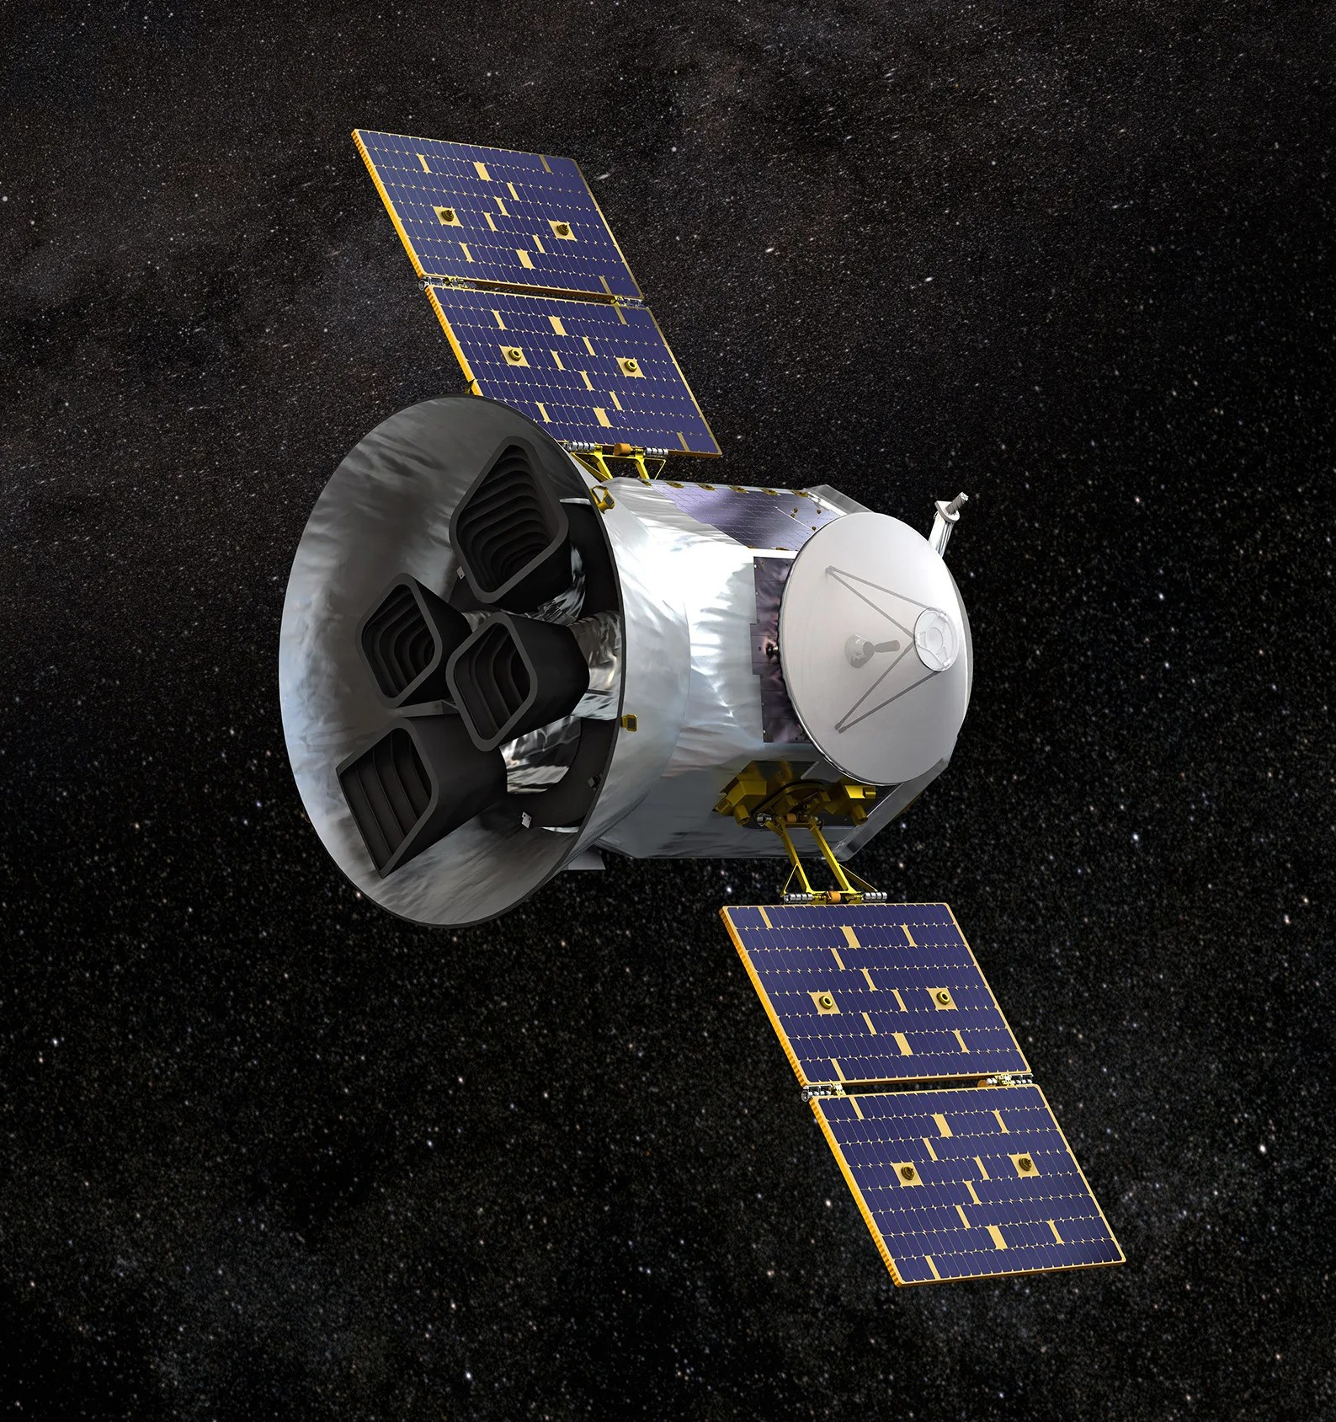
The Transiting Exoplanet Survey Satellite (TESS)
Space telescope launched on April 2018.
Observing field: ${24}^{o} x {96}^{o}$.
Sector mean duration. 27 days.
Observing cadence: 2 min (short) and 30 min (long).
Composed of 4 cameras with 7 lenses/camera.
Prime misión: 07/25/2018 to 07/04/2020.
Confirmed planets: 440 (until 06/05/2024;
Exoplanet Archive)

Slide 7
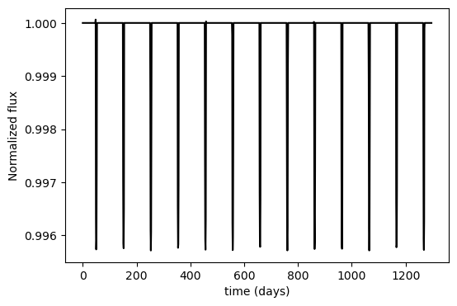
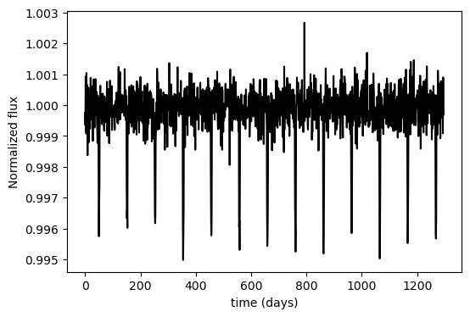
Dataset simulation
There are not enough real light curves with transits.
Batman package: simulates light curves with transits but without noise.
Noise: Gaussian considering the SNR expected for TESS light curves..
Stellar and planetary parameters: simulated considering physical limits.
$$SNR=\log_{10}\left(\frac{μ}{σ}\right)$$
Stellar Magnitude | SNR
8 | 40.84
10 | 36.20
12 | 31.56
14 | 26.92
16 | 22.28
Gaussian noise

Slide 8
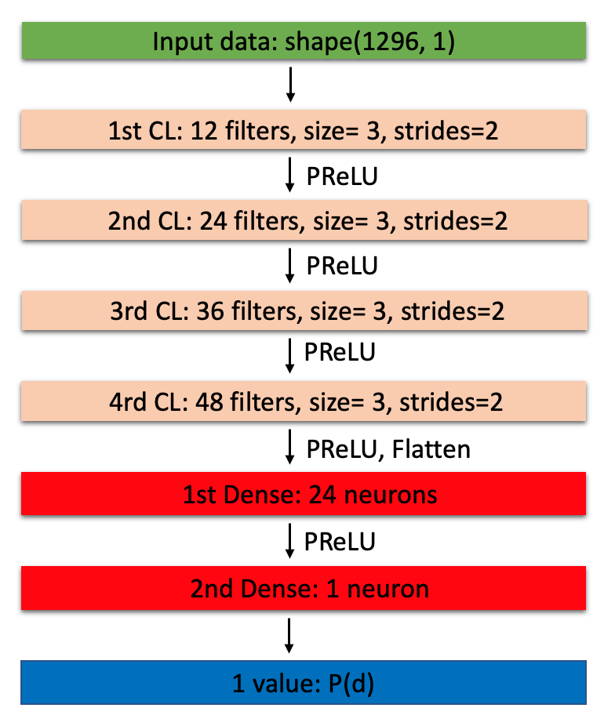
Two 1D CNN models: train a test
Models: 4-layers Convolutional part and 2-layers MLP part.
2 datasets for training and testing the model ($6.5∗{10}^{5}$ and $1.5∗{10}^{5}$)
Model 1:
Input: complete light curves.
Output: orbital period.
Model 2:
Input: pase-folded light curves.
Ourput: planet radius and semimajor axis of the orbit.
Parameter | MAE | MAPE(%)
P(d) | 0.015 | 4.19
$$R_{P}[R_{⋆}]$$ | 0.0003 | 5.70
a$[R_{⋆}]$ | 0.91 | 5.15

Slide 9
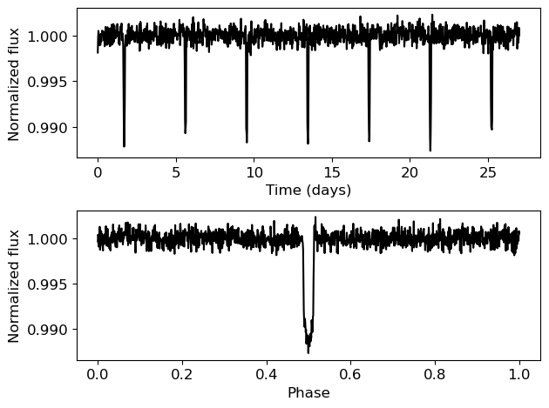
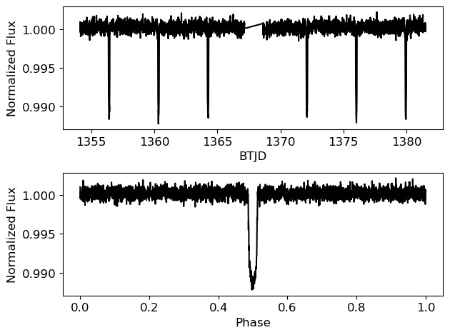
Comparison: Real vs simulated data
We tested our models on real TESS.
The results were similar.
The CNN results were compared with the ones from Transit Least Squares.
Simulated light curve
Real light curve: TIC 183537452

Slide 10
Summary and conclusions
1D-CNN models automatize the transits search.
1D-CNN are able to extract the main planetary parameters.
The timeframe needed is much lower ((2-10)s/lc with current algorithms vs 74s for $3∙{10}^{5}$ lc.)
Avoids human judge when classifying lc.
Can be generalized to different surveys and telescopes.

Slide 11
Thanks for your attention

