Slide 1
Asteroid morphological modelling and YORP detection by light curve inversion method
Javier Rodríguez Rodríguez

Slide 2
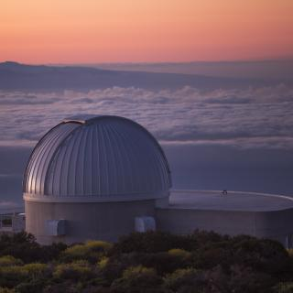
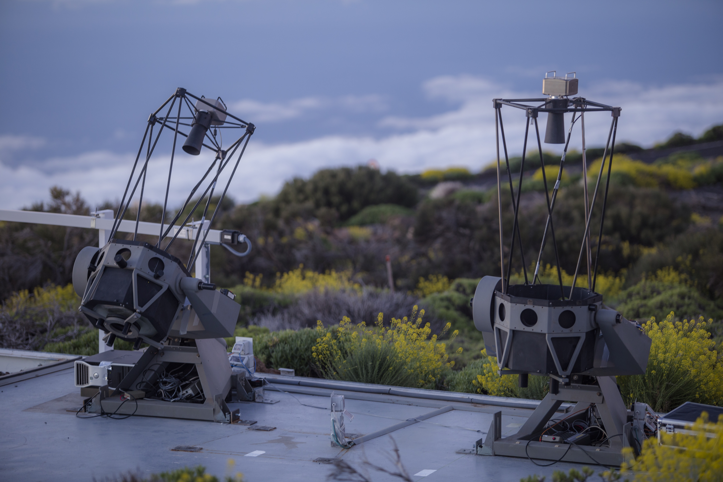
Light Curve Inversion Method
From dense light curves a shape model and the rotational properties (P_{rot}, λ, β, ν) of the asteroid are obtained.
Archival data obtained from the DAMIT (Ďurech et al. 2010) (Ra-Shalom, Eger and Cacus) and ALCDEF (Stephens et al. 2018) (Tukmit, 7335, 7822, 154244 and 159402) databases.
New photometric data obtained from 2021, 2022 and 2023 by Instituto de Astrofísica de Canarias (IAC) in the framework of the ViNOS (Licandro et al. 2023) and NEOROCKS* programs.
Lightcurve inversion performed with the DAMIT code (Ďurech et al. 2010) with constant period. Also, with the code allowing linear evolution of the rotation period (Josef Ďurech in personal communication).
^{*https://www.neorocks.eu/}
ViNOS instruments. Top: IAC80 telescope. Bottom: TAR and TAR2 telescopes.

Slide 3
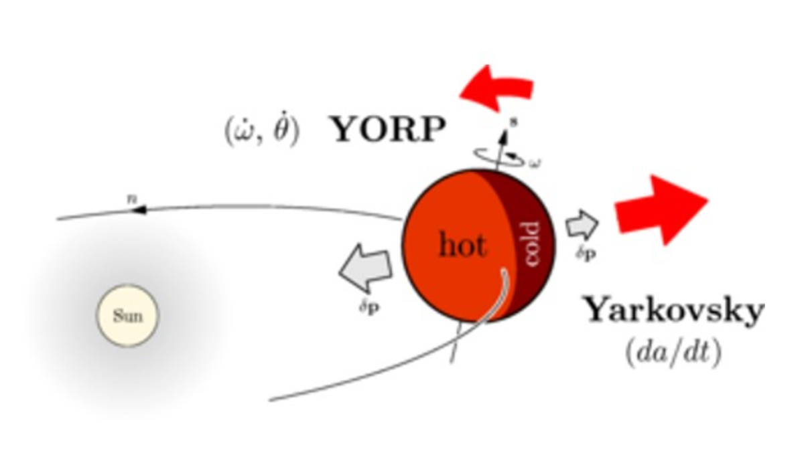
YORP effect
Detectable in asteroids smaller than ~ 40 km and typically in large time span datasets, of the order of 35-40 years.
Anisotropic thermal re-emission of absorbed solar radiation generates a small thrust that can modify the asteroid’s rotation rate and obliquity.
If the asteroid is affected by this effect, the model obtained with the constant period code will have a poor adjust.
YORP effect representation.

Slide 4
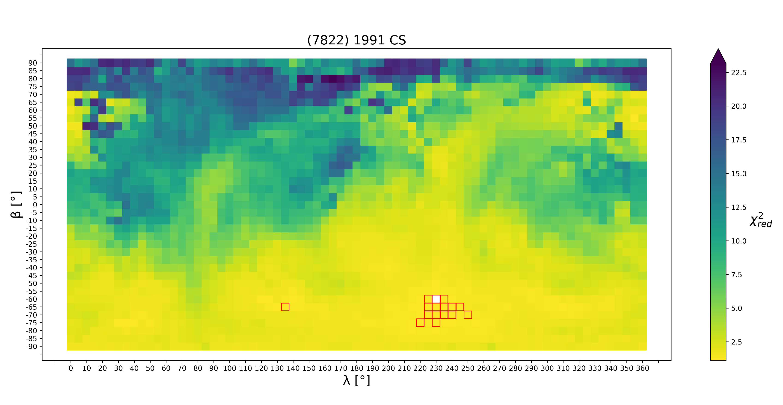
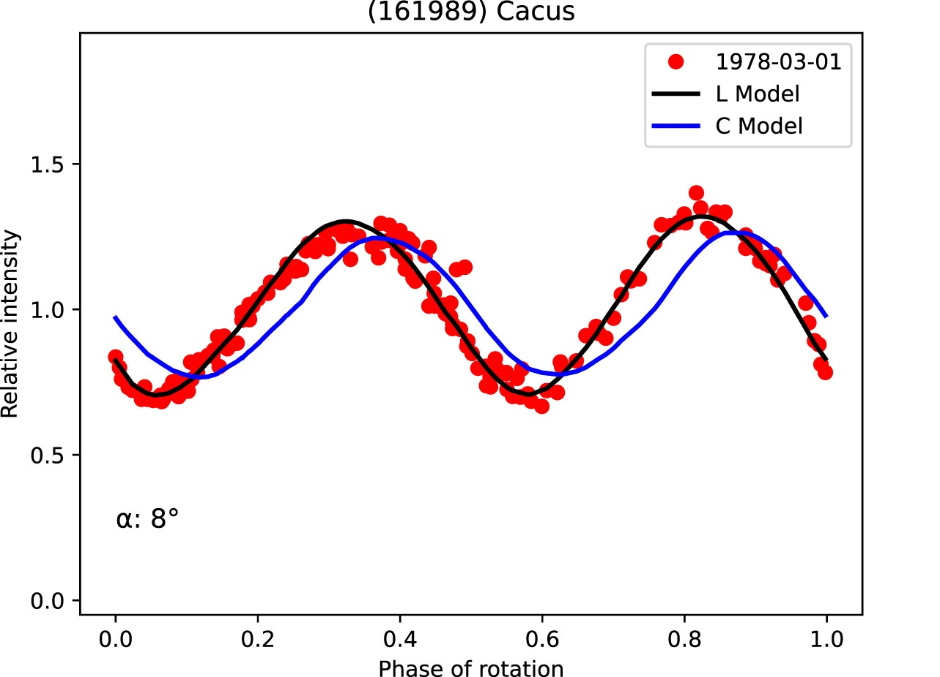
Methodology
Period Search Tool.
Medium Search in all the sphere.
Fine Search around best χ²_{red}.
Uncertainty estimation.

Slide 5
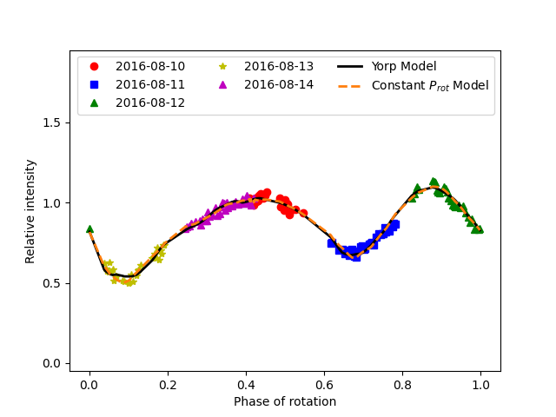
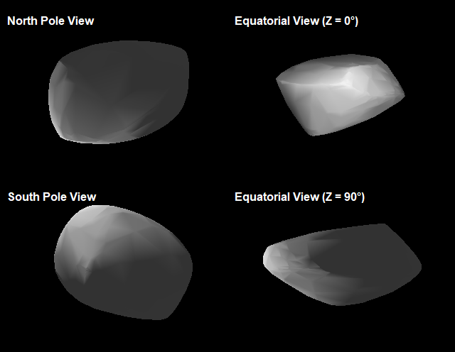
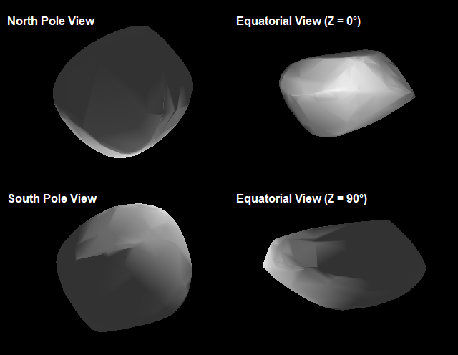
(2100) Ra-Shalom
This object has a previously published (Kaasalainen et al. 2004, Ďurech et al. 2012, Ďurech et al. 2018) model with no YORP effect detected:
P_{rot} = 19.8200±0.0003 h
λ = 292°±15°
β = -65°±10°
We computed a continuous period model (no YORP effect):
P_{rot} = 19.820056±0.000012 h
λ = 278°±18°
β = -60°±8°
And another model with YORP effect enabled:
P_{rot} = 19.820107±0.000040 h
λ = 278°±8°
β = -60°±5°
ν = 0.22·10⁻⁸±0.16·10⁻⁸ rad/d²
Both models show similar fit to the data, but the YORP model has lower uncertainties.
After this manuscript was published (Rodríguez et al. 2024), another manuscript (Ďurech et al. 2024), detected YORP effect ν = 0.29·10⁻⁸±0.20·10⁻⁸ rad/d² which agrees with our result.
Top: fit between several sets of data and both no YORP and YORP models. Bottom left: no YORP shape model. Bottom right: YORP shape model.

Slide 6
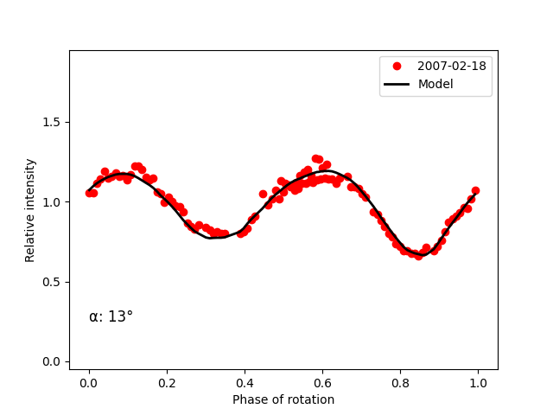
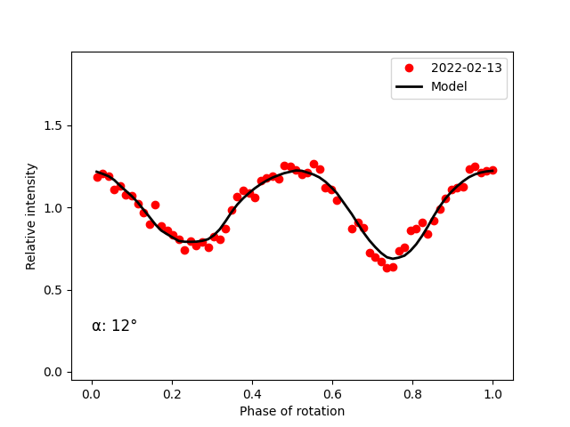
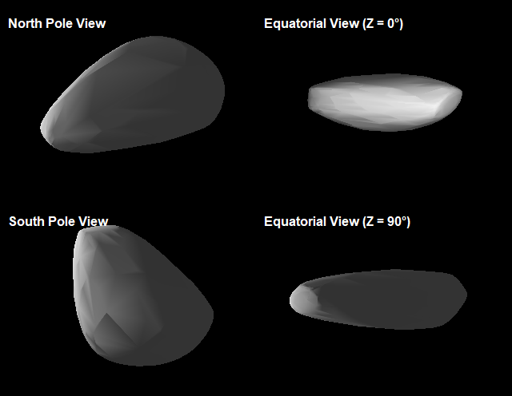
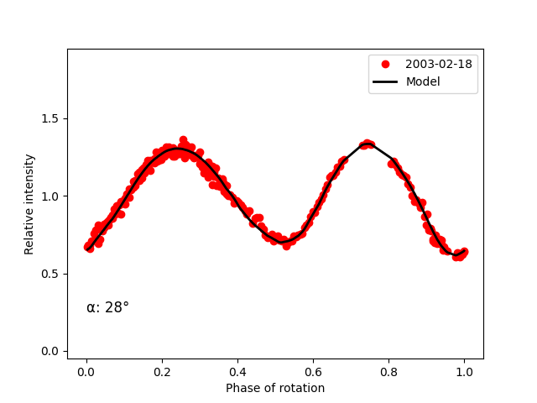
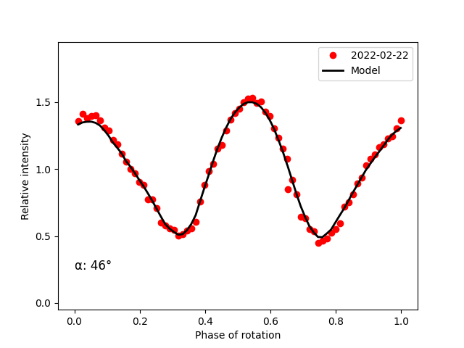
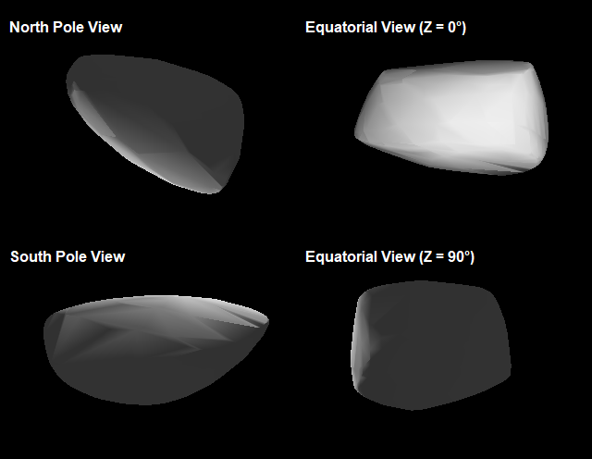
(3103) Eger & (161989) Cacus
(3101) Eger has a previously published (Ďurech et al. 2012, Ďurech et al. 2018) model with YORP effect detected:
P_{rot} = 5.710156±0.000007 h
λ = 226°±15°
β = -70°±4°
ν = 1.4·10⁻⁸±0.6·10⁻⁸ rad/d²
We computed a model with YORP effect enabled:
P_{rot} = 5.710148±0.000001 h
λ = 214°±3°
β = -71°±1°
ν = 0.85·10⁻⁸±0.05·10⁻⁸ rad/d²
(161989) Cacus has a previously published (Ďurech et al. 2012, Ďurech et al. 2018) model with YORP effect detected:
P_{rot} = 3.755067±0.000002 h
λ = 254°±5°
β = -62°±2°
ν = 1.9·10⁻⁸±0.3·10⁻⁸ rad/d²
We computed a model with YORP effect enabled:
P_{rot} = 3.755067±0.000001 h
λ = 251°±6°
β = -62°±2°
ν = 1.91·10⁻⁸±0.05·10⁻⁸ rad/d²
We computed also a model without YORP effect for both asteroids, but the fit between model and data were much better with YORP.
(3103) Eger. Top left and right: fit of the data to the model in two different epochs. Bottom: shape model of the asteroid.
(161989) Cacus. Top left and right: fit of the data to the model in two different epochs. Bottom: shape model of the asteroid.

Slide 7
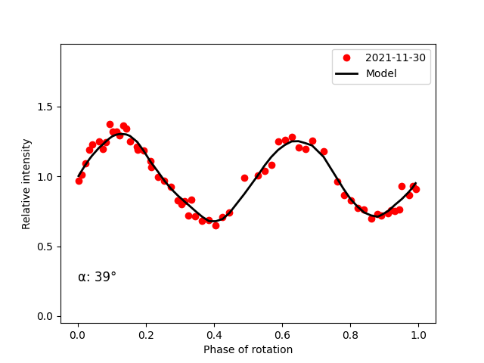
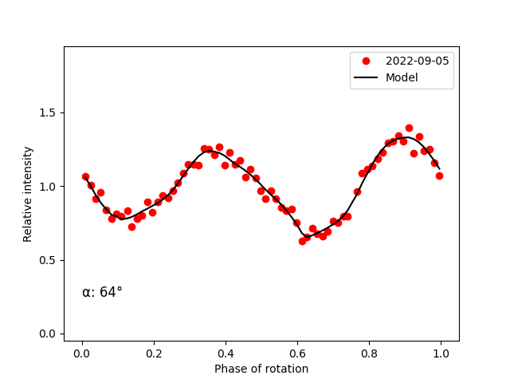
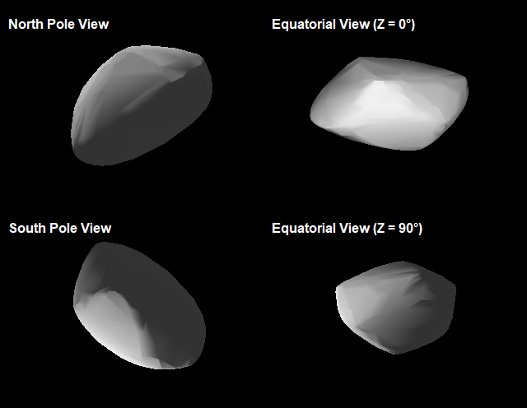
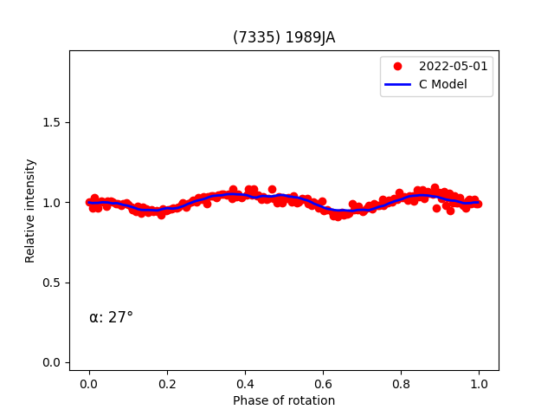
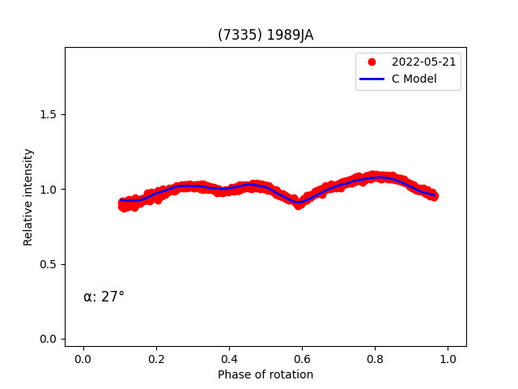
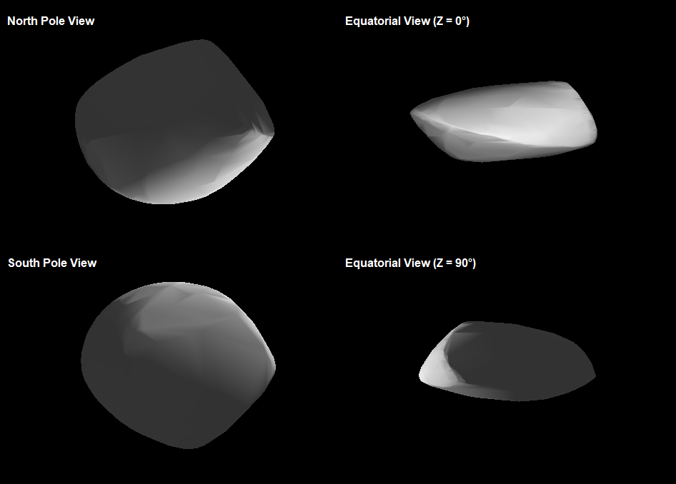
(12711) Tukmit & (7335) 1989 JA
Both asteroids have only previously periods published; hence these are first models.
For (12711) Tukmit the obtained spin parameters were:
P_{rot} = 3.484900±0.000031 h
λ = 27°±8°
β = 9°±15°
For (7335) 1989 JA the spin parameters obtained were:
P_{rot} = 2.590432±0.000391 h
λ = 243°±17°
β = -61°±6°
Since the temporal span for both were short no YORP effect could be detected.
More observations are needed to improve both models.
(12711) Tukmit. Top left and right: fit of the data to the model in two epochs. Bottom: shape model of the asteroid.
(7335) 1989 JA. Top left and right: fit of the data to the model in two different epochs. Bottom: shape model of the asteroid.

Slide 8
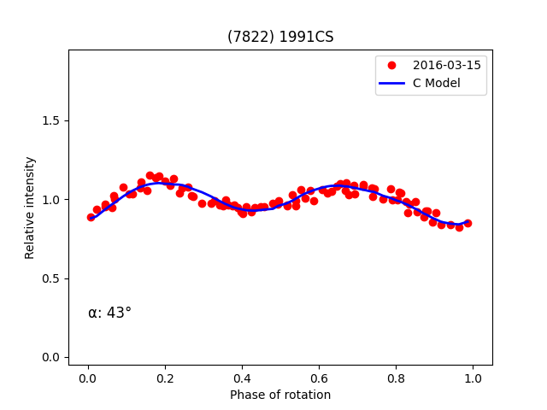
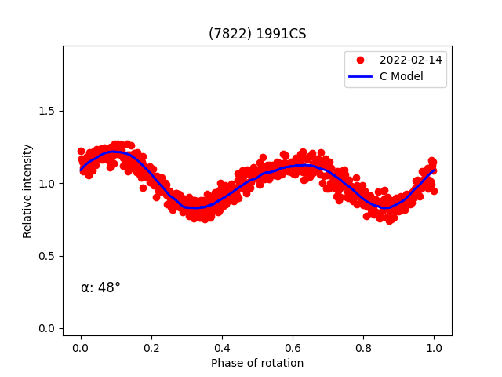
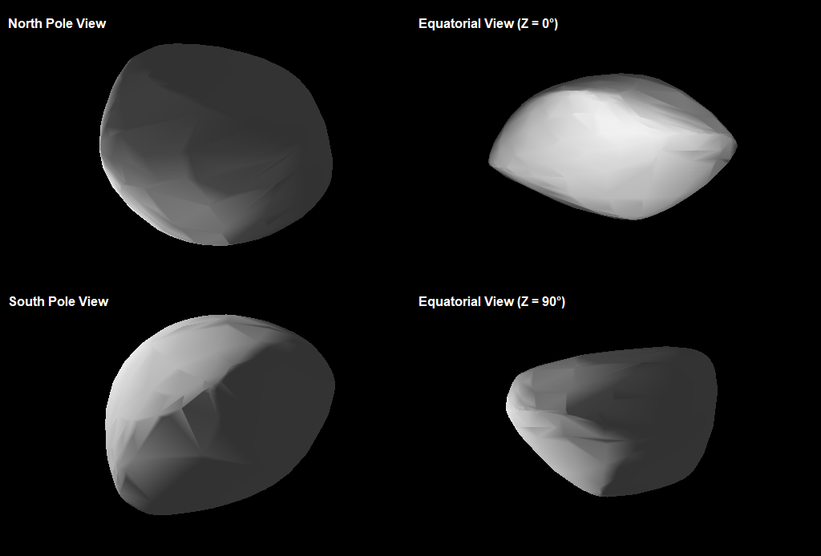
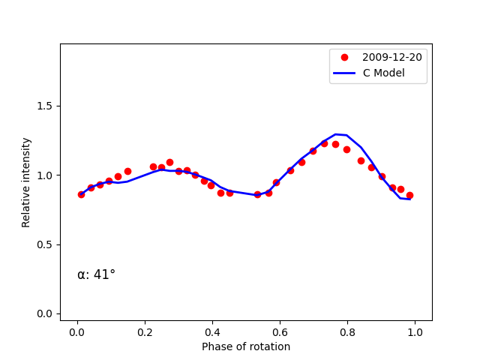
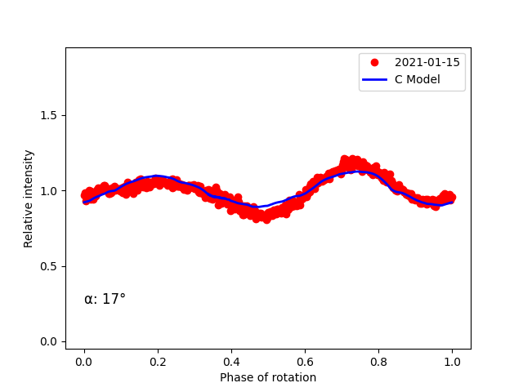
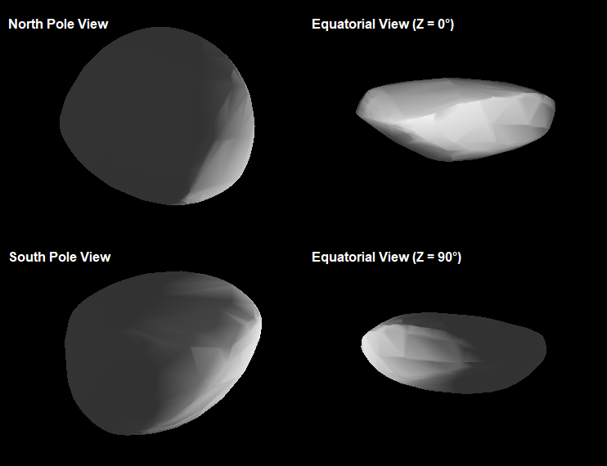
(7822) 1991 CS & (159402) 1999 AP10
Again, both asteroids have only previously periods published; hence these are first models.
For (7822) 1991 CS the obtained spin parameters were:
P_{rot} = 2.390157±0.000002 h
λ = 242°±9°
β = -57°±7°
For (159402) 1999 AP10 the spin parameters obtained were:
P_{rot} = 7.921917±0.000005 h
λ = 49°±2°
β = -60°±3°
No YORP effect could be detected with the data in this work.
(7822) 1991 CS. Top left and right: fit of the data to the model in two different epochs. Bottom: shape model of the asteroid.
(159402) 1999 AP10. Top left and right: fit of the data to the model in two different epochs. Bottom: shape model of the asteroid.

Slide 9
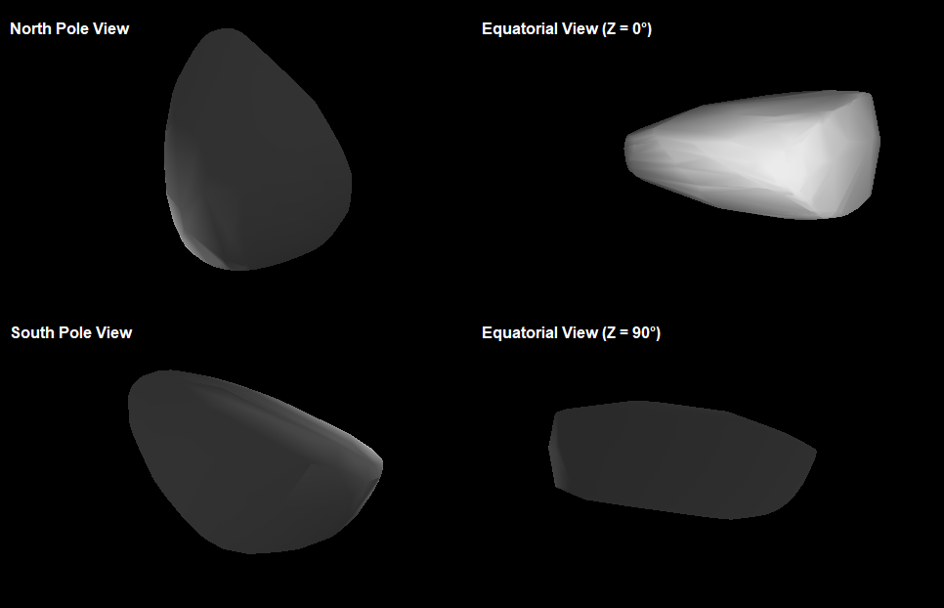
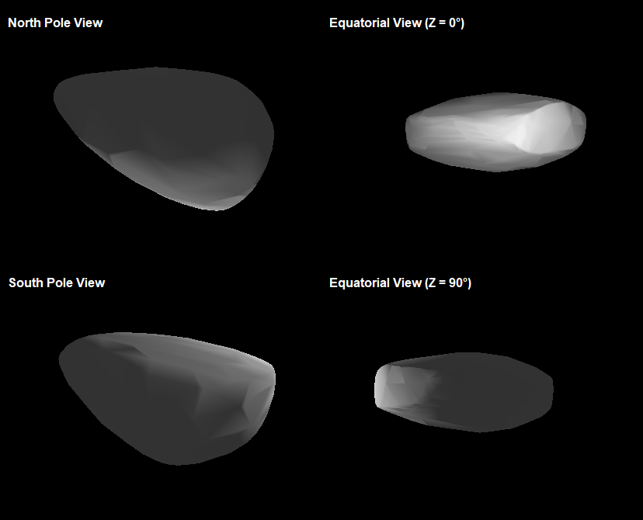
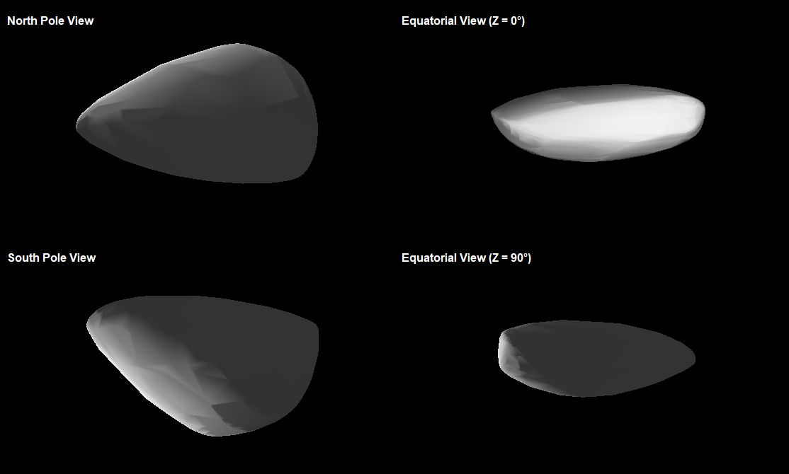
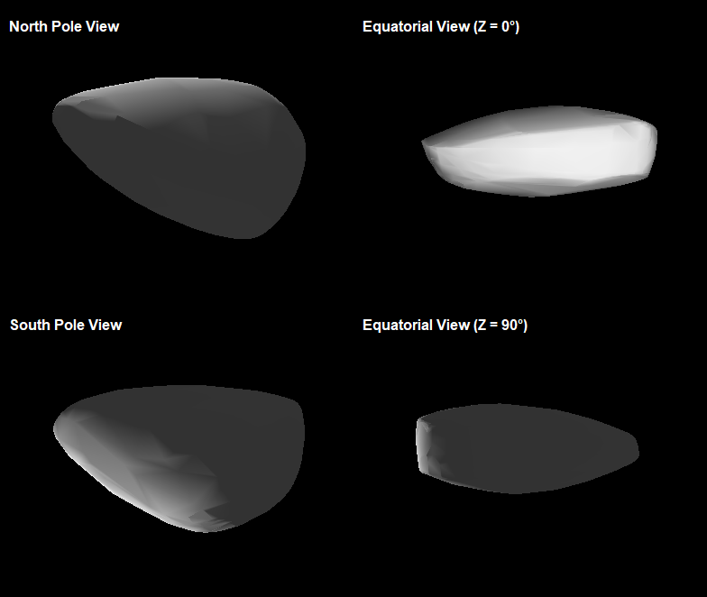
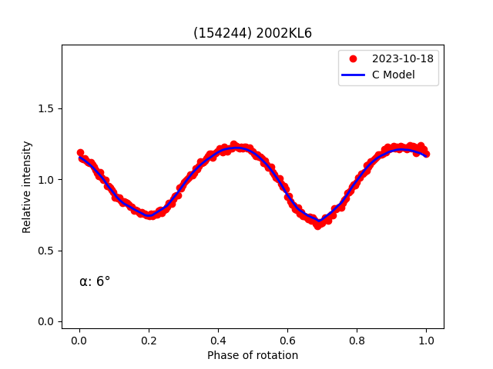
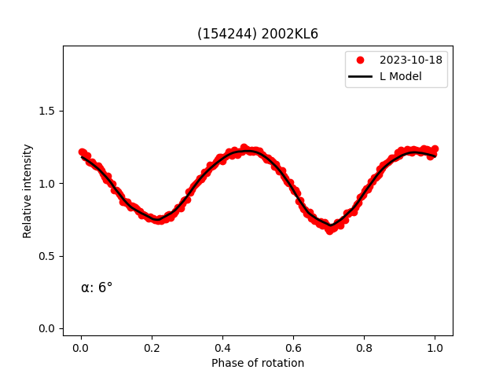
(154244) 2002 KL6
This asteroid besides the period also has a published pole, with no model.
With our data a pair of solutions were obtained:
P_{rot} = 4.610235±0.000001 h
λ₁ = 153°±21°
β₁ = -90°±4°
λ₂ = 334°±28°
β₂ = -90°±4°
We attempted to detect YORP with the following parameters:
P_{rot} = 4.610232±0.000001 h
λ₁ = 152°±15°
β₁ = -90°±2°
ν₁ = -7.12·10⁻⁹±1.65·10⁻⁹ rad/d²
λ₂ = 333°±18°
β₂ = -89°±2°
ν₂ = -7.14·10⁻⁹±1.93·10⁻⁹ rad/d²
Again, both models have similar fit to the data, with the YORP model having lower uncertainties.
This is the very first asteroid discovered affected by a negative YORP, which implies that the asteroid is being decelerated.
(154244) 2002 KL6. The four obtained models for this asteroid. Top left and right: Constant models. Bottom left and right: linearly increasing models.
Fit between Constant (λ=334º) and Linearly Incresing (λ=333º) period models and the data.

Slide 10
Conclusions
New observations provided by IAC get results with better uncertainty for (3103) Eger and (161989) Cacus.
For (2100) Ra-Shalom the results considering the YORP effect have a better uncertainty and slightly better fit to the data, which led us to think that the object is affected by it, and later publications confirmed it.
New models are presented for (12711) Tukmit, (7335) 1989 JA, (7822) 1991 CS, (154244) 2002 KL6 and (159402) 1999 AP10.
In the special case of (154244) 2002 KL6 considering the YORP effect the results yield better uncertainties along a slightly better fit to the data. If the asteroid is affected by this effect, it would be the very first asteroid with a negative YORP.

