Slide 1
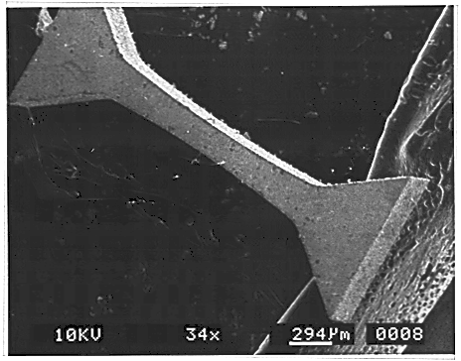
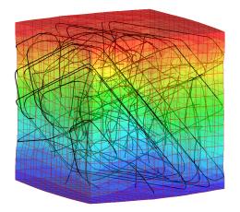
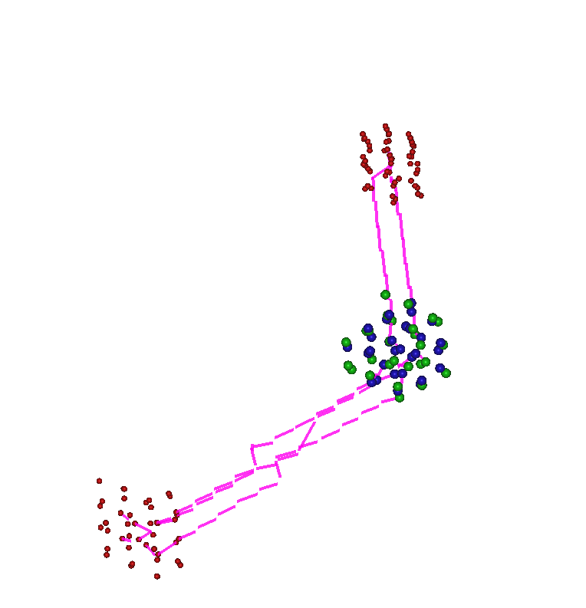
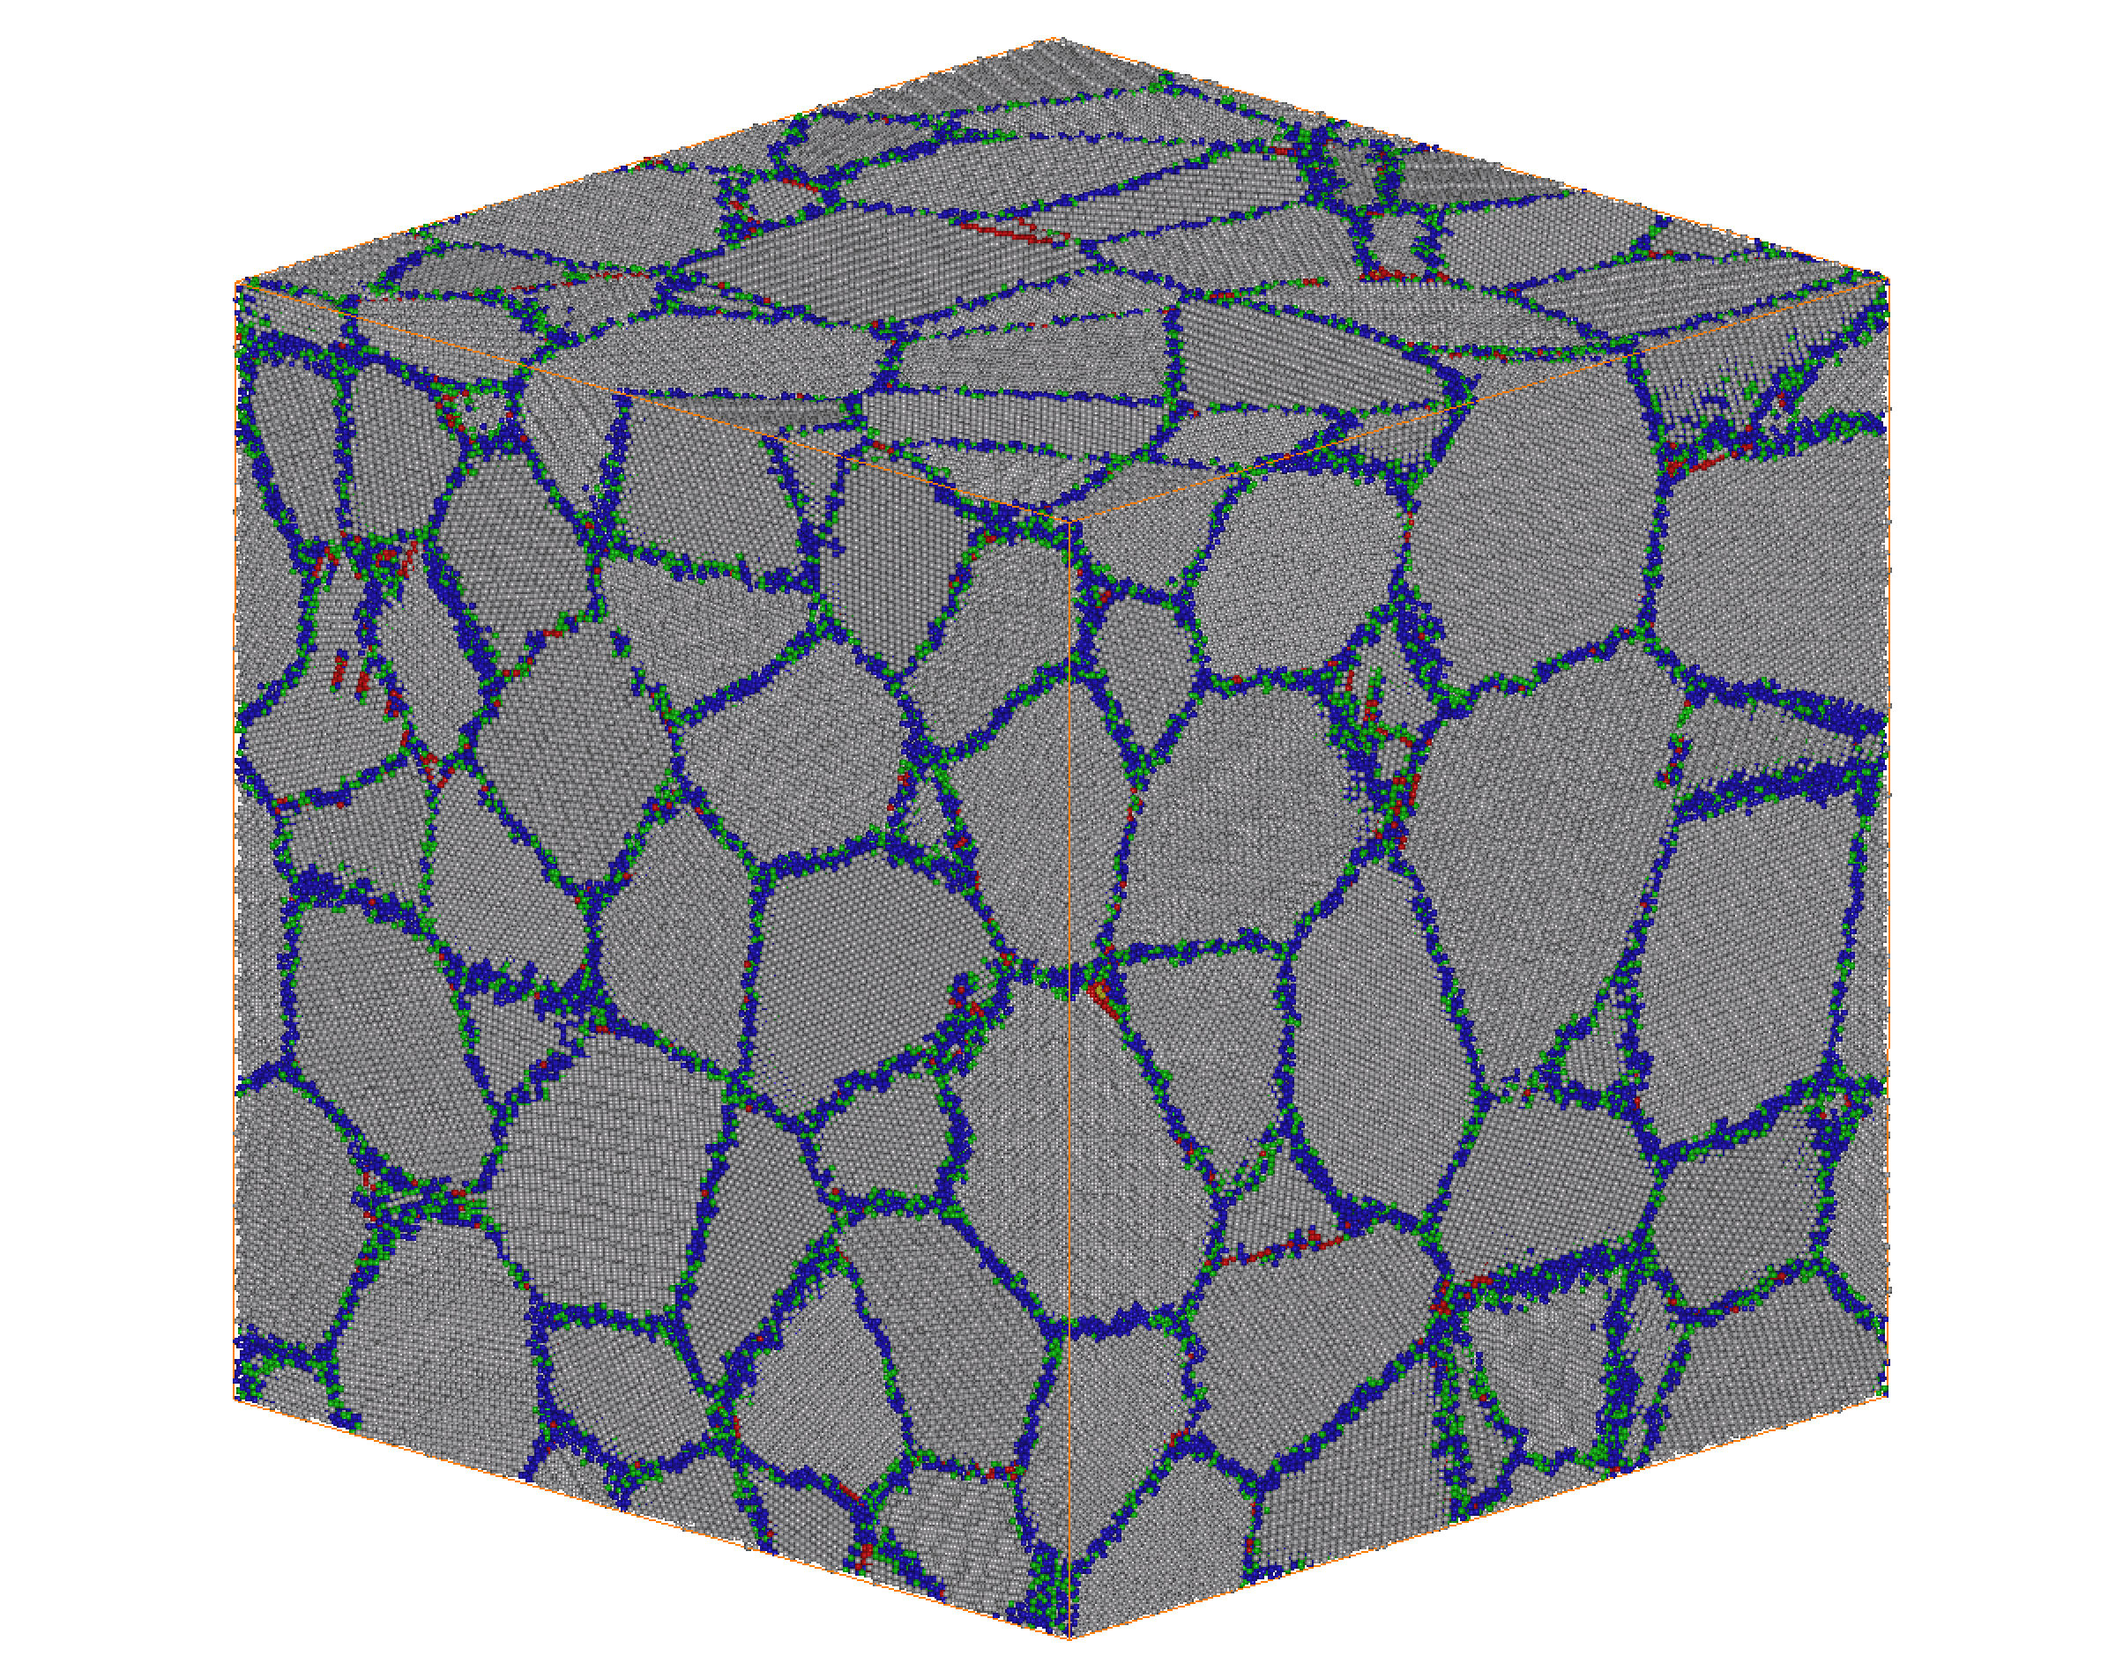
CIMACO
Computational Materials Science and Multiscale Modelling at Uniovi
M. A. Cerdeira, J. M. Fernández-Díaz, D. Fernández-Pello, S. L. Palacios, C. González (UCM), P. Nieves, J. Suárez-Recio, R. Iglesias
Collaborations
UNIOVI: J. M. M. Aguado, B. Fernández-Pérez, A. Rubio, J. L. R. Gallego, J. M. Recio, M. A. Salvadó, J. A. Blanco, P. Gorria, M. Rivas; BSC: J. J. Gutiérrez
IFN (UPM): J. M. Perlado, R. González-Arrabal, A. Rivera, O. Peña,
J. Kohanoff; US: J. J. Plata, A. M. Márquez; ICAMCyL: S. Cuesta-López
HUCA: D. Rodríguez-Latorre, A. Villacé, J. Fernández, S. Fernández
HT-MAT (PSI): M. Pouchon, A. Froideval; Synapsis: I. García-Bragado
Princeton: R. Car; GWU: A. Caro; Clemson: E. Martínez; IC2N: A. Fraile
Texas A&M: M. Demkowicz; LLNL: M. Victoria, A. Tamm
NOMATEN: J. Domínguez; CTU: T. Polcar, L. Juha; NGune: P. Piaggi
IT4I: S. Arapan, D. Legut, I. Korniienko; UNICA: F. Delogu, M. Mascia, A. Locci
ENEA: M. L. Grilli, A. Rizzo, D. Valerini; UTartu: A. Aabloo, V. Zadin
U. Helsinki: K. Nordlund, F. Djurabekova, A. López-Cazalilla
LSBU: S. Goel, G. Goel; UUppsala: M. Klintenberg, E. Metsanurk
COST CRM-EXTREME, ITHACA, COST TUMIEE, COST EuMINe, COST EU-MACE, SOCIEMAT, CEMAG, AUSE, SETN, CEIDEN, EMMC,
EERA-JPNM, TMS, ERRIN, S3P

Slide 2
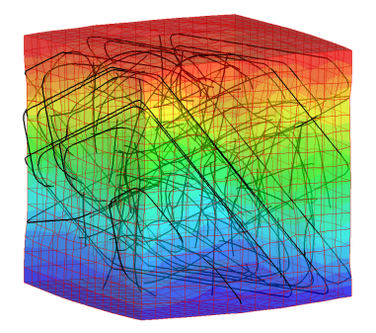
Continuum
Time [s]
Modelling
Dislocation
Dynamics
5 μm
10000 segments
10⁰
10⁻³
10⁻⁶
10⁻⁹
10⁻¹²
10⁻¹⁵
Kinetic
Monte Carlo
1 μm
1000s
Molecular
Dynamics
1.2 million atoms
24 nm
100 ps
ab initio
10²-10³ atoms
1.3 nm
Experimental
validation
10⁻¹⁰ 10⁻⁹ 10⁻⁶ 10⁻³ 10⁰
Length [m]

Slide 3
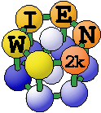
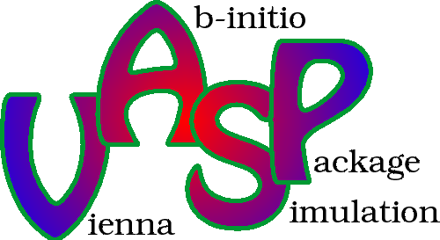
Multiscale modelling
MM approach= powerful tool:
• Prediction of long term behaviour of materials.
• Avoidance of experimental extra cost, issues related to time and space scales.
• Establish methodologies/ theories not accessible to experiments.
Research lines
• Computational characterization (structure, magnetism, transport) of materials for highly demanding engineering applications.
• Surface and interface simulations, high-throughput computational screening.
• Modelling of the degradation and reliability of crystalline materials and heterointerfaces in multilayered nanocomposites subject to radiation damage.
• Multiscale modelling of materials: diffusivity data for kMC, ML-based interatomic potential build-up, coupled TDDFT-ED approach to ionising radiation
Substitution, recovery and recycling of critical raw materials in extreme conditions and aggressive environments.
Artificial Intelligence (ML, DM, EA) techniques: materials by (inverse) design

Slide 4
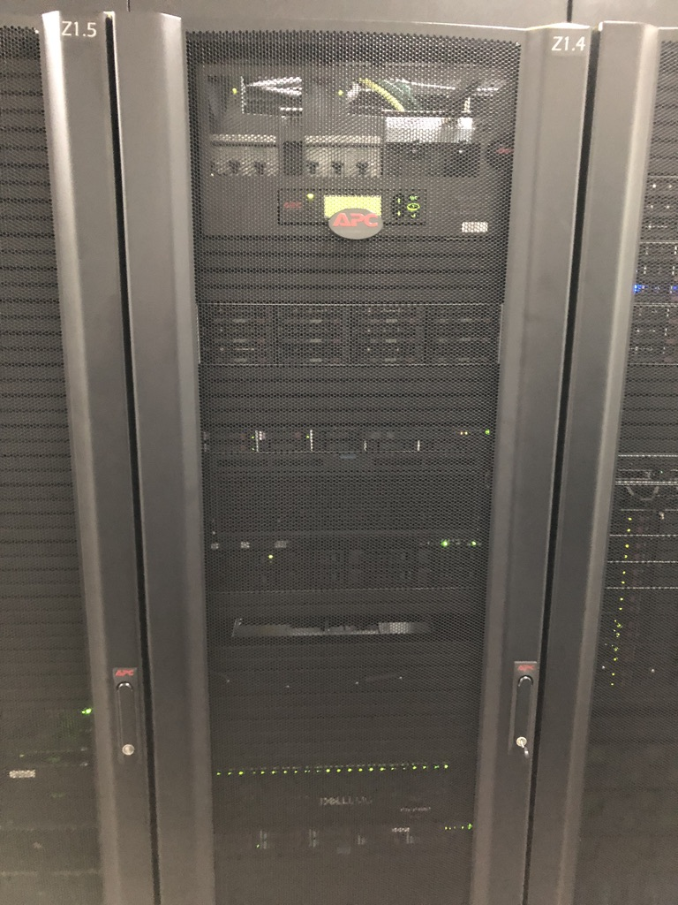
Equipment
OFELIA
4 AMD Opteron 6386SE 2.8 GHz 16-core processors, 3 900 GB HD, 24x8GB DDR3 RAM, 4-port Gigabit switch
8 Xeon Westmere X5650 2.66 GHz 6-core processors, 3 500GB HD, 1 TB extra HD, 24x4GB DDR3 RAM, 16-port Gigabit switch
DESDEMONA
ROSALIND
OTELO
AZServer 4G+ Pro with 2 x 4-core Intel Xeon E5-2609v2, 2 x Intel Xeon Phi 7120P 1,24GHz 61 cores, 1TB HD
RICHARD3
SHYLOCK
RES, PRACE, JFRS-1 (EUROFusion), IT4i, C3 Uniovi
October 2024: 20 k€ funding

Slide 5
Contact details
Roberto Iglesias
Department of Physics
University of Oviedo
+34 985102898
roberto@uniovi.es
https://cimaco.grupos.uniovi.es

