Slide 1







European Strategy on Particle Physics
Celso Martínez Rivero –IFCA (CSIC-UC)-
LHC/LEP
PS
SPS
FCC
http://cern.ch/fcc

Slide 2
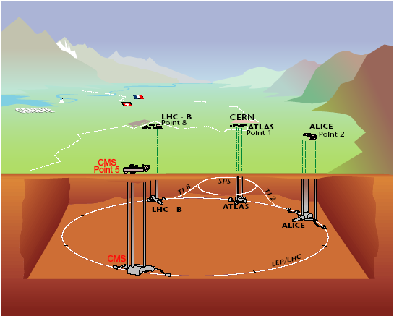
Accelerator LHC: CMS detector
      Since year 2009 the proton-proton collider LHC is taken data. One of the four detectors is CMS (UO, IFCA, UAM and CIEMAT work on it)
Celso Martínez Rivero. IFCA (CSIC-UC)

Slide 3
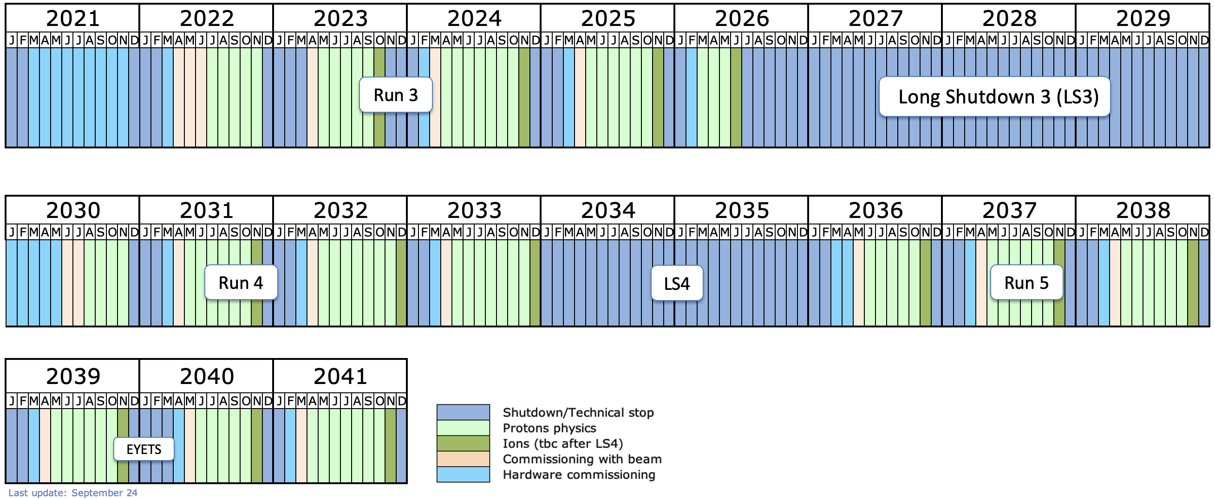
What Will happen at CERN when HL-LHC will finish in 2041?
New since september 2024
Celso Martínez Rivero. IFCA (CSIC-UC)

Slide 4
European Strategy for Particle Physics: “Third update”
The first ESPP upgrade was adopted by the CERN Council in 2013. Following the discovery of the Higgs boson in 2012, the decision was made, first and foremost, to build the High Luminosity LHC.
The second ESPP update, following the Open Symposium in Granada in May 2019, was approved by the CERN Council in June 2020. The HL-LHC needed to be completed, and then an electron-positron Higgs collider would be a top priority. Later, the European particle physics community aims to operate a proton-proton collider at the highest possible energy.
The third update of the ESPP will be finalized at the CERN Council in January 2026. More than 200 inputs have been submitted by all European countries associated with CERN to the European Strategy Group (ESG) by 31 March 2025. Following an Open Symposium in Venice in June 2025, all inputs will be discussed and the recommendations defined by all countries will be sent to the CERN Council via the ESG.
Celso Martínez Rivero. IFCA (CSIC-UC)

Slide 5
European Strategy for Particle Physics Update 2020 “High-priority future initiatives”
      An electron-positron Higgs factory is the highest-priority next collider. For the longer term, the European particle physics community has the ambition to operate a proton-proton collider at the highest achievable energy.
      “Europe, together with its international partners, should investigate the technical and financial feasibility of a future hadron collider at CERN with a centre-of-mass energy of at least 100 TeV and with an electron-positron Higgs and electroweak factory as a possible first stage.
      Such a feasibility study of the colliders and related infrastructure should be established as a global endeavour and be completed on the timescale of the next Strategy update..”
→ launch of Future Circular Collider Feasibility Study in summer 2021
Celso Martínez Rivero. IFCA (CSIC-UC)

Slide 6
FCC Feasibility Study (2021-2025): high-level objectives
demonstration of the geological, technical, environmental and administrative feasibility of the tunnel and surface areas and optimisation of placement and layout of the ring and related infrastructure;
pursuit, together with the Host States, of the preparatory administrative processes required for a potential project approval to identify and remove any showstopper;
optimisation of the design of the colliders and their injector chains, supported by R&D to develop the needed key technologies;
elaboration of a sustainable operational model for the colliders and experiments in terms of human and financial resource needs, as well as environmental aspects and energy efficiency;
development of a consolidated cost estimate, as well as the funding and organisational models needed to enable the project’s technical design completion, implementation and operation;
identification of substantial resources from outside CERN’s budget for the implementation of the first stage of a possible future project (tunnel and FCC-ee);
consolidation of the physics case and detector concepts for both colliders.

Slide 7
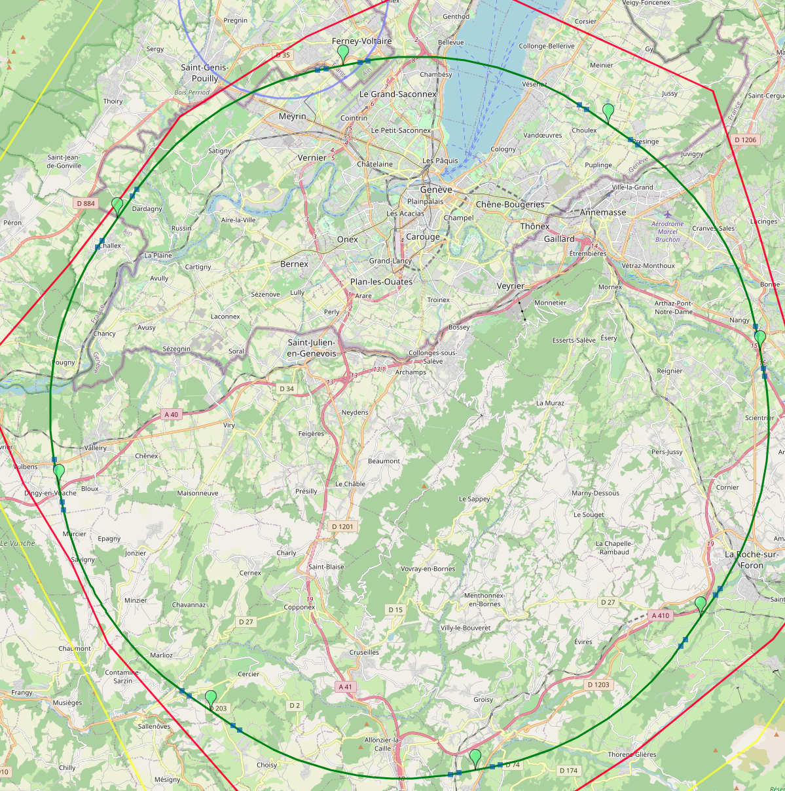
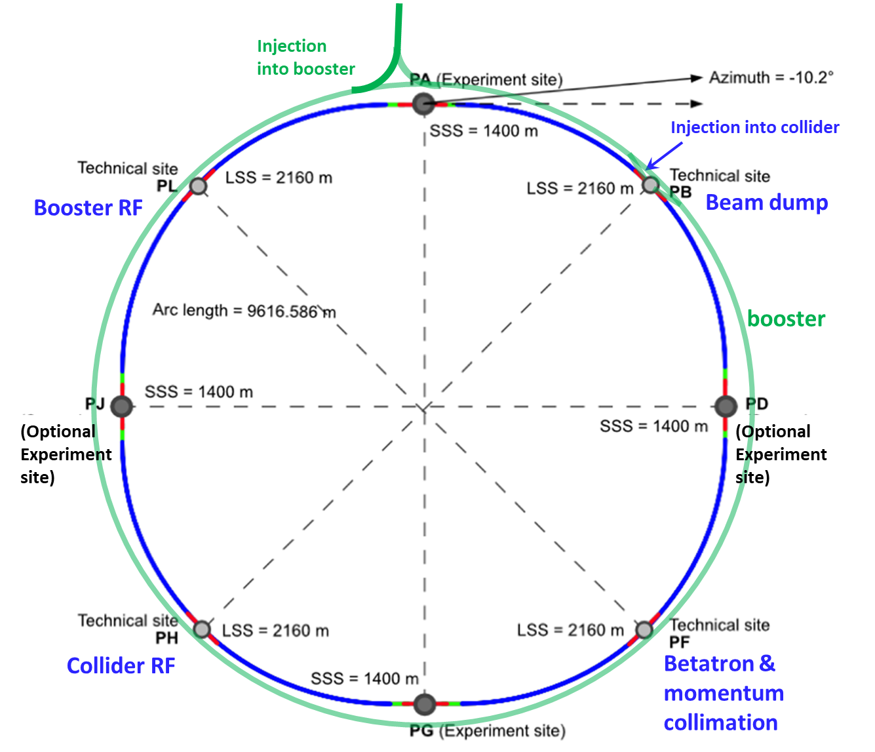
Optimized placement and layout for feasibility study
V. Mertens,
J. Gutleber
Layout chosen out of ~ 100 initial variants, based on geology and
surface constraints (land availability, access to roads, etc.), environment, (protected zones), infrastructure (water, electricity, transport), machine performance etc.
“Avoid-reduce-compensate” principle of EU and French regulations
PA: Experiment
PB: technical
PL: technical
Overall lowest-risk baseline: 90.7 km ring, 8 surface points,
Whole project now adapted to this placement
Number of surface sites | 8
Surface requirements | ~40 ha
LSS@IP (PA, PD, PG, PJ) | 1400 m
LSS@TECH (PB, PF, PH, PL) | 2032 m
Arc length | 9.6 km
Sum of arc lengths | 76.9 m
Total length | 90.7 km
PD: experiment
PJ: experiment
PF: technical
PH: technical
8
PG: experiment

Slide 8
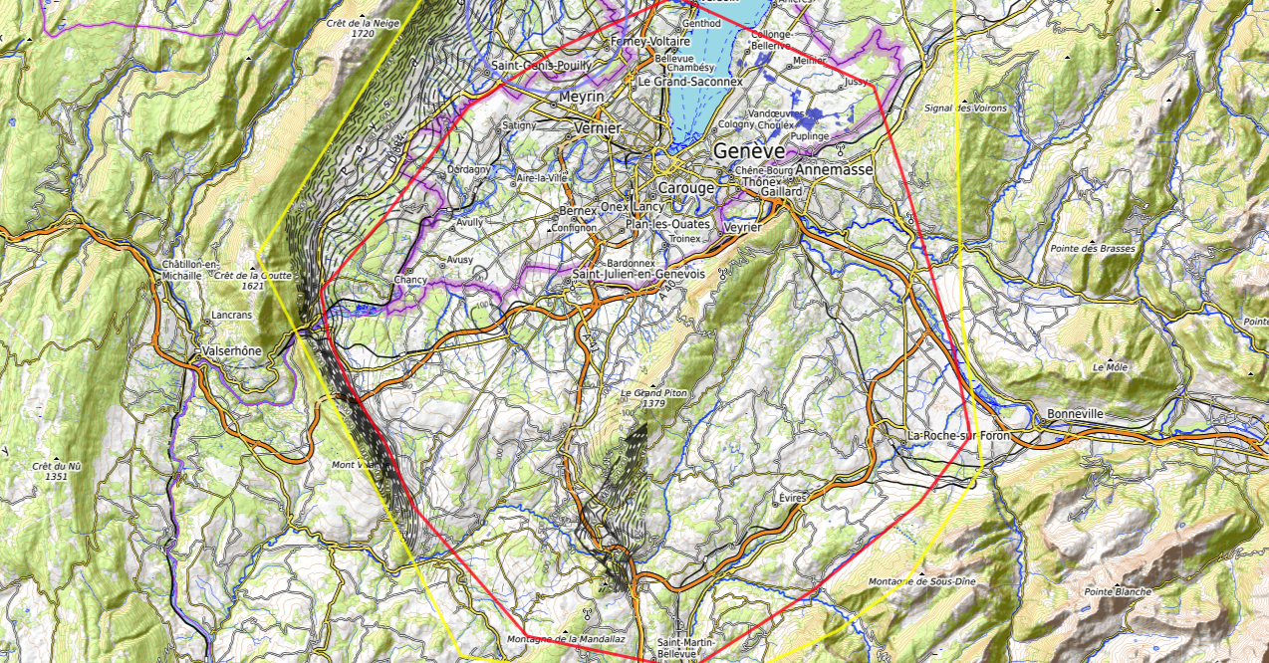
Constraints
Feasibility Study: Placements studies (i)
J. Gutleber, V. Mertens
Discouraged due
to likely oppositions
Densely urbanized
and agriculture/nature
Strict landscape protection
and re-naturalization areas
Jura limestone
Protected forest
Densely urbanized
and emerging areas
Densely urbanized
Clustered residential
areas and farm areas
Terrain difficult to
access and water
reservoirs
Known water reservoirs and
protected nature in CH
(legal + technical reasons)
Water protection and
natural zones without
developed access
Densely urbanized
and emerging areas
(some spots possible)
Water protection zones,
landscape protection zones,
altitudes
High mountains (900 m)
north of Fillière river valley
Vuache limestone
and faults
Likely major opposition:
local urbanistic planning
for traffic calming &
nature protection
High altitudes
Densely populated

Slide 9
European Strategy for Particle Physics
The result is a feasibility study report that was recently published in March 2025.
The report covers various aspects related to the potential implementation of such a project. These include physical objectives, geology, civil engineering, technical infrastructure, territorial and environmental dimensions, R&D requirements for the accelerators and detectors, socioeconomic benefits, and project cost. The construction cost of the FCC's electron-positron stage, including the tunnel and all infrastructure, amounts to 15 billion Swiss francs.
The Council could make a decision on whether to proceed with the FCC project around 2028.
Celso Martínez Rivero. IFCA (CSIC-UC)

Slide 10
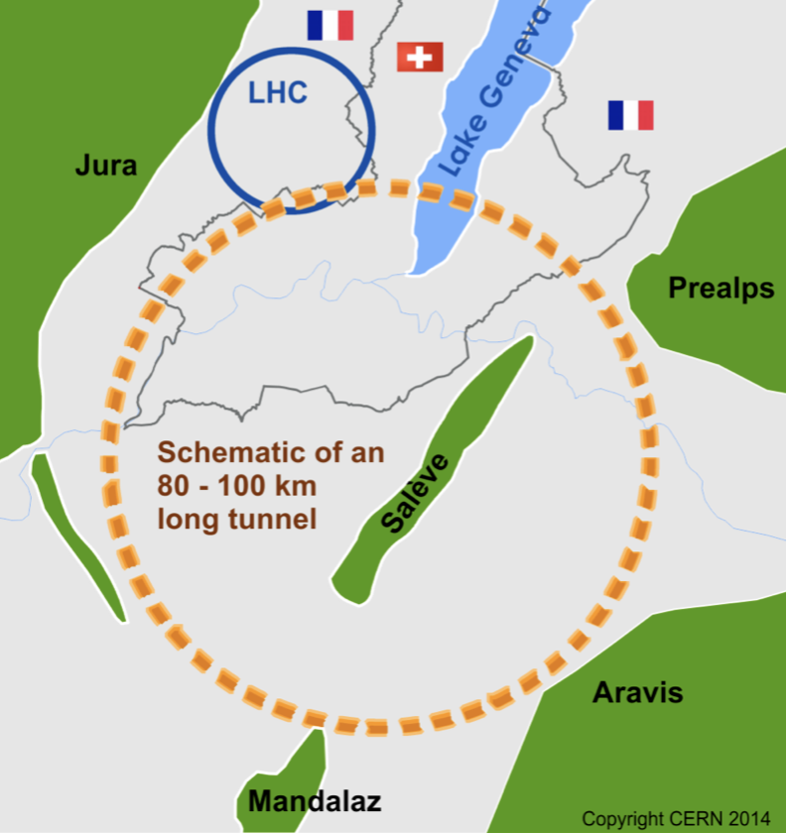
Motivations for pp colliders beyond the LHC
Future projects in HEP such as the have two objectives:
explore the energy frontier, as solutions to known and unexplained phenomena beyond the standard model (might be within reach at the next high energy collider):
    Dark Matter, Neutrinos, Matter-antimatter asymmetry
measure to high precision the physics of the electroweak symmetry breaking:
  The shape of the Higgs potential
  Higgs couplings, in particular to first two generations and gauge bosons
Within the FCC collaboration (CERN as host lab), 4 main accelerator facilities have been studied :
  pp-collider (FCC-hh): 16T → 100TeV in 100 km tunnel
  ee-collider (FCC-ee): as a (potential) first step
  ep collider (FCC-eh)
  HE-LHC: 27 TeV: 16T magnets in the LHC tunnel
Celso Martínez Rivero. IFCA (CSIC-UC)

Slide 12
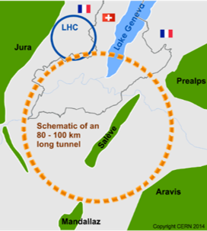
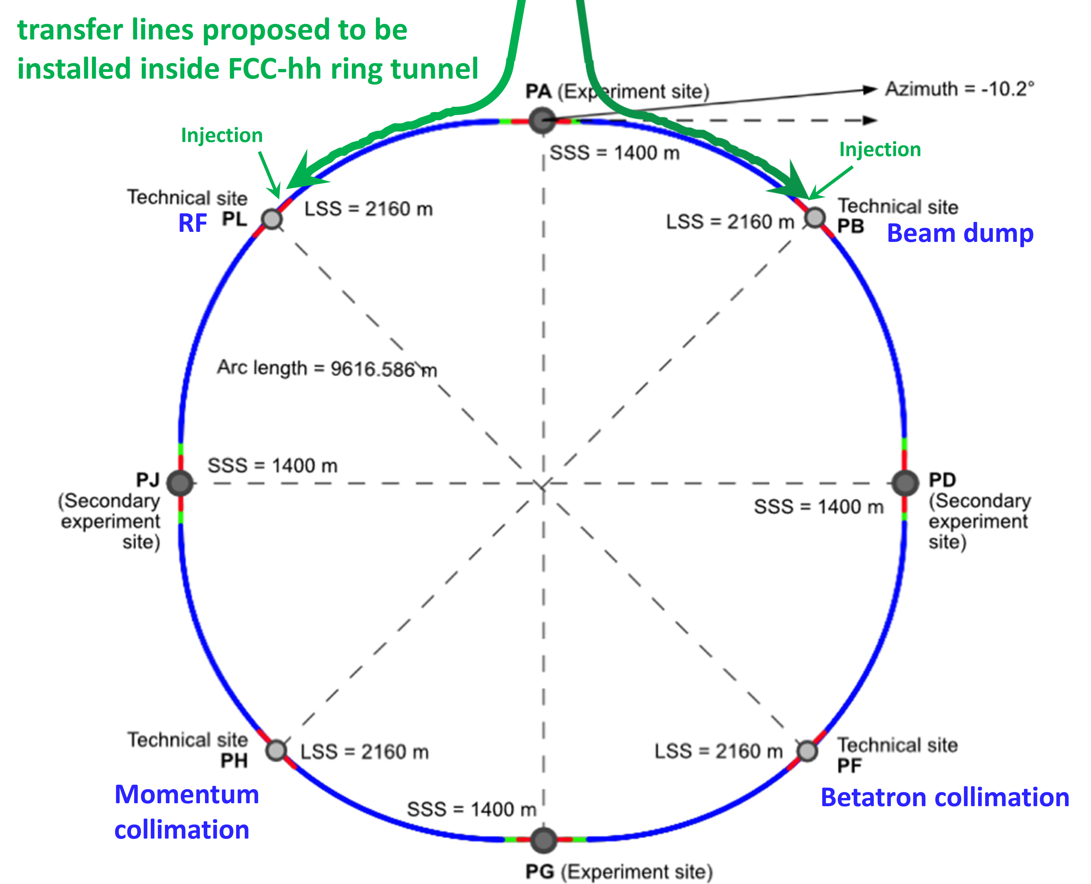
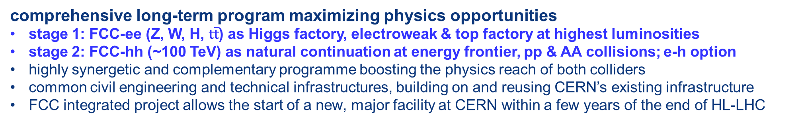
FCC integrated program
comprehensive long-term program maximizing physics opportunities
stage 1: FCC-ee (Z, W, H, $\text{t}\overline{\text{t}}$) as Higgs factory, electroweak & top factory at highest luminosities
stage 2: FCC-hh (~100 TeV) as natural continuation at energy frontier, pp & AA collisions; e-h option
highly synergetic and complementary programme boosting the physics reach of both colliders
common civil engineering and technical infrastructures, building on and reusing CERN’s existing infrastructure
FCC integrated project allows the start of a new, major facility at CERN within a few years of the end of HL-LHC
FCC-ee
FCC-hh

Slide 13
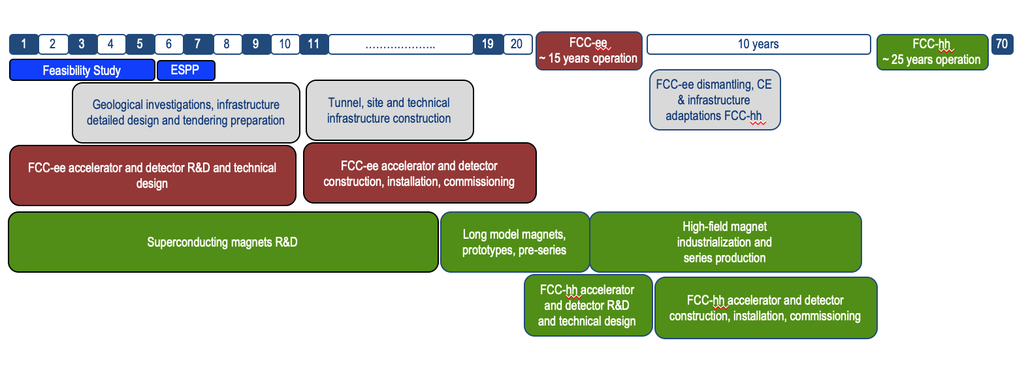
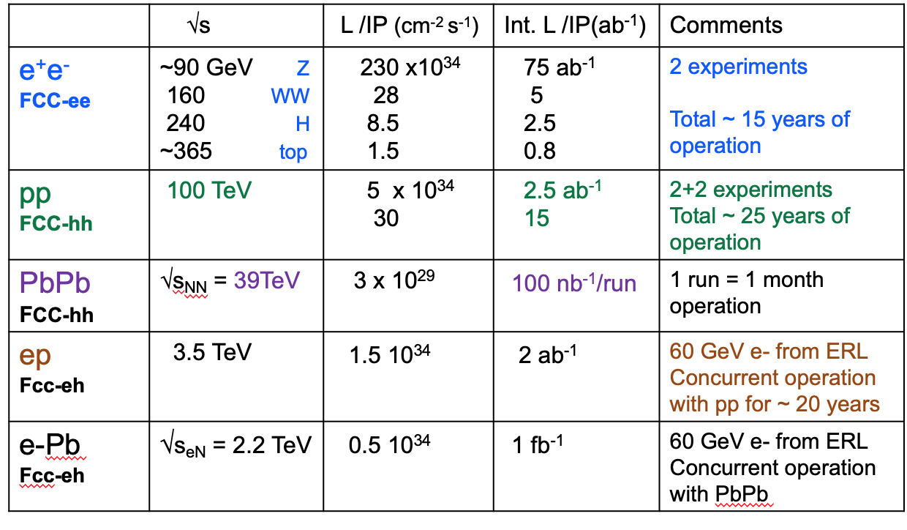
Timeline of the FCC integrated programme
Technical
schedule
2-4 experiments
20-30
In 2 hours => all LEP !
Feasibility Study: 2021-2025
If project approved before end of
decade → construction can start
beginning 2030s
FCC-ee operation ~2045-2060
FCC-hh operation 2070-2090++
Energy Recovery Linac
F. Gianotti

Slide 14
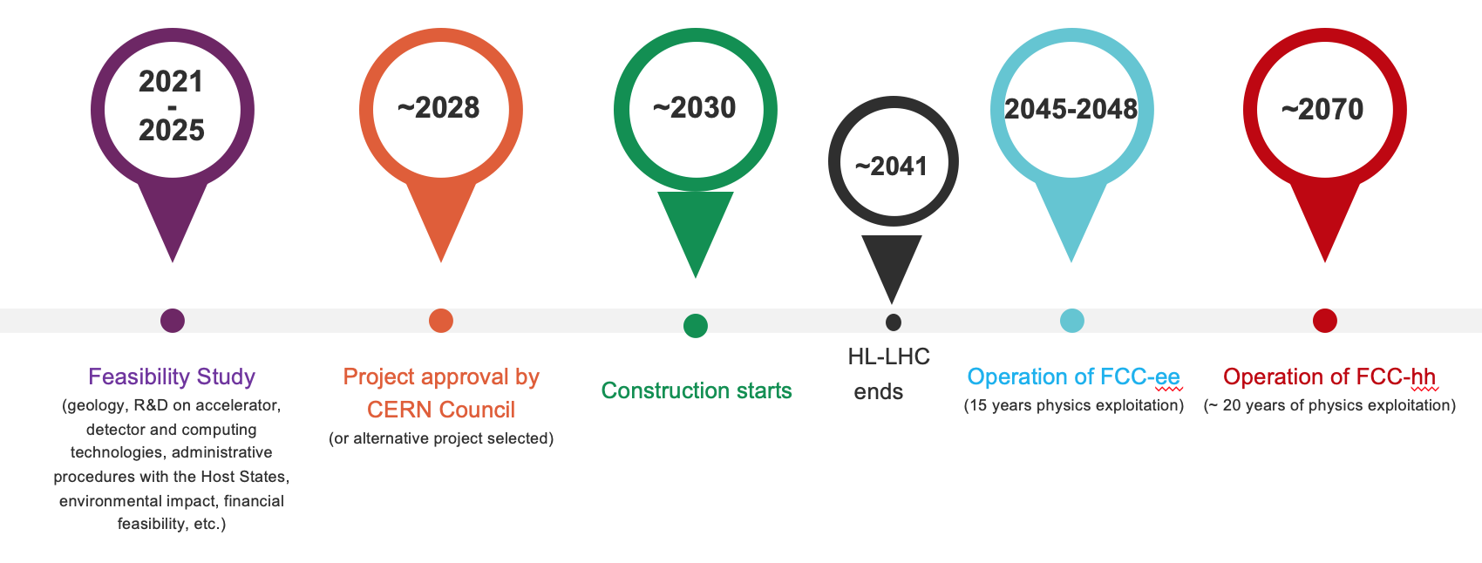
Timeline of the FCC integrated programme
Technical
schedule
“Realistic” schedule taking into account:
past experience in building colliders at CERN
approval timeline: ESPP, Council decision
that HL-LHC will run until 2041
Can be accelerated if more resources available

Slide 15
Theorist’s visión: The Higgs requires more precision
“The Higgs isn’t everything; it’s the only thing!”*
The scalar discovery in 2012 has been an important milestone for HEP. Many of us are still excited about it. Others should be too.
Higgs = new forces of different nature than the interactions known so far
  No underlying local symmetry.
  No quantised charges.
  Deeply connected to the space-time vacuum structure
The knowledge of the values of the Higgs couplings is essential to understand the deep structure of matter/Universe:
mW, mZ ↔ Higgs couplings ✓
me, mu, md ↔ Higgs couplings ?
EWSB @ t~10⁻¹⁰s ↔ Higgs self-coupling(s); Higgs(es) potential ?
matter/anti-matter ↔ CPV in Higgs sector ?
HL-LHC will make remarkable progress.
But it won’t be enough.
A new collider is needed!
* Grojean febr. 2024

Slide 16
FCC: The Physics Case
Results from the LHC so far have transformed the particle-physics landscape. The discovery of the Higgs boson with a mass of 125GeV has completed the long-predicted matrix of particles and interactions of the Standard Model (SM) and cleared the decks for a new phase of exploration.
On the other hand, the lack of evidence for an anticipated supporting cast of particles beyond the SM (BSM) gives no clear guidance as to what form this exploration may take. For the first particle physicists are voyaging into completely uncharted territory, where our only compass is the certitude that the SM in isolation cannot account for all observations.
This absence of theoretical guidance calls for a powerful experimental programme to push the frontiers of the unknown as far as posible: The integrated Future Circular Collider (FCC)!

Slide 17


Status of FCC global collaboration
The CERN Council reviewed the work undertaken in a fruitful meeting on 2 February 2024.
It congratulated and thanked all the teams involved in the study for the excellent and significant work done so far and for the impressive progress, and looks forward to receiving the final report in 2025.
150
Institutes
32
Companies
34
Countries
EC
H2020
FCC Feasibility Study: Aim is to increase further the collaboration, on all aspects,
in particular, on Accelerator and Particle/Experiments/Detectors (PED).

Slide 18
These last few years I have been fortunate enough to be the Spanish representative in the RECFA

Slide 19
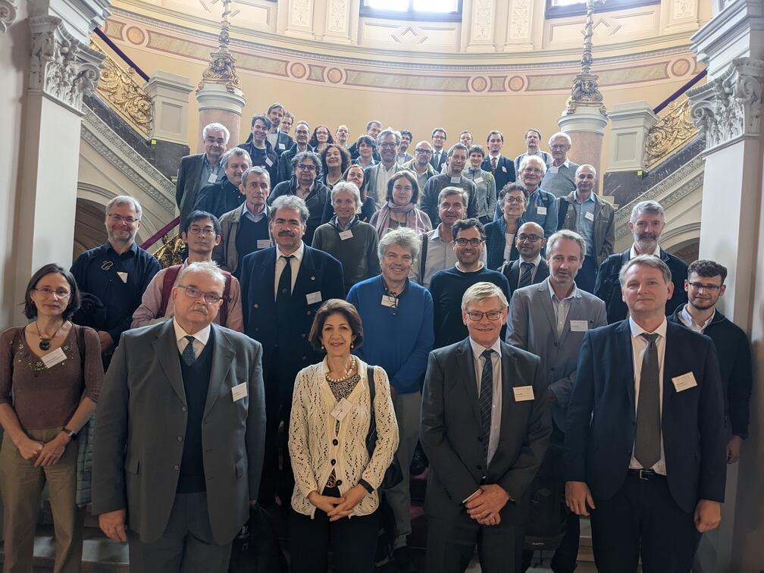
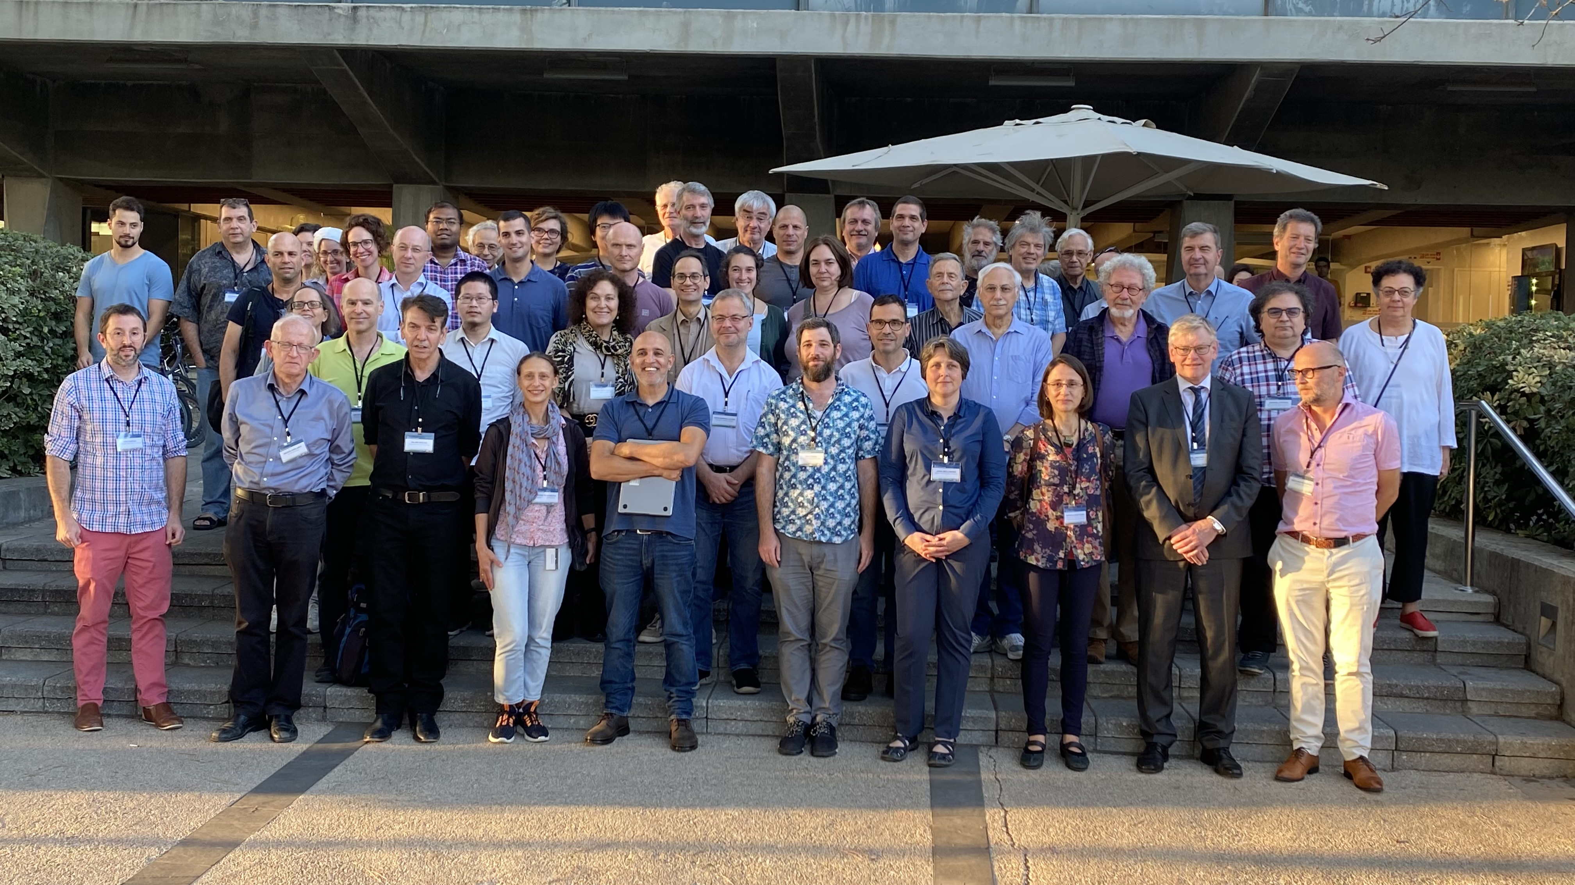
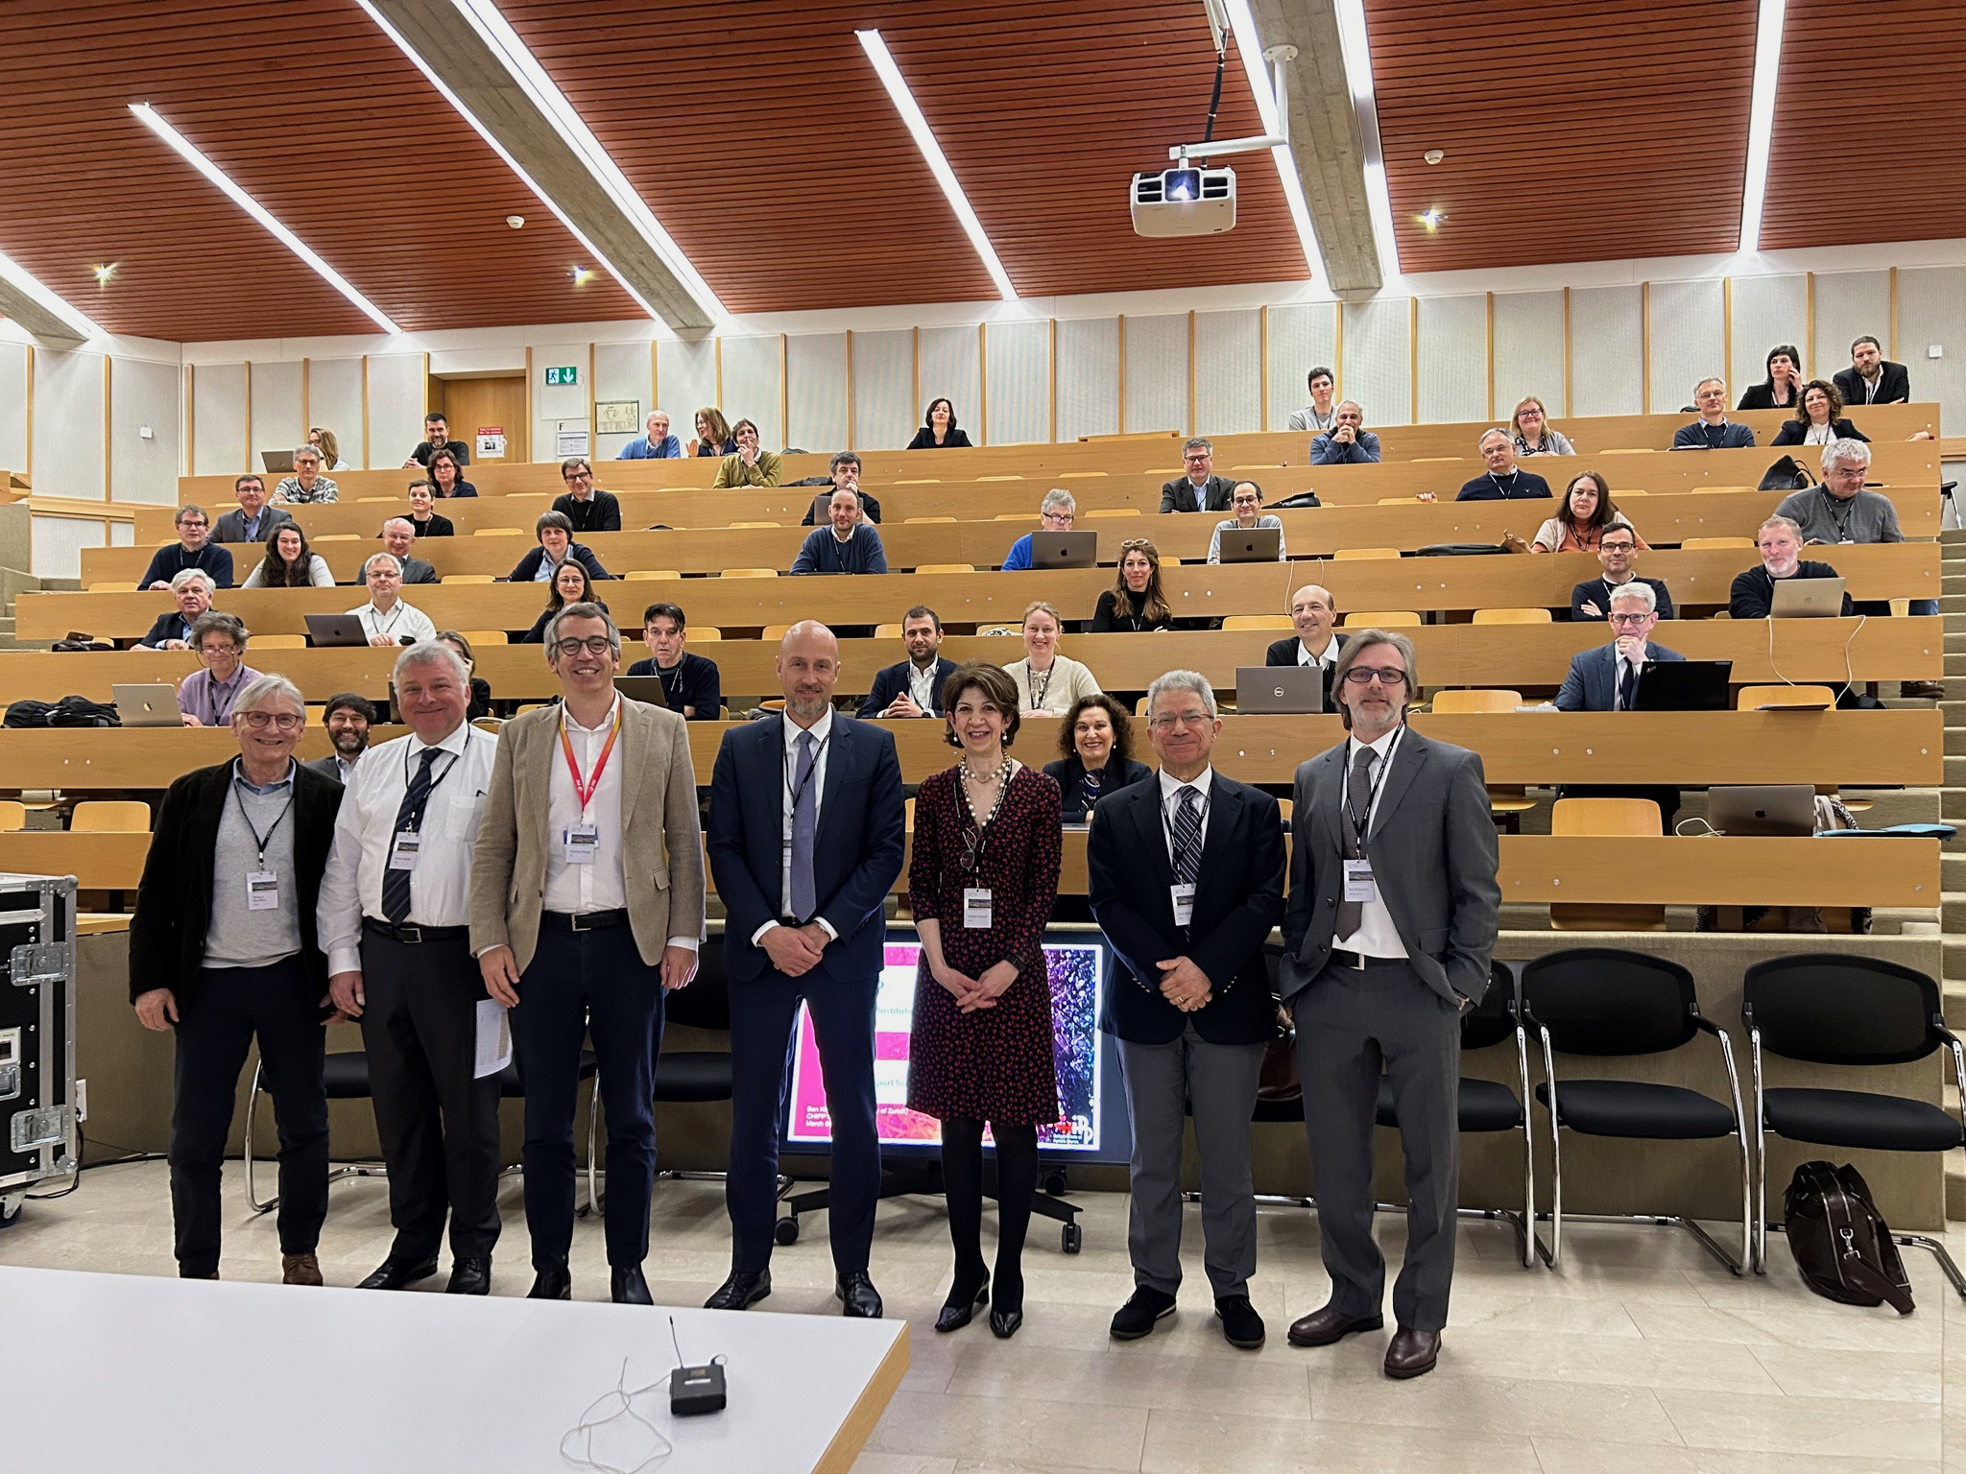
Spanish Delegate in the RECFA (january 2021 – december 2026)
The Restricted ECFA is composed of one member per country, with a maximum of two three-year terms. The RECFA assists and advises the President and Secretary on the ongoing functioning of the ECFA and acts as a communication channel for each participating country, its physical community, and national institutes and authorities.
It was founded in 1963 and makes recommendations to CERN and external organizations.
Since 2021 we have visited France (2021), Italy, Germany, Denmark, Hungary and Israel (2022), the Czech Republic, Norway, Portugal and Greece (2023) and Switzerland –PSI-, Sweden, the United Kingdom and Serbia (2024), Bulgaria, Finland, Belgium and Türkiye (2025)
RECFA is one of those responsible for the process to reach a document in 2026 for the ESPP
Hungría (Budapest) 2022
Israel (Weizmann Institute) 2022
Suiza (PSI) 2024

Slide 20
Backup

Slide 21
FCC-ee: main machine parameters
Parameter | Z | WW | H (ZH) | ttbar
beam energy [GeV] | 45.6 | 80 | 120 | 182.5
beam current [mA] | 1270 | 137 | 26.7 | 4.9
number bunches/beam | 11200 | 1780 | 440 | 60
bunch intensity [10¹¹] | 2.14 | 1.45 | 1.15 | 1.55
SR energy loss / turn [GeV] | 0.0394 | 0.374 | 1.89 | 10.4
total RF voltage 400/800 MHz [GV] | 0.120/0 | 1.0/0 | 2.1/0 | 2.1/9.4
long. damping time [turns] | 1158 | 215 | 64 | 18
horizontal beta* [m] | 0.11 | 0.2 | 0.24 | 1.0
vertical beta* [mm] | 0.7 | 1.0 | 1.0 | 1.6
horizontal geometric emittance [nm] | 0.71 | 2.17 | 0.71 | 1.59
vertical geom. emittance [pm] | 1.9 | 2.2 | 1.4 | 1.6
horizontal rms IP spot size [μm] | 9 | 21 | 13 | 40
vertical rms IP spot size [nm] | 36 | 47 | 40 | 51
beam-beam parameter ξ_{x} / ξ_{y} | 0.002/0.0973 | 0.013/0.128 | 0.010/0.088 | 0.073/0.134
rms bunch length with SR / BS [mm] | 5.6 / 15.5 | 3.5 / 5.4 | 3.4 / 4.7 | 1.8 / 2.2
luminosity per IP [10³⁴ cm⁻²s⁻¹] | 140 | 20 | 5.0 | 1.25
total integrated luminosity / IP / year [ab⁻¹/yr] | 17 | 2.4 | 0.6 | 0.15
beam lifetime rad Bhabha + BS [min] | 15 | 12 | 12 | 11
Design and parameters
dominated by the
choice to allow for
50 MW synchrotron
radiation per beam.
4 years
5 x 10¹² Z
LEP x 10⁵
2 years
> 10⁸ WW
LEP x 10⁴
3 years
2 x 10⁶ H
5 years
2 x 10⁶ tt pairs
x 10-50 improvements on all EW observables
up to x 10 improvement on Higgs coupling (model-indep.) measurements over HL-LHC
x10 Belle II statistics for b, c, τ
indirect discovery potential up to ~ 70 TeV
direct discovery potential for feebly-interacting particles over 5-100 GeV mass range
Up to 4 interaction points → robustness,
statistics, possibility of specialised detectors
to maximise physics output
F. Gianotti

Slide 22
FCC-hh parameters
parameter | FCC-hh | HL-LHC | LHC
collision energy cms [TeV] | 81 - 115 | 14 | 14
dipole field [T] | 14 - 20 | 8.33 | 8.33
circumference [km] | 90.7 | 26.7 | 26.7
arc length [km] | 76.9 | 22.5
beam current [A] | 0.5 | 1.1 | 0.58
bunch intensity [10¹¹] | 1 | 2.2 | 1.15
bunch spacing [ns] | 25 | 25 | 25
synchr. rad. power / ring [kW] | 1020 - 4250 | 7.3 | 3.6
SR power / length [W/m/ap.] | 13 - 54 | 0.33 | 0.17
long. emit. damping time [h] | 0.77 – 0.26 | 12.9 | 12.9
peak luminosity [10³⁴ cm⁻²s⁻¹] | ~30 | 5 (lev.) | 1
events/bunch crossing | ~1000 | 132 | 27
stored energy/beam [GJ] | 6.1 - 8.9 | 0.7 | 0.36
Integrated luminosity/main IP [fb⁻¹] | 20000 | 3000 | 300
With FCC-hh after FCC-ee: significantly
more time for high-field magnet R&D
aiming at highest possible energies
Formidable challenges:
high-field superconducting magnets: 14 - 20 T
power load in arcs from synchrotron radiation: 4 MW → cryogenics, vacuum
stored beam energy: ~ 9 GJ → machine protection
pile-up in the detectors: ~1000 events/xing
energy consumption: 4 TWh/year → R&D on cryo, HTS, beam current, …
Formidable physics reach, including:
Direct discovery potential up to ~ 40 TeV
Measurement of Higgs self to ~ 5% and ttH to ~ 1%
High-precision and model-indep (with FCC-ee input)
measurements of rare Higgs decays (𝛄𝛄, Z𝛄, µµ)
Final word about WIMP dark matter
F. Gianotti

Slide 23
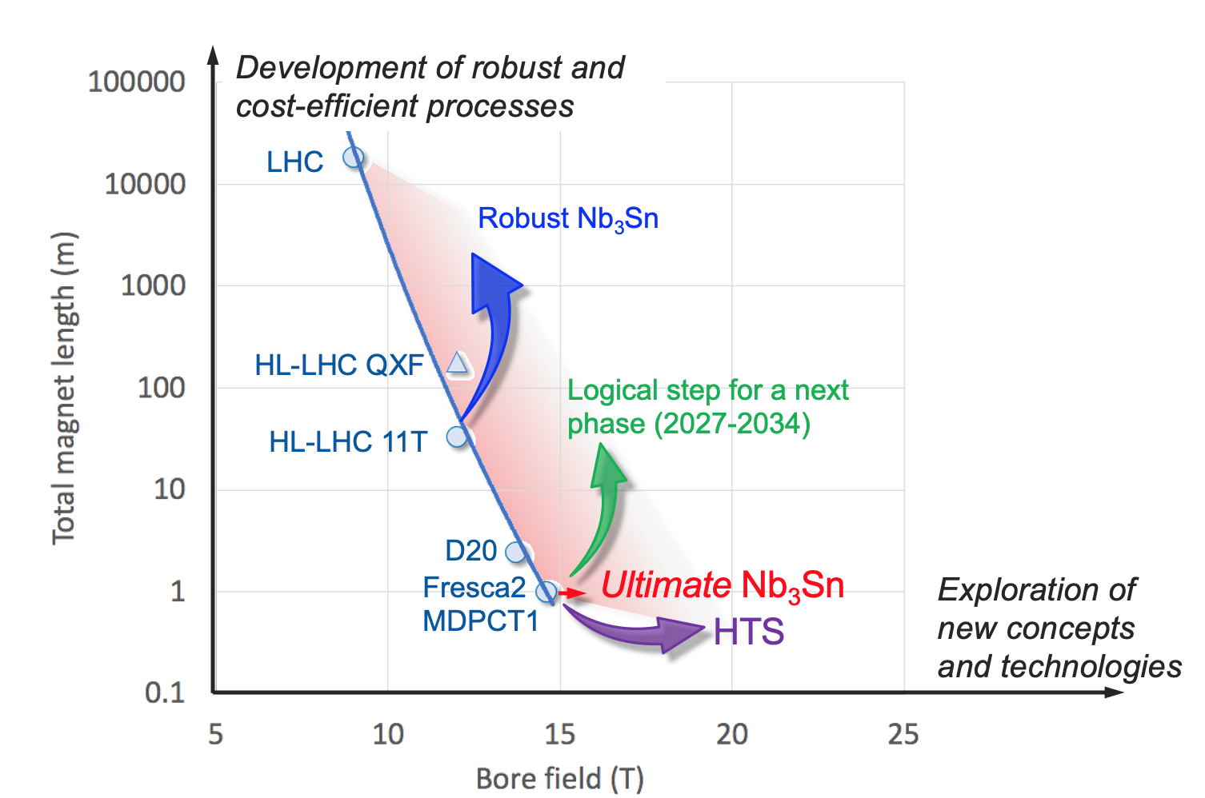
High-field magnets R&D: 1st steps towards FCC-hh
In parallel to FCC studies, HFM development program as long-term separate R&D project
CERN budget for high-field magnets doubled in 2020 Medium-Term Plan (~ 200 MCHF over ten years)
Main R&D activities:
materials: goal is ~16 T for Nb₃Sn, at least ~20 T for HTS inserts
magnet technology: engineering, mechanical robustness, insulating materials, field quality
production of models and prototypes: to demonstrate material, design and engineering choices,
industrialisation and costs
infrastructure and test stations: for tests up to ~ 20 T and 20-50 kA
Detailed deliverables and timescale being defined through Accelerator R&D roadmap under development
L. Bottura, F. Gianotti

Slide 24
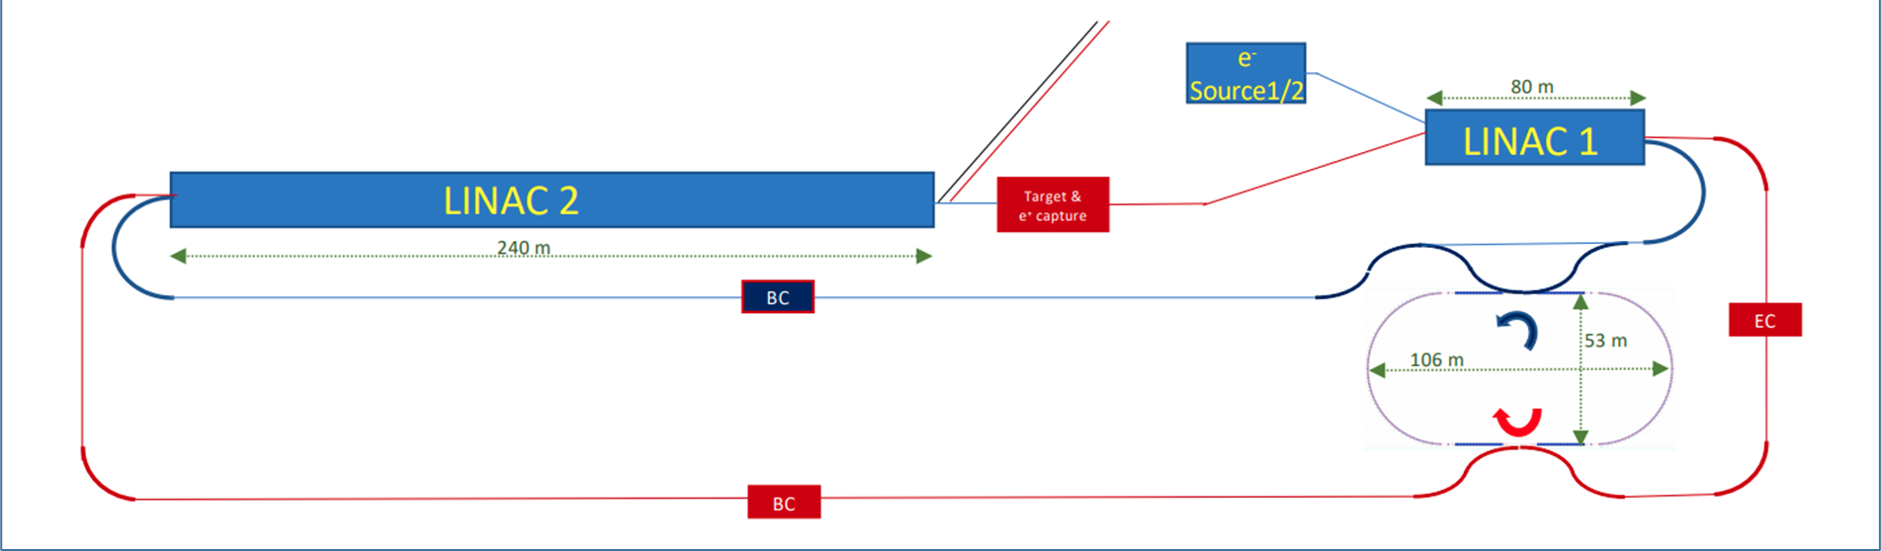
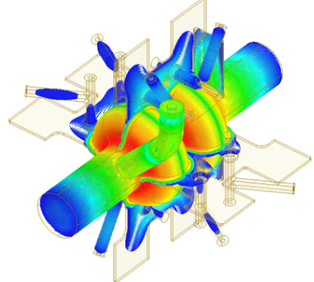
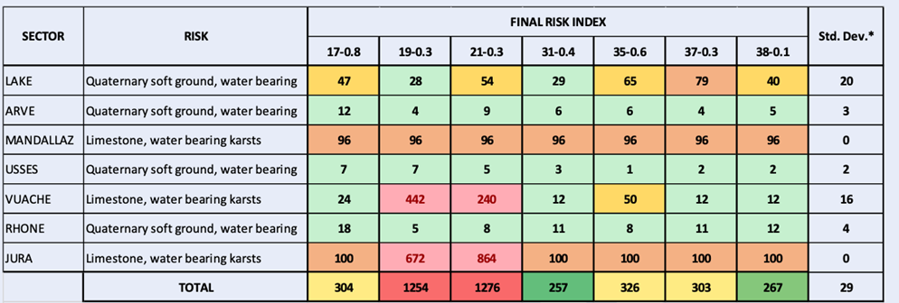
Technical reviews on injector, RF, placement in 2021
SRF:
study alternative RF frequency of 600 or 650 MHz (synergies with EIC, JLEIC, PIP-II, CEPC); explore heavily damped cavity concept with slotted waveguides as option for all energies.
FCC-ee injector: new layout (single energy in linac, higher e+ prod. energy) ; linac extension ~20 GeV
Placement:
minimizing the risk → new baseline layout, C=91.1 km;
full 4-superperiodicity & symmetry, compatible with 2 or 4 IPs for FCC-ee

Slide 25
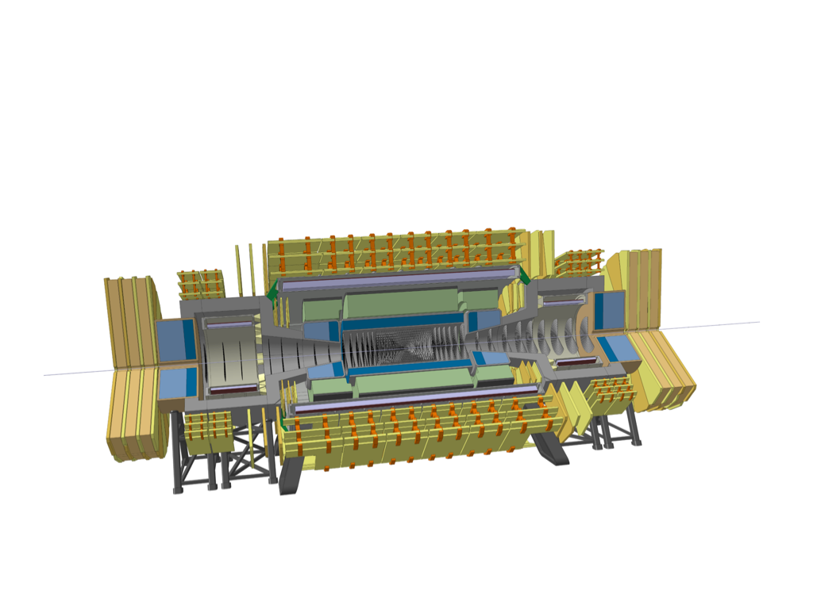

The FCC-hh detector
Central Magnet +
Fwd solenoids
Tracker: σ_{pT}/p_{T} ~ 20% at 10 TeV (1.5m radius)
Barrel ECAL: LAr/Pb
σE/E ~10%/√E ⊕ 0.7 %
30 X₀
lat. segm: ΔηΔφ≈ 0.01
long. segm: 8 layers
9 m
23 m
Fwd HCAL: LAr/Cu
σE/E ~100%/√E ⊕ 10 %
lat. segm: ΔηΔφ≈ 0.05
long. segm: 6 layers
Fwd ECAL: LAr/Cu
σE/E ~30%/√E ⊕ 1 %
lat. segm: ΔηΔφ≈ 0.01
long. segm: 6 layers
Barrel HCAL: Sci/Pb/Fe
σE/E ~50-60%/√E ⊕ 3 %
11 λ (ECAL+HCAL)
lat. segm: ΔηΔφ≈ 0.025
long. segm: 10 layers

Slide 26
FCC Feasibility Study – mid-term status summary
The first part of the FCC Feasibility Study has been completed with the mid-term review
20 – 22 November 2023: SPC and FC review meetings on mid-term review
2 February 2024: CERN Council meeting on mid-term review
Focus 2021 - 2023:
identifying best placement & layout and adapting entire project to new placement
this provided the input for the mid-term review documentation and cost estimate update
Fruitful collaboration between scientific & technical actors, in close cooperation with the host state services concerned, at departmental/cantonal and local level. Direct exchange in place with communes concerned by surface sites. Environmental studies ongoing.
Focus 2024 - 2025:
Subsurface investigations, further optimization of implementation, surface sites, synergies, etc.
Full design iteration in view of technical and cost optimisation of entire project.
Cost containment and reduction of cost uncertainties, development of risk register.
Further development of an affordable funding model and related governance implications (with Council).
Environmental impact (civil engineering, excavated materials, sustainability); geological investigations
Completion of the FCC Feasibility Study in 2025.

