Slide 1
Exploring Optical Neural Networks for Real-Time Adaptive Optics in Large Telescopes
Carlos González Gutiérrez
Notes:
Mencionar que es como compendio y la mención internacional.
Instituto Universitario de Ciencias y Tecnologías Espaciales de Asturias

Slide 2
Index
What we are doing in Adaptive Optics
New ways of sensing
Predicting the future
What we want to do in Adaptive Optics
Speeding up: Optical neural networks

Slide 3
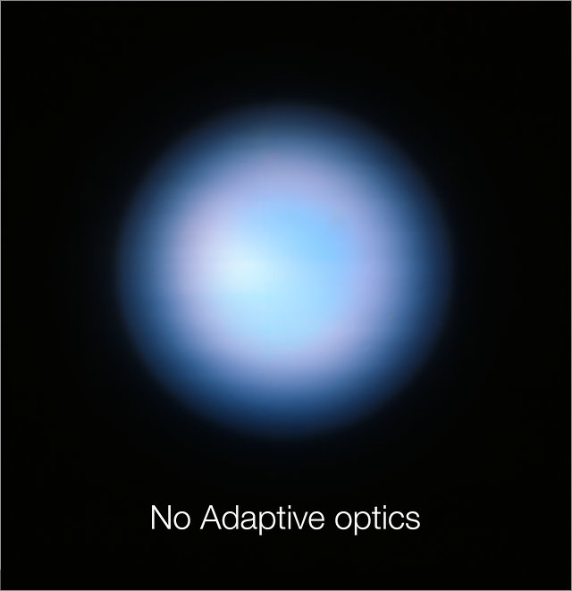
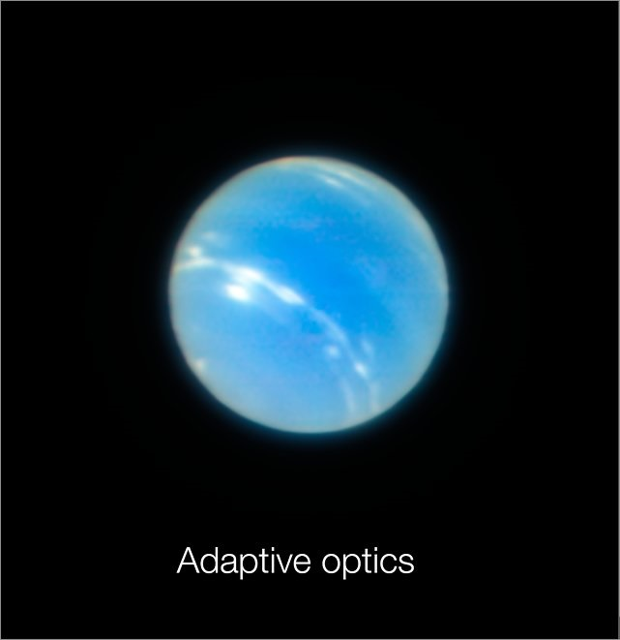
Earth’s atmosphere
Adaptive Optics helps to remove the effect of the atmosphere in terrestrial telescopes
Credit ESO - P. Weilbacher
Notes:
Por un lado, caracterización de la turbulencia.
Introducción breve a los sistemas de óptica adaptative.

Slide 4
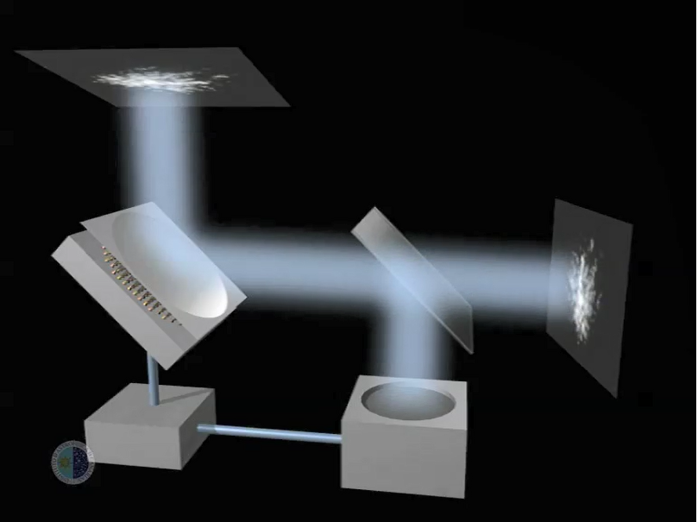
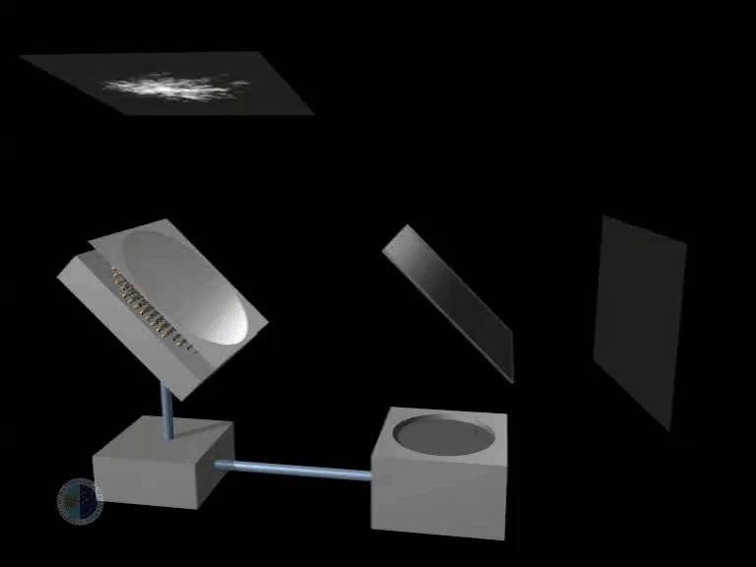
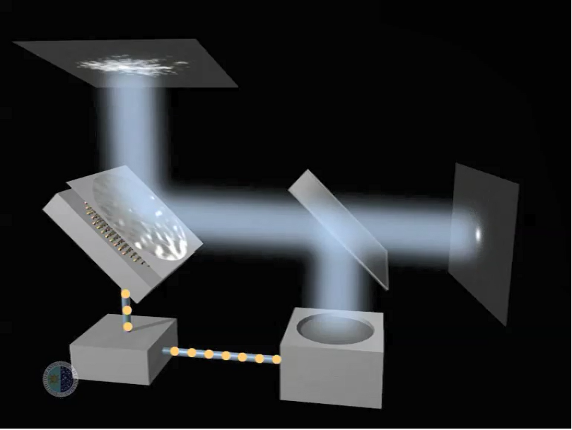
Adaptive Optics
Mirror
Camera
Sensor
Reconstructor
Credit: Instituto de Astrofísica de Canarias
Notes:
Esquema en bucle cerrado.
La luz llega al Espejo y es reflejada.
Del Espejo va a un beam-splitter donde es enviada a un sensor y al CCD de ciencia.
Con la información del sensor, el reconstructor modifica el Espejo.
Elementos importantes: Sensores, Configuraciones y Reconstructores.

Slide 5
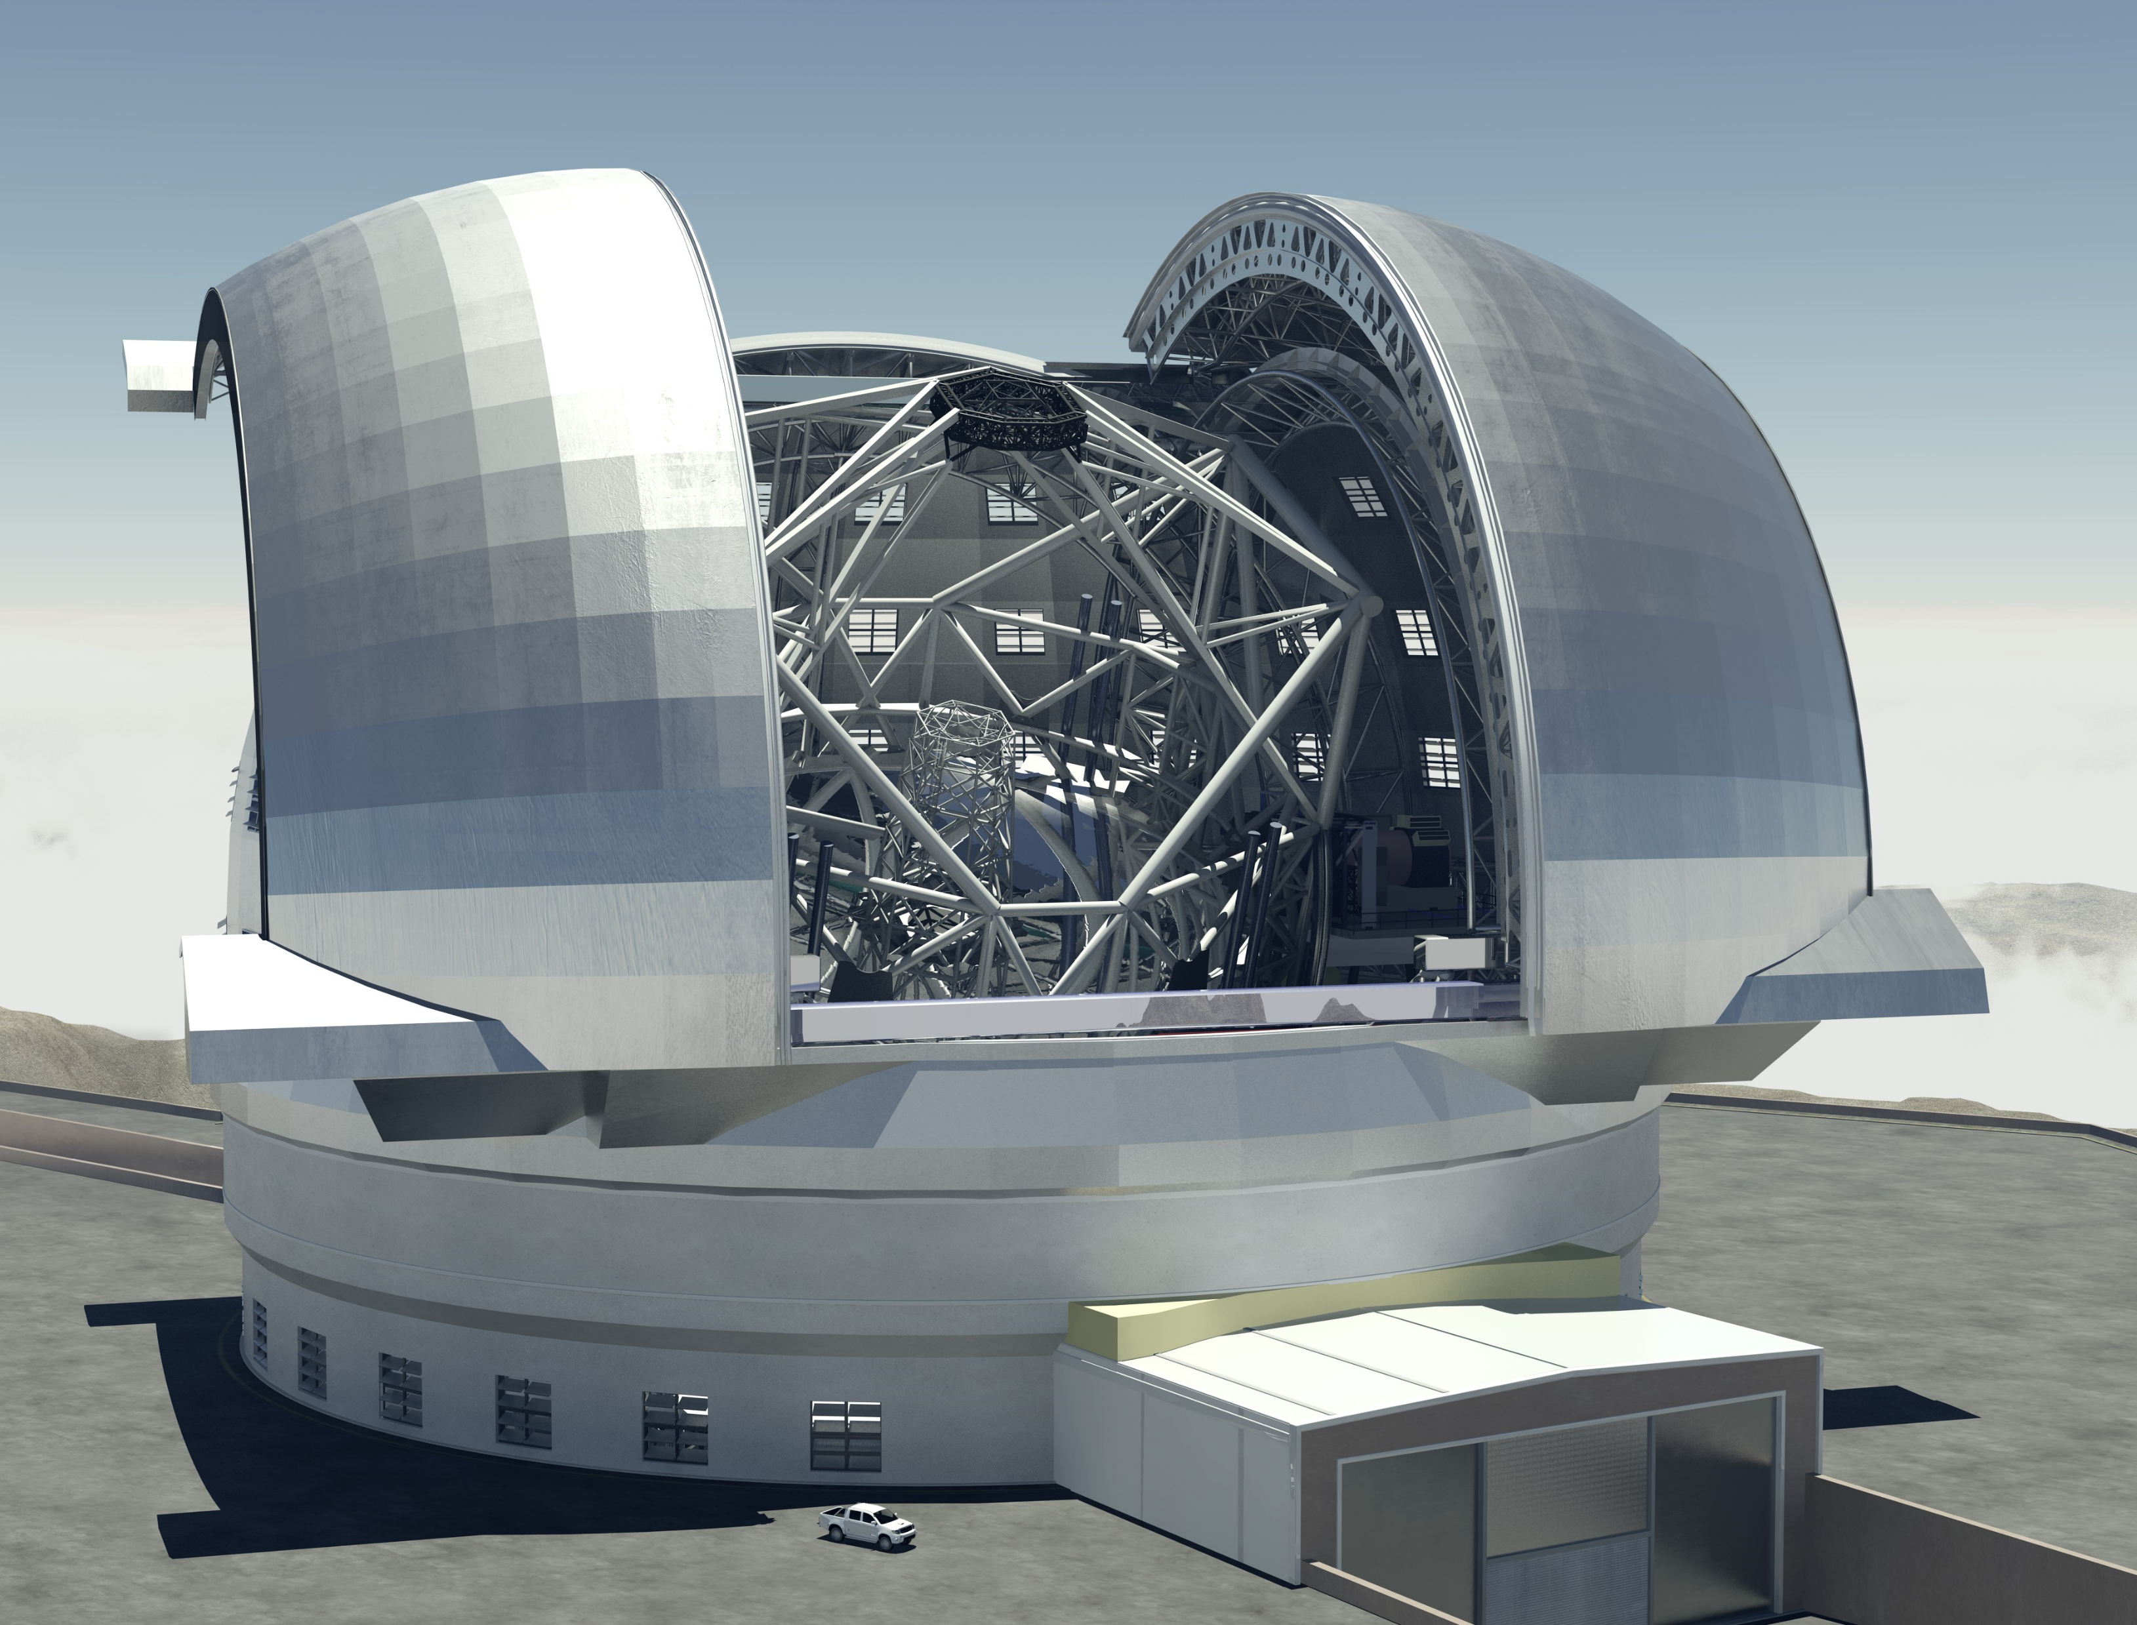
Challenges
+
How can we use AI to keep pushing AO to its limits?
Notes:
Retos: Combinar los grandes telescopios y la IA
Uno más específico, CARMEN+ELT
Otro más genérico ¿y otros telescopios?

Slide 6
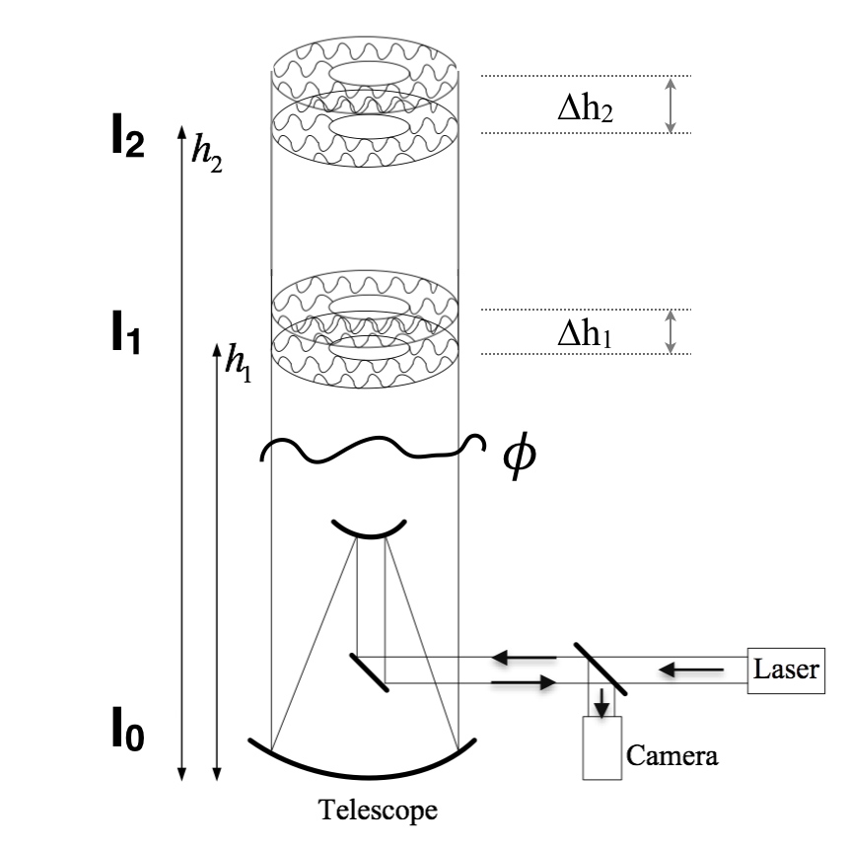
Projected Pupil Plane Pattern (P4)
Wide laser beam reflected off primary mirror
Remove cone-effect and anisoplanatism
Can work with only one image

Slide 7
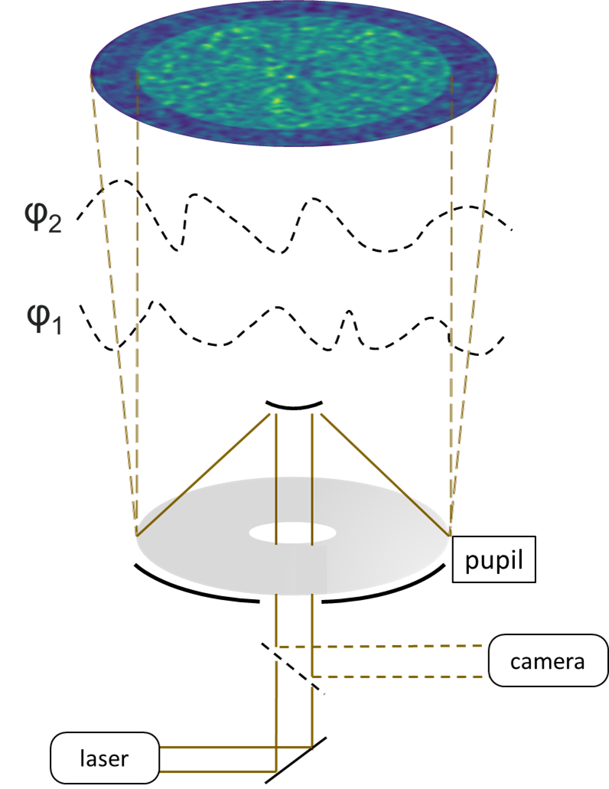
WOMBAT
P4 evolution: Single image but focus/defocus
Off-axis stars
Wider field of view

Slide 8
Pyramidal sensor
New type of sensor
Huge bust in performance by using CNNs

Slide 9
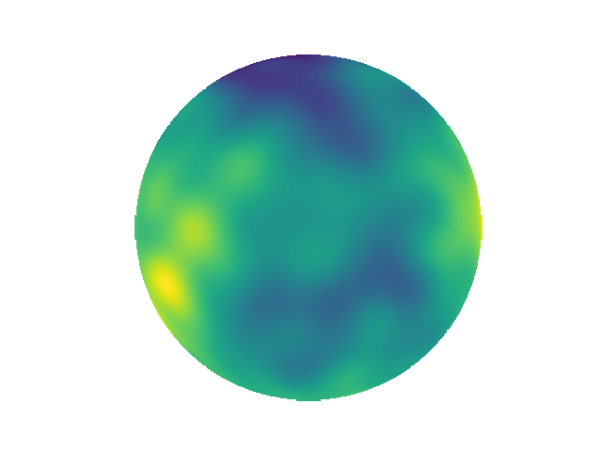
Atmospheric prediction
Wavefront aberration -> Milliseconds
Is it purely random? Can we predict it?

Slide 10
Atmospheric prediction
Recurrent neural networks
Robust prediction under varying observation conditions
Strong performance when predicting several time-steps ahead

Slide 11
Index
What we are doing in Adaptive Optics
New ways of sensing
Predicting the future
What we want to do in Adaptive Optics
Speeding up: Optical neural networks

Slide 12
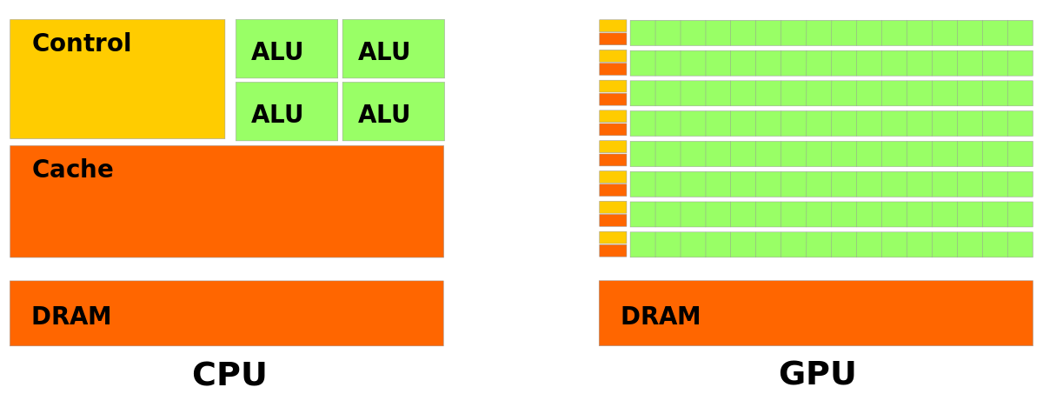
Graphics Processing Units
Widely used in neural networks
Faster than CPUs, but not always enough
Credit Nvidia

Slide 13
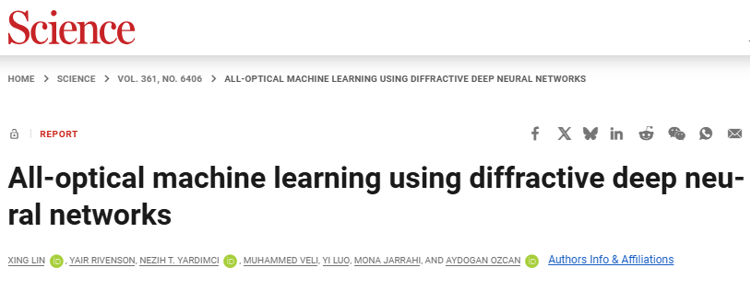
Optical Neural Networks (ONN)
Fast computation -> Speed of light!
Classifier -> MNIST or ImageNet

Slide 14
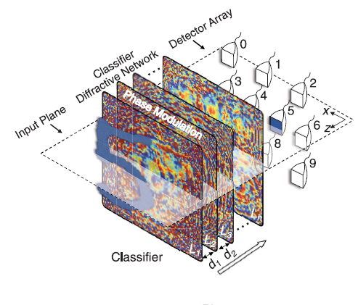
Optical Neural Networks
Change phase and amplitude
Printed lenses

Slide 15
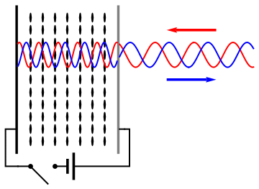
Spatial Light Modulator (SLM)
More flexible, not statically printed
Easy to adapt to different conditions
Credit: Wikipedia (Jacopo Bertolotti)

Slide 16
Project
Optical Neural Networks + SLM + AO
Speed up our reconstructors:
CARMEN
ConvCARMEN
P4 / WOMBAT

Slide 17
Optical vs Traditional
Pros:
Powerful option for large neural networks
Really fast
Cons:
Harder to test
Big networks require complex system

Slide 18
Summary
Neural networks + Adaptive optics
Optical Neural Networks + SLM + AO
New networks ⇔ New challenges
Notes:
Recordar la mejora de los tiempos gracias a la mejoras de las tarjetas.
La mejora con más GPUs incrementará al aumentar el tamaño de las redes.

Slide 19
Thank you
Notes:
Poner tabla más bonita con más detalles de la información.

