Slide 1
Astro Exploration
Santiago Iglesias Álvarez
Javier Rodríguez Rodríguez
Ramón Hevia Díaz
Enrique Díez Alonso

Slide 2
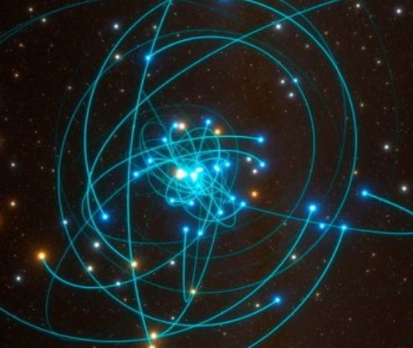
Exoplanet detection and characterization
Near Earth Asteroids characterization
Identification and follow up of artificial satellites
Pro – Am collaborations

Slide 3
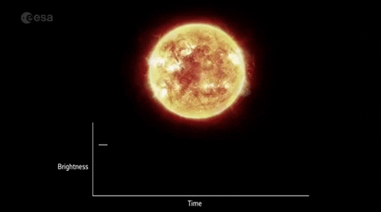
Exoplanet detection: the transit method
Consists of detecting periodic dimmings in stellar light curves.

Slide 4
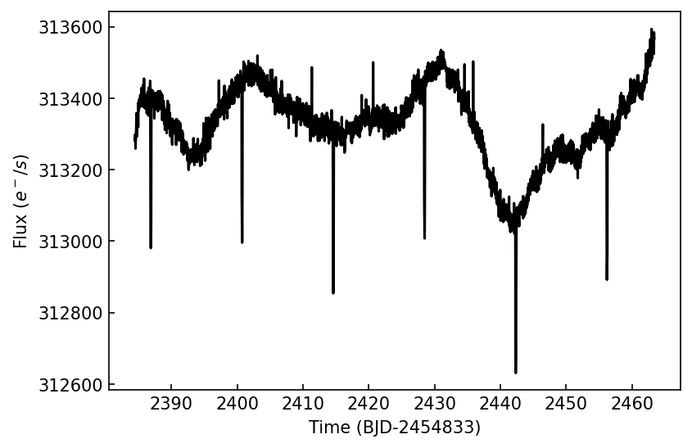
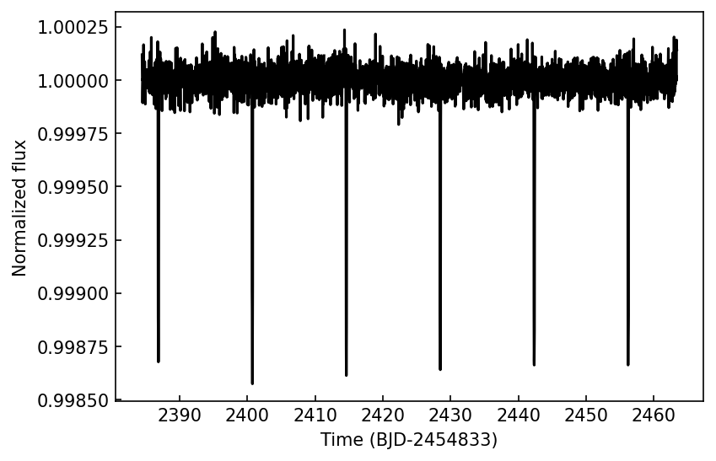
Exoplanet detection: detrended light curves
Long-term trends are induced by stellar variability phenomena.
These trends have to be removed before analyzing light curves.

Slide 5
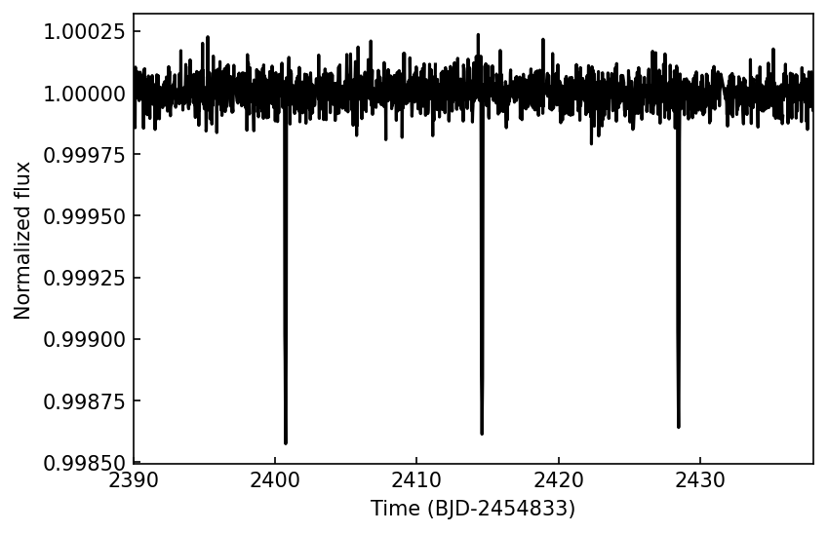
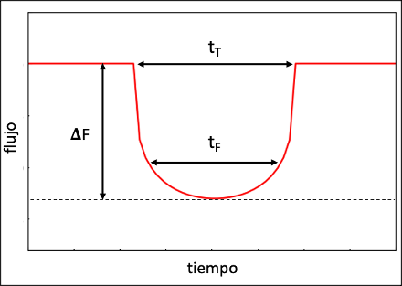
Shape dependency of transit-like signals
Limb darkening effect makes the transits getting rounded.
From a transit, different parameters can be inferred.
P(d)
P(d)
Flux
Time

Slide 6
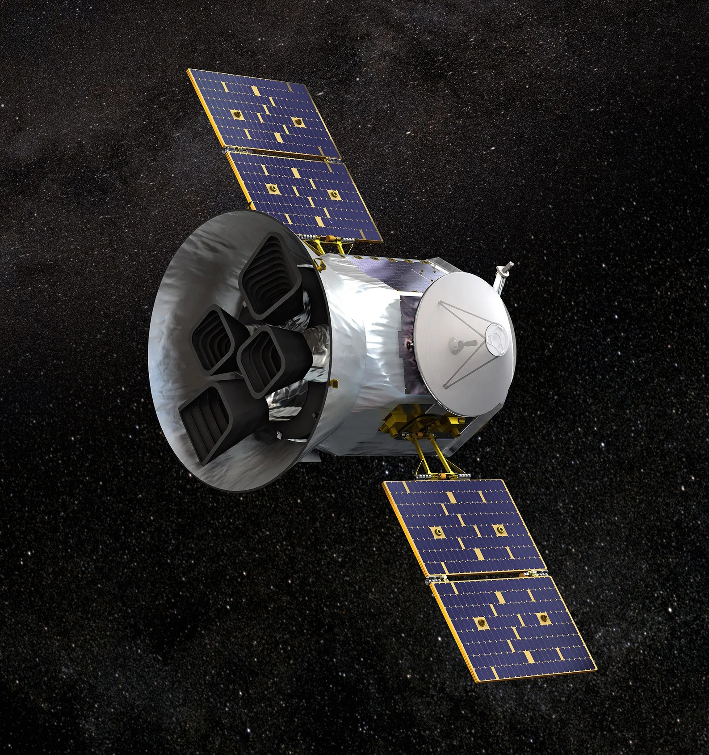
Virtually millions of light curves to analyze from facilities like TESS or Kepler.
Classical algorithms are robust but very time demanding.
Solution: applying machine learning techniques to detect and characterize the systems.

Slide 7
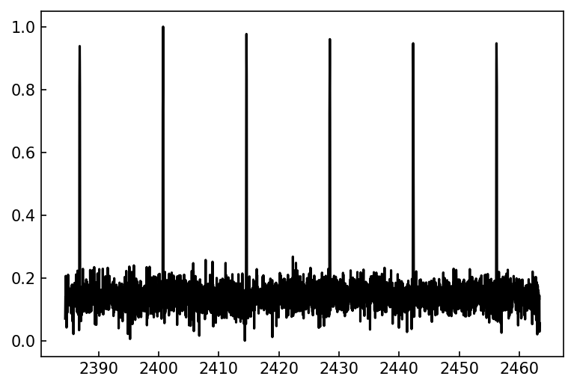
Convolutional Neural Networks (CNN)
CNN are a type of Artificial Intelligence (AI) ideal for detecting shape-dependency features.
CNN filters extract the main characteristics (i.e. transits).
Output

Slide 8
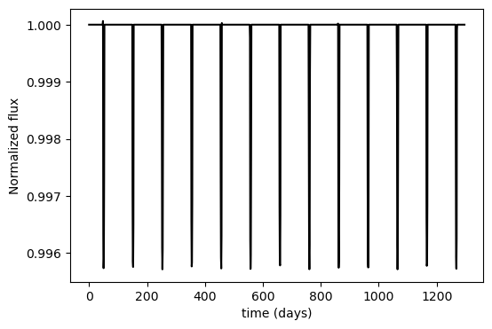
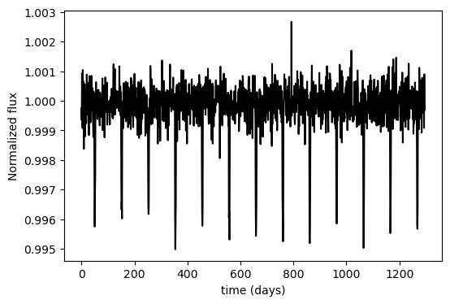
Dataset simulation
There are not enough real light curves with transits to train the models.
Batman package: simulates light curves with transits but without noise.
Noise: Gaussian considering the SNR expected for TESS light curves..
Stellar and planetary parameters: simulated considering physical limits.
Stellar Magnitude | SNR
8 | 40.84
10 | 36.20
12 | 31.56
14 | 26.92
16 | 22.28
Gaussian noise

Slide 9
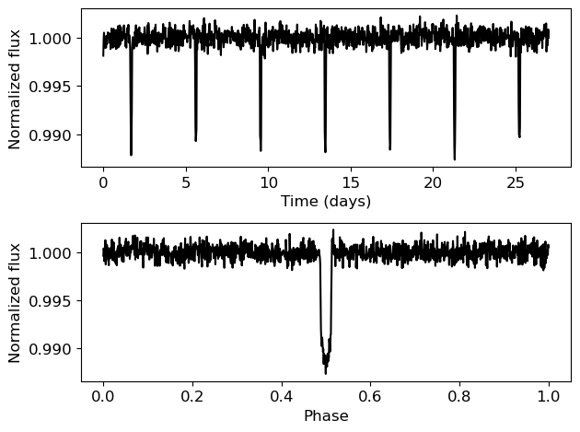
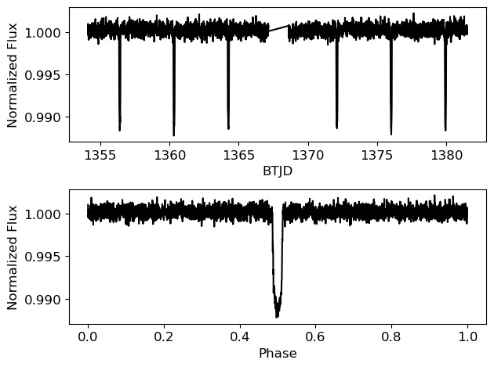
Results…
Inputs: complete light curves
Outputs: presence of exoplanets, orbital period, planet radius, semimajor axis of the orbit.
Simulated light curve
Real light curve: TIC 183537452

Slide 10
So… why 1D-CNN models are a good option?
1D-CNN models automatize the transits search.
1D-CNN are able to extract the main planetary parameters.
The timeframe needed is much lower ((2-10)s/lc with current algorithms vs 74s for $3∙{10}^{5}$ lc.)
Avoids human judge when classifying.
Easy to generalize to different surveys and telescopes.

Slide 11
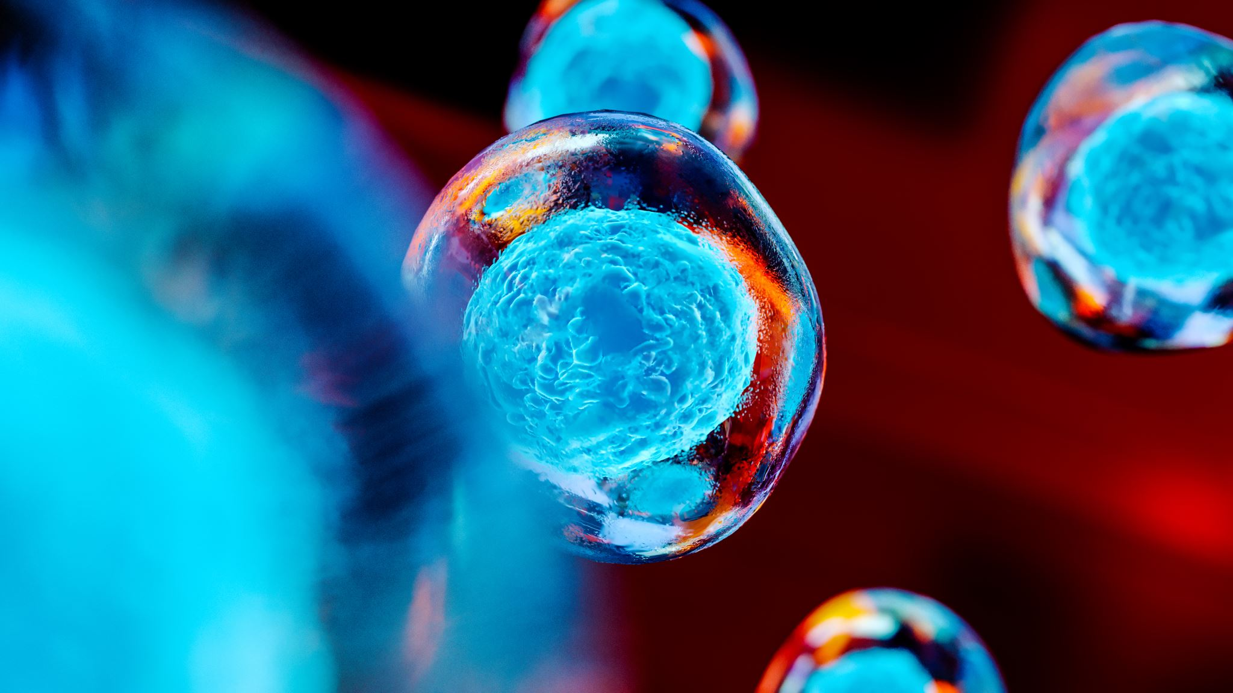
Exoplanet detection and characterization
Near Earth Asteroids characterization
Identification and follow up of artificial satellites
Pro – Am collaborations

Slide 12
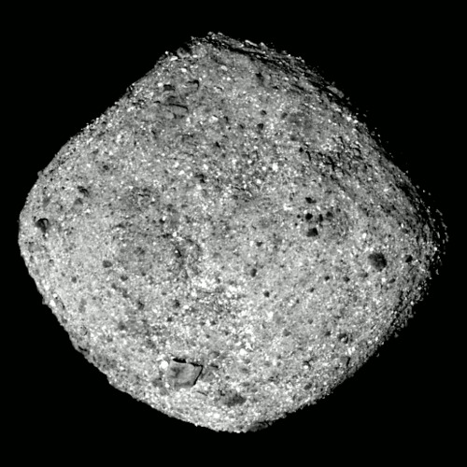
Near Earth Asteroids are rocky objects in the Solar System whose trayectories get close to the Earth ( < 0.3 Astronomical Units).
Due to their size ( ̴km) we observe these objects as point sources, even with big (optical) telescopes.
We study their rotation period, spin state and shape using light curves from multiple seasons applying the light curve inversion method (LCIM).
The LCIM finds the best fitting model for the asteroid parameters (spin and shape) for the observed light curves.

Slide 13
Data and shape modelling
New data provided from Instituto Astrofísico de Canarias (IAC); observations taken in 2020-2022.
Archival data from DAMIT and ALCDEF databases.
Lightcurve inversion method done with DAMIT code with both YORP and no YORP taken into account.

Slide 14
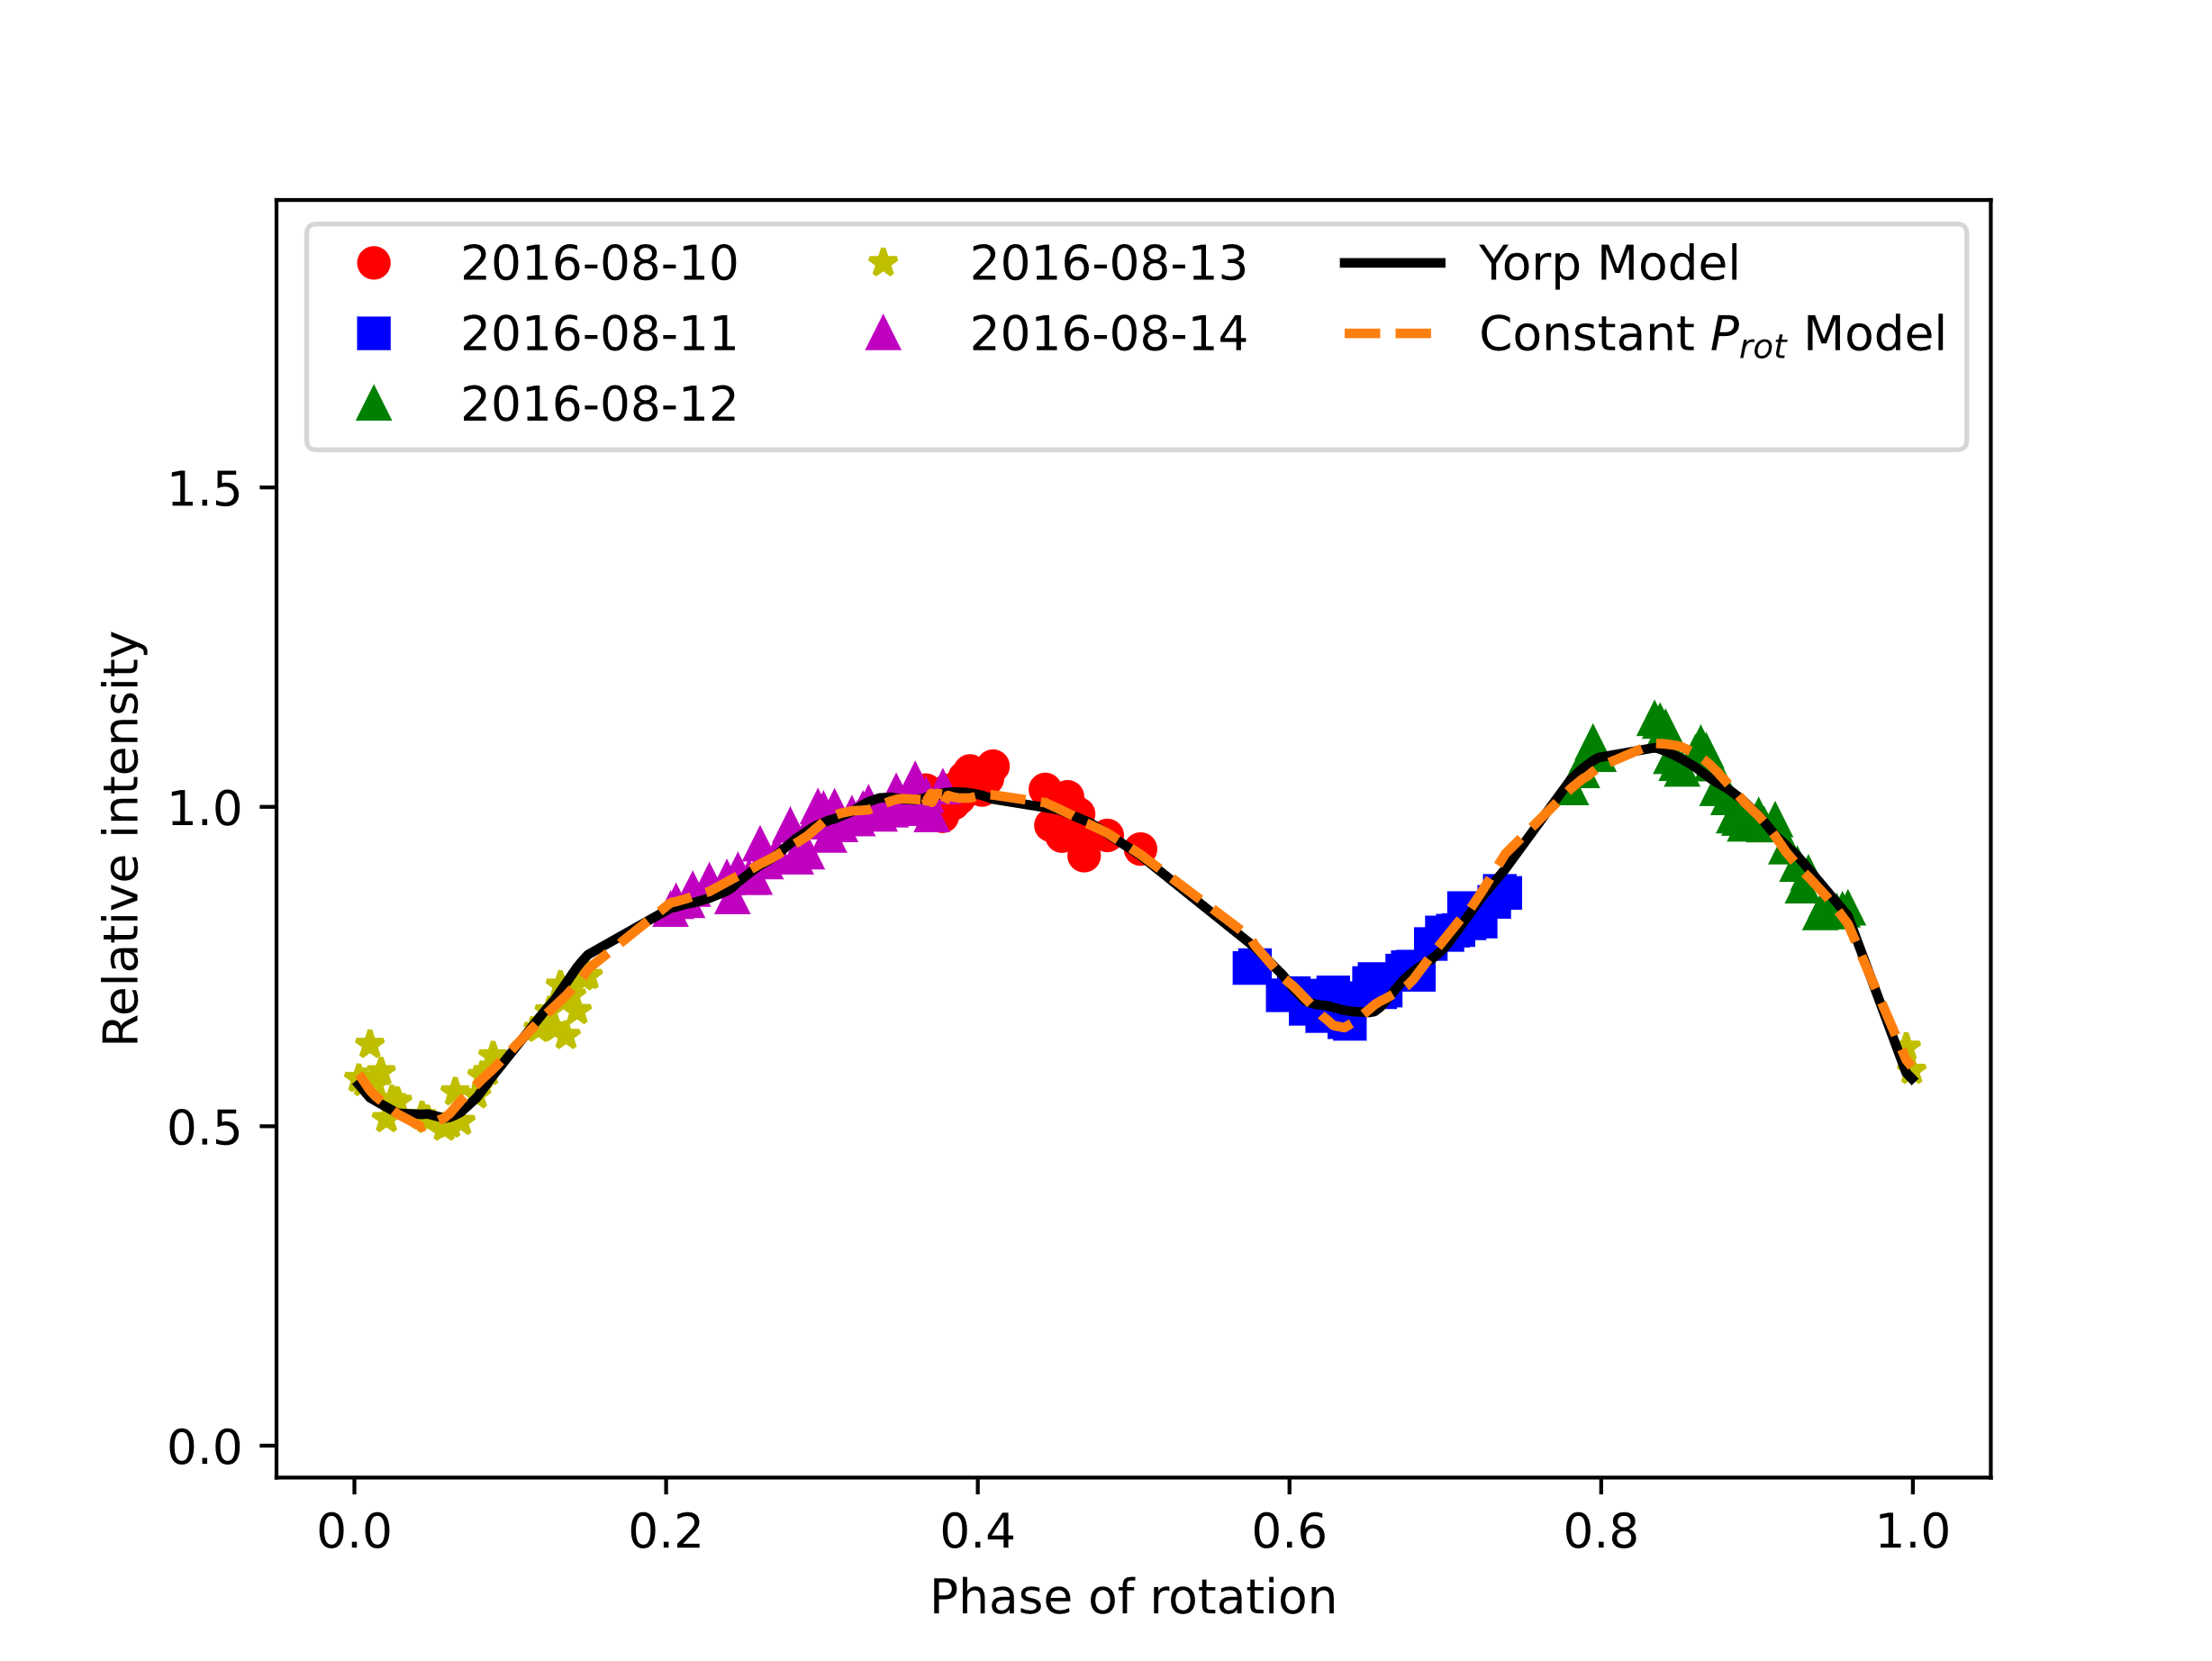
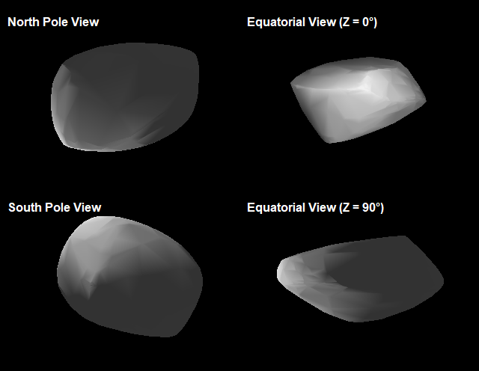
Some results…
(2100) Ra-Shalom
λ = 278° ± 8°
β = -60° ± 5°
P_{rot}= 19.820107 hr ± 0.000040 hr
υ = (0.22 ± 0.16) × 10⁻⁸ rad d⁻²
The model with YORP effect has lower RMS and uncertainty, which could mean that this would be the slowest rotator being affected by YORP discovered.

Slide 15
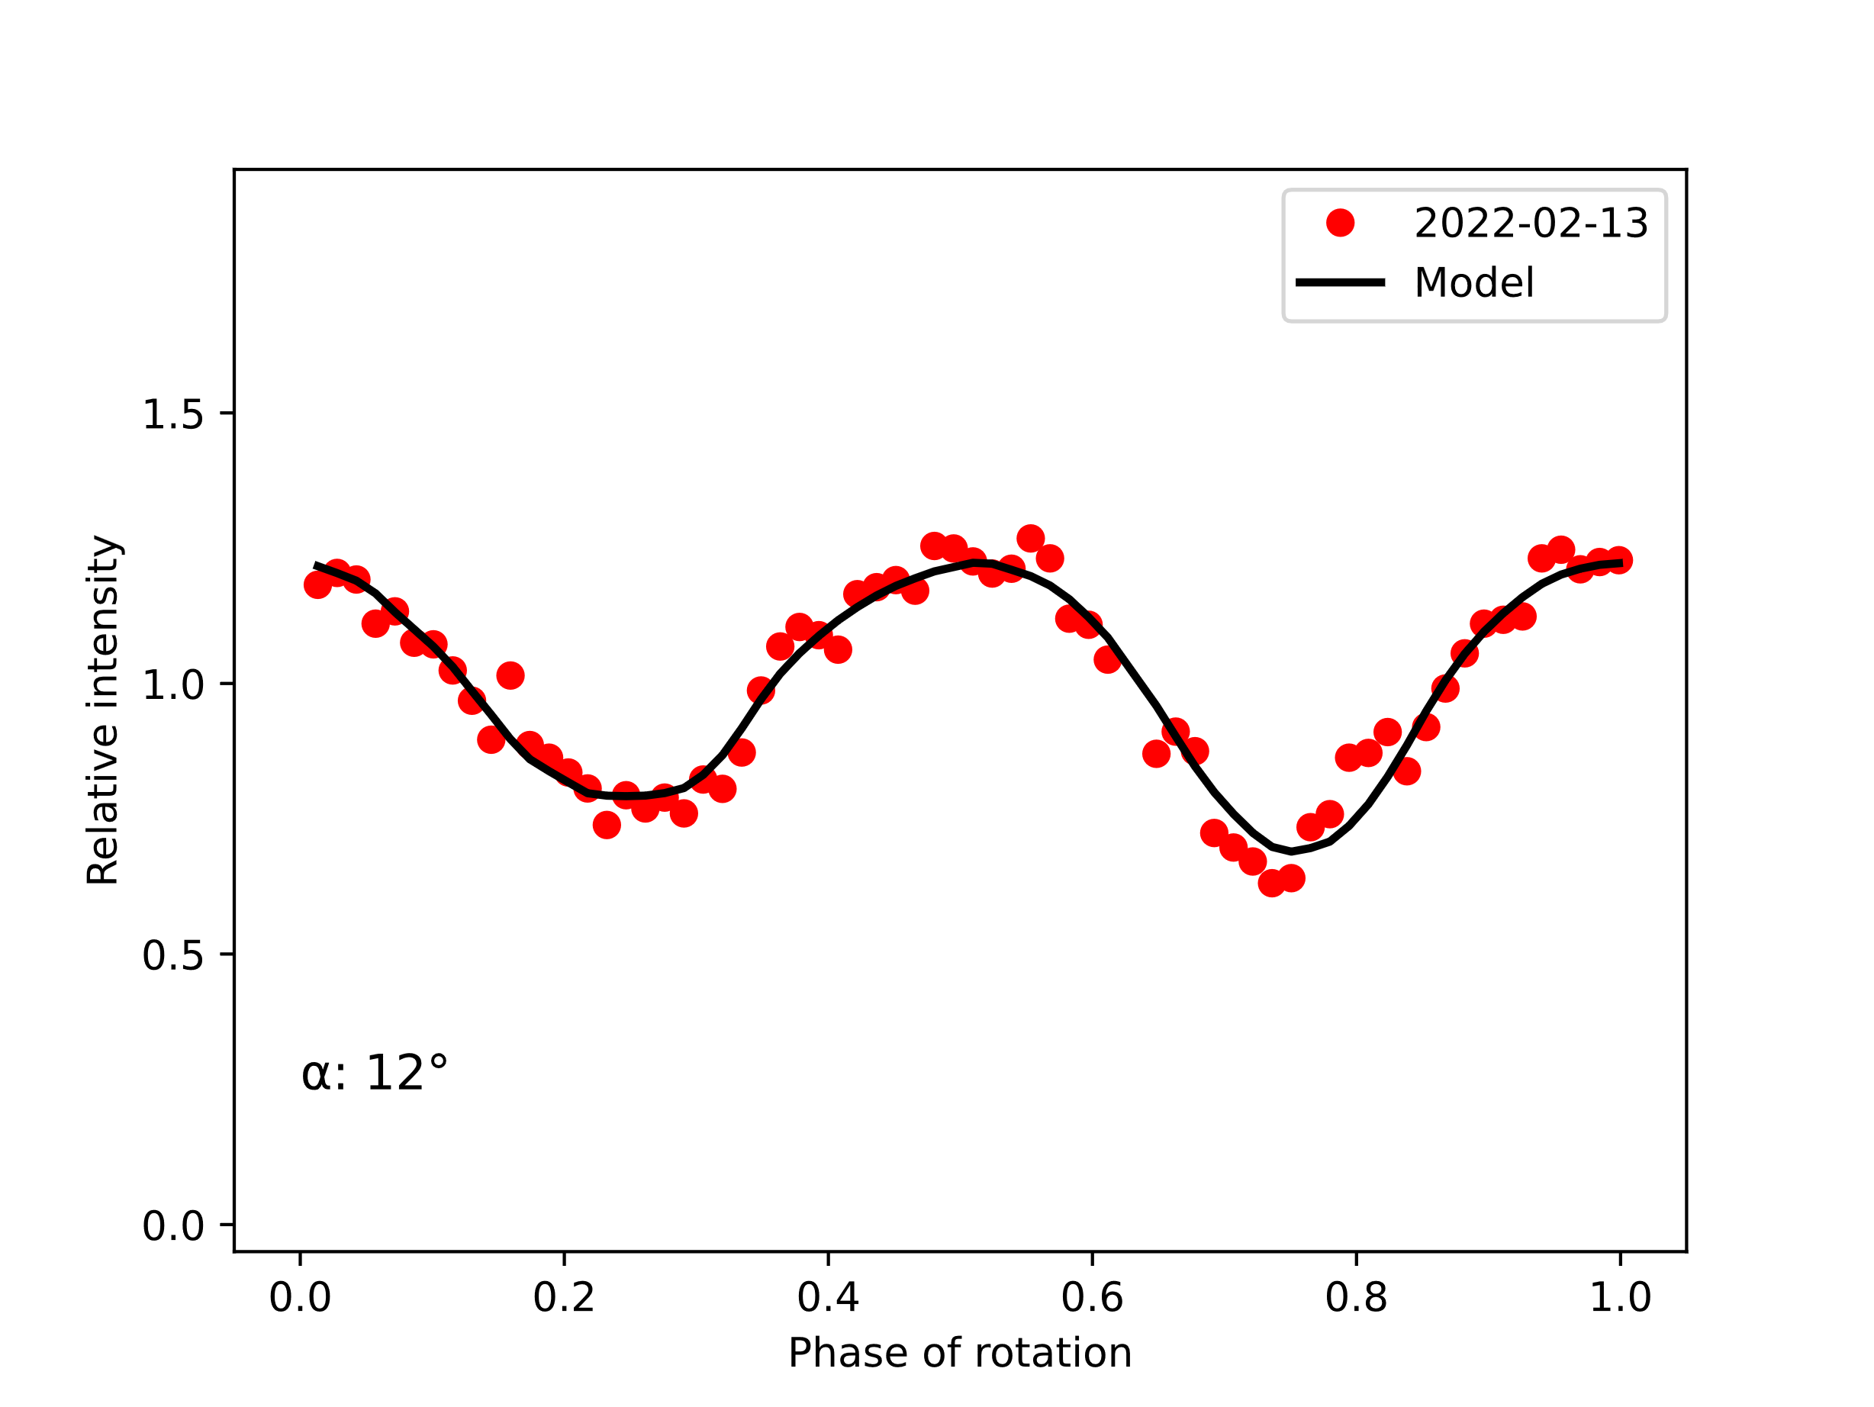
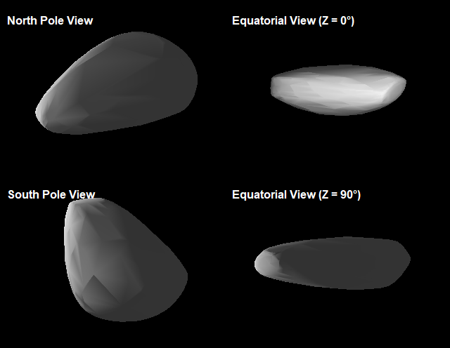
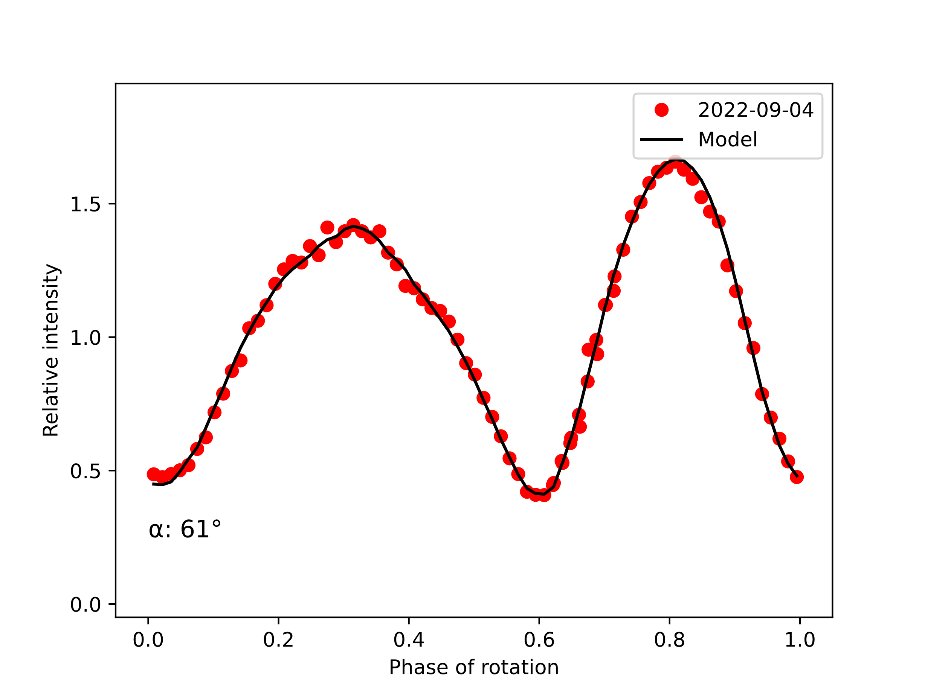
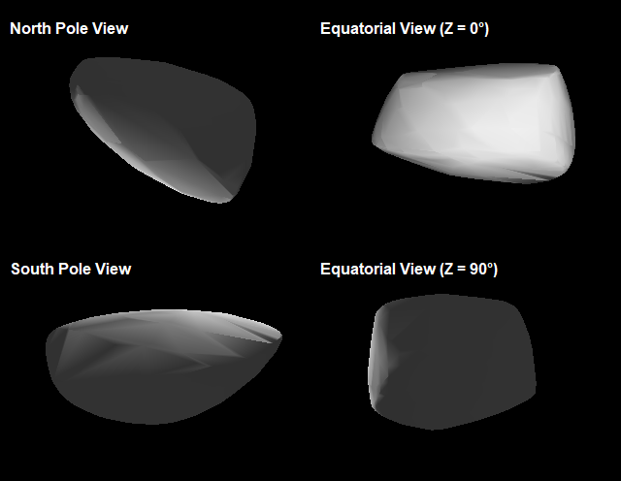
(3103) Eger
λ = 214° ± 3°
β = -71° ± 1°
P_{rot}= 5.710148 hr ± 0.0000006 hr
υ = (0.85 ± 0.05) × 10⁻⁸ rad d⁻²
(161989) Cacus
λ = 251° ± 6°
β = -62° ± 2°
P_{rot}= 3.755067 hr ± 0.000001 hr
υ = (1.91 ± 0.05) × 10⁻⁸ rad d⁻²

Slide 16
Exoplanet detection and characterization
Near Earth Asteroids characterization
Identification and follow up of artificial satellites
Pro – Am collaborations

Slide 17
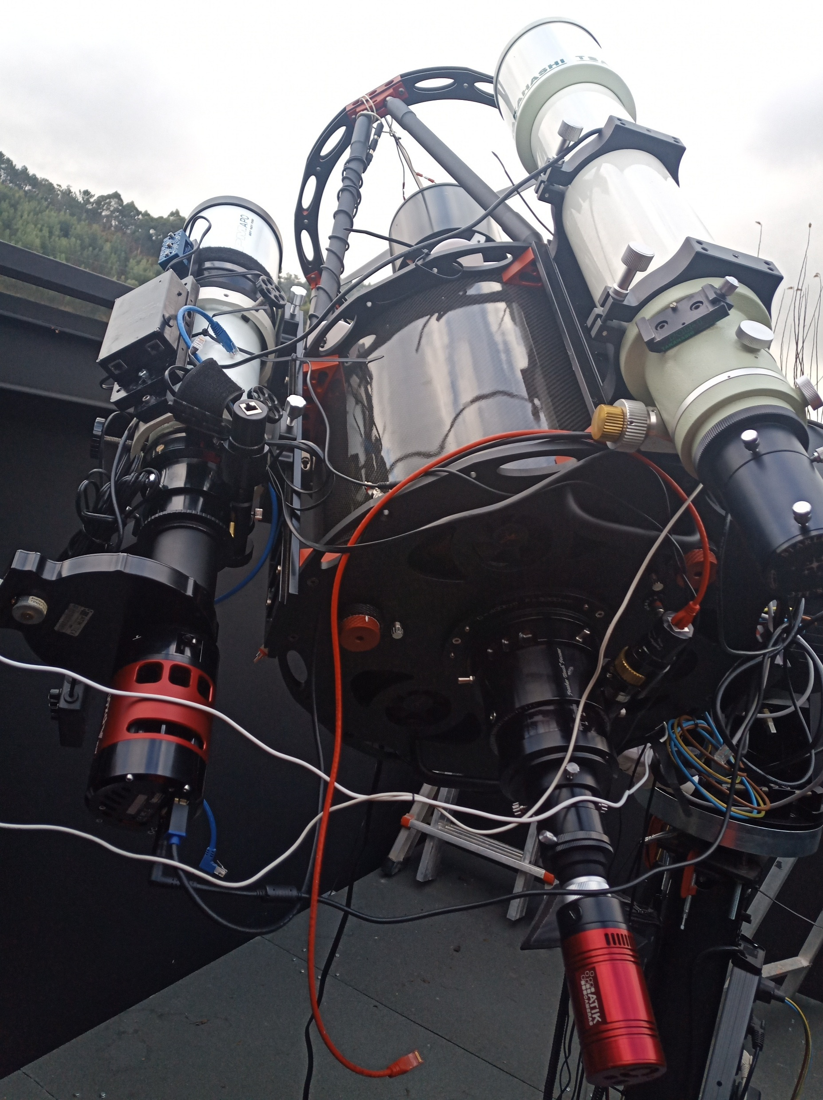
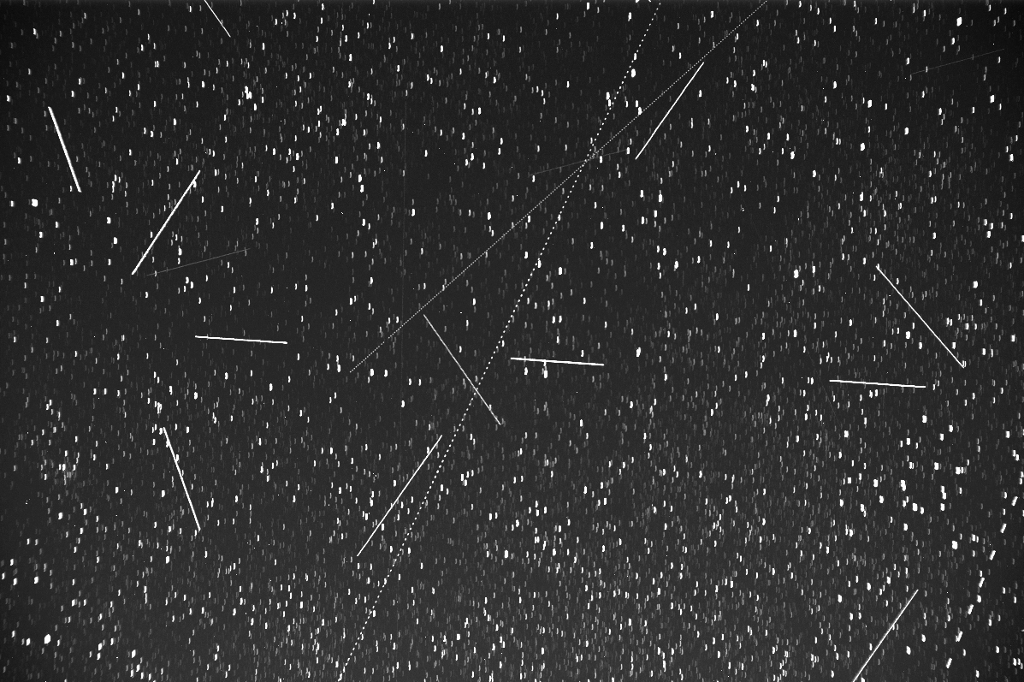
Main goal: develop an autonomous detection system focussing on artificial satellites, space debris and also NEOs.
Optical facilities and machine learning techniques.
Real data
Collaboration with Dr. René Duffard (Instituto de Astrofísica de Andalucía). More than 11.000 images to search for satellite tracks.
Pillarno Observatory (Ritchey-Chrétien 400 mm diameter telescope).

Slide 18
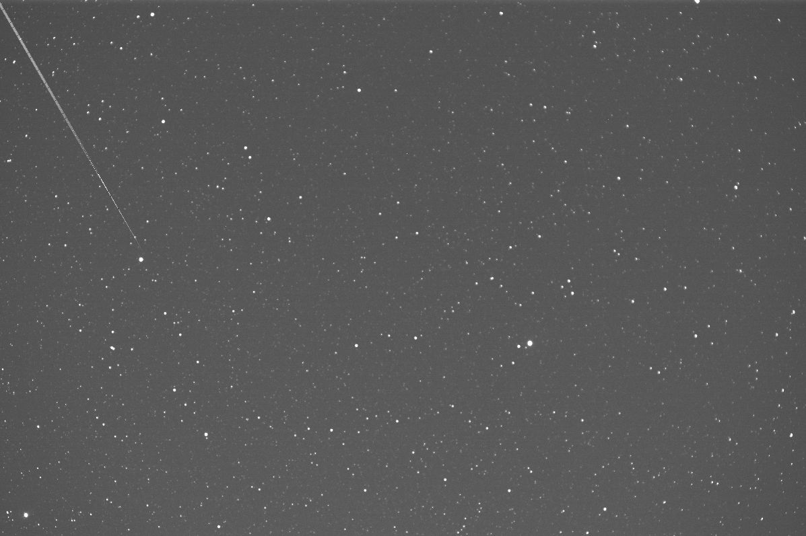
Also simulated data...

Slide 19
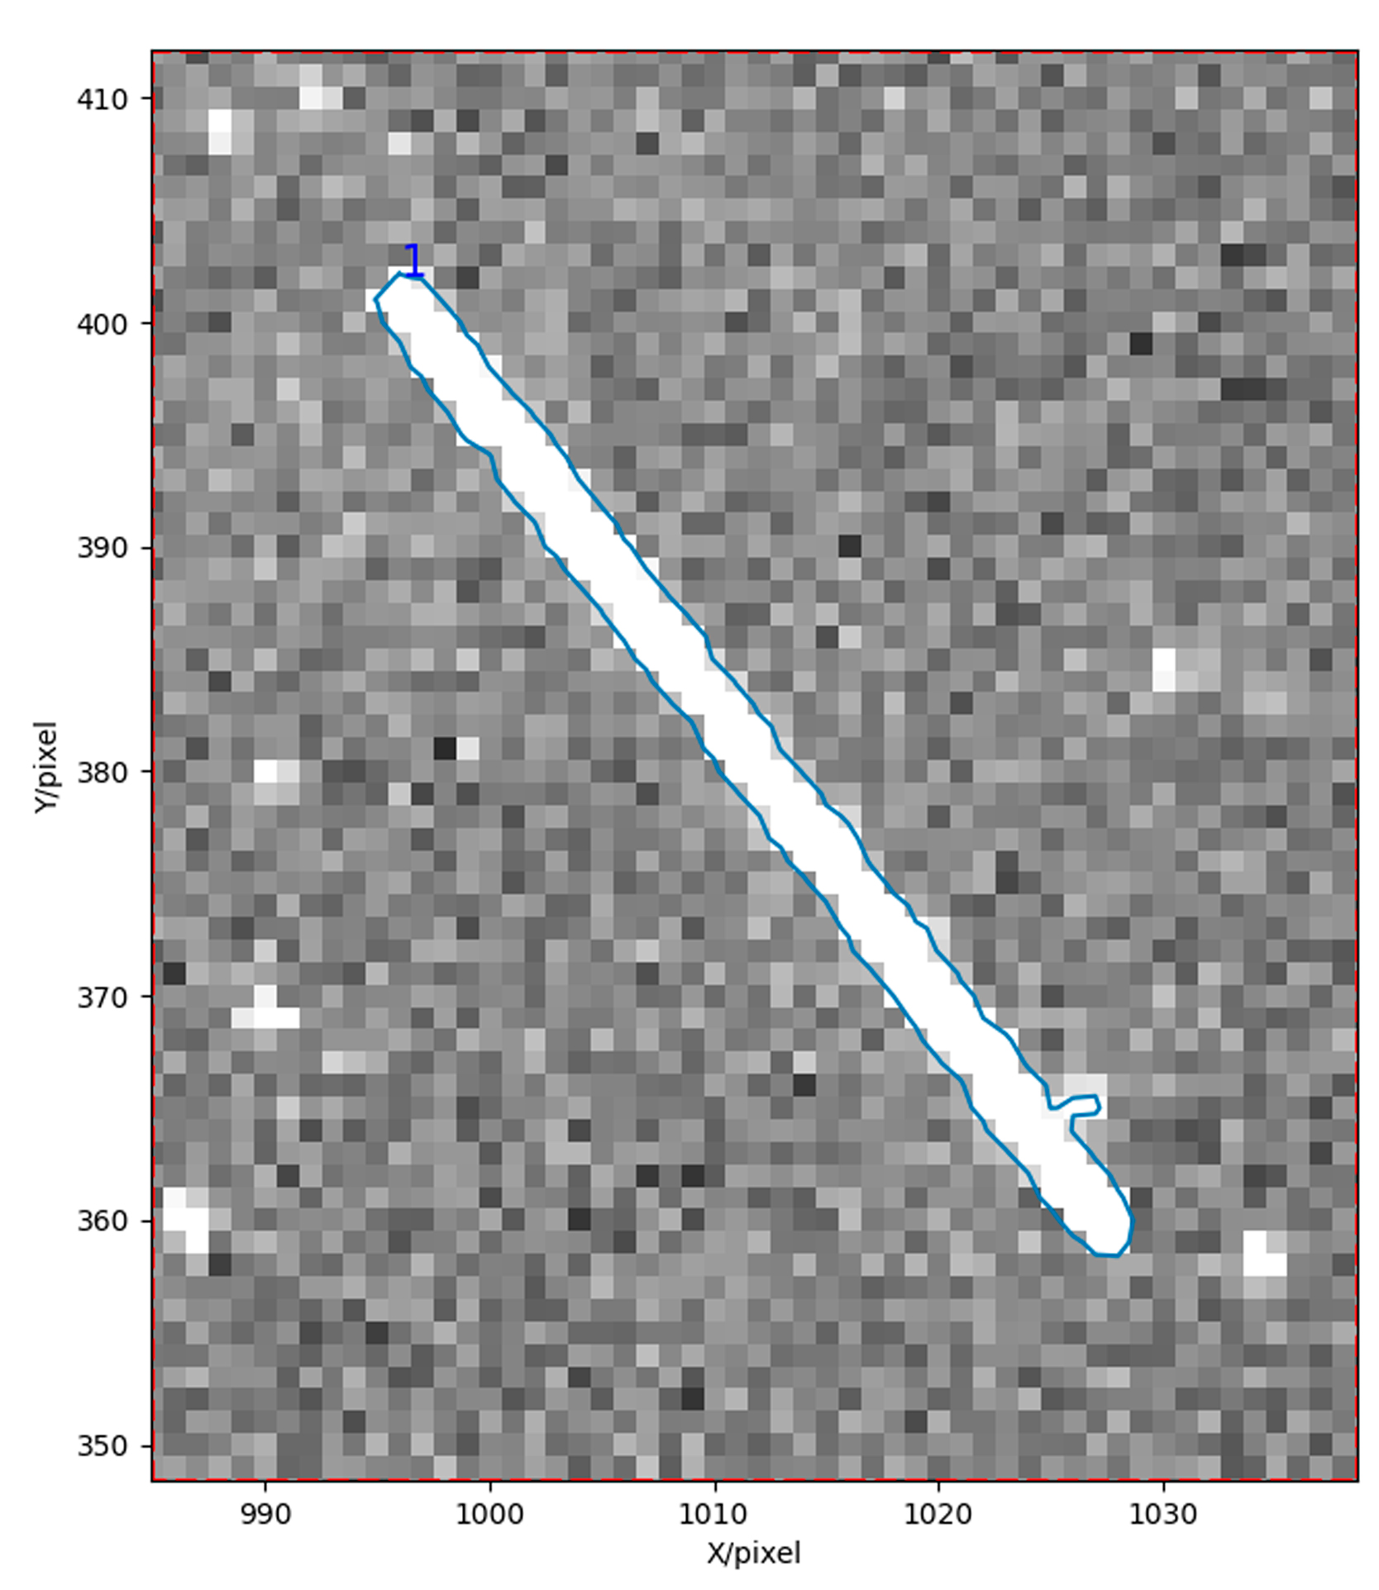
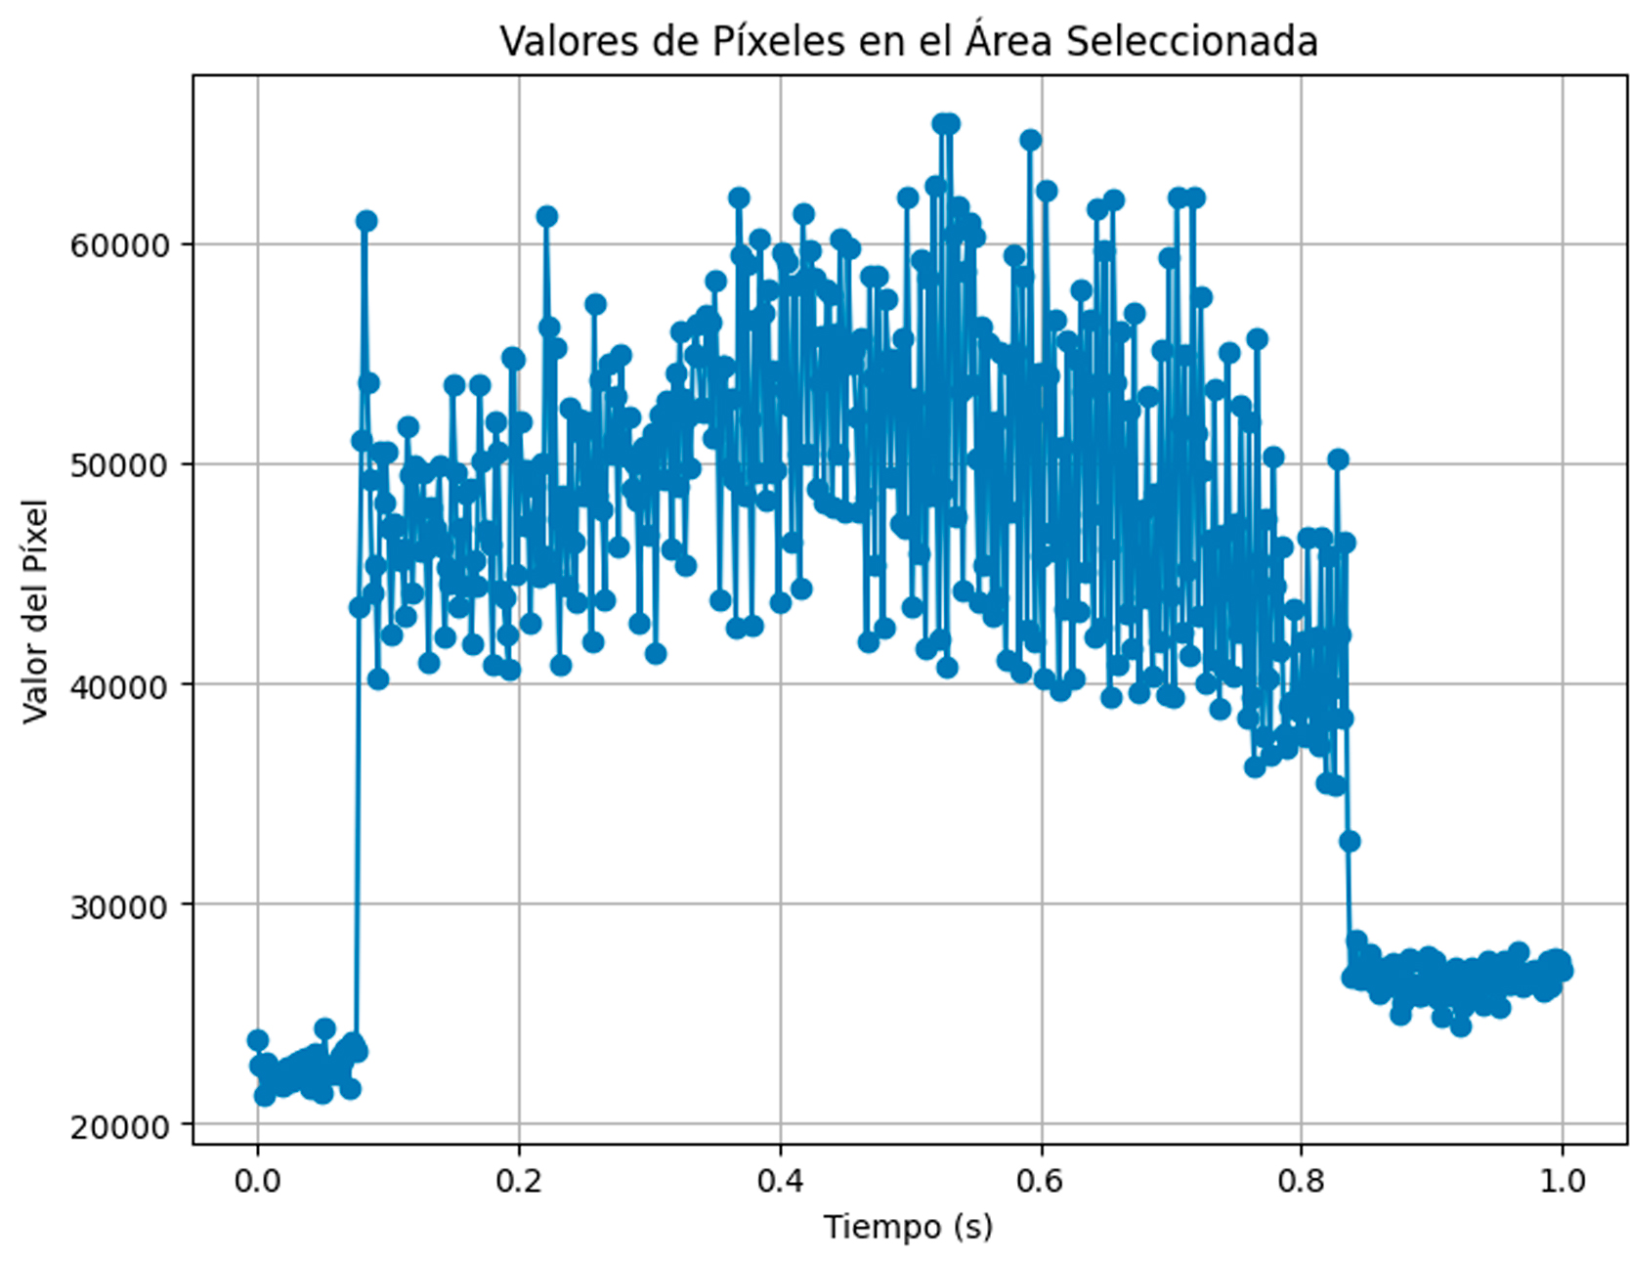
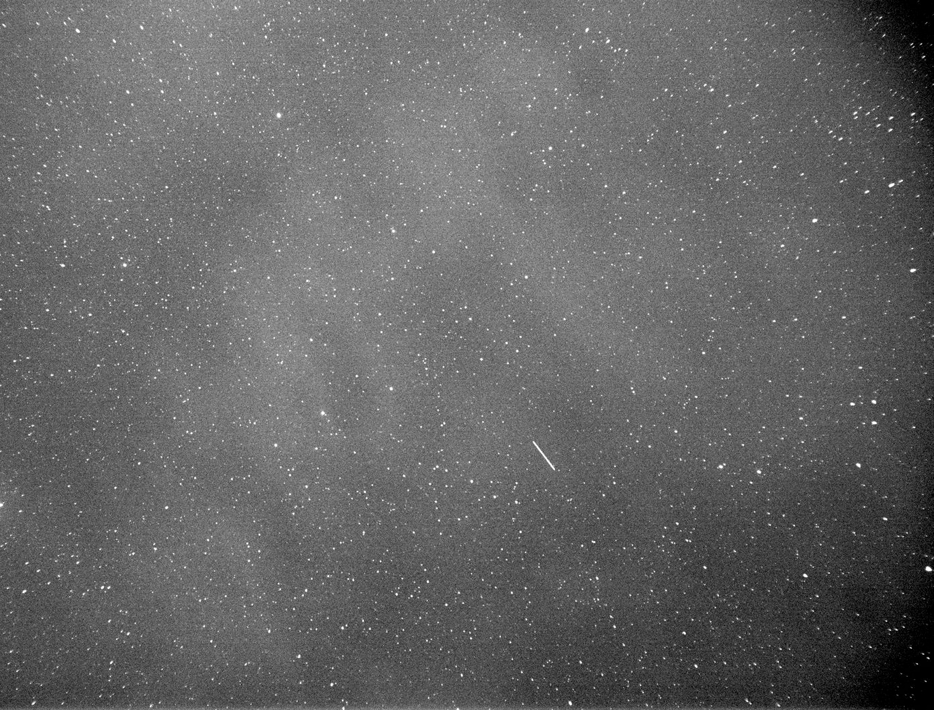
We identify the track of the satellite.
Comparing the observed with the predicted (from ephemeris) coordinates of the satellite we can determine orbital changes.
Also observing certain features in its light curve it is posible to infer its rotation state and operational status.

Slide 20
Exoplanet detection and characterization
Near Earth Asteroids characterization
Identification and follow up of artificial satellites
Pro – Am collaborations

Slide 21
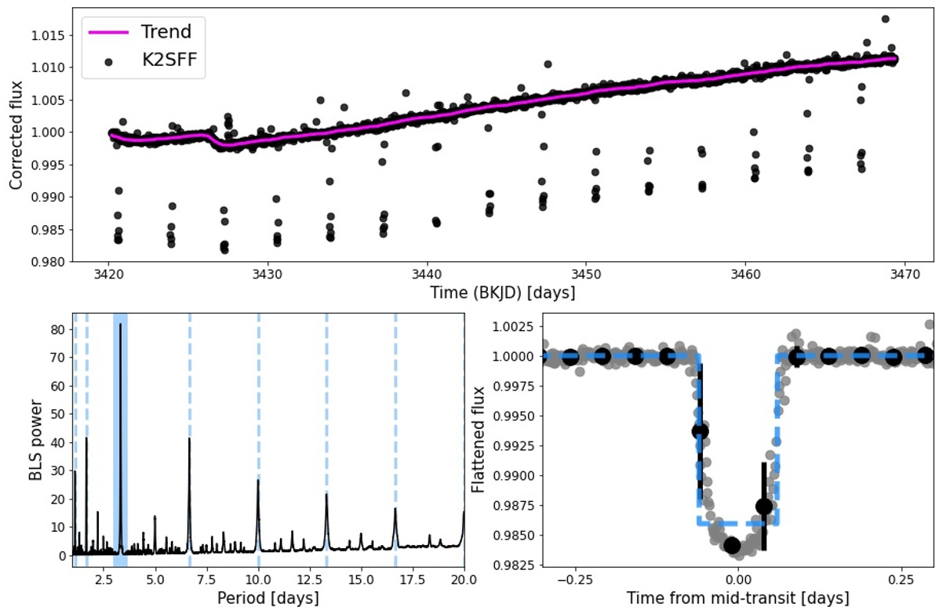
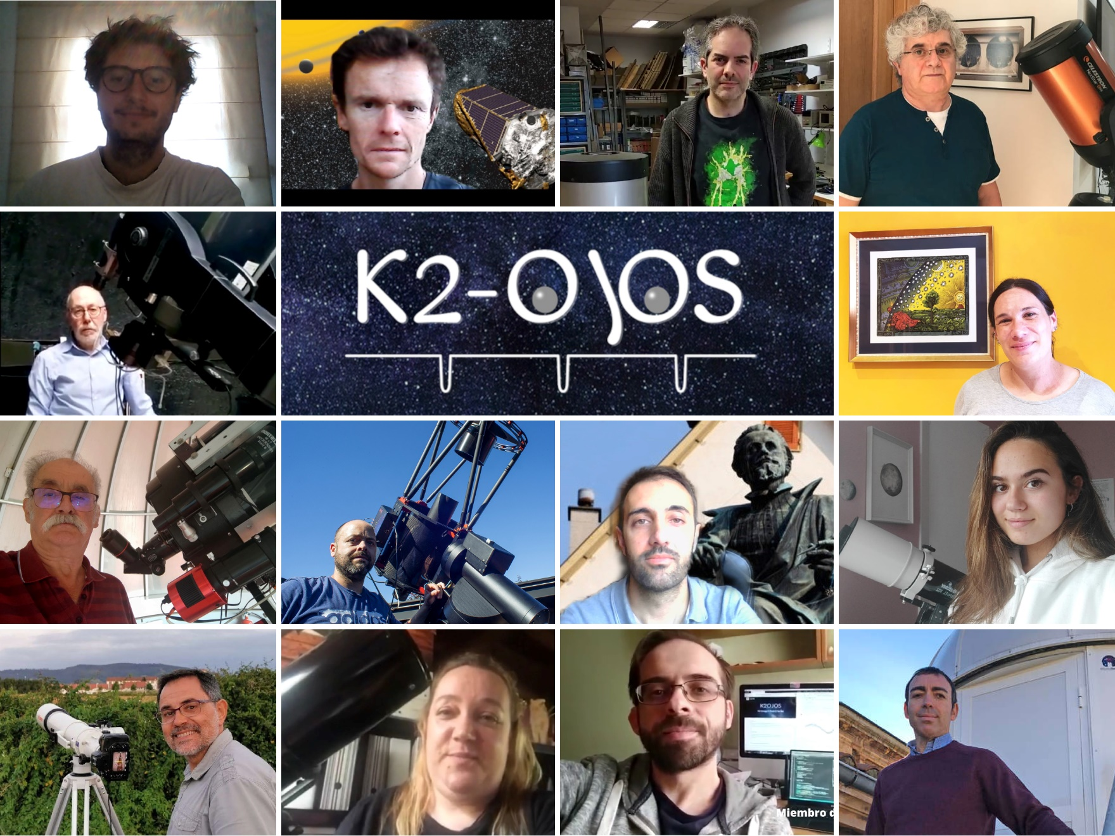
The K2-OjOs project is a pro am collaboration between researchers from ICTEA and amateur astronomers from SAA Omega.
The goal of the project was to visually inspect light curves from the K2 mission to search for exoplanets.
As a results 4 new planets were discoverd, along with 14 candidates; the power of the eye against modern techniques…

Slide 22
To this day, despite thousands of exoplanets discovered, no exomoon has been detected.
A few projects have automatically inspected light curves of the highest precision and high cadence in search of signals of possible exomoons, but the exomoons remain elusive (only one candidate: Kepler - 1625b I).
Pro-am collaboration goal: trained (am) observers will inspect all the planetary transits present in short cadence light curves of the Kepler main mission to search for subtle signals that could be the signature of exomoons.

Slide 23
Simulated data

Slide 24
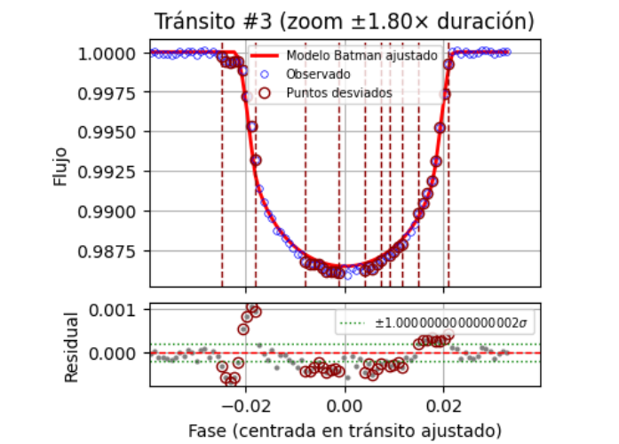
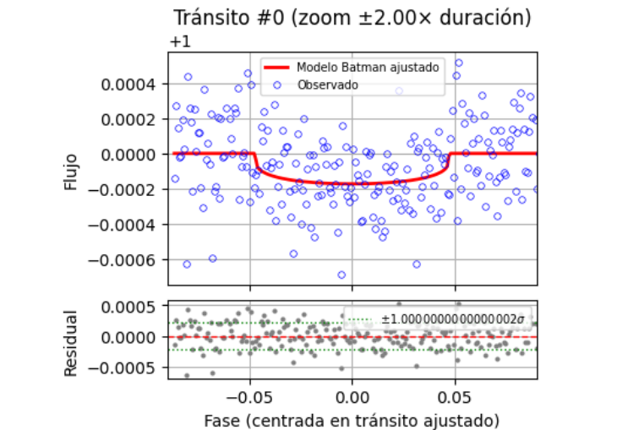
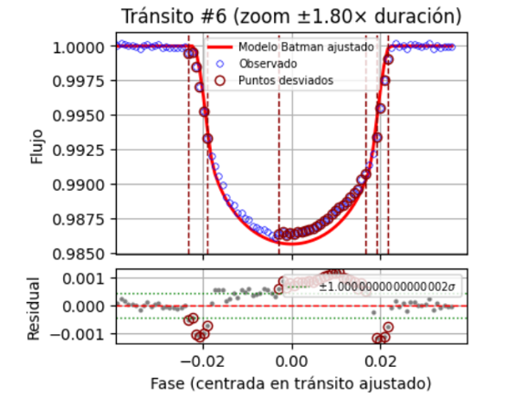
What to look for?
Moon transits first
Real data: super Earth Kepler 10 b
Mutual event in transit

Slide 25
Focusing on…
Light curves with short cadence data (2 minutes).
Exoplanets with transit timing variations (TTVs) and transit duration variations (TDVs).
Exoplanets with transits of long duration.
Inspect light curves of exoplanets not expected to harbor moons.
Inspect exoplanets with long cadence data (30 minutos) and eventually all the light curves of exoplanet in Kepler data.
Extend the search to other facilities as TESS.

