Slide 1
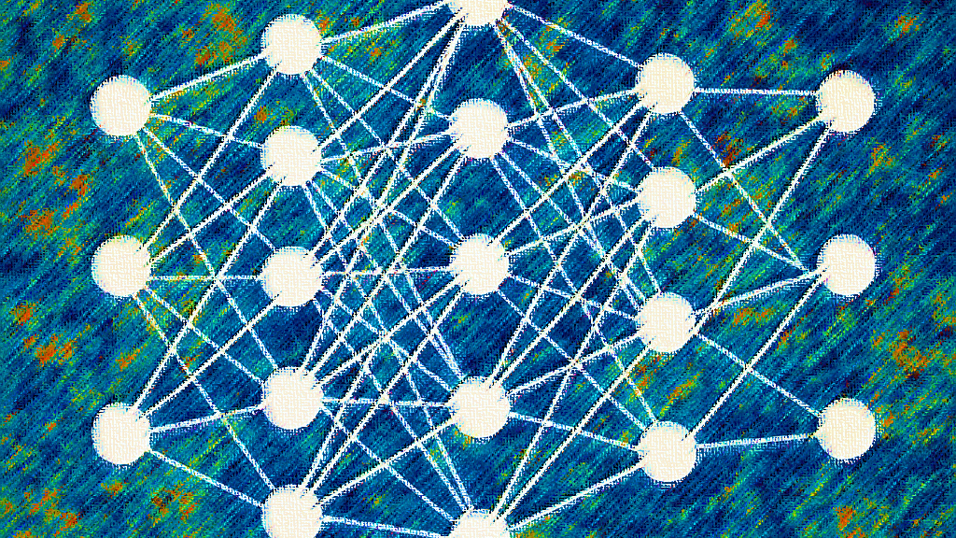
Artificial Neural Networks Applications to CMB Observations
PhD student: Valentina Franco Velásquez
Advisors: Laura Bonavera and R. Belén Barreiro
June 20, 2025

Slide 2
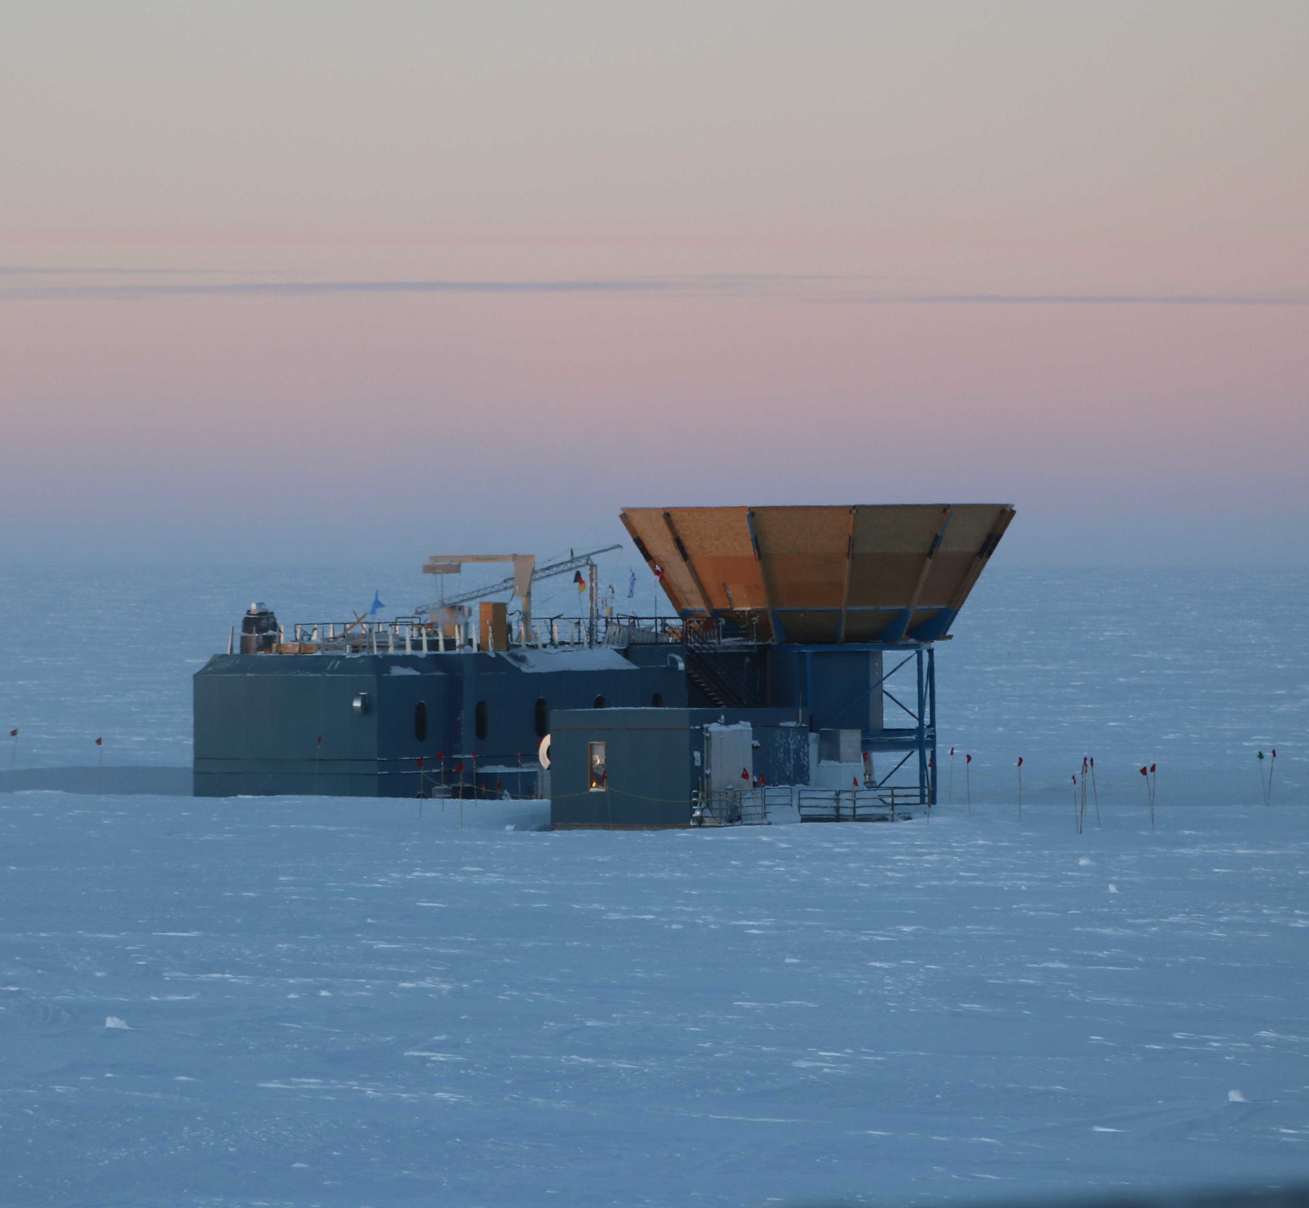
Content
The cosmic microwave background (CMB)
What is that?
The power spectrum and what it can say about the universe.
CMB polarization: what it is and how important it is.
The tensor-to-scalar ratio: deepening our knowledge.
The annoying foregrounds.
My research Project
Outline.
What has been done so far…
Ongoing and future work.
References
BICEP/Keck telescope at the South Pole

Slide 3
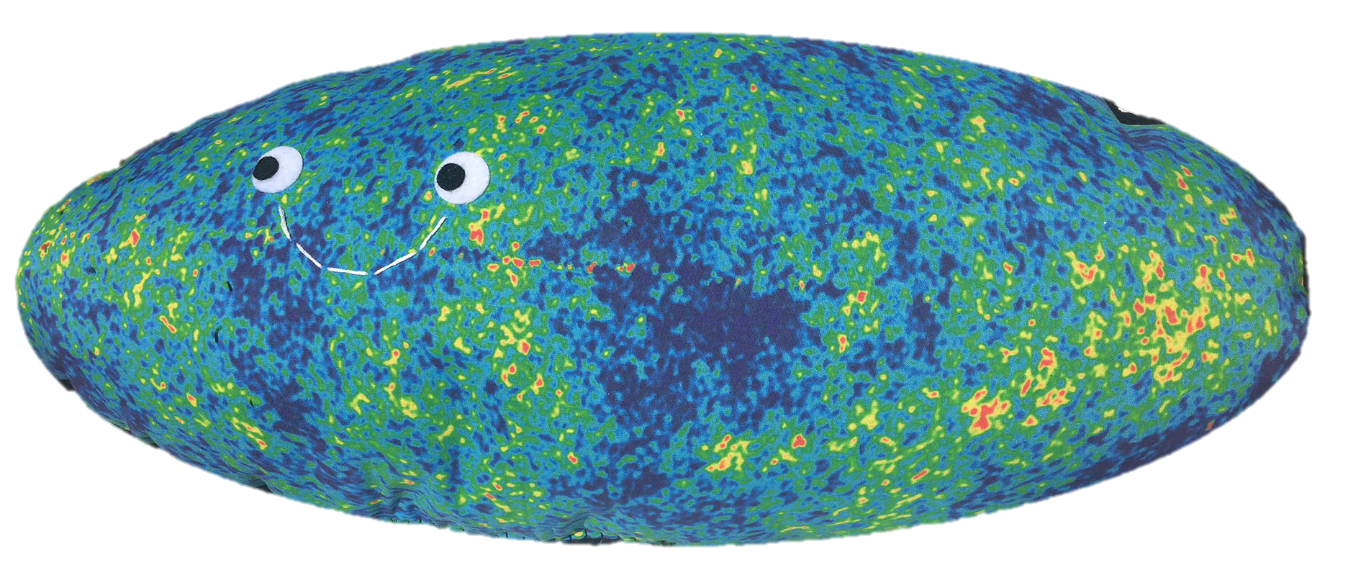
The cosmic microwave background

Slide 4
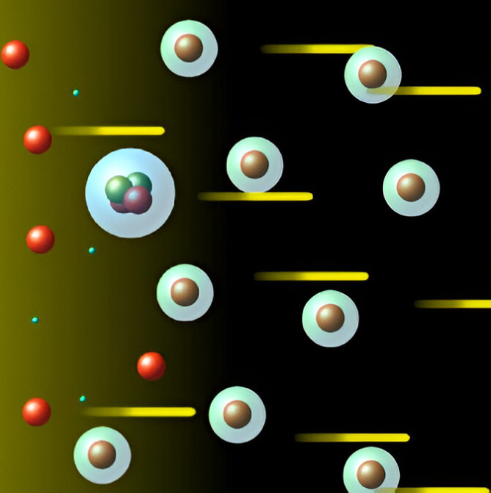
What is that?
The Cosmic Microwave Background, or CMB for short, is nothing but the cooled remnant of the first light that could ever travel freely throughout the Universe.
1/35

Slide 5
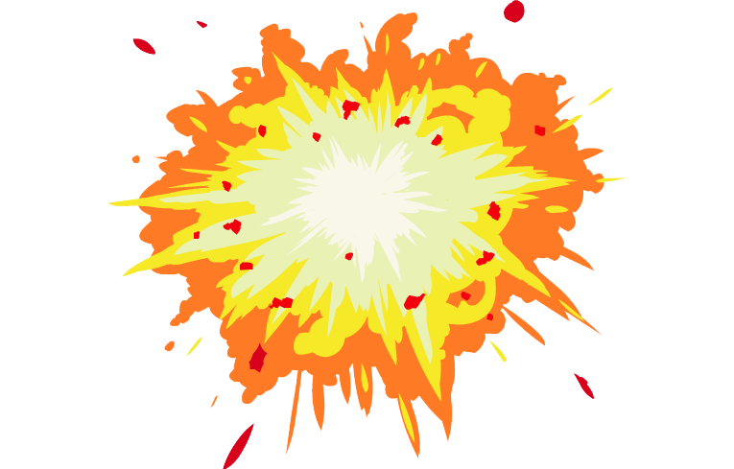
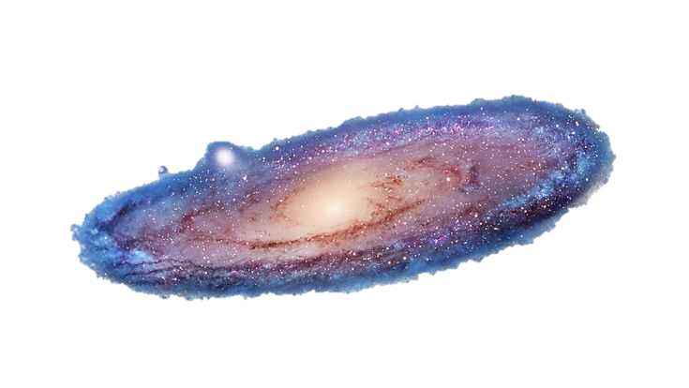
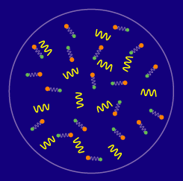
What exactly does that mean?
$$3.000 K$$
$$2,725 K$$
BB
$$380.000 yr$$
$$13,8 Gyr$$
PARTICLES
INTERACTIONS
Electrons
Coulomb interactions
Protons
Photons
Neutrons
Thomson scattering
Helium nuclei
Neutrinos
The photon-baryon plasma
2/35

Slide 6
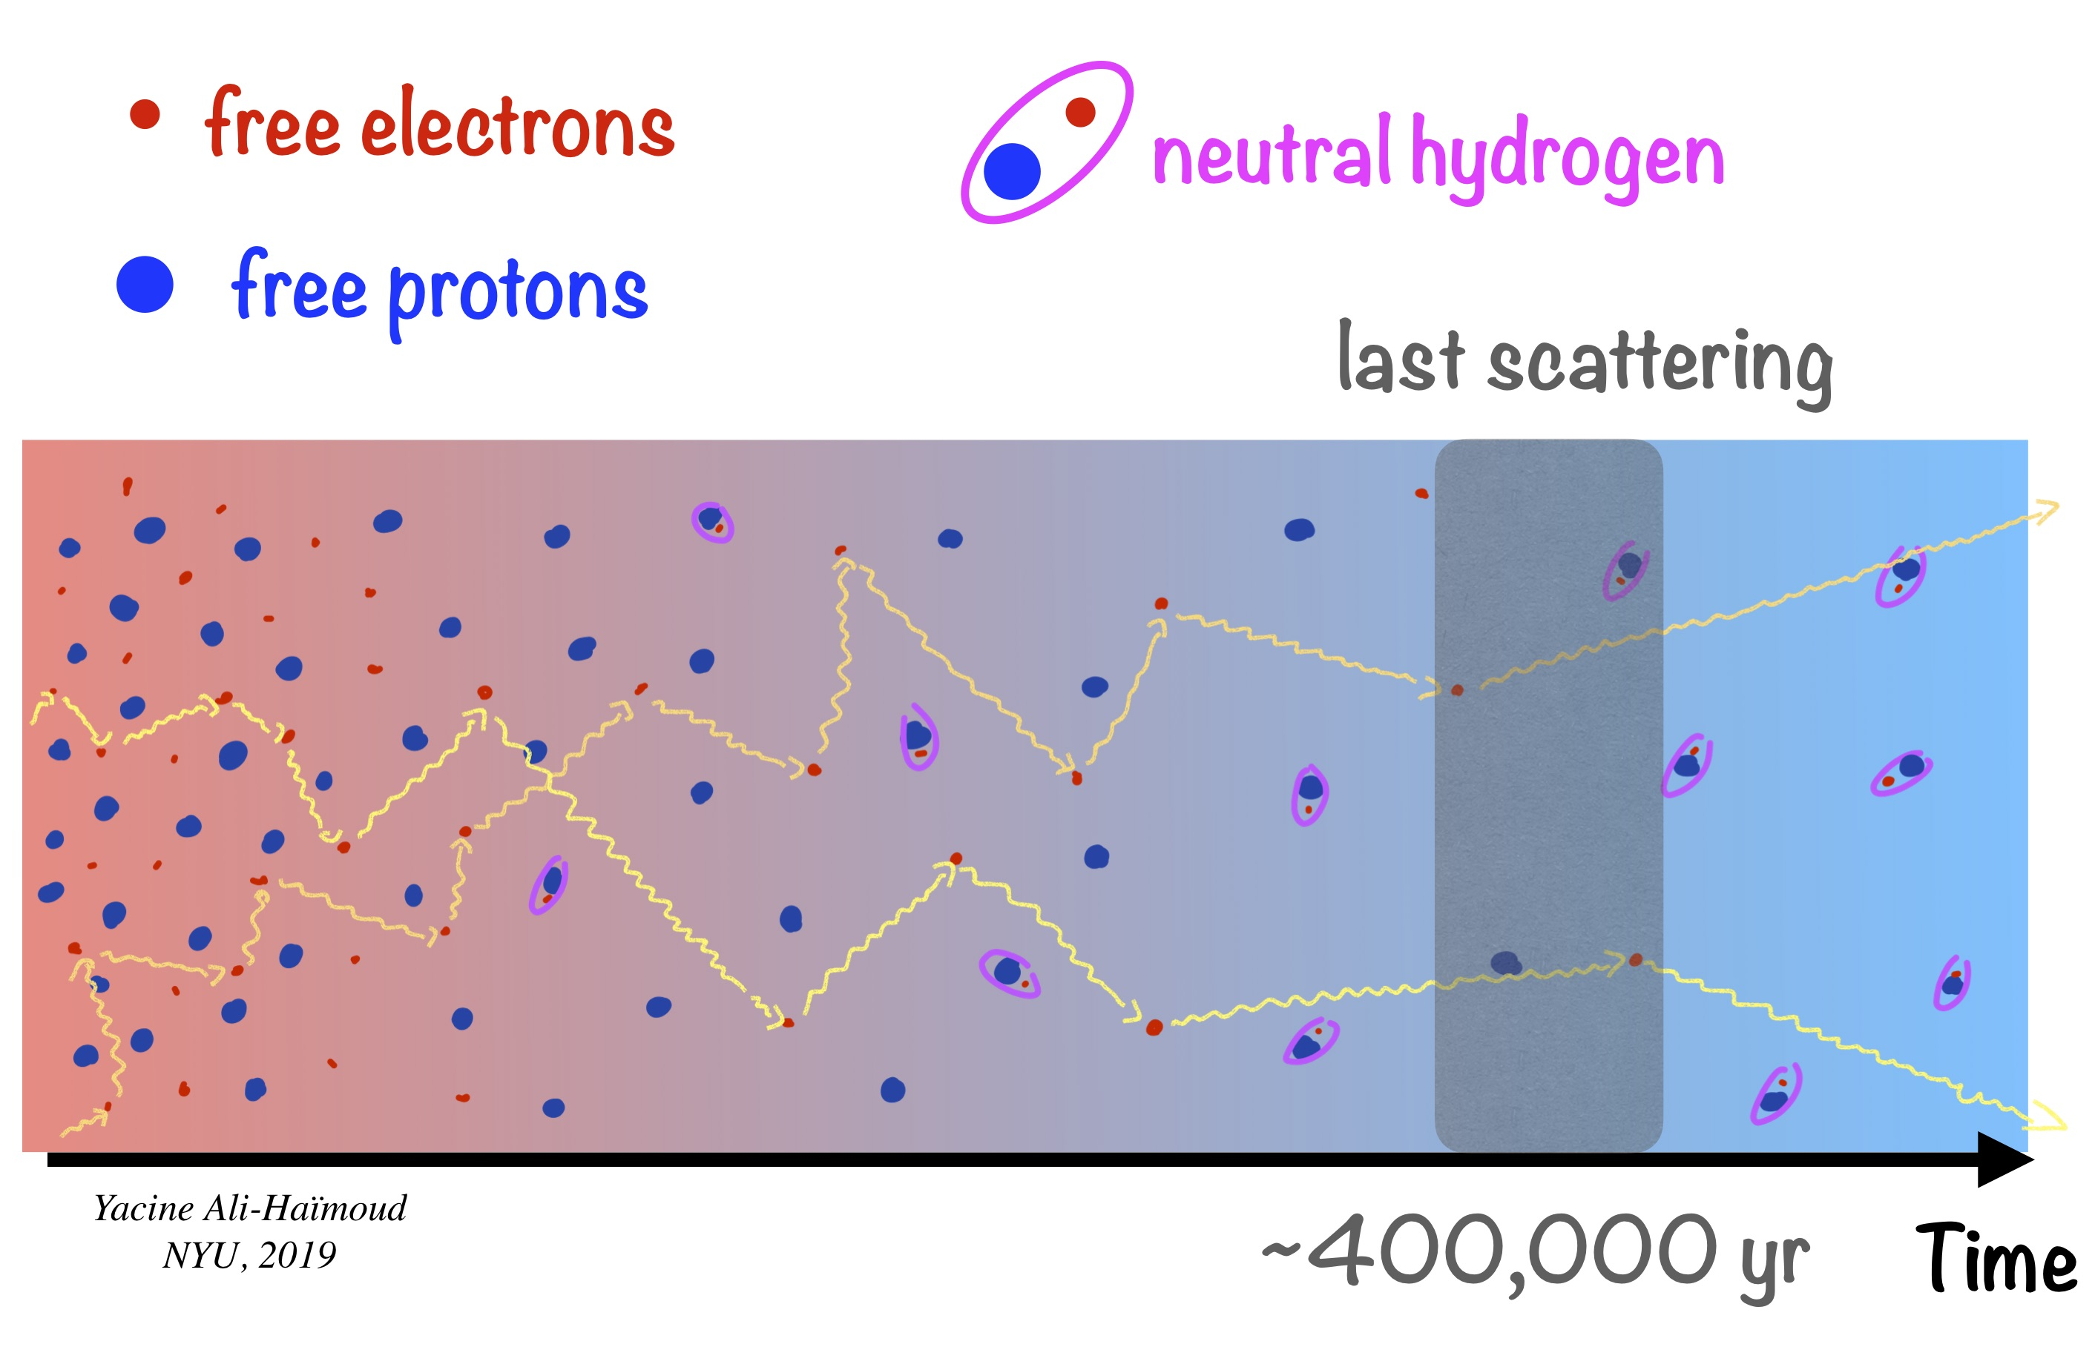
RECOMBINATION
TODAY
$$3.000 K$$
$$2,725 K$$
BB
$$380.000 yr$$
$$13,8 Gyr$$
Cosmological redshift
3/35

Slide 7
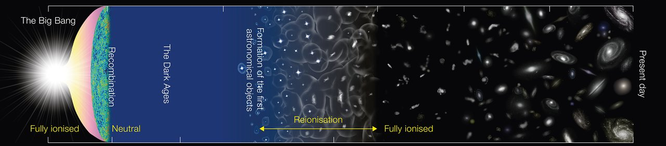
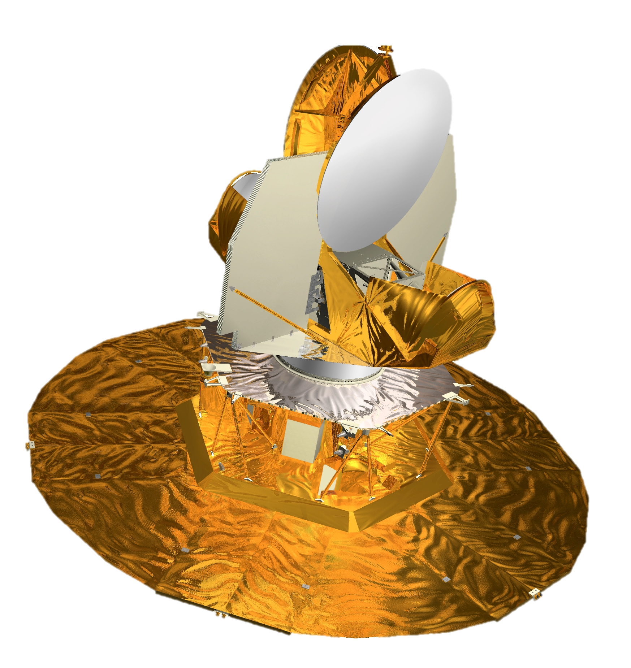
RECOMBINATION
TODAY
$$3.000 K$$
$$2,725 K$$
BB
$$380.000 yr$$
$$13,8 Gyr$$
What do those photons look like to us?
4/35

Slide 8
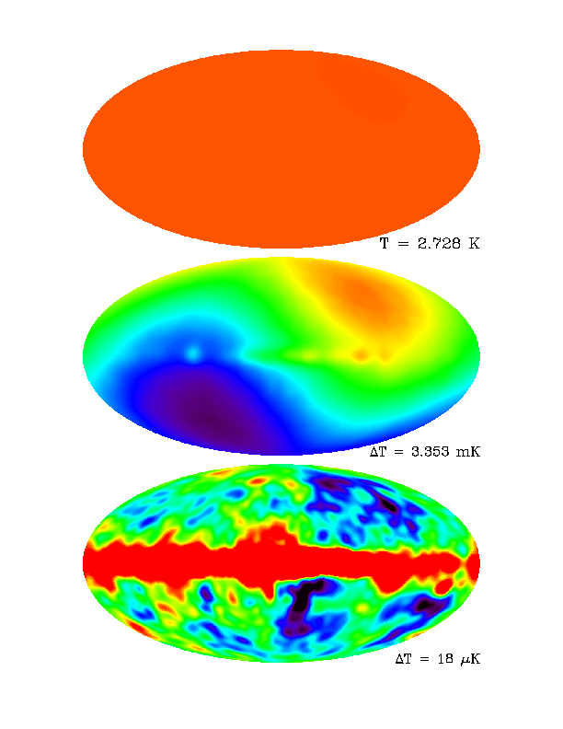
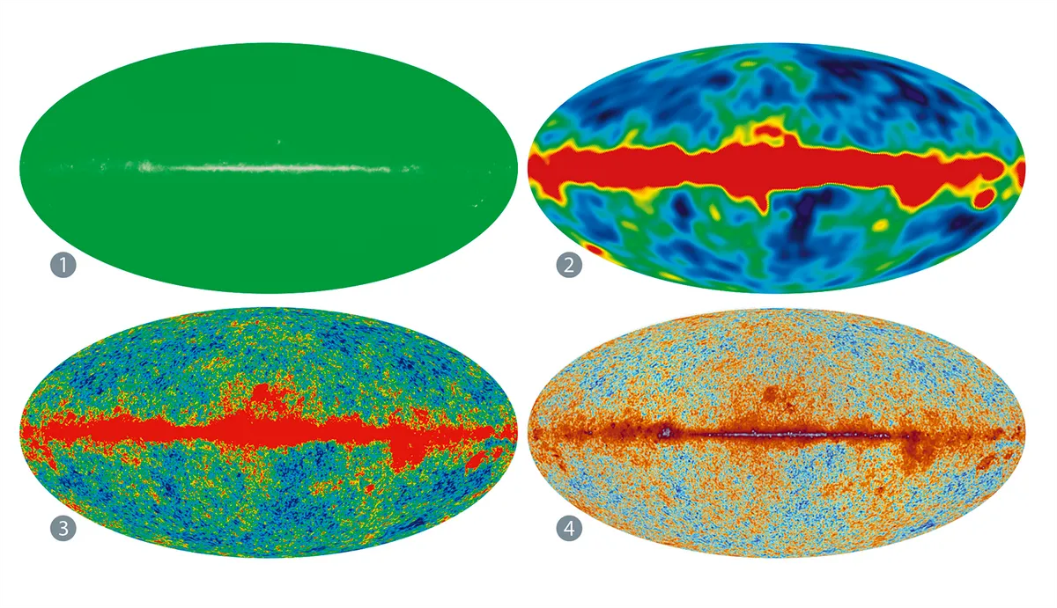
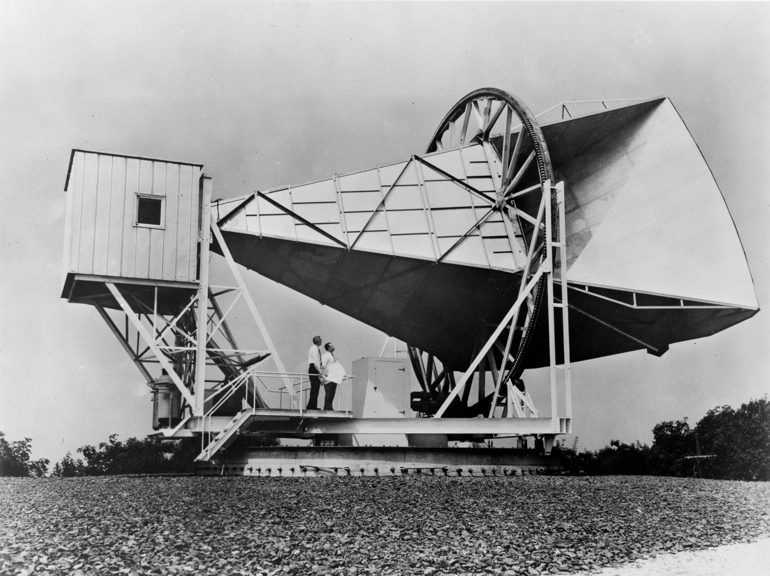
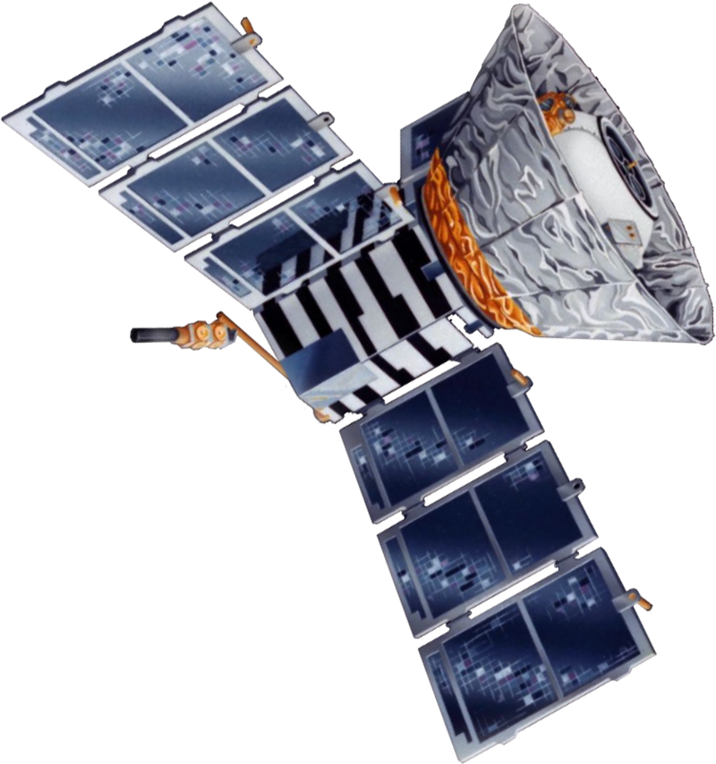
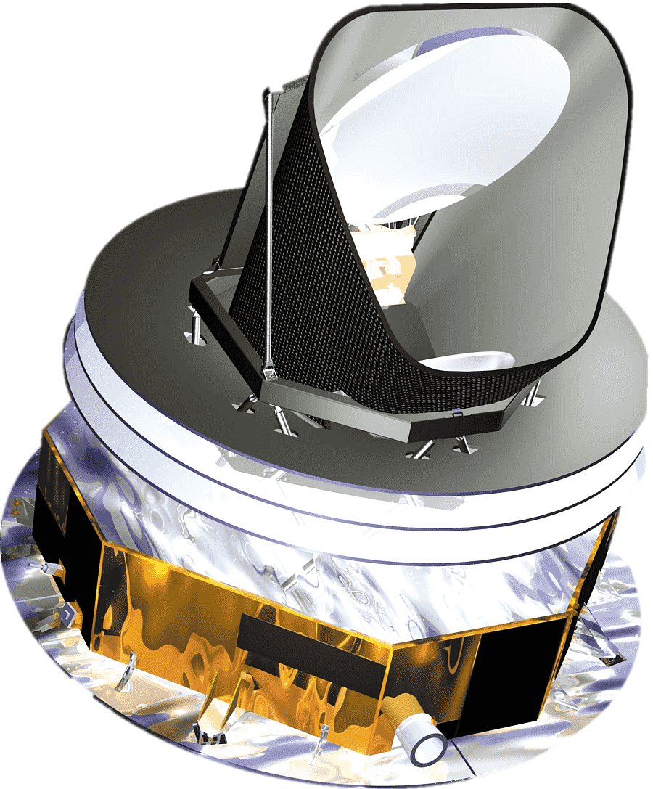
It depends…
On the instrument
&
The scale
Average temperature
PENZIAS AND WILSON - 1965
Relative motion
1/1000
COBE - 1992
Anisotropies
1/100.000
WMAP - 2003
PLANCK - 2013
5/35

Slide 9
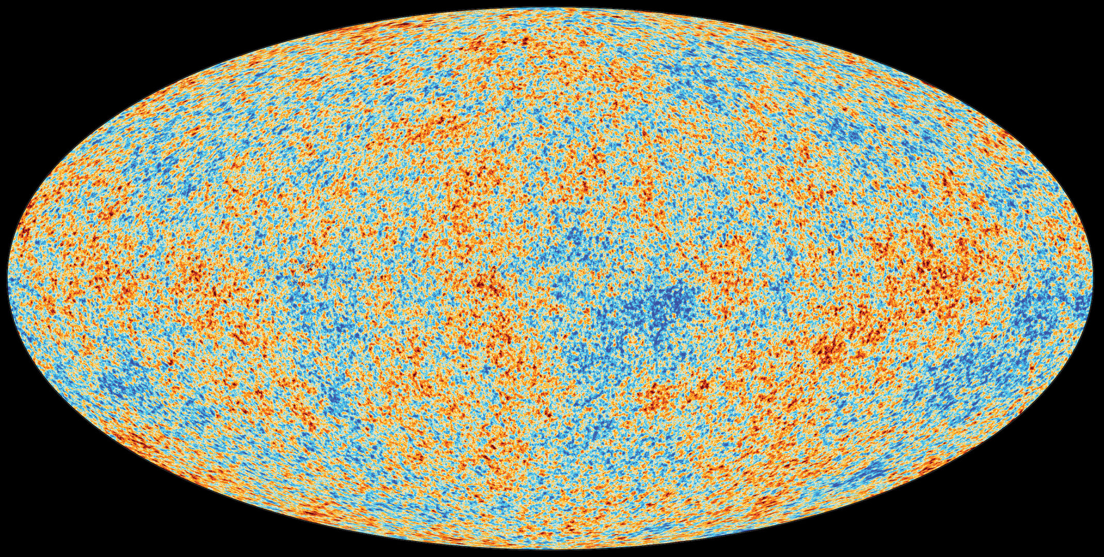
So, once we have the maps…
¿?
What do we do?
How can we extract information from them?
6/35

Slide 10
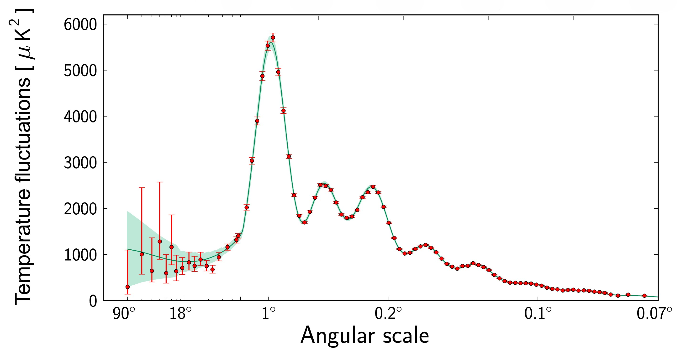
… We plot the magnitude of the temperature variations (size of the fluctuations) against the sizes of the hot and cold spots in a graph called a power spectrum, and the result is something familiar…
7/35

Slide 11
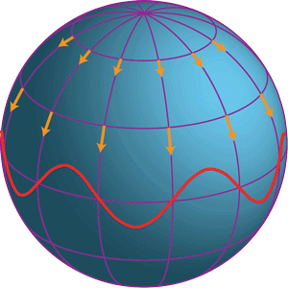
But … ¿What can it tell us about the universe?
It most likely tells us that…
RECOMBINATION
TODAY
$$3.000 K$$
$$2,725 K$$
BB
8/35
$$380.000 yr$$
$$13,8 Gyr$$

Slide 12
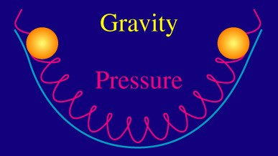
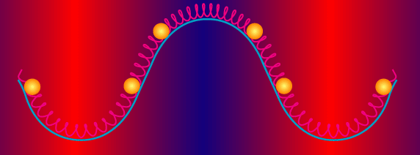
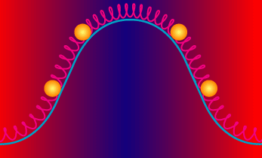
But … ¿What can it tell us about the universe?
Baryon acoustic oscillations
9/35

Slide 13
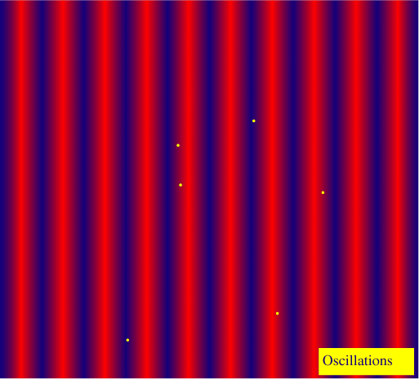
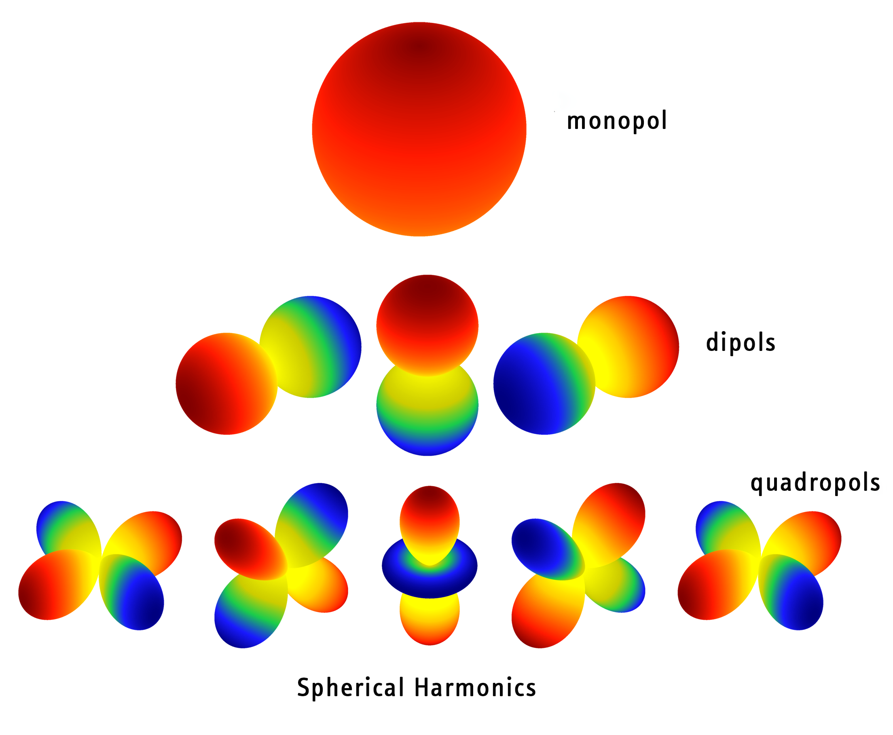
We study those anisotropies using spherical harmonics
A spatial inhomogeneity at recombination becomes an angular anisotropy.
10/35

Slide 14
The decomposition in spherical harmonics of the CMB allows us to isolate the wave modes and construct the corresponding power spectrum.
11/35

Slide 15
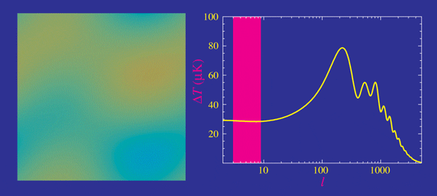
When we look at the power spectrum from left to right, we are moving to increasingly smaller scales.
12/35

Slide 16
Besides…
1st peak
Flat universe
CMB anisotropies are sensitive to a host of cosmological parameters: {$A_{s}, n_{s},ω_{b}, ω_{m}, Ω_{Λ}, τ$}
The problem is the parameter degeneracy: the fact that cosmological parameters tend to have similar effect on the power spectrum.
3rd peak
Dark matter
2nd peak
Baryonic dark matter
* Precision of parameter estimation depends on instrumental noise, resolution, and sample variance.
13/35

Slide 17
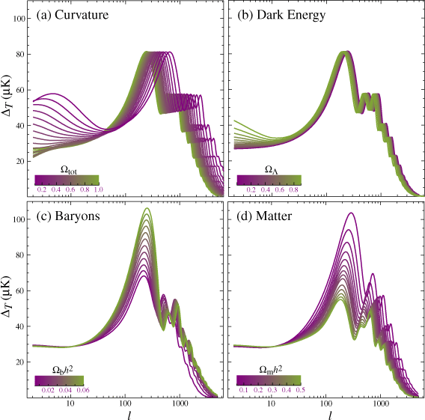
* Sensitivity of the acoustic temperature spectrum to four fundamental cosmological parameters.
14/35

Slide 18
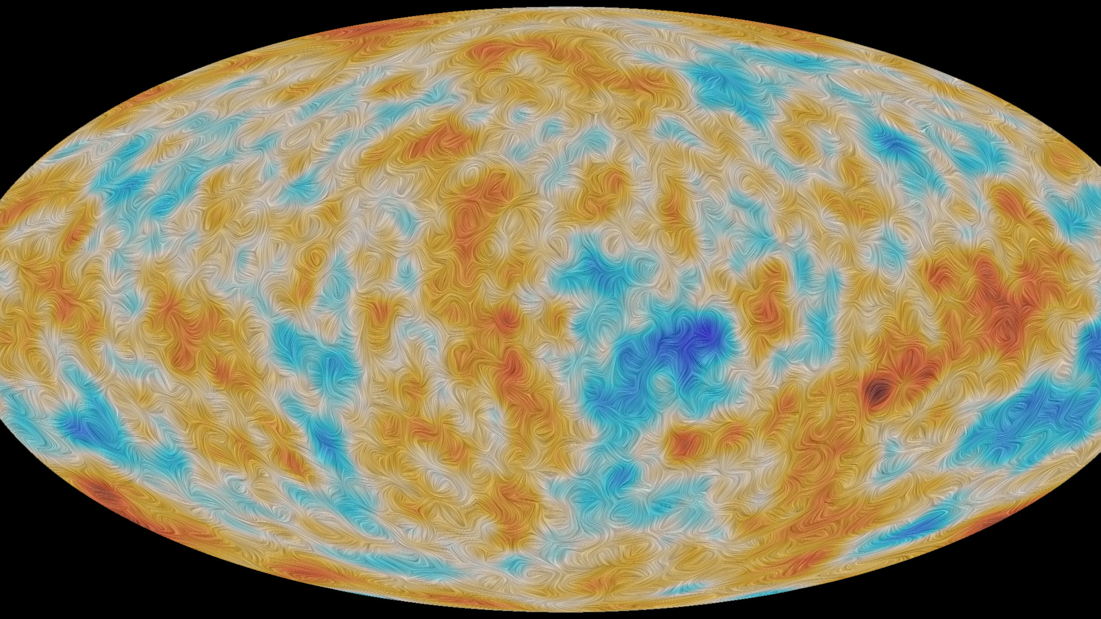
CMB polarization
It refers to the linear polarization pattern observed on the sky generated by Thomson scattering of temperature anisotropies on the last scattering surface of the photons.
15/35

Slide 19
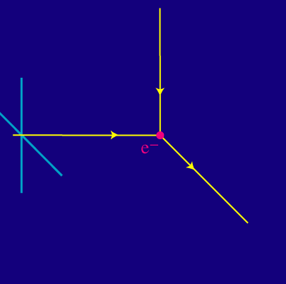
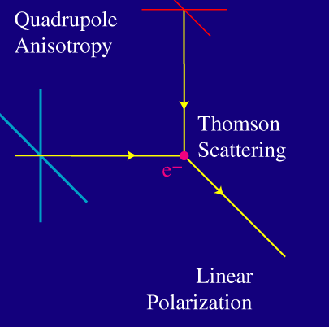
How does this polarization occur?
In general
In particular
The incident unpolarized light "shakes" the electrons. This shaking re-radiates the outgoing reflected light so that its polarization is perpendicular to the plane of the scattering.
Only a quadrupole temperature anisotropy generates linear polarization
16/35

Slide 20
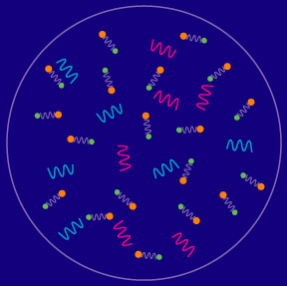
Where does the quadrupole anisotropy come from?
Before recombination, Thomson scattering between the photons and electrons was extremely rapid. As scattering randomly changes the direction of the photons, any difference in temperature with direction rapidly goes away.
Scattering exponentially reduces the level of anisotropy in the radiation.
RECOMBINATION
TODAY
$$3.000 K$$
$$2,725 K$$
BB
17/35
$$380.000 yr$$
$$13,8 Gyr$$

Slide 21
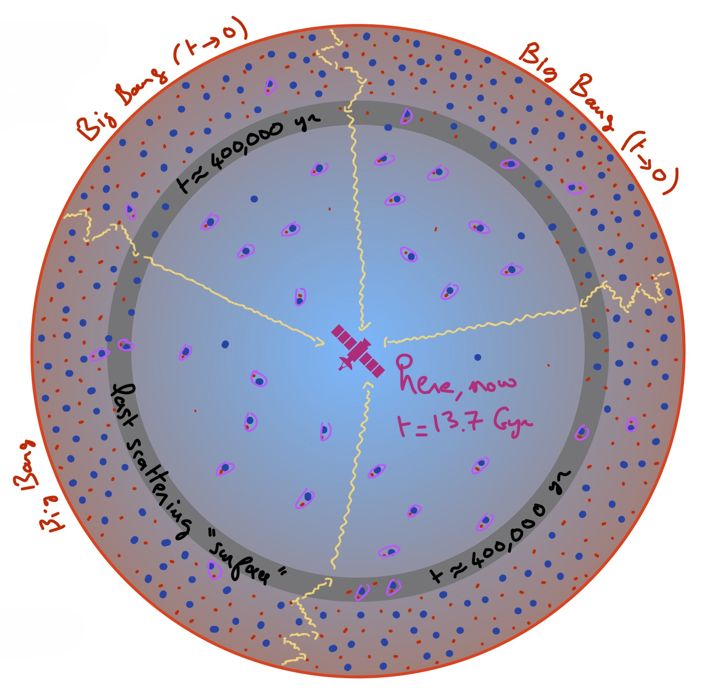
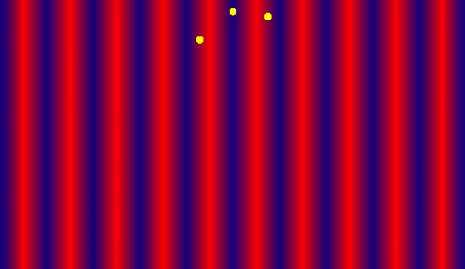
Where does the quadrupole anisotropy come from?
The observer today sees the linear polarization vary across the sky in a pattern which is the projection of the quadrupole anisotropies at recombination.
$$3.000 K$$
$$2,725 K$$
BB
18/35
$$380.000 yr$$
$$13,8 Gyr$$

Slide 22
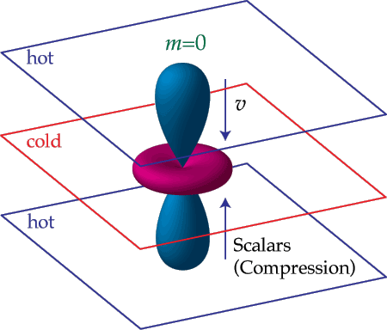
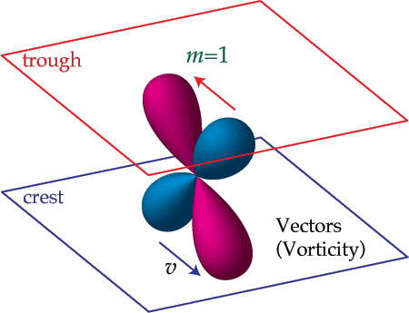
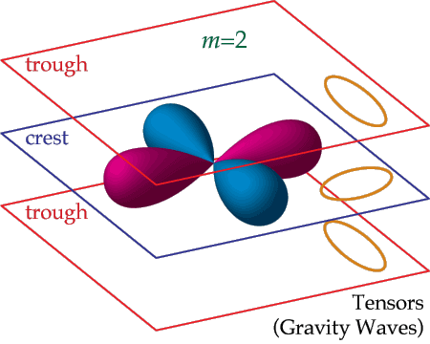
Actually, there are three sources to the quadrupole anisotropy at recombination…
a)
b)
c)
Acoustic density perturbations $→S$calar perturbations
Vorticity $→$ Vector perturbations
Induces a doppler shift
Gravitational waves $→$ Tensor perturbations
stretch the space
19/35

Slide 23
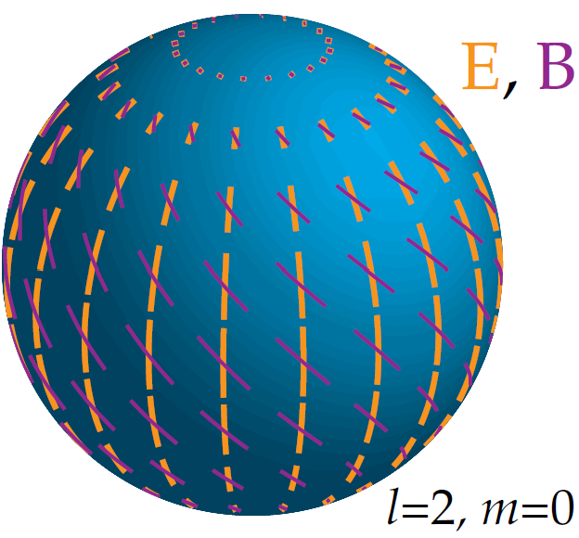
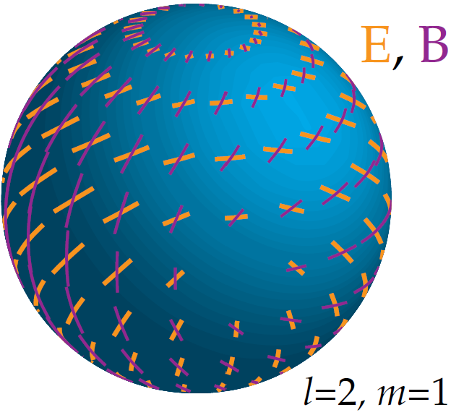
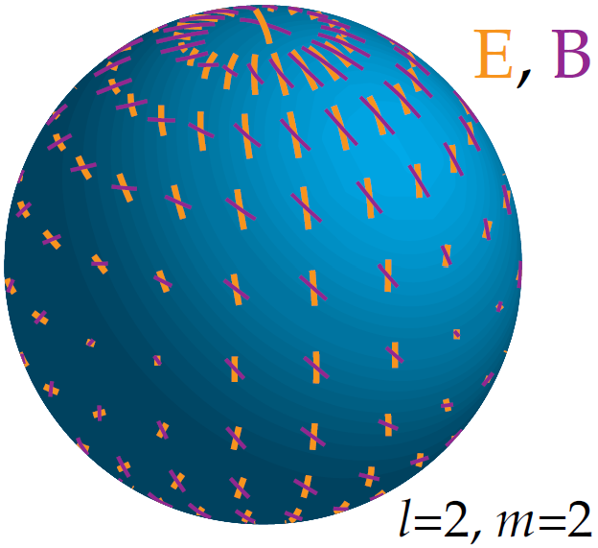
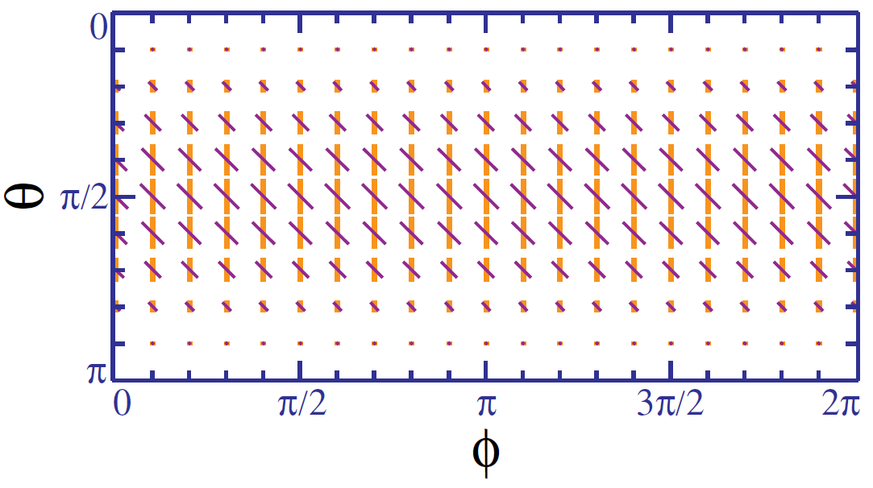
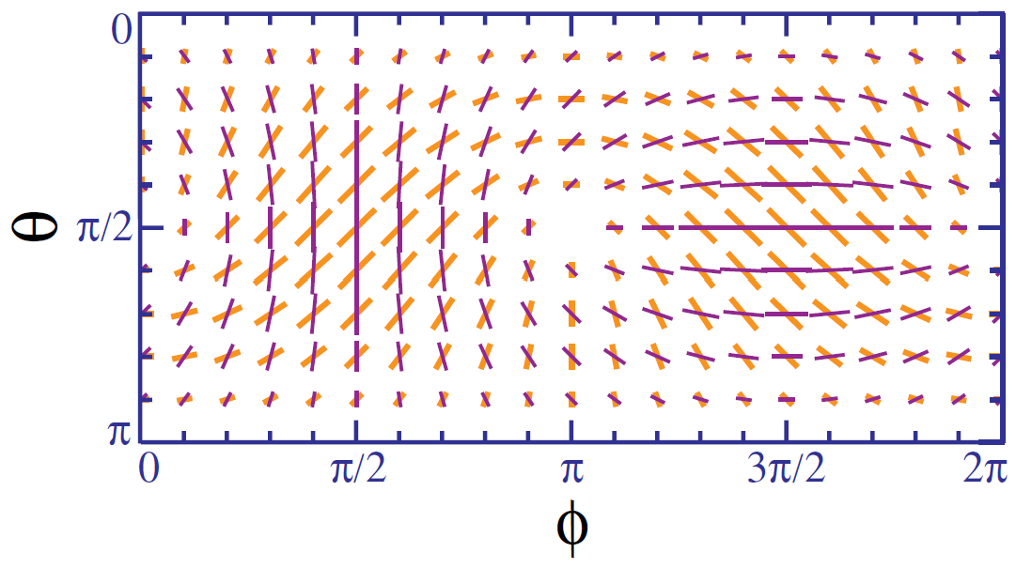
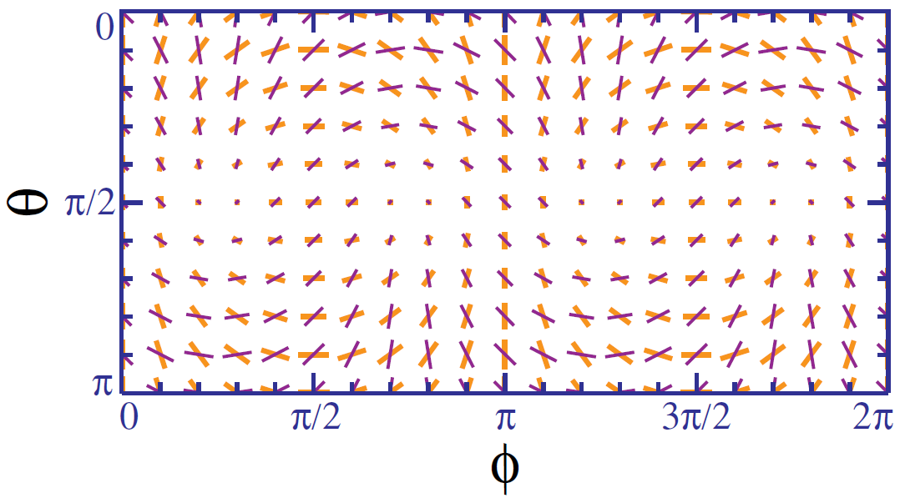
Each source generates a distinctive polarization pattern
a)
b)
c)
$S$calar perturbations
Vector perturbations
Tensor perturbations
20/35

Slide 24
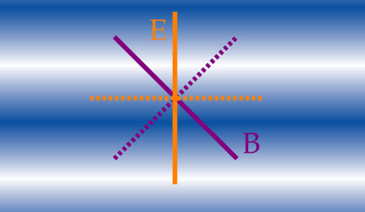
The polarization pattern has two geometrical components
If the polarization is parallel or perpendicular to the wave direction ($\hat{k}$), it is called an E-mode polarization.
If it is crossed at 45-degree angles, it is called a B-mode polarization.
$$\hat{k}$$
NOTE: Thomson scattering can only produce E-modes locally, and that is true for scalars, tensors, and vector sources. The B modes result from the modulation of the local E-mode pattern due to plane wave fluctuations on the last scattering surface.
21/35

Slide 25
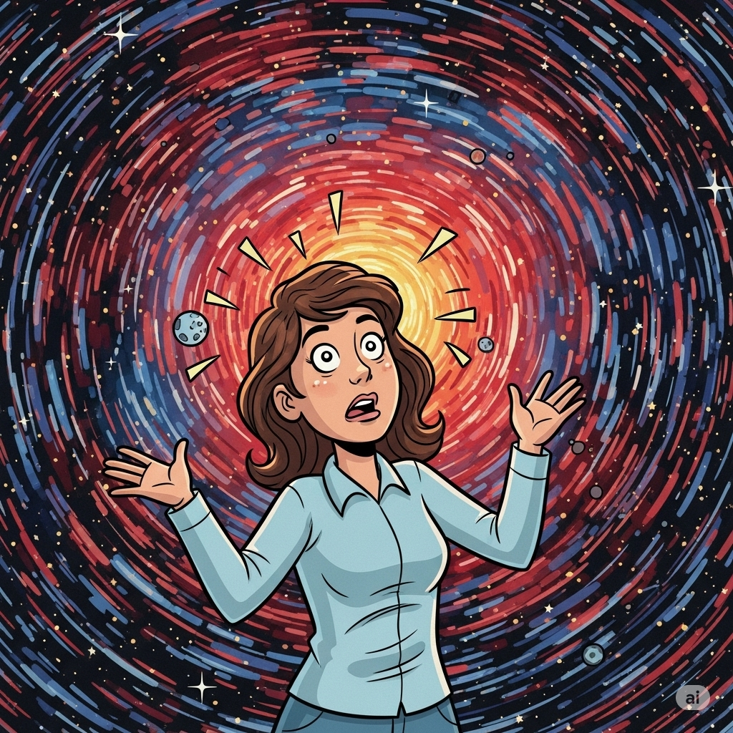
A full polarization pattern is a superposition of E and B modes resulting from the different sources of anisotropy and a spectrum of fluctuations, each with a different $\hat{k}$.
So, how can we differentiate their contributions?
The answer to this comes from two considerations
22/35

Slide 26
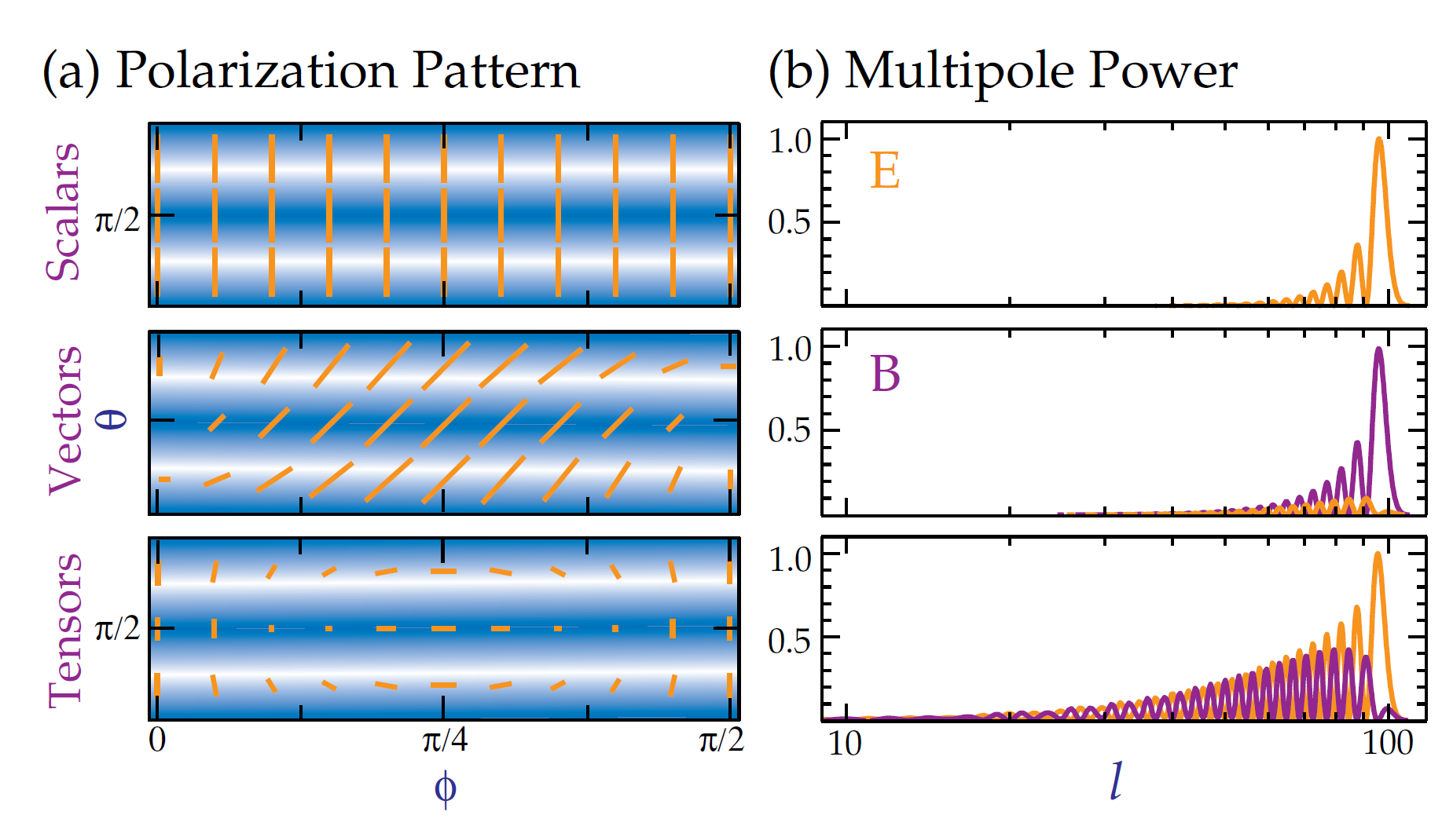
1st consideration
It can be proved that scalar sources generate only E-modes, vectors mainly B-modes, and tensors comparable amounts of both.
23/35

Slide 27
2nd consideration
The polarization patterns of the E and B modes, due to a superposition of plane waves, are clearly distinguishable.
E-mode
B-mode
* The radial wave that generates the patterns shown can be thought of as a superposition of plane waves with equal phases and amplitudes, but different azimuthal angles
24/35

Slide 28
What characteristics do we expect to find in a power spectrum of polarization?
A sharp decline at large angles.
For that associated with a scalar source: a peak near the diffusion scale, a signal of several micro Kelvin, a second peak on large scales from reionization, and acoustic oscillations.
For that arising from gravitational waves: similar contributions from E and B modes, a power in the B-mode corresponding to a tenth of a micro Kelvin signal on scales of $l∼100$.
25/35

Slide 29
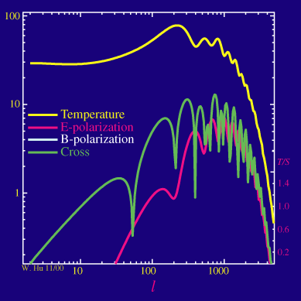
The tensor-to-scalar ratio
Also called $r$, it is a quantity defined as the ratio of power in the gravitational wave (tensor, T) versus density (scalar, S) modes.
Different values of $r$ change the relative amplitudes in the power spectrum both in temperature and in polarization, as can be seen in the animation.
26/35

Slide 30
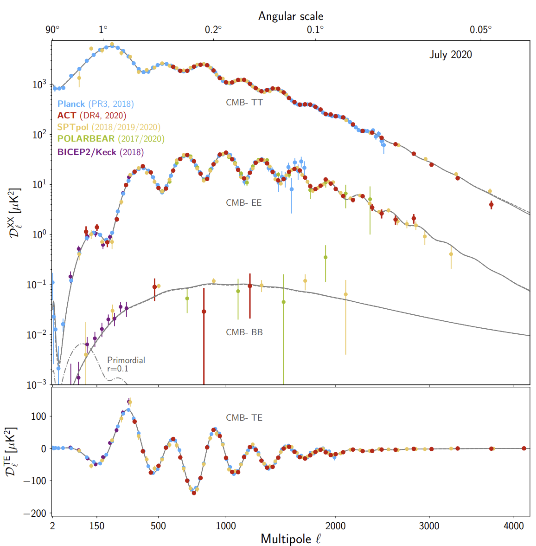
The actual measured polarization spectrum
Lensing induced
Reionization
arXiv:2007.07289v2 [astro-ph.CO] 23 Nov 2020
Decay of GW on subhorizon scales
27/35

Slide 31
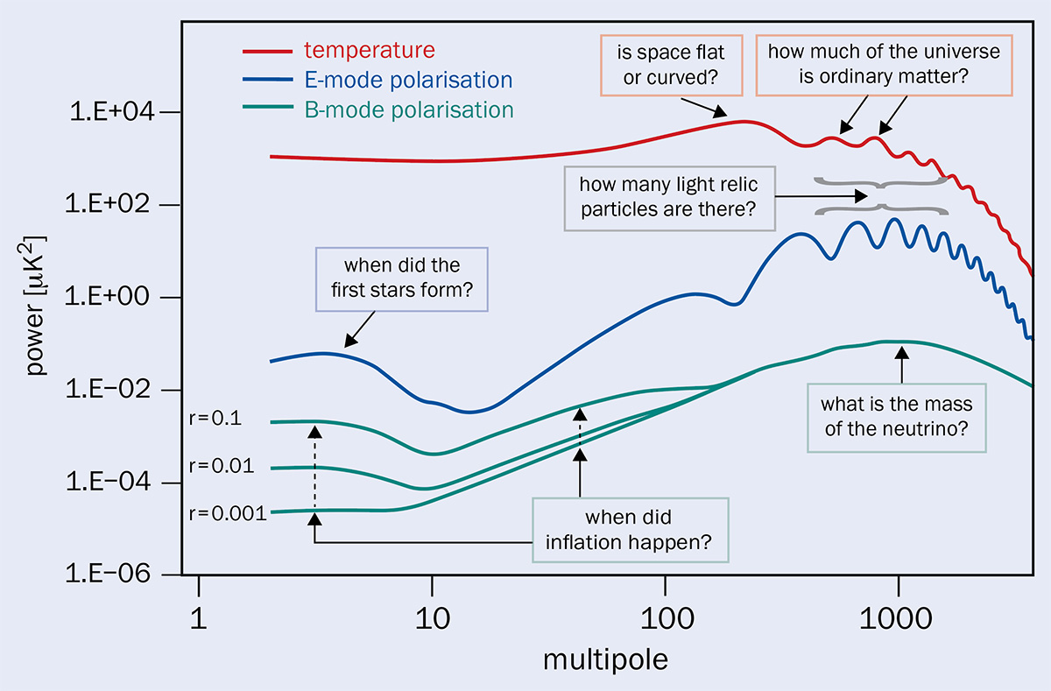
Why is it important to measure the CMB polarization?
Is our most direct probe of the universe at the epoch of recombination, as well as the later reionization of the Universe by the first stars.
Serves as a fundamental consistency check on our interpretation of acoustic peaks and the inflationary paradigm.
Helps to break parameter degeneracies found for the temperature fluctuations.
As primordial density fluctuations cannot produce a B-mode polarization signal, such a signal is a unique discovery channel for primordial gravitational waves predicted by models of inflation.
28/35

Slide 32
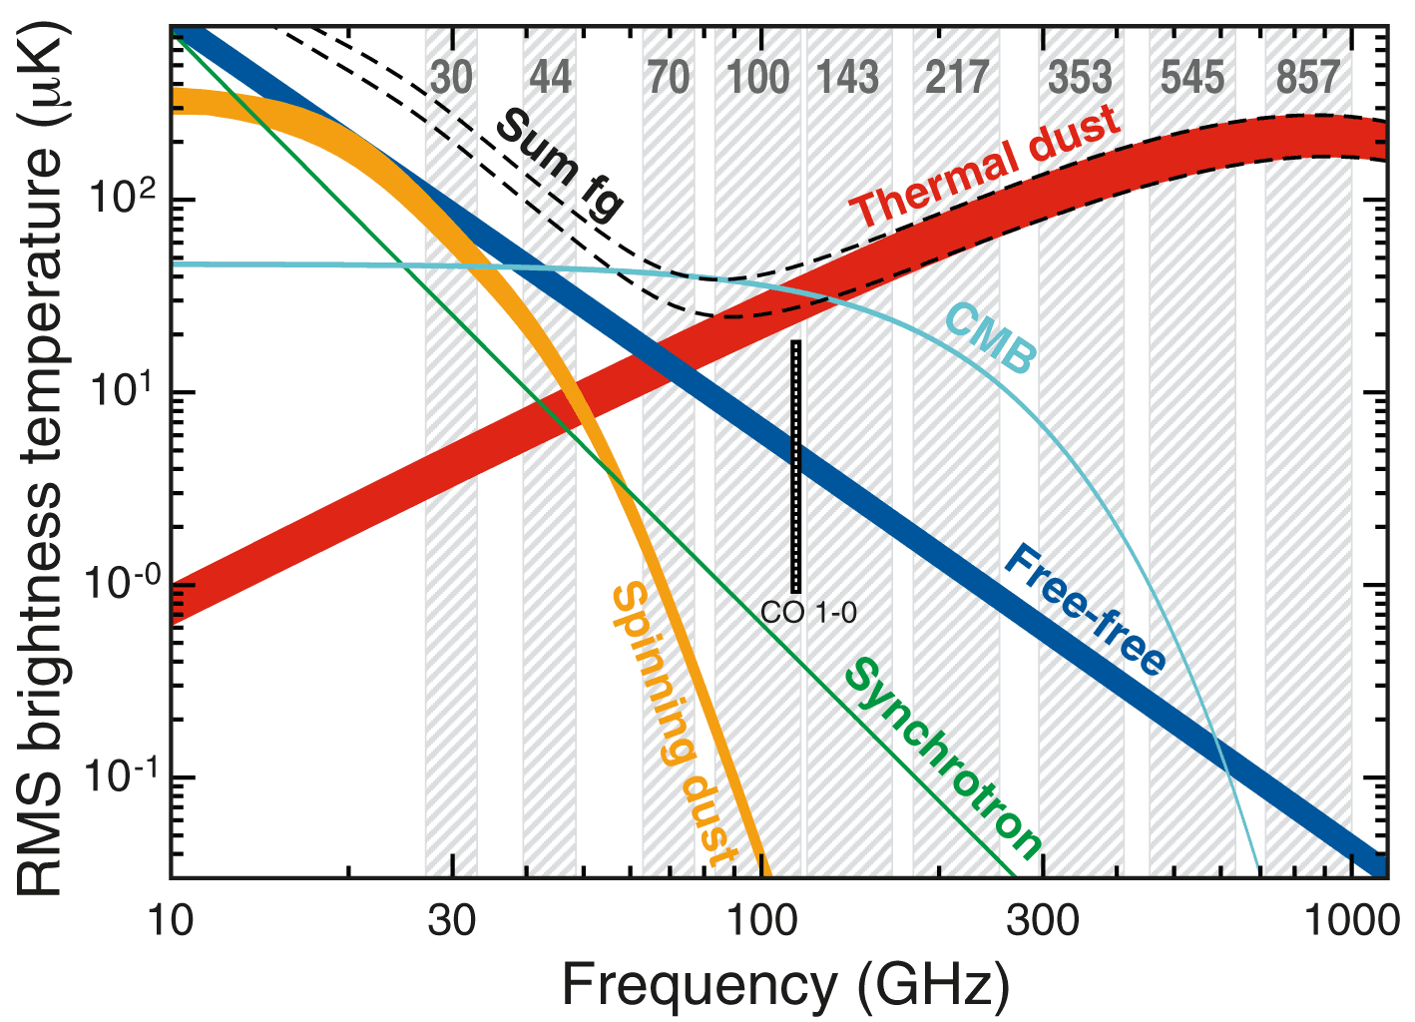
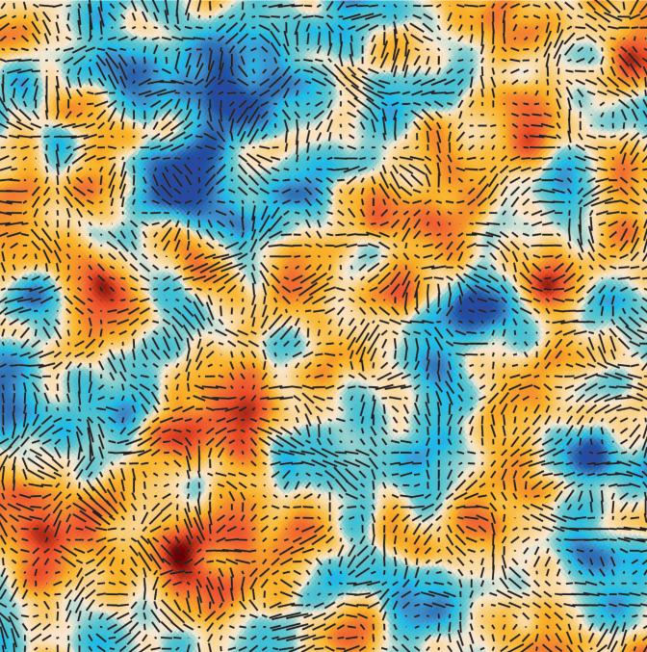
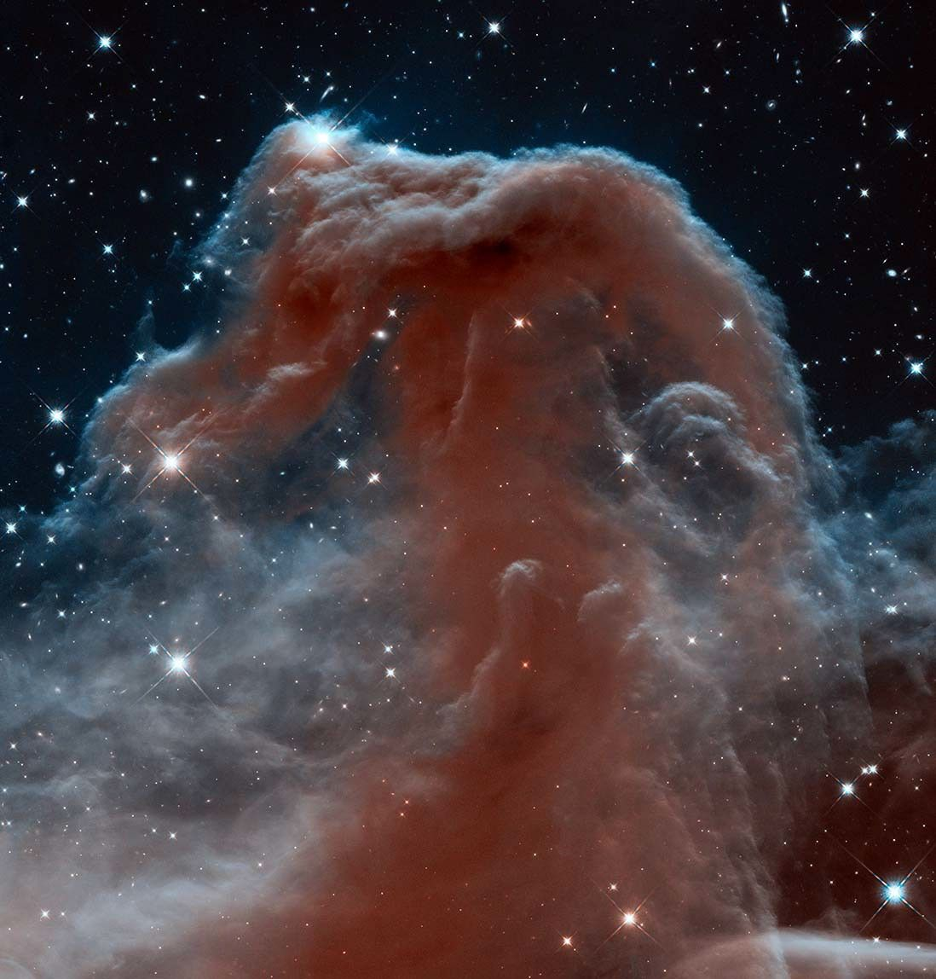
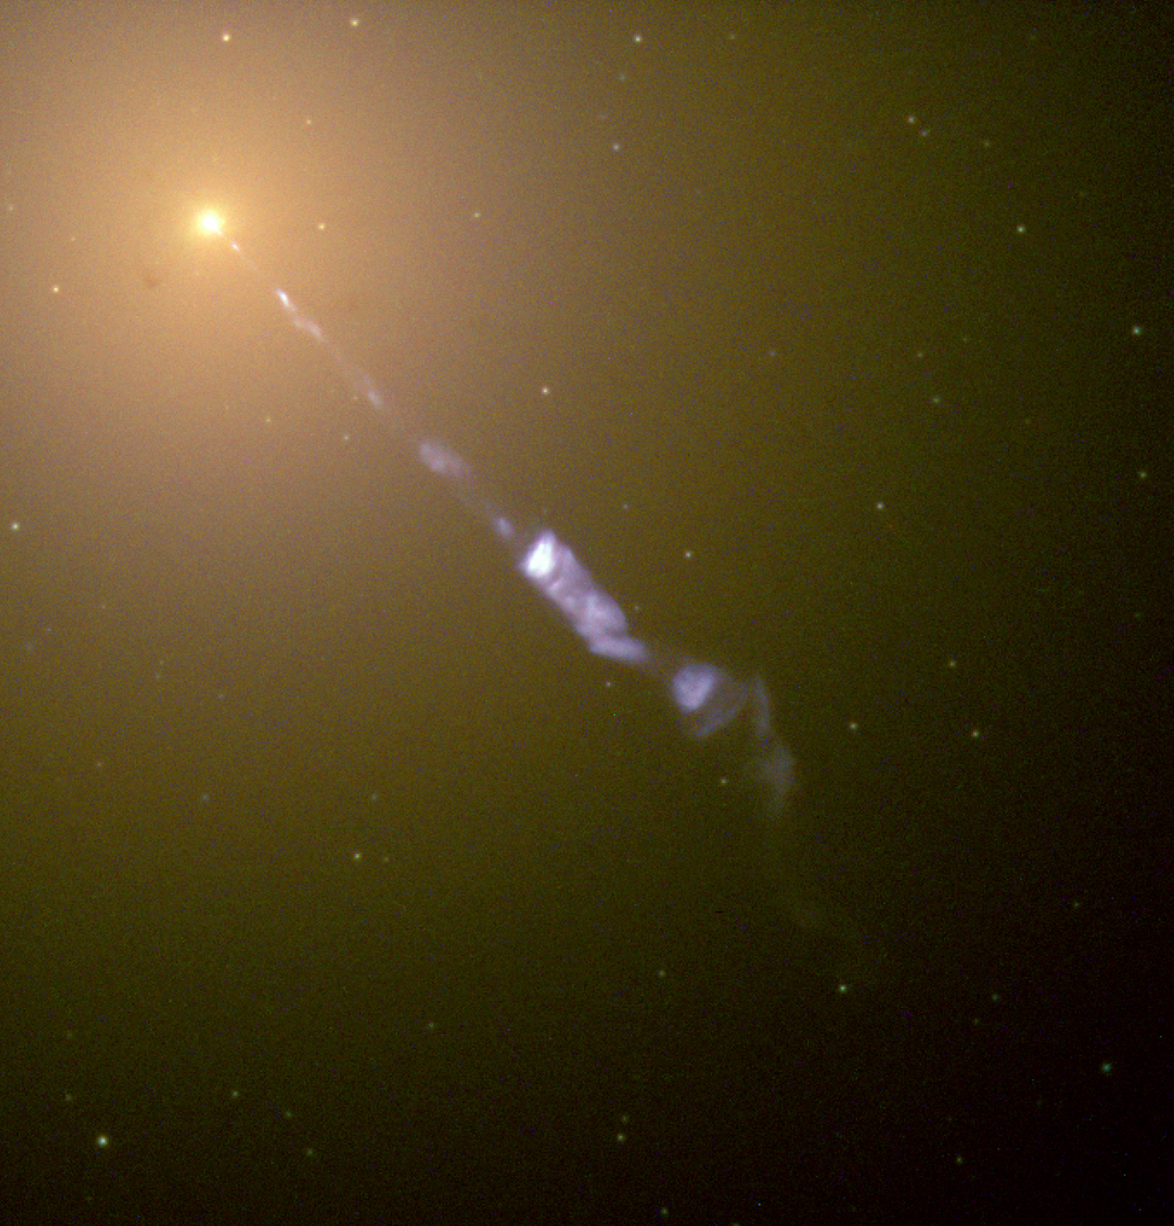
Problems measuring the polarization spectrum
Gravitational waves probe the physics of inflation but require a thorough understanding of foregrounds, which also produce B-modes, and secondary effects for their detection, as it is a very weak signal.
$$=$$
$$+$$
$$+$$
$$+$$
Thermal dust
Hot interstellar médium (20 K)
Synchrotron
Relativistic electrons going through a magnetic field
Instrumental noise
CMB
29/35

Slide 33
My research project so far

Slide 34
Outline
By employing modern neural network (NN) architectures, this project aims to deliver an accurate and efficient separation of the CMB signal from foreground contaminants with minimal masking or developing methods capable of directly estimating power spectra. This novel approach not only increases the efficiency of data analysis but also enhances the accuracy of polarization measurements, particularly for the challenging BB-mode signal, which is a key observable for probing inflationary gravitational waves.
30/35

Slide 35
So far …
During this year, the research project has been devoted to:
Learn the principles underlying the CMB polarization, its current importance, the present and past experiments devoted to their measurement, the difficulties present in its experimental and theoretical understanding, and the techniques and computational tools used for its study.
Study if we can recover the E and B-mode power spectrum with error bars such that we estimate the tensor-to-scalar ratio ($r$) to good accuracy from the ideal case of simulated CMB maps without foregrounds and instrumental noise.
31/35

Slide 36
So far …
In our approach to the second point, we have studied the impact on the determination of $r$ that has the choice of the size, resolution, and projection on the sky of a CMB patch.
U
Q
$$+$$
$$+$$
$C_{ℓ}$’s
$$+$$
CAMB
Python package
Healpy
Python package
NaMaster
Python package
32/35

Slide 37
So far …
Finally, we use an estimator to compute $r$ from the obtained data.
33/35

Slide 38
So far …
Small pixsize + high npix
Large pixsize + low npix
34/35

Slide 39
Ongoing and future work
We have concluded that the error bars achieved through our methodology are still too big to obtain a reasonable value for $r$. So, to overcome the present difficulties, we are planning to:
Use different estimators to compute $r$.
Take patches in several positions on the sky.
Work with E and B, instead of Q and U maps.
Try to use different projections for the patch.
Reproject patches to the entire sky.
Try to implement a kind of parametric approach to the problem using Machine Learning techniques that allow us to work with all sky maps pixel by pixel, instead of the limiting sky patches.
35/35

Slide 40
Parametrization of the components
+
* Ongoing collaboration with Dr. Biuse Casaponsa, IFCA

Slide 41
References
[1] Wayne Hu’s Tutorials, The University of Chicago. Online: https://background.uchicago.edu/~whu/
[2] Hu, W., & White, M. (1997). A CMB polarization primer. arXiv preprint astro-ph/9706147.
[3] Hu, W., & White, M. (2004). The cosmic symphony. Scientific American, 290(2), 44-53.
[4] Baumann, D. (2022). Cosmology. Cambridge University Press.
[5] Mapping the Universe with Spherical Harmonics. Online resource: https://www.youtube.com/watch?v=Ov8VFq1qLkI
[6] Acoustic Peaks in the Power Spectrum. Online resource: https://www.youtube.com/watch?v=HJPFy-TTchQ&t=22s
[7] The cosmic microwave background. Online resource: https://ned.ipac.caltech.edu/level5/Sept02/Kinney/Kinney3.html
[8] Excerpts from 2018 Warner Prize lecture. Online resource: https://cosmo.nyu.edu/yacine/teaching/warner/warner.html
[9] Schematic diagram of the history of the Universe. Online resource: https://www.eso.org/public/images/eso1620a/

Slide 42
References
[10] COBE DMR 2 & 4 Year Images. Online resource: https://aether.lbl.gov/www/projects/cobe/COBE_home/DMR_Images.html
[11] Cosmic Microwave Background (CMB) radiation. Online resource: https://www.esa.int/Science_Exploration/Space_Science/Cosmic_Microwave_Background_CMB_radiation
[12] Planck's power spectrum of temperature fluctuations in the cosmic microwave background. Online resource: https://sci.esa.int/s/wRVmdjw
[13] Hu, W., & Dodelson, S. (2002). Cosmic microwave background anisotropies. Annual Review of Astronomy and Astrophysics, 40(1), 171-216.
[14] Polarisation of the cosmic microwave background. Online resource: https://sci.esa.int/web/planck/-/55387-polarisation-of-the-cosmic-microwave-background
[15] Exploring the CMB like never before. Online resource: https://cerncourier.com/a/exploring-the-cmb-like-never-before/
[16] Foreground Overview. Online resource: https://lambda.gsfc.nasa.gov/product/foreground/
[17] Komatsu, E. (2022). New physics from the polarized light of the cosmic microwave background. Nature Reviews Physics, 4(7), 452-469.

