Slide 1
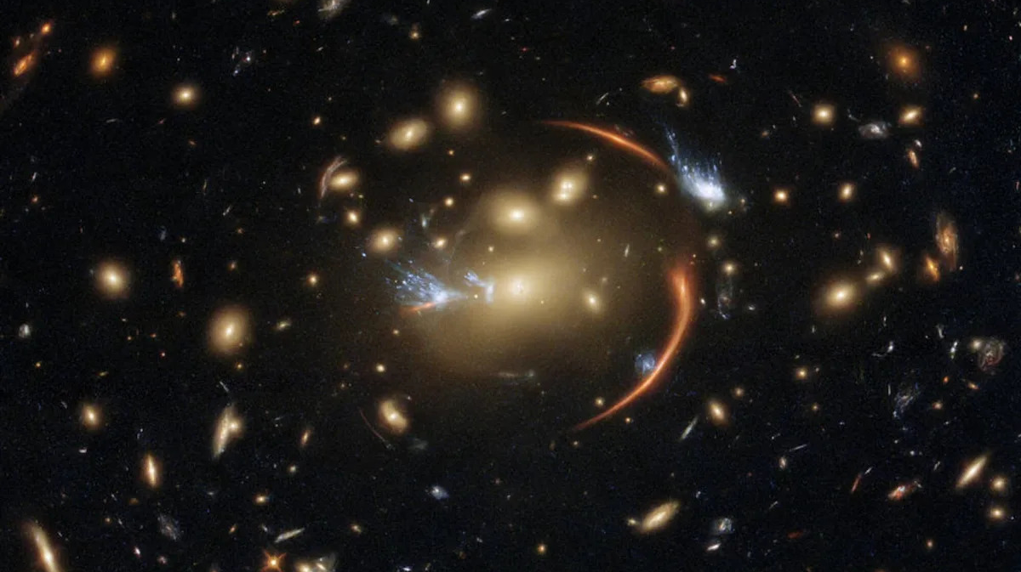


Zoom in a la materia oscura
con el sesgo de magnificación
David Crespo Iglesias
Codirección científica:
Dra. Laura Bonavera
Dr. Joaquín González-Nuevo
D. Crespo
Ciclo de Seminarios del ICTEA
3 Diciembre 2025

Slide 3

Introduction
Brief History of Gravitational Lensing
Theoretical Framework
Methodology
Results
arcminute Scales ($\sim 260kpc$)
kiloparsec Scales
Einstein Gap
Discussion & conclusions
D. Crespo
Ciclo de Seminarios del ICTEA
3 Diciembre 2025

Slide 4
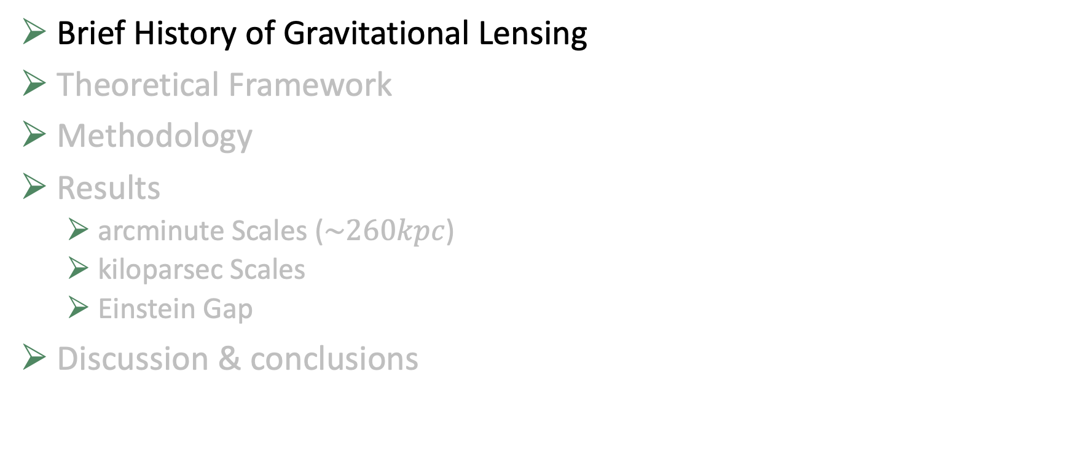
Brief History of Gravitational Lensing
Brief History of Gravitational Lensing
Theoretical Framework
Methodology
Results
arcminute Scales ($\sim 260kpc$)
kiloparsec Scales
Einstein Gap
Discussion & conclusions
D. Crespo
Ciclo de Seminarios del ICTEA
3 Diciembre 2025

Slide 5
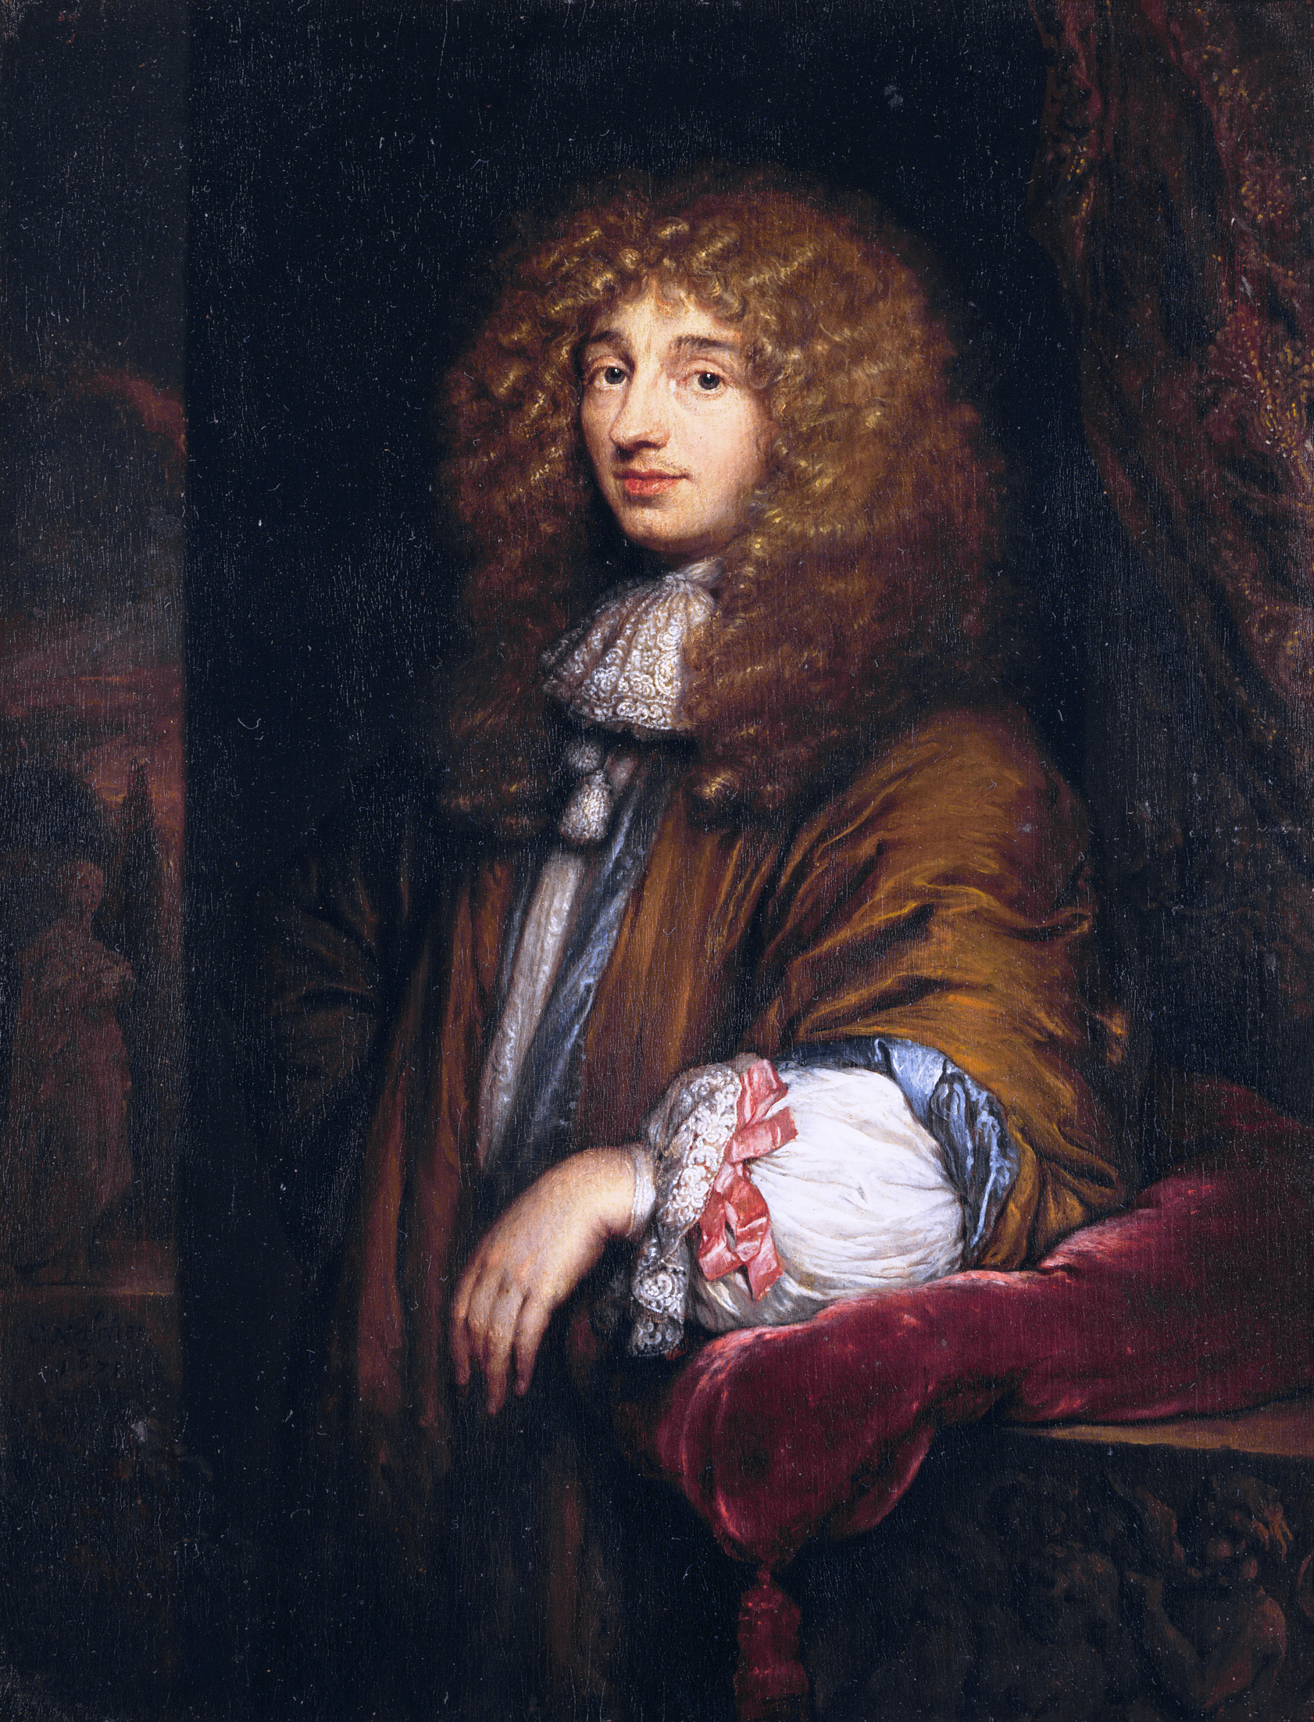
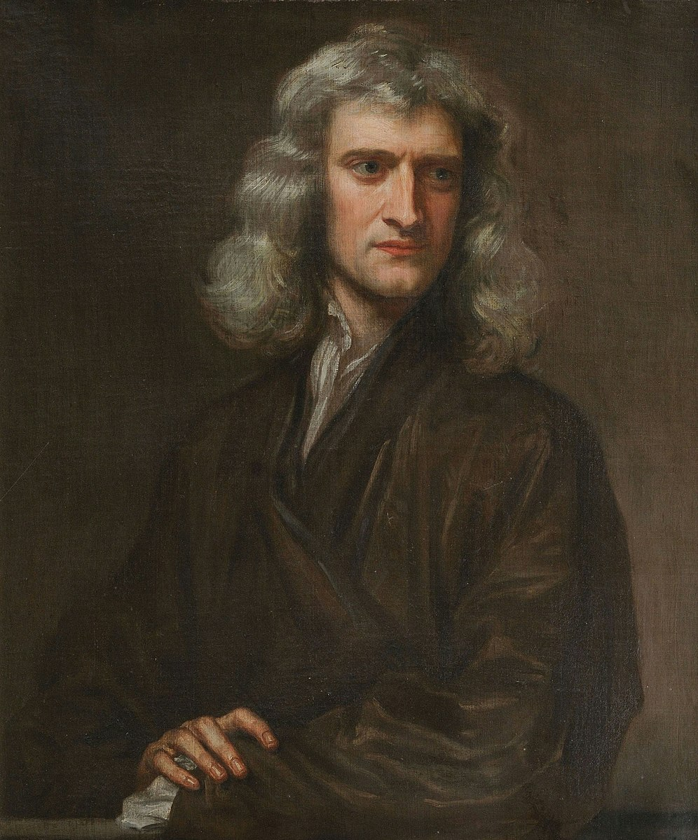
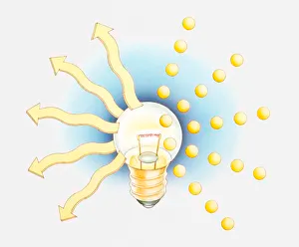
Brief History of Gravitational Lensing
True Nature of Light
s. XVII
Wave theory
1690
Corpuscular theory
1704
Christiaan Huygens (1629-1695)
Sir Isaac Newton (1643-1727)
D. Crespo
Ciclo de Seminarios del ICTEA
3 Diciembre 2025

Slide 6
Brief History of Gravitational Lensing
True Nature of Light
s. XVIII
Wave theory
1690
Corpuscular theory
1704
Christiaan Huygens (1629-1695)
Sir Isaac Newton (1643-1727)
D. Crespo
Ciclo de Seminarios del ICTEA
3 Diciembre 2025

Slide 7
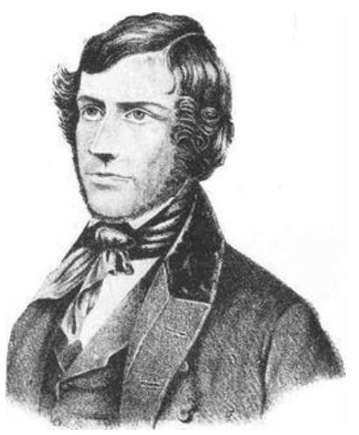
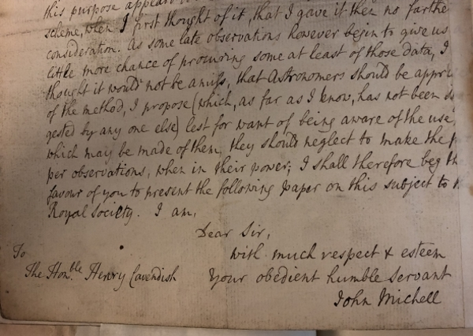
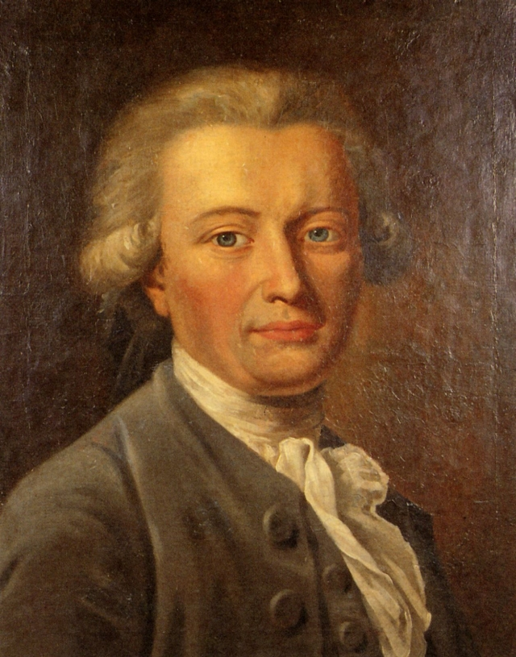
Brief History of Gravitational Lensing
True Nature of Light
s. XVIII
Letter
1784
John Michel (1724-1793)
Henry Cavendish (1731-1810)
D. Crespo
Ciclo de Seminarios del ICTEA
3 Diciembre 2025

Slide 8
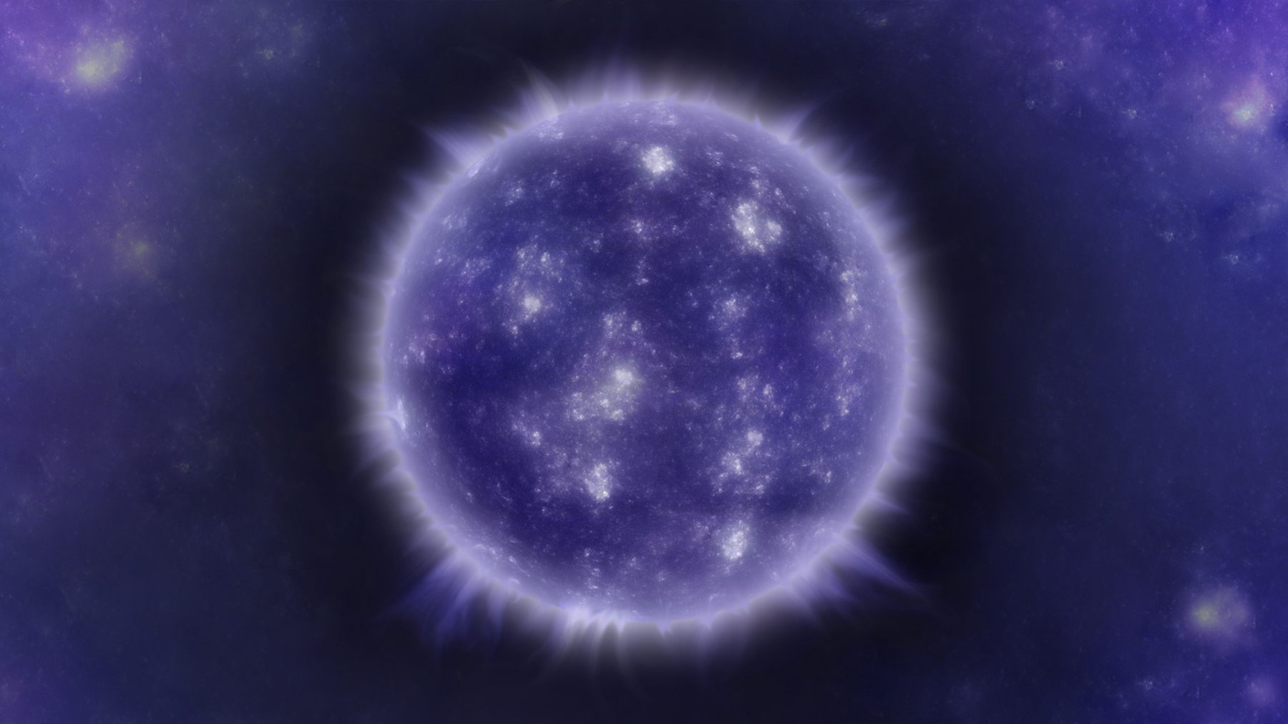
Brief History of Gravitational Lensing
True Nature of Light
s. XVIII
1784
John Michel (1724-1793)
D. Crespo
Ciclo de Seminarios del ICTEA
3 Diciembre 2025

Slide 9
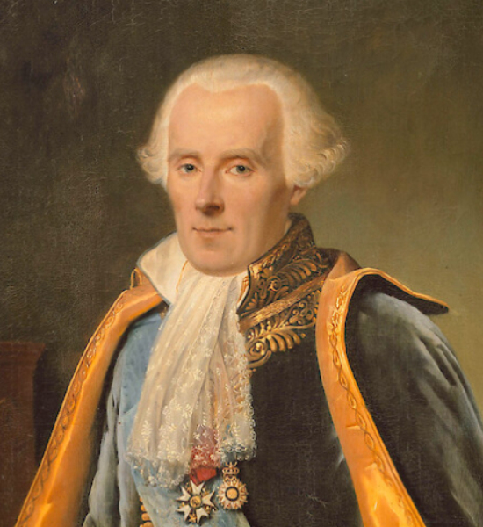
Brief History of Gravitational Lensing
True Nature of Light
s. XVIII
1796
Pierre-Simon Laplace (1749-1827)
D. Crespo
Ciclo de Seminarios del ICTEA
3 Diciembre 2025

Slide 10
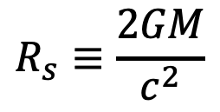
Brief History of Gravitational Lensing
True Nature of Light
s. XVIII
1796
Schwarzschild radius
$$R_{s}≡\frac{2GM}{c^{2}}$$
Dark Stars
Pierre-Simon Laplace (1749-1827)
D. Crespo
Ciclo de Seminarios del ICTEA
3 Diciembre 2025

Slide 11
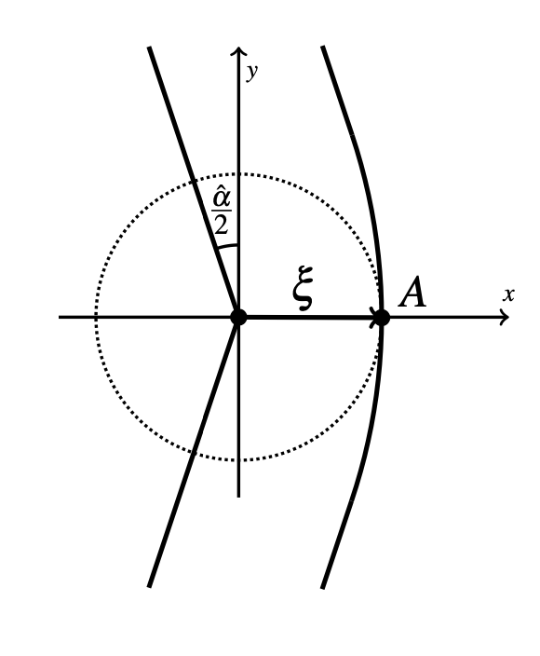
Brief History of Gravitational Lensing
True Nature of Light
s. XVIII
Henry Cavendish (1731-1810)
D. Crespo
Ciclo de Seminarios del ICTEA
3 Diciembre 2025

Slide 12
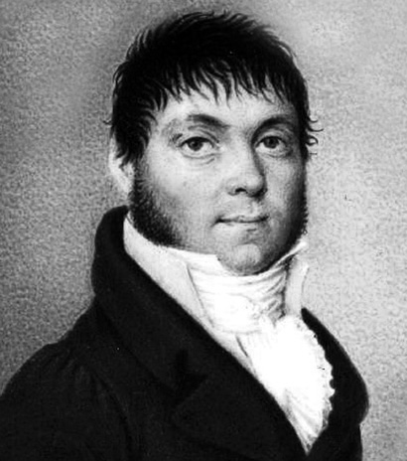

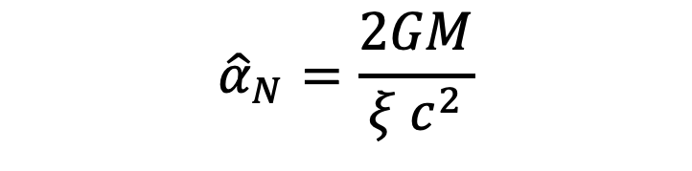
Brief History of Gravitational Lensing
True Nature of Light
s. XIX
1804
Deflection angle
$${\hat{α}}_{N}=\frac{2GM}{{ξ c}^{2}}$$
$${\hat{α}}_{N}\left(Sun\right)=0.875′′$$
Johann Georg von Soldner (1776-1833)
D. Crespo
Ciclo de Seminarios del ICTEA
3 Diciembre 2025

Slide 13
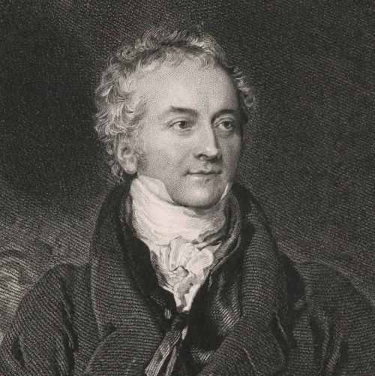
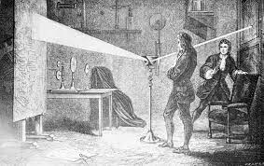
Brief History of Gravitational Lensing
True Nature of Light
s. XIX
Double-slit experiment
1802
Thomas Young (1831-1879)
D. Crespo
Ciclo de Seminarios del ICTEA
3 Diciembre 2025

Slide 14
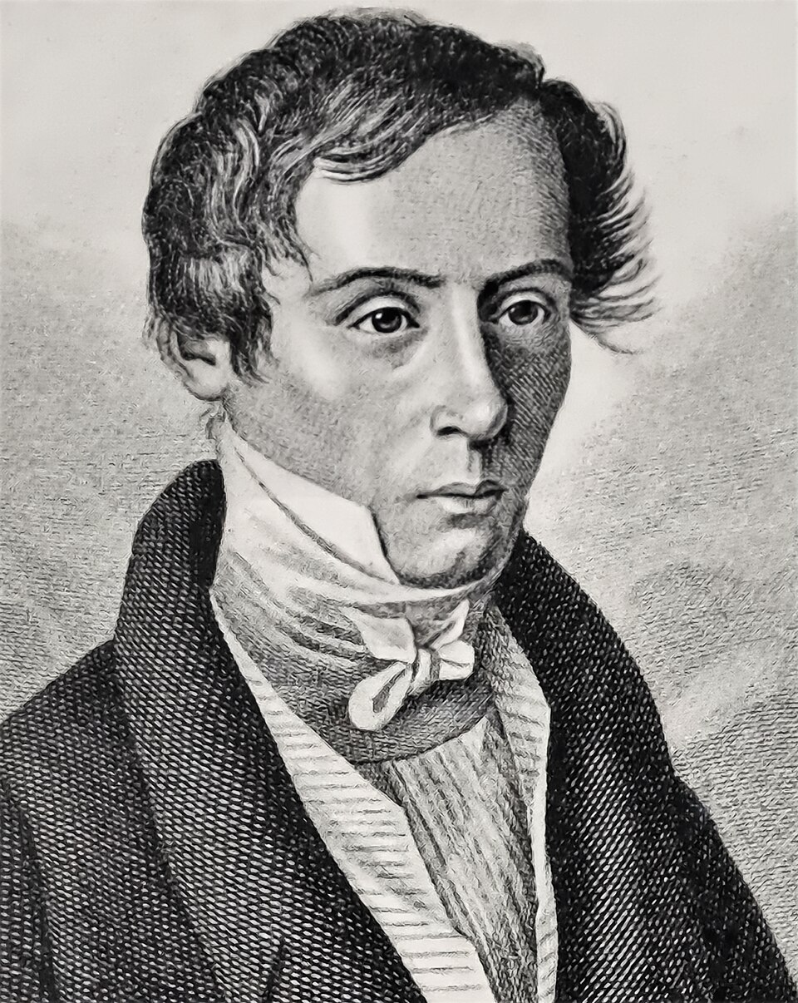
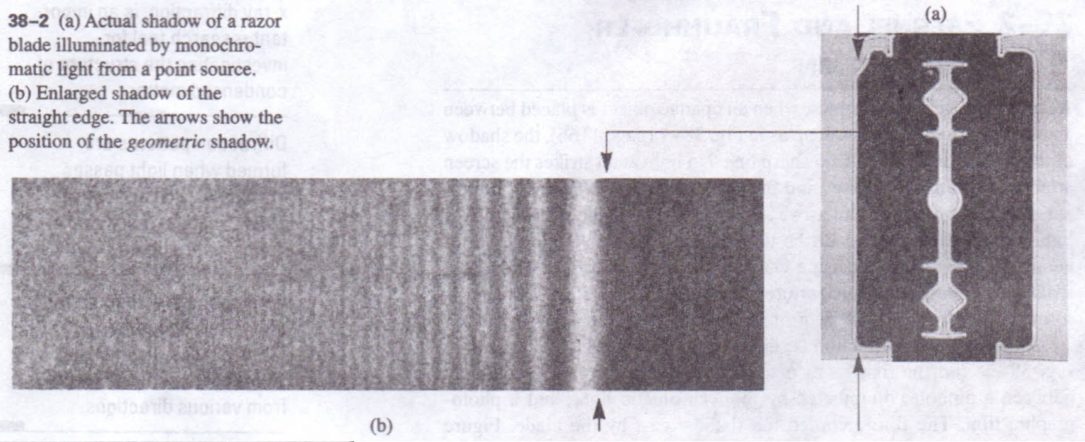
Brief History of Gravitational Lensing
True Nature of Light
s. XIX
Equations for calculating light diffraction patterns
1818
Augustin-Jean Fresnel(1788-1827)
Fuente: Adaptado de Halliday, Resnick & Walker, Fundamentals of Physics, sección 38-2.
D. Crespo
Ciclo de Seminarios del ICTEA
3 Diciembre 2025

Slide 15
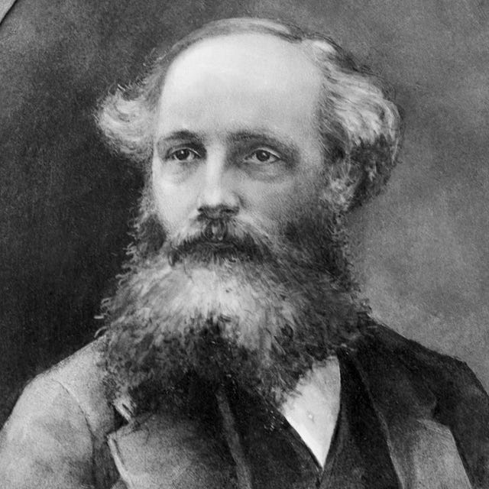
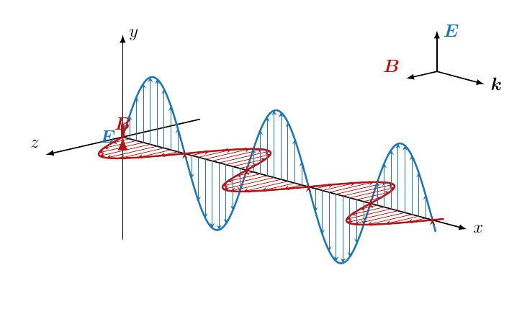
Brief History of Gravitational Lensing
True Nature of Light
s. XIX
Electromagnetic Waves
1865
James Clerk Maxwell (1831-1879)
D. Crespo
Ciclo de Seminarios del ICTEA
3 Diciembre 2025

Slide 16
Brief History of Gravitational Lensing
True Nature of Light
s. XIX
Wave theory
1690
Corpuscular theory
1704
Gravity affects light
Christiaan Huygens (1629-1695)
Sir Isaac Newton (1643-1727)
D. Crespo
Ciclo de Seminarios del ICTEA
3 Diciembre 2025

Slide 17
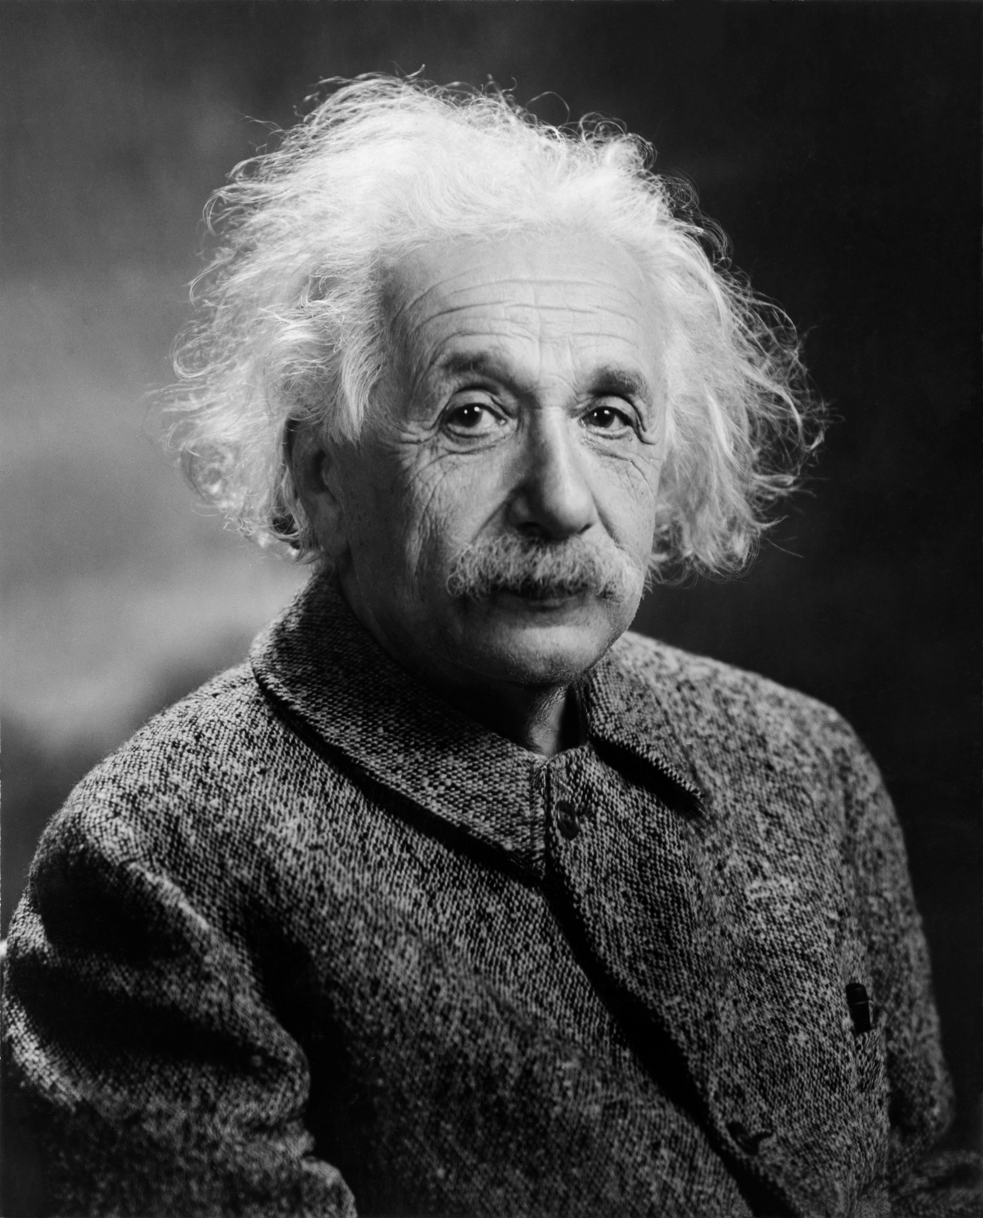

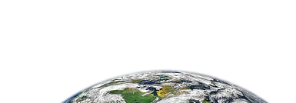



Brief History of Gravitational Lensing
True Nature of Light
s. XX
1907
Principle of Equivalence
$$g=9.8m/s^{2}$$
$$g=9.8m/s^{2}$$
Albert Einstein (1879-1955)
Physically equivalent
D. Crespo
Ciclo de Seminarios del ICTEA
3 Diciembre 2025

Slide 18
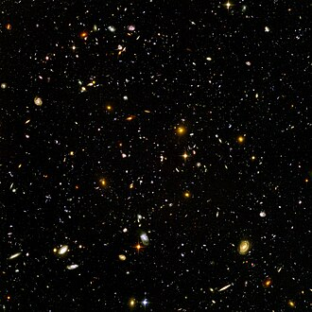
Brief History of Gravitational Lensing
True Nature of Light
s. XX
1907
Principle of Equivalence
Albert Einstein (1879-1955)
Physically equivalent
D. Crespo
Ciclo de Seminarios del ICTEA
3 Diciembre 2025

Slide 19
Brief History of Gravitational Lensing
True Nature of Light
s. XX
1907
Principle of Equivalence
only can be true if gravity is to be understood as a manifestation of spacetime curvature
rather than as a conventional force
Albert Einstein (1879-1955)
D. Crespo
Ciclo de Seminarios del ICTEA
3 Diciembre 2025

Slide 20
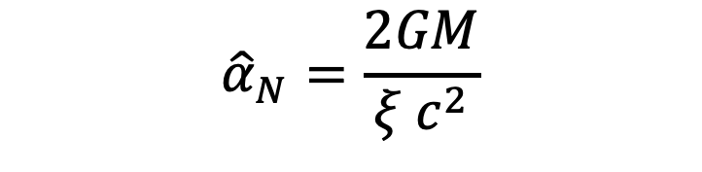
Brief History of Gravitational Lensing
True Nature of Light
s. XX
1911
Theory of Special Relativity
Deflection angle
$${\hat{α}}_{N}=\frac{2GM}{{ξ c}^{2}}$$
I agree!
Albert Einstein (1879-1955)
D. Crespo
Ciclo de Seminarios del ICTEA
3 Diciembre 2025

Slide 21
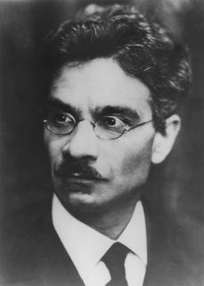
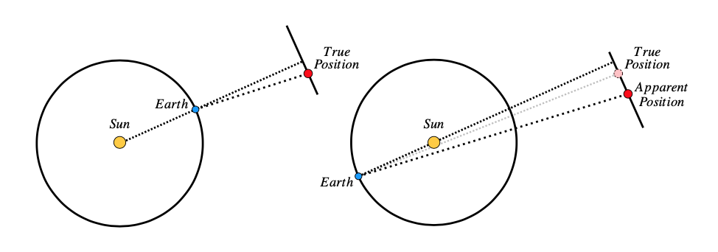
Brief History of Gravitational Lensing
True Nature of Light
s. XX
During a total solar eclipse
Erwin Freundlich (1885-1964)
D. Crespo
Ciclo de Seminarios del ICTEA
3 Diciembre 2025

Slide 22

Brief History of Gravitational Lensing
The Eclipse Expeditions
s. XX
$\begin{matrix}\text{10 }\text{October}\text{ 1912} \\ Argentine Observatory\end{matrix}$
D. Crespo
Ciclo de Seminarios del ICTEA
3 Diciembre 2025

Slide 23
Brief History of Gravitational Lensing
The Eclipse Expeditions
s. XX
$\begin{matrix}\text{10 }\text{October}\text{ 1912} \\ Argentine Observatory\end{matrix}→Storm$
D. Crespo
Ciclo de Seminarios del ICTEA
3 Diciembre 2025

Slide 24
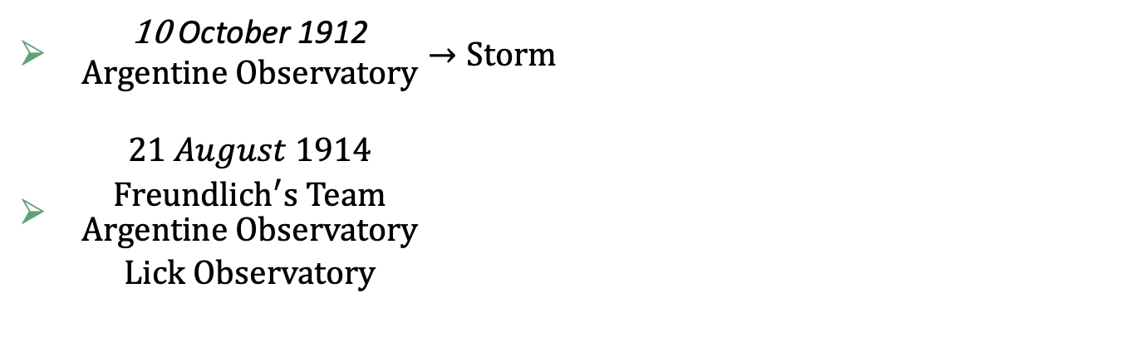
Brief History of Gravitational Lensing
The Eclipse Expeditions
s. XX
$\begin{matrix}\text{10 }\text{October}\text{ 1912} \\ Argentine Observatory\end{matrix}→Storm$
$\begin{matrix}21 August 1914 \\ {Freundlich}^{′}s Team \\ \begin{matrix}Argentine Observatory \\ Lick Observatory\end{matrix}\end{matrix}$
D. Crespo
Ciclo de Seminarios del ICTEA
3 Diciembre 2025

Slide 25
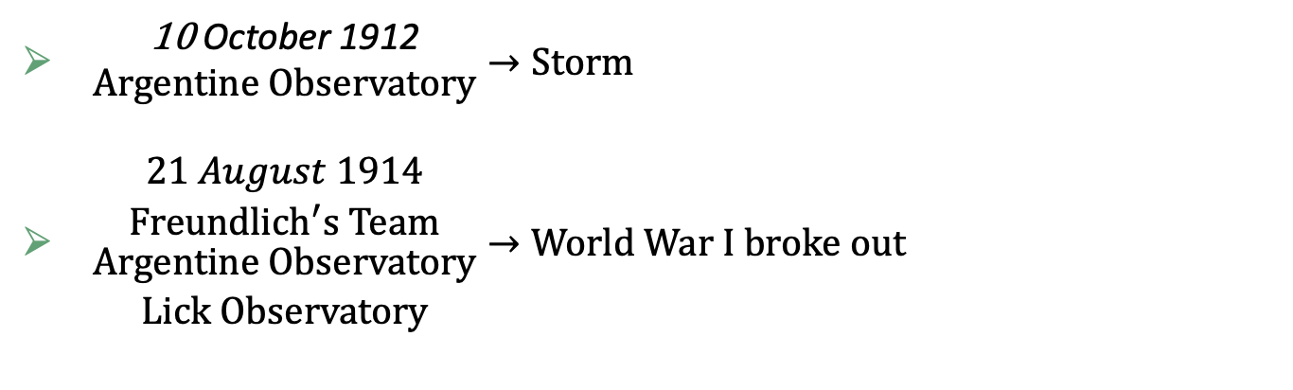
Brief History of Gravitational Lensing
The Eclipse Expeditions
s. XX
$\begin{matrix}\text{10 }\text{October}\text{ 1912} \\ Argentine Observatory\end{matrix}→Storm$
$\begin{matrix}21 August 1914 \\ {Freundlich}^{′}s Team \\ \begin{matrix}Argentine Observatory \\ Lick Observatory\end{matrix}\end{matrix}→World War I broke out$
D. Crespo
Ciclo de Seminarios del ICTEA
3 Diciembre 2025

Slide 26
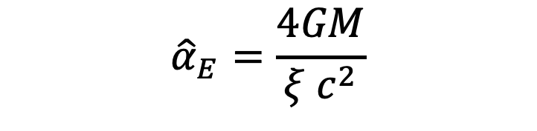

Brief History of Gravitational Lensing
The Eclipse Expeditions
s. XX
1915
Theory of General Relativity
Deflection angle
$${\hat{α}}_{E}=\frac{4GM}{{ξ c}^{2}}$$
$${\hat{α}}_{E}\left(Sun\right)\sim 1.75′′$$
Albert Einstein (1879-1955)
D. Crespo
Ciclo de Seminarios del ICTEA
3 Diciembre 2025

Slide 27
Brief History of Gravitational Lensing
The Eclipse Expeditions
s. XX
$\begin{matrix}\text{10 }\text{October}\text{ 1912} \\ Argentine Observatory\end{matrix}→Storm$
$\begin{matrix}21 August 1914 \\ {Freundlich}^{′}s Team \\ \begin{matrix}Argentine Observatory \\ Lick Observatory\end{matrix}\end{matrix}→World War I broke out$
D. Crespo
Ciclo de Seminarios del ICTEA
3 Diciembre 2025

Slide 28
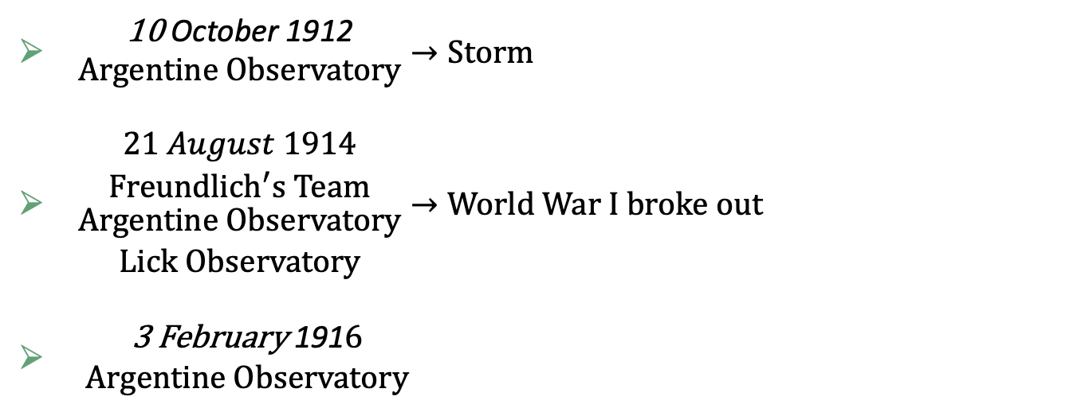
Brief History of Gravitational Lensing
The Eclipse Expeditions
s. XX
$\begin{matrix}\text{10 }\text{October}\text{ 1912} \\ Argentine Observatory\end{matrix}→Storm$
$\begin{matrix}21 August 1914 \\ {Freundlich}^{′}s Team \\ \begin{matrix}Argentine Observatory \\ Lick Observatory\end{matrix}\end{matrix}→World War I broke out$
$\begin{matrix}\text{3 }\text{February} \text{191}6 \\ Argentine Observatory\end{matrix}$
D. Crespo
Ciclo de Seminarios del ICTEA
3 Diciembre 2025

Slide 29

Brief History of Gravitational Lensing
The Eclipse Expeditions
s. XX
$\begin{matrix}\text{10 }\text{October}\text{ 1912} \\ Argentine Observatory\end{matrix}→Storm$
$\begin{matrix}21 August 1914 \\ {Freundlich}^{′}s Team \\ \begin{matrix}Argentine Observatory \\ Lick Observatory\end{matrix}\end{matrix}→World War I broke out$
$\begin{matrix}\text{3 }\text{February} \text{191}6 \\ Argentine Observatory\end{matrix}→Equipment in Russian hands$
D. Crespo
Ciclo de Seminarios del ICTEA
3 Diciembre 2025

Slide 30

Brief History of Gravitational Lensing
The Eclipse Expeditions
s. XX
$\begin{matrix}\text{10 }\text{October}\text{ 1912} \\ Argentine Observatory\end{matrix}→Storm$
$\begin{matrix}21 August 1914 \\ {Freundlich}^{′}s Team \\ \begin{matrix}Argentine Observatory \\ Lick Observatory\end{matrix}\end{matrix}→World War I broke out$
$\begin{matrix}\text{3 }\text{February} \text{191}6 \\ Argentine Observatory\end{matrix}→Equipment in Russian hands$
$\begin{matrix}\text{8} \text{June} \text{1918} \\ Lick Observatory\end{matrix}$
D. Crespo
Ciclo de Seminarios del ICTEA
3 Diciembre 2025

Slide 31

Brief History of Gravitational Lensing
The Eclipse Expeditions
s. XX
$\begin{matrix}\text{10 }\text{October}\text{ 1912} \\ Argentine Observatory\end{matrix}→Storm$
$\begin{matrix}21 August 1914 \\ {Freundlich}^{′}s Team \\ \begin{matrix}Argentine Observatory \\ Lick Observatory\end{matrix}\end{matrix}→World War I broke out$
$\begin{matrix}\text{3 }\text{February} \text{191}6 \\ Argentine Observatory\end{matrix}→Equipment in Russian hands$
$\begin{matrix}\text{8} \text{June} \text{1918} \\ Lick Observatory\end{matrix}→War materials took precedence$
D. Crespo
Ciclo de Seminarios del ICTEA
3 Diciembre 2025

Slide 32

Brief History of Gravitational Lensing
The Eclipse Expeditions
s. XX
$\begin{matrix}\text{10 }\text{October}\text{ 1912} \\ Argentine Observatory\end{matrix}→Storm$
$\begin{matrix}21 August 1914 \\ {Freundlich}^{′}s Team \\ \begin{matrix}Argentine Observatory \\ Lick Observatory\end{matrix}\end{matrix}→World War I broke out$
$\begin{matrix}\text{3 }\text{February} \text{191}6 \\ Argentine Observatory\end{matrix}→Equipment in Russian hands$
$\begin{matrix}\text{8} \text{June} \text{1918} \\ Lick Observatory\end{matrix}→War materials took precedence$
$29 may 1919$
D. Crespo
Ciclo de Seminarios del ICTEA
3 Diciembre 2025

Slide 33
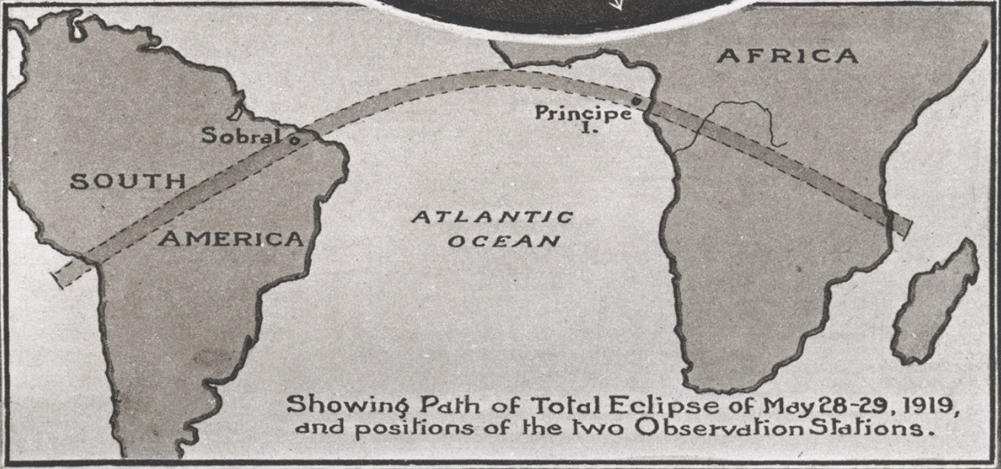




Brief History of Gravitational Lensing
The Eclipse Expeditions
29 may 1919
$$British Scientists$$
$$Lick Observatory$$
$$Argentine Observatory$$
$$Erwin Freundlich$$
D. Crespo
Ciclo de Seminarios del ICTEA
3 Diciembre 2025

Slide 34
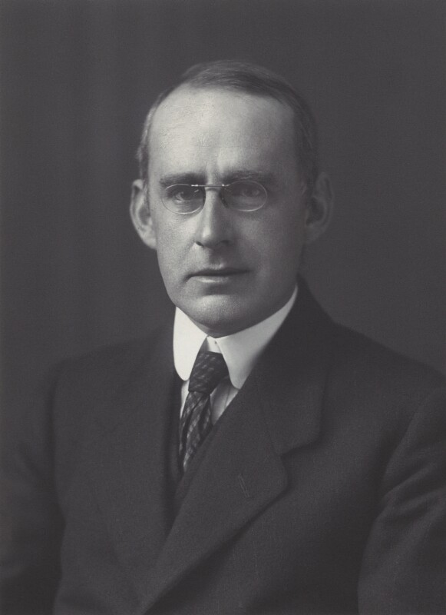
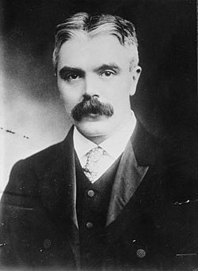
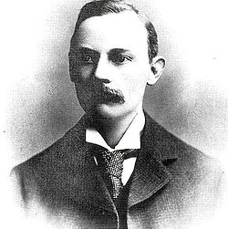
Brief History of Gravitational Lensing
The Eclipse Expeditions
29 may 1919
Arthur Stanley Eddington (1882-1944)
Frank Watson Dyson (1868-1939)
+ Charles Rundle Davidson
(1875-1970)
Andrew Crommelin (1875-1939)
D. Crespo
Ciclo de Seminarios del ICTEA
3 Diciembre 2025

Slide 35
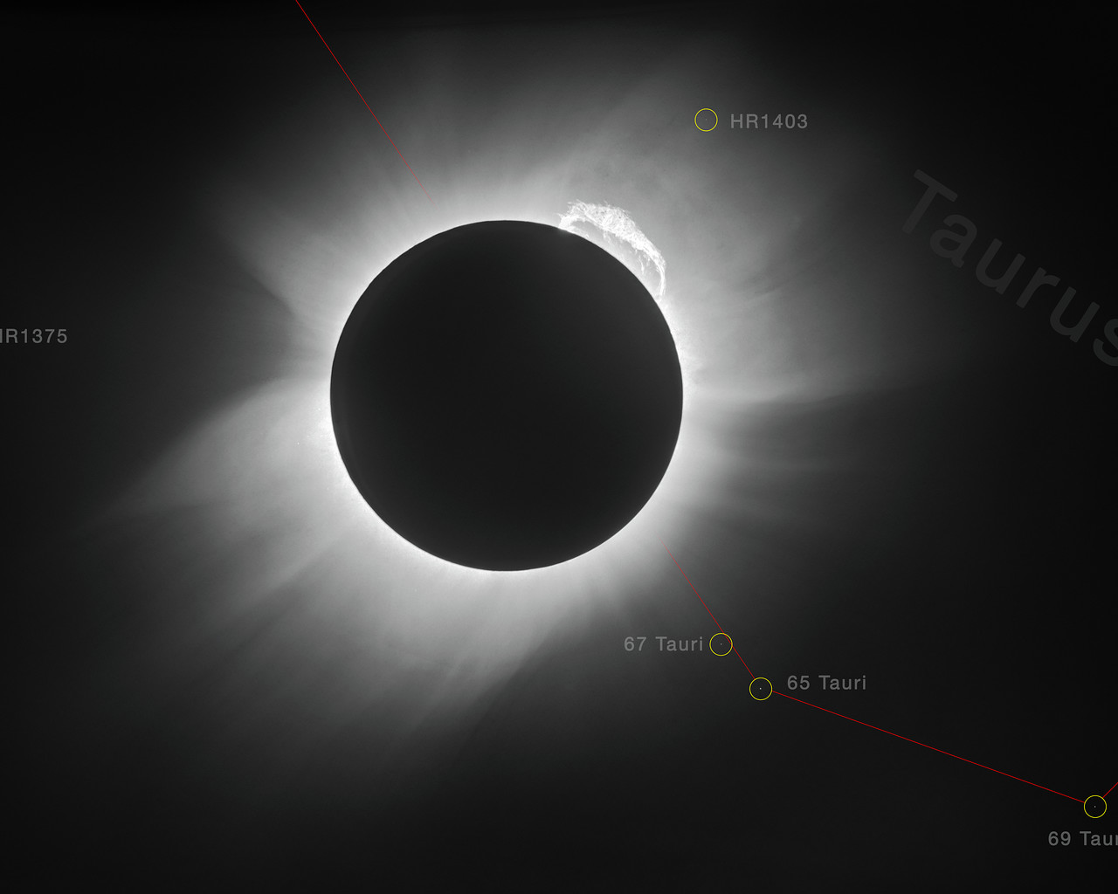
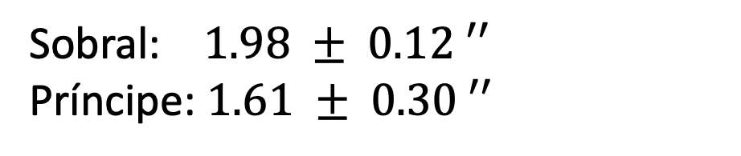
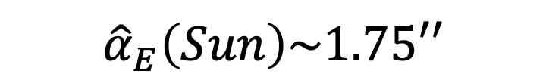
Brief History of Gravitational Lensing
The Eclipse Expeditions
29 may 1919
Sobral: $1.98 ± 0.12 ′′$
Príncipe: $1.61 ± 0.30 ′′$
$${\hat{α}}_{E}\left(Sun\right)\sim 1.75′′$$
D. Crespo
Ciclo de Seminarios del ICTEA
3 Diciembre 2025

Slide 36
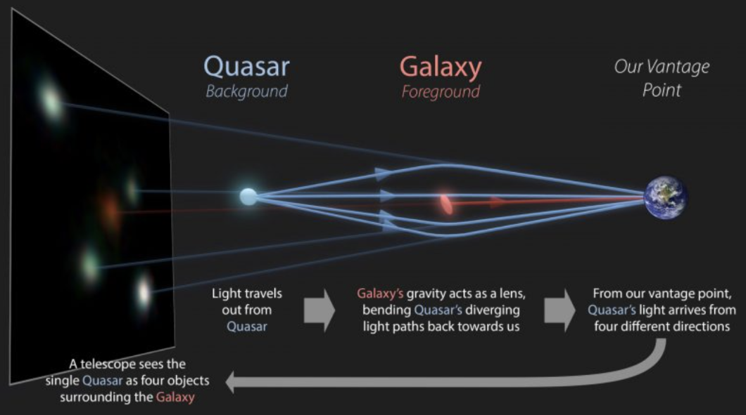
Brief History of Gravitational Lensing
Gravitational lensing as a tool
D. Crespo
Ciclo de Seminarios del ICTEA
3 Diciembre 2025

Slide 37
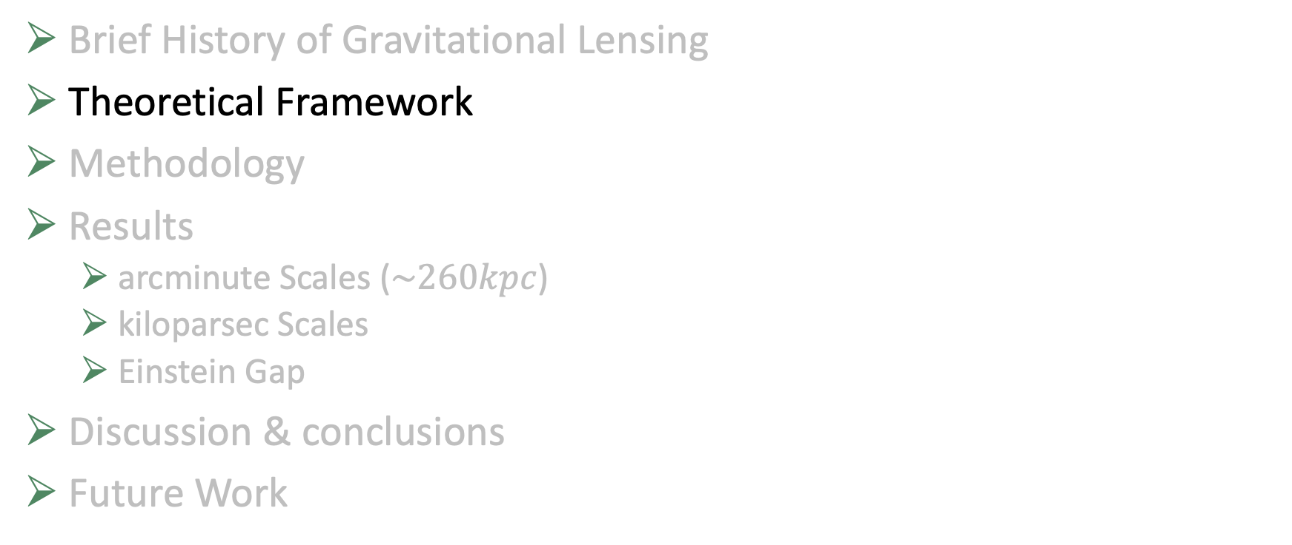
Theoretical Framework
Brief History of Gravitational Lensing
Theoretical Framework
Methodology
Results
arcminute Scales ($\sim 260kpc$)
kiloparsec Scales
Einstein Gap
Discussion & conclusions
Future Work
D. Crespo
Ciclo de Seminarios del ICTEA
3 Diciembre 2025

Slide 38
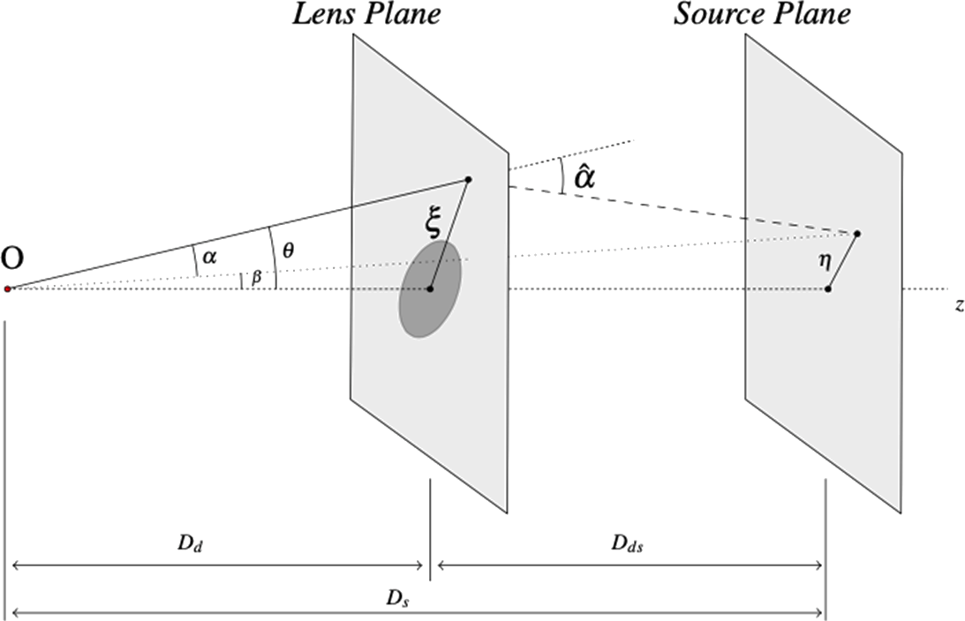


Theoretical Framework
Lens equation
$$β=θ−α(θ)$$
Critical surface
mass density
$$Σ_{cr}=\frac{c^{2}}{4πG}\frac{D_{s}}{D_{d}D_{ds}}$$
D. Crespo
Ciclo de Seminarios del ICTEA
3 Diciembre 2025

Slide 39
Theoretical Framework
Critical surface mass density
$$Σ_{cr}=\frac{c^{2}}{4πG}\frac{D_{s}}{D_{d}D_{ds}}$$
$$\vec{α}\left(\vec{θ}\right)=\frac{1}{π}\int_{ℝ^{2}}{d^{2}{\vec{θ}}^{′}κ\left({\vec{θ}}^{′}\right)\frac{\vec{θ}−\vec{θ}′}{{\left|\vec{θ}−\vec{θ}\right|}^{2}}}$$
$κ\left(\vec{θ}\right)≔\frac{Σ\left(D_{d}θ\right)}{Σ_{cr}}$
surface mass density or convergence
D. Crespo
Ciclo de Seminarios del ICTEA
3 Diciembre 2025

Slide 40
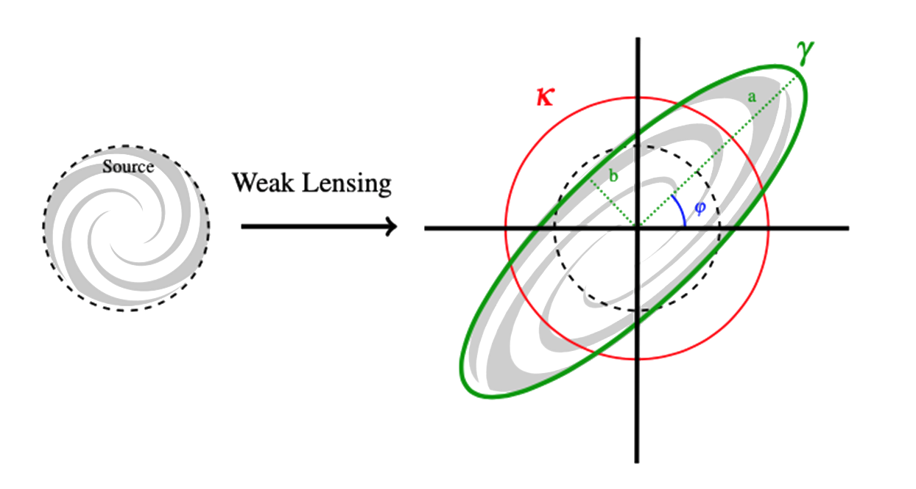
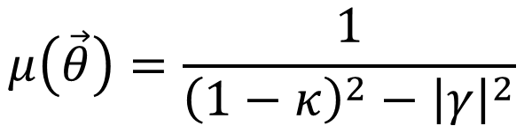
Theoretical Framework
Magnification and Distortion
$$μ\left(\vec{θ}\right)=\frac{1}{{\left(1−κ\right)}^{2}−{\left|γ\right|}^{2}}$$
D. Crespo
Ciclo de Seminarios del ICTEA
3 Diciembre 2025

Slide 41
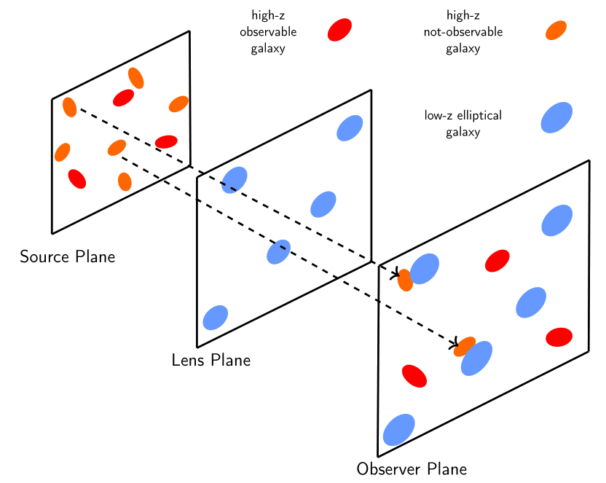

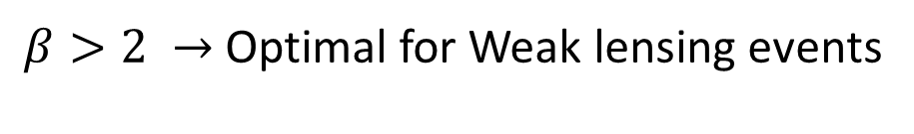

Theoretical Framework
Magnification Bias
Is a gravitational lensing effect.
Excess/Deficit of background sources nearby the lens position
$$N\left(>S\right)=N_{0}S^{−β}$$
$β>1 →$ Amplification
$β>2 →$ Optimal for Weak lensing events
Direct probe of total mass
(∼ dark matter)
Magnification Bias implies non-zero signal
D. Crespo
Ciclo de Seminarios del ICTEA
3 Diciembre 2025

Slide 42
Theoretical Framework
Sub-millimetre galaxies (SMGs)
High redshift distribution
Steep source number counts
Fairly invisible in the optical band
$$Optimal background sources for weak lensing studies!$$
D. Crespo
Ciclo de Seminarios del ICTEA
3 Diciembre 2025

Slide 43

Methodology
Introduction & Objetives
Theoretical Framework
Methodology
Results
arcminute Scales ($\sim 260kpc$)
kiloparsec Scales
Einstein Gap
Discussion & conclusions
Future Work
D. Crespo
PhD Thesis
20 Octubre 2025

Slide 44


Theoretical Framework
Traditional Cross-Correlation Funtion Estimation
The estimator (Landy & Szalay 1993, Herranz 2001)
$${\tilde{ω}}_{fb}\left(θ\right)=\frac{D_{f}D_{b}\left(θ\right)−D_{f}R_{b}\left(θ\right)−R_{f}D_{b}\left(θ\right)+R_{f}R_{b}\left(θ\right)}{R_{f}R_{b}\left(θ\right)}$$
Excess probability at a given $θ$
D. Crespo
Ciclo de Seminarios del ICTEA
3 Diciembre 2025

Slide 45





Theoretical Framework
Stacking Technique
Define a radius $r$ around each lens
Compute the impact parameters for all background sources
Build a $\left[n_{pix}×n_{pix}\right]$grid with pixel size $s_{pix}$, such that
Place sources on the grid to create a density map.
$$r=\frac{n_{pix}⋅s_{pix}}{2}$$
D. Crespo
Ciclo de Seminarios del ICTEA
3 Diciembre 2025

Slide 46
Theoretical Framework
Stacking Technique
Advantages:
Positional errors → Gaussian Smoothing filter
Follow the pairs contributing to the final stacked map
D. Crespo
Ciclo de Seminarios del ICTEA
3 Diciembre 2025

Slide 47

Theoretical Framework
Cross-Correlation Funtion Estimation
The estimator (Davis & Peebles et al. 1983)
$${\tilde{ω}}_{χ}\left(θ\right)=\frac{DD\left(θ\right)}{RR\left(θ\right)}−1$$
D. Crespo
Ciclo de Seminarios del ICTEA
3 Diciembre 2025

Slide 48


Theoretical Framework
Random Function
Simulated catalogue
Analytically
$$RR\left(θ\right)=ρ⋅A_{ring}\left(θ\right)$$
$×10$ foregorund
D. Crespo
Ciclo de Seminarios del ICTEA
3 Diciembre 2025

Slide 49

Theoretical Framework
Random Function
D. Crespo
Ciclo de Seminarios del ICTEA
3 Diciembre 2025

Slide 50
Theoretical Framework
CCF & Magnification Bias
alters the apparent density of background sources near foreground lenses.
The signal is purely lensing-induced and expressed as
$$ω_{χ}\left(θ\right)=μ^{β−1}\left(θ\right)−1$$
μ(θ) is the magnification field generated by the lens at an angular separation θ, and β is the logarithmic slope of the background number counts
$$μ\left(θ\right)=\frac{1}{\left(1−κ\left(θ\right)\right)\left(1+\overline{κ}\left(θ\right)−2κ\left(θ\right)\right)}$$
D. Crespo
Ciclo de Seminarios del ICTEA
3 Diciembre 2025

Slide 51
Theoretical Framework
Mass Density Profiles
Singular Isothermal Sphere (SIS)
Navarro Frenk White (NFW)
Sérsic Profile
SISSA Profile
Burkert Profile
D. Crespo
Ciclo de Seminarios del ICTEA
3 Diciembre 2025

Slide 52
Theoretical Framework
Mass Density Profiles
Singular Isothermal Sphere (SIS)
Navarro Frenk White (NFW)
Sérsic Profile
SISSA Profile
Burkert Profile
D. Crespo
Ciclo de Seminarios del ICTEA
3 Diciembre 2025

Slide 53


Theoretical Framework
Mass Density Profiles
Singular Isothermal Sphere (SIS)
$$ρ\left(r\right)=\frac{σ_{v}^{2} }{2πGr^{2}}$$
It is usually used for elliptical galaxies or bulges.
D. Crespo
Ciclo de Seminarios del ICTEA
3 Diciembre 2025

Slide 54
Theoretical Framework
Mass Density Profiles
Navarro Frenk White (NFW)
Sérsic Profile
SISSA Profile
Burkert Profile
D. Crespo
Ciclo de Seminarios del ICTEA
3 Diciembre 2025

Slide 55


Theoretical Framework
Mass Density Profiles
Navarro Frenk White (NFW)
$$ρ\left(r\right)=\frac{ρ_{s}}{\left(r/{r_{z}}\right){\left(1+r/{r_{s}}\right)}^{2}}$$
It is usually used for describe dark matter halos.
D. Crespo
Ciclo de Seminarios del ICTEA
3 Diciembre 2025

Slide 56
Theoretical Framework
Mass Density Profiles
Sérsic Profile
SISSA Profile
Burkert Profile
D. Crespo
Ciclo de Seminarios del ICTEA
3 Diciembre 2025

Slide 57


Theoretical Framework
Mass Density Profiles
Sérsic Profile
$Σ\left(θ\right)=Σ_{e}⋅exp⁡(−b_{n}\left({\left(\frac{θ}{θ_{e}}\right)}^{\frac{1}{n}}−1\right)$
Proposed for brightness or luminosity profiles
D. Crespo
Ciclo de Seminarios del ICTEA
3 Diciembre 2025

Slide 58
Theoretical Framework
Mass Density Profiles
SISSA Profile
Burkert Profile
D. Crespo
Ciclo de Seminarios del ICTEA
3 Diciembre 2025

Slide 59


Theoretical Framework
Mass Density Profiles
SISSA Profile
$Σ\left(s\right)=Σ_{0}⋅{\left(\frac{s}{s_{0}}\right)}^{−η}$
Combination of
NFW+Sérsic
D. Crespo
Ciclo de Seminarios del ICTEA
3 Diciembre 2025

Slide 60
Theoretical Framework
Mass Density Profiles
Burkert Profile
D. Crespo
Ciclo de Seminarios del ICTEA
3 Diciembre 2025

Slide 61


Theoretical Framework
Mass Density Profiles
Burkert Profile
$ρ\left(r\right)=\frac{ρ_{0} r_{c}^{3}}{\left(r+r_{c}\right)\left(r^{2}+r_{c}^{2}\right)}$
phenomenological dark matter density model
D. Crespo
Ciclo de Seminarios del ICTEA
3 Diciembre 2025

Slide 62

Results: Arcminute Scales
Introduction & Objetives
Theoretical Framework
Methodology
Results
arcminute-scales ($\sim 260kpc$)
kiloparsec Scales
Einstein Gap
Discussion & conclusions
Future Work
D. Crespo
Ciclo de Seminarios del ICTEA
3 Diciembre 2025

Slide 63


Results: arcminute-scales
Data
Background
• Submillimetre Galaxies by Herschel Space Observatory in H-ATLAS
(e.g. Eales et al. 2010, Valiante et al. 2016)
Foreground
• Galaxies in the GAMA II spectroscopic survey (Driver et al. 2011;
Baldry et al. 2010, 2014; Liske et al. 2015)
Overlapping: GAMA(9h,12h,14.5h) región
• Quasi-stellar Objects (QSOs) in SDSS-II and SDSS-III; DR7(Schneider
et al. 2010) and DR12 (Pâris et al. 2017)
Overlapping: GAMA(9h,12h,14.5h) and SGP regions
• Clusters by Sloan Digital Sky Survey III (SDSS III) (Wen et al. 2012)
Overlapping: GAMA(9h,12h,14.5h) and NGP regions
→ 5 Richness Bins
D. Crespo
Ciclo de Seminarios del ICTEA
3 Diciembre 2025

Slide 64

Results: arcminute-scales
Data
Background
SMGs
$1.2<z_{phot}<4.0$
$$\left(70 707\right) \left(49 293\right) (27 517)$$
Foreground
Clusters QSOs Galaxies
$0.05<z_{spec}<0.8$
$$\left(3 651\right) \left(1 546\right) \left(102 672\right)$$
D. Crespo
Ciclo de Seminarios del ICTEA
3 Diciembre 2025

Slide 65



Results: arcminute-scales
Analysis
$r=200\operatorname{arcsec}{→400×400 pix→σ=2.4′′}$
NFW
Theoretical
Profiles
SIS
D. Crespo
Ciclo de Seminarios del ICTEA
3 Diciembre 2025

Slide 66

Results: arcminute-scales
Galaxies Sample
 | $${NFW}_{small}$$ |  | $$SIS$$ | $${NFW}_{large}$$
 | $$M_{200}\left(M_{⊙}\right)$$ | $$C$$ | $M_{200}\left(M_{⊙}\right)$ | $$M_{200}\left(M_{⊙}\right)$$ | $$C$$
$$Clusters$$ | $$4.08⋅{10}^{13}$$ | $$4.17$$ | $$5.45⋅{10}^{12}$$ | $$5.46⋅{10}^{13}$$ | $$1.84$$
$$QSOs$$ | $$3.24⋅{10}^{13}$$ | $$6.85$$ | $$8.59⋅{10}^{12}$$ | $$2.75⋅{10}^{13}$$ | $$0.37$$
$$Galaxies$$ | $$2.09⋅{10}^{13}$$ | $$8.23$$ | $$6.08⋅{10}^{12}$$ | $$6.03⋅{10}^{12}$$ | $$1.21$$
D. Crespo
Ciclo de Seminarios del ICTEA
3 Diciembre 2025

Slide 67

Results: arcminute-scales
Discussion
Comparison with Prior Results and Lens-Type Interpretation
$$M_{NFW}\sim {10}^{14}M_{⊙} C\sim 3.5$$
However, the low concentration
suggested that the halos were not relaxed
or were in early stages of formation.
We perform independent NFW adjustments
for the inner (central lens-dominated)
and outer (host halo-dominated) regions.
Bonavera et al. 2019
D. Crespo
Ciclo de Seminarios del ICTEA
3 Diciembre 2025

Slide 68

Results: arcminute-scales
Discussion
Lack of signal at ~10 arcsec
Our data a systematic dip or valley in the signal at this intermediate scale.
This feature is not statistical noise, as it appears in multiple samples and analyses.
Main Interpretation:
It could mark the transition zone between the gravitational potential dominated by the BCG and the cluster halo.
Other factors such as miscentering or baryonic feedback could also contribute.
D. Crespo
Ciclo de Seminarios del ICTEA
3 Diciembre 2025

Slide 69

Results: kiloparsec-scales
Introduction & Objetives
Theoretical Framework
Methodology
Results
arcminute Scales ($\sim 260kpc$)
kiloparsec Scales
Einstein Gap
Discussion & conclusions
Future Work
D. Crespo
PhD Thesis
20 Octubre 2025

Slide 70


Results: kiloparsec-scales
The arcmin-scale analysis was limited by the positional uncertainty of the background sources (H-ATLAS SMGs, $σ$= 2.4‘’).
To study the central regions, we needed greater precision.
Improve positional accuracy:
SMGs by a cross match with
NASA’s Wide-field Infrared
(WISE, Wright et al. 2010)
and H-ATLAS
D. Crespo
Ciclo de Seminarios del ICTEA
3 Diciembre 2025

Slide 71
Results: kiloparsec-scales
Data
Background
• Submillimetre Galaxies by Herschel Space Observatory in H-ATLAS
(e.g. Eales et al. 2010, Valiante et al. 2016)
• Submillimetre Galaxies by a cross match with NASA’s Wide-field Infrared
(WISE, Wright et al. 2010)
Foreground
• Galaxies in the GAMA II spectroscopic survey (Driver et al. 2011;
Baldry et al. 2010, 2014; Liske et al. 2015)
Overlapping: GAMA(9h,12h,14.5h) región
• Quasi-stellar Objects (QSOs) in SDSS-II and SDSS-III; DR7(Schneider
et al. 2010) and DR12 (Pâris et al. 2017)
Overlapping: GAMA(9h,12h,14.5h) and SGP regions
• Clusters by Sloan Digital Sky Survey III (SDSS III) (Wen et al. 2012)
Overlapping: GAMA(9h,12h,14.5h) and NGP regions
• Clusters by SDSS (Zou et al. 2021)
Overlapping: GAMA(9h,12h,14.5h) and NGP regions
D. Crespo
Ciclo de Seminarios del ICTEA
3 Diciembre 2025

Slide 72

Results: kiloparsec-scales
Data
Galaxies
$$\left(102 672\right) z\sim 0.30$$
QSOs
$$\left(1 649\right) z\sim 0.72$$
Clusters WEN
$$\left(3 598\right) z\sim 0.38$$
Clusters ZOU
$$\left(9 056\right) z\sim 0.49$$
D. Crespo
Ciclo de Seminarios del ICTEA
3 Diciembre 2025

Slide 73

Results: kiloparsec-scales
Analysis
$$r=\left\{\begin{aligned}200\operatorname{arcsec}{→400×400 pix →σ=2.4′′ }Low Resolution \\ 50\operatorname{arcsec}{→2000×2000 pix →σ=0.3′′ High Resolution}\end{aligned}\right.$$
Theoretical Random Function
NFW
Sersic
Theoretical
Profiles
SIS
Burkert
D. Crespo
Ciclo de Seminarios del ICTEA
3 Diciembre 2025

Slide 74






Results: kiloparsec-scales
Comparison H-ATLAS vs WISE
Clusters ZOU Galaxies
QSOs Clusters WEN
D. Crespo
Ciclo de Seminarios del ICTEA
3 Diciembre 2025

Slide 75






Results: kiloparsec-scales
Comparison High vs Low Resolution
Clusters ZOU Galaxies
QSOs Clusters WEN
D. Crespo
Ciclo de Seminarios del ICTEA
3 Diciembre 2025

Slide 76


Results: kiloparsec-scales
Mass Density Profile Modelling
Low Resolution High Resolution
Sersic would be the one that
best explains the central data
None of the profiles seem to correctly
explain the measured signal.
D. Crespo
Ciclo de Seminarios del ICTEA
3 Diciembre 2025

Slide 77

Results: arcminute-scales
Discussion
Signal drop at ~10 arcsec
robust and clearly
observed in the high-resolution data especially for galaxies and QSOs.
D. Crespo
Ciclo de Seminarios del ICTEA
3 Diciembre 2025

Slide 78



Results: arcminute-scales
Discussion
Signal drop at ~10 arcsec
Is it a real mass deficit?
Visual Evidence:
Optical images of the clusters show that many BCGs appear to be in a region relatively devoid of bright satellites at those scales.
D. Crespo
Ciclo de Seminarios del ICTEA
3 Diciembre 2025

Slide 79


Results: arcminute-scales
Discussion
Signal drop at ~10 arcsec
Is it a real mass deficit?
Preliminary Satellite Analysis:
We stacked the positions of real satellite galaxies in clusters. The satellite density profile shows a dip morphologically similar to the lensing signal.
$\sim$28 Clusters
D. Crespo
Ciclo de Seminarios del ICTEA
3 Diciembre 2025

Slide 80

Results: arcminute-scales
Discussion
Signal drop at ~10 arcsec
Is it a systematic issues?
Magnification Bias Simulation
(a simplistic approximation focused exclusively on magnification without considering other gravitational lensing phenomena like shear or convergence)
No significant systematic effects were introduced
by the data processing pipeline
D. Crespo
Ciclo de Seminarios del ICTEA
3 Diciembre 2025

Slide 81
Results: Einstein Gap
Introduction & Objetives
Theoretical Framework
Methodology
Results
Arcminute Scales
Kiloparsec Scales
Einstein Gap
Discussion & conclusions
Future Work
D. Crespo
Ciclo de Seminarios del ICTEA
3 Diciembre 2025

Slide 82
Results: Einstein Gap
The signal drop observed around 10″ (Einstein Gap)
could arise from a combination of strong lensing, baryonic cores, and satellite depletion.
We need to test its origin statistically and physically.
Is this drop purely a strong lensing effect from the Central Galaxy (BCG)
or does it reflect the true density distribution of satellites and substructure?
Expanding our satellite galaxy catalog
from 28 clusters to 540 433 clusters from Zou et al. 2021
Improving the simulator
Including more realistic models (NFW to SISSA)
Incorporating ray tracing
D. Crespo
Ciclo de Seminarios del ICTEA
3 Diciembre 2025

Slide 83

Results: Einstein Gap
Data
540 433 clusters from
Zou et al. 2021
12 046 450 galaxies
7 Bins (mass BCGs)
D. Crespo
Ciclo de Seminarios del ICTEA
3 Diciembre 2025

Slide 84

Results: Einstein Gap
Data
Background
• Submillimetre Galaxies by Herschel Space Observatory in H-ATLAS
(e.g. Eales et al. 2010, Valiante et al. 2016)
• Submillimetre Galaxies by a cross match with NASA’sWide-field Infrared
(WISE, Wright et al. 2010)
Foreground
• Galaxies in the GAMA II spectroscopic survey (Driver et al. 2011;
Baldry et al. 2010, 2014; Liske et al. 2015)
Overlapping: GAMA(9h,12h,14.5h) región
• Quasi-stellar Objects (QSOs) in SDSS-II and SDSS-III; DR7(Schneider
et al. 2010) and DR12 (Pâris et al. 2017)
Overlapping: GAMA(9h,12h,14.5h) and SGP regions
• Clusters by Sloan Digital Sky Survey III (SDSS III) (Wen et al. 2012)
Overlapping: GAMA(9h,12h,14.5h) and NGP regions
• Clusters by SDSS (Zou et al. 2021)
Overlapping: GAMA(9h,12h,14.5h) and NGP regions
→ 7 Richness Bins
D. Crespo
Ciclo de Seminarios del ICTEA
3 Diciembre 2025

Slide 85


Results: Einstein Gap
Analysis
$r=200\operatorname{arcsec}{→800×800 pix→σ=2.4′′ }$
$r=200\operatorname{arcsec}{→400×400 pix→σ=2.4 }$
Satellite
Positions
$$Σ_{sat}$$
Lensing
Theoretical
Profiles
NFW
D. Crespo
Ciclo de Seminarios del ICTEA
3 Diciembre 2025

Slide 86


Results: Einstein Gap
Satellite Number Density Profile
Smaller scales ($θ<2′′−3′′$):
Clear Break
Intermediate scales ($θ\sim 5′′−10′′$):
Small fluctuations due to statistical limitations.
Large scales ($θ>10′′$):
Smooth and continuous
D. Crespo
Ciclo de Seminarios del ICTEA
3 Diciembre 2025

Slide 87


Results: Einstein Gap
Members separation by BCG mass ranges: Lensing and NFW profile fits
 | $$\log_{10}({M_{BCG}}/{M_{⊙})}$$ | $$\log_{10}({M_{200}}/{M_{⊙})}$$ | $$C$$
BIN 1 | $$<10.2$$ | $$13.13±0.17$$ | $$0.11±0.04$$
BIN 2 | $$10.2−10.5$$ | $$13.33±0.07$$ | $$0.19±0.08$$
BIN 3 | $$10.5−10.8$$ | $$13.89±0.06$$ | $$0.20±0.07$$
BIN 4 | $$10.8−11.1$$ | $$13.43±0.04$$ | $$0.30±0.07$$
BIN 5 | $$11.1−11.4$$ | $$13.91±0.01$$ | $$0.72±0.07$$
BIN 6 | $$11.4−11.7$$ | $$13.96±0.01$$ | $$1.10±0.09$$
BIN 7 | $$>11.7$$ | $$13.66±0.03$$ | $$1.12±0.02$$
D. Crespo
Ciclo de Seminarios del ICTEA
3 Diciembre 2025

Slide 88


Results: Einstein Gap
Central halo mass as a function of stellar mass
$M_{∗}<{10}^{10.8}$
Inferred halo masses are significantly higher than expected
${{10}^{10.8}<M}_{∗}<{10}^{11.7}$
Reasonably well with previous SHMR estimates.
$M_{∗}>{10}^{11.7}$
Halo mass lies below the expected value
D. Crespo
Ciclo de Seminarios del ICTEA
3 Diciembre 2025

Slide 89


Results: Einstein Gap
Miscentring
BIN 1
BIN 7
D. Crespo
Ciclo de Seminarios del ICTEA
3 Diciembre 2025

Slide 90




Results: Einstein Gap
Development of the Lensing Simulator
Limitations of the
small-scale simulator
SISSA too rigid
need for greater flexibility to explore different mass distribution scenarios
Strong Lensing effects using ray-tracing methodology.
$$M_{h}\sim 5⋅{10}^{14}M_{⊙}$$
D. Crespo
Ciclo de Seminarios del ICTEA
3 Diciembre 2025

Slide 91
Results: Einstein Gap
Central halo mass as a function of stellar mass
$M_{∗}<{10}^{10.8}$
Inferred halo masses are significantly higher than expected
${{10}^{10.8}<M}_{∗}<{10}^{11.7}$
Reasonably well with previous SHMR estimates.
$M_{∗}>{10}^{11.7}$
Halo mass lies below the expected value
D. Crespo
Ciclo de Seminarios del ICTEA
3 Diciembre 2025

Slide 92
Conclusion
Introduction & Objetives
Theoretical Framework
Methodology
Results
Arcminute Scales
Kiloparsec Scales
Einstein Gap
Discussion & conclusions
Future Work
D. Crespo
PhD Thesis
20 Octubre 2025

Slide 93

Conclusions
Dark matter halos are complex and cannot be described with a single mass profile.
A combination of dark matter, baryons, and satellite substructures is required to reproduce the observed magnification signal.
The high resolution reveals baryonic dominance in the nucleus.
In the innermost regions, baryonic matter plays a dominant gravitational role,
shaping the magnification profile and producing a central excess in the correlation function.
The "Einstein Gap" is a true signature of the strong lensing regime.
The consistent suppression of signal around $\sim 10″$across all lens samples
and simulations confirms its physical origin
Magnification bias is a precision tool for halo substructure.
It allows us to trace both the smooth dark-matter distribution and small-scale substructures,
offering a powerful and complementary tool to shear-based weak-lensing studies
D. Crespo
Ciclo de Seminarios del ICTEA
3 Diciembre 2025

Slide 94
Conclusions
“But the reason I call myself by my childhood name is to remind myself that a scientist must also be absolutely like a child. If he sees a thing, he must say that he sees it, whether it was what he thought he was going to see or not. See first, think later, then test. But always see first. Otherwise you will only see what you were expecting. Most scientists forget that.”
– Douglas Adams, So Long, and Thanks for All the Fish.
D. Crespo
Ciclo de Seminarios del ICTEA
3 Diciembre 2025

Slide 95
Muchas gracias por su atención
David Crespo Iglesias
Codirección científica:
Dra. Laura Bonavera
Dr. Joaquín González-Nuevo
D. Crespo
Ciclo de Seminarios del ICTEA
3 Diciembre 2025

Slide 96




Results: arcminute-scales
Cluster Sample
$$M_{NFW}^{small}=4.08⋅{10}^{13}M_{⊙} C=4.17$$
$$M_{SIS}=5.45⋅{10}^{12}M_{⊙}$$
$$M_{NFW}^{large}=5.46⋅{10}^{13}M_{⊙} C=1.84$$
D. Crespo
Ciclo de Seminarios del ICTEA
3 Diciembre 2025

Slide 97
Results: arcminute-scales
Cluster Sample - Richness
D. Crespo
Ciclo de Seminarios del ICTEA
3 Diciembre 2025

Slide 98
Results: arcminute-scales
Cluster Sample - Richness
D. Crespo
Ciclo de Seminarios del ICTEA
3 Diciembre 2025

Slide 99
Results: arcminute-scales
Cluster Sample - Richness
D. Crespo
Ciclo de Seminarios del ICTEA
3 Diciembre 2025

Slide 100




Results: arcminute-scales
QSOs Sample
$$M_{NFW}^{small}=3.24⋅{10}^{13}M_{⊙} C=6.85$$
$$M_{SIS}=8.59⋅{10}^{12}M_{⊙}$$
$$M_{NFW}^{large}=2.75⋅{10}^{13}M_{⊙} C=0.37$$
D. Crespo
Ciclo de Seminarios del ICTEA
3 Diciembre 2025

Slide 101



Results: arcminute-scales
Galaxies Sample
$$M_{NFW}^{small}=2.09⋅{10}^{13}M_{⊙} C=8.23$$
$$M_{SIS}=6.08⋅{10}^{12}M_{⊙}$$
$$M_{NFW}^{large}=6.03⋅{10}^{12}M_{⊙} C=1.21$$
D. Crespo
Ciclo de Seminarios del ICTEA
3 Diciembre 2025

Slide 102

Appendix
D. Crespo
Ciclo de Seminarios del ICTEA
3 Diciembre 2025

Slide 103

Appendix
D. Crespo
Ciclo de Seminarios del ICTEA
3 Diciembre 2025

Slide 104

Appendix
D. Crespo
Ciclo de Seminarios del ICTEA
3 Diciembre 2025

Slide 105

Appendix
D. Crespo
Ciclo de Seminarios del ICTEA
3 Diciembre 2025

Slide 106




Results: Einstein Gap
Inferring central stellar mass via satellite and lensing
$$\log_{10}({M_{200}}/{M_{⊙})}$$ | $$C$$
$$13.46±0.01$$ | $$0.26±0.02$$
$$13.82±0.02$$ | $$0.58±0.09$$
$$13.93±0.01$$ | $$1.37±0.07$$
$$13.75±0.01$$ | $$1.00±0.07$$
Clusters WEN Galaxies
QSOs Clusters ZOU
D. Crespo
Ciclo de Seminarios del ICTEA
3 Diciembre 2025

Slide 107

Appendix
D. Crespo
Ciclo de Seminarios del ICTEA
3 Diciembre 2025

