Slide 1
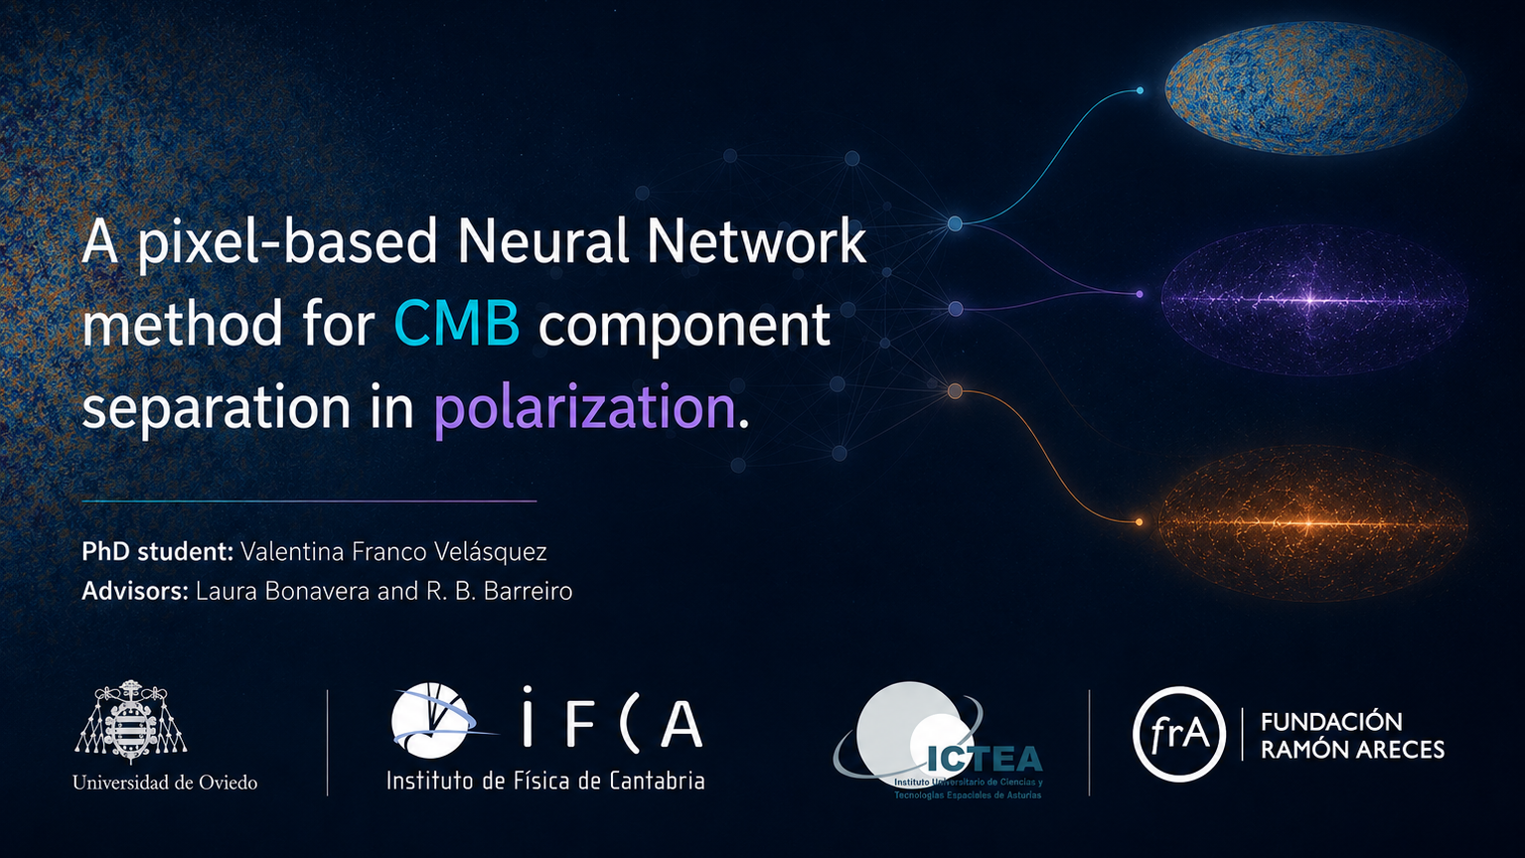

Slide 2
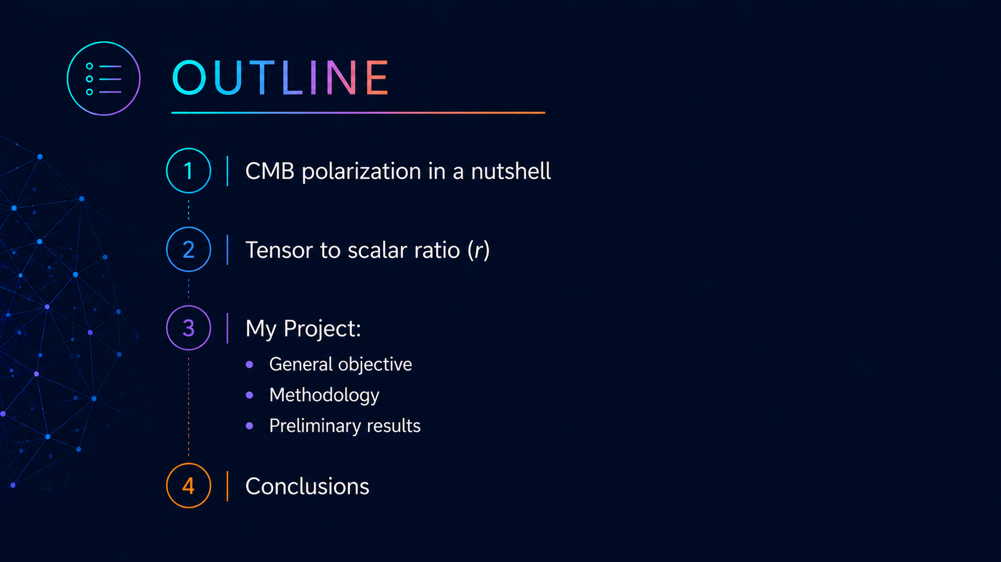

Slide 3
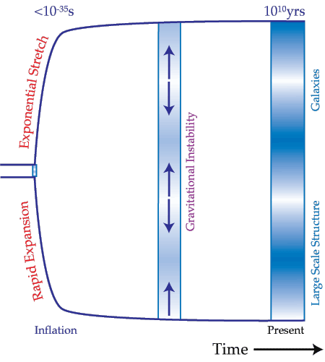
CMB polarization in a nutshell
The Cosmic Microwave Background (CMB) is the cooled remnant of the first light that could ever travel freely throughout the Universe.
Inflation + photon-baryon fluid = sound waves frozen in time
1/20

Slide 4
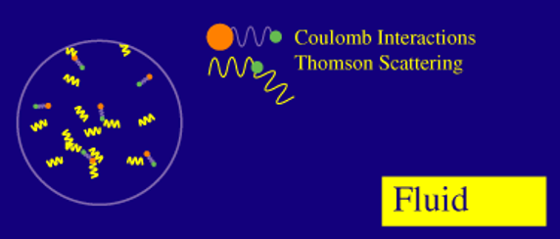
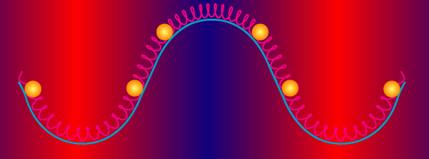
CMB polarization in a nutshell
The Cosmic Microwave Background (CMB) is the cooled remnant of the first light that could ever travel freely throughout the Universe.
Inflation + photon-baryon fluid = sound waves frozen in time
Gravity
Pressure
1/20

Slide 5
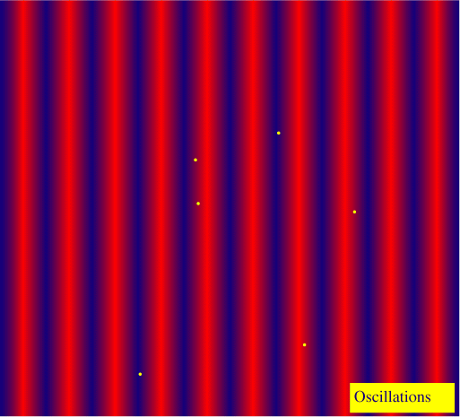
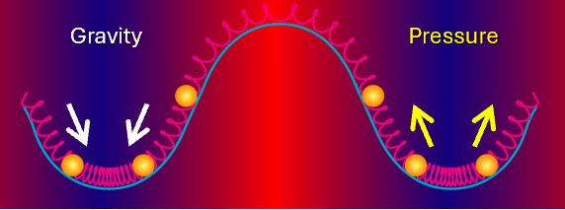
CMB polarization in a nutshell
The Cosmic Microwave Background (CMB) is the cooled remnant of the first light that could ever travel freely throughout the Universe.
Inflation + photon-baryon fluid = sound waves frozen in time
Recombination
(380,000 yr after BB)
1/20

Slide 6
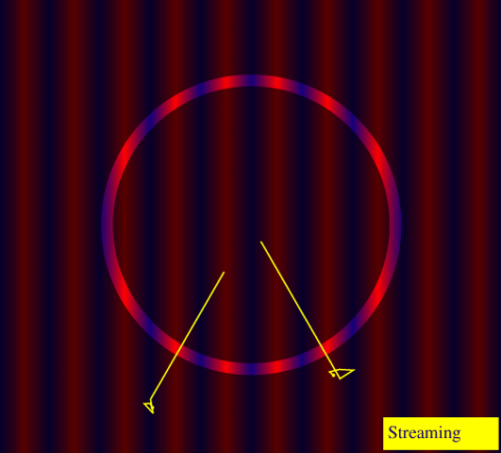
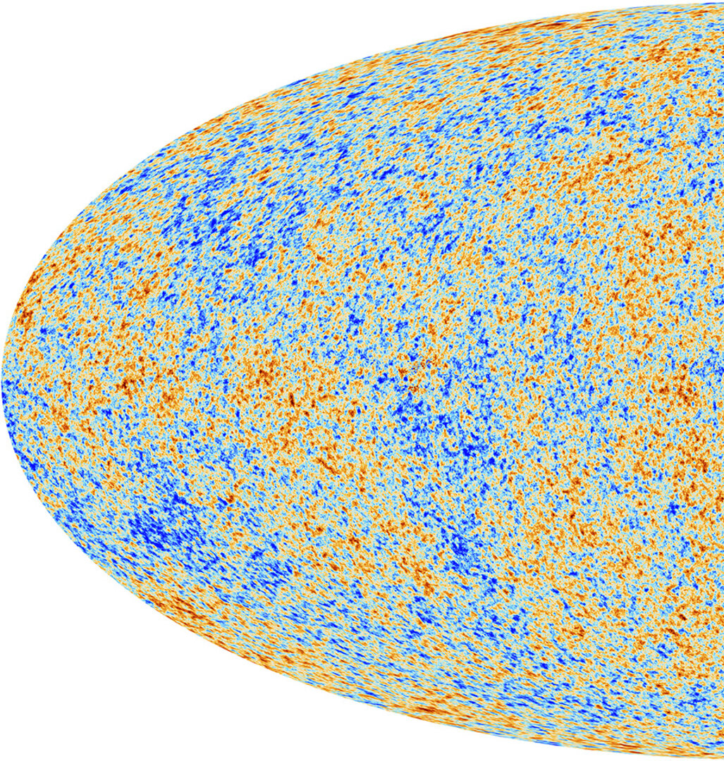
CMB polarization in a nutshell
The Cosmic Microwave Background (CMB) is the cooled remnant of the first light that could ever travel freely throughout the Universe.
Inflation + photon-baryon fluid = sound waves frozen in time
Recombination
(380.000 yr after BB)
CMB
(Today)
1/20

Slide 7
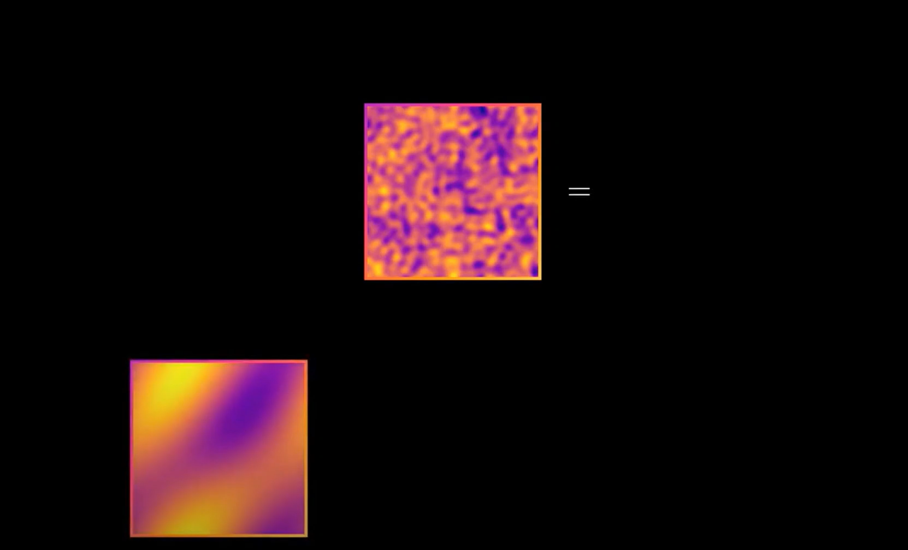
CMB polarization in a nutshell
The discovery of sound waves in the CMB has transformed cosmology into a precision science where we can measure things like:
The curvature of the universe.
The amount of dark and baryonic matter.
The density of neutrinos.
* Temperature fluctuations may evolve between last scattering and the present.
2/20

Slide 8
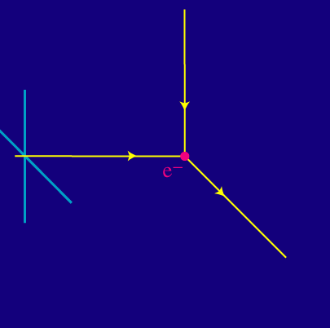
What about polarization?
CMB polarization is produced by Thomson scattering.
In general
3/20

Slide 9
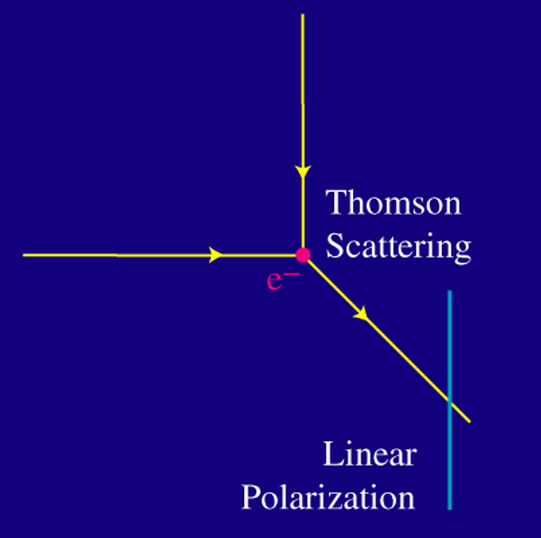
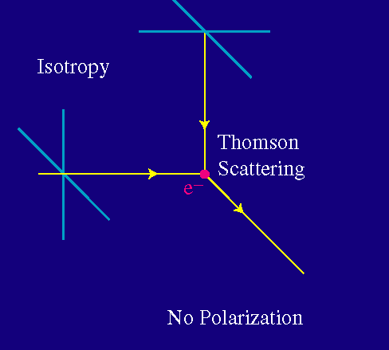
What about polarization?
CMB polarization is produced by Thomson scattering.
In general
In practice (?)
3/20

Slide 10
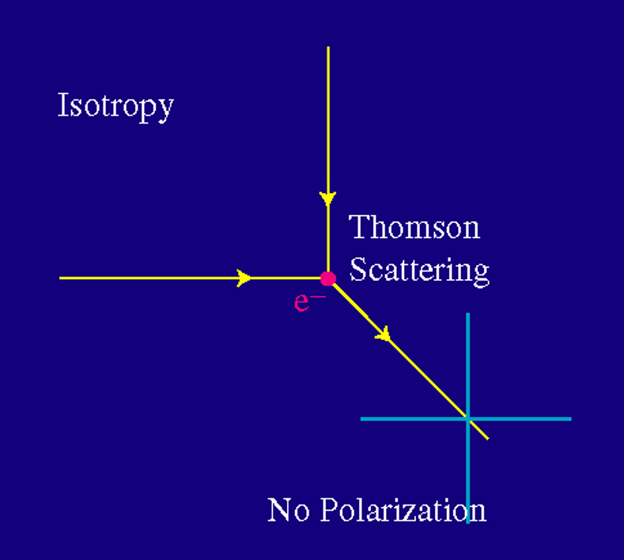
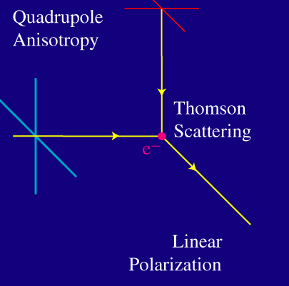
What about polarization?
CMB polarization is produced by Thomson scattering.
In general
In practice (?)
Is this case even possible?
3/20

Slide 11
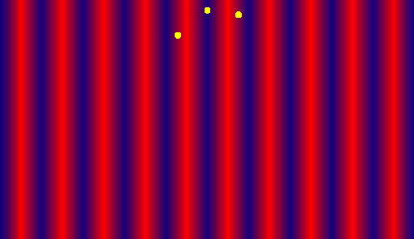
What about polarization?
Yes, it is !
As polarization can only be generated by Thomson scattering, the polarization spectrum of the CMB is thus a direct snapshot of conditions on the last scattering surface.
4/20

Slide 12
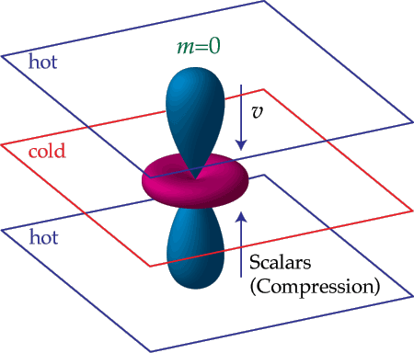
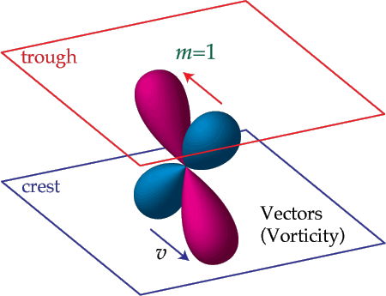
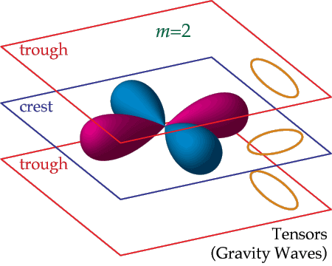
What about polarization?
3 sources of polarization
5/20

Slide 13
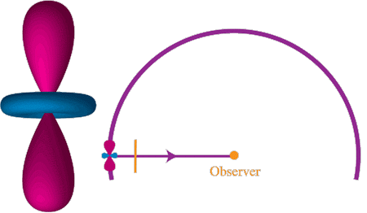
What about polarization?
Projection on the sky
3 sources of polarization
5/20

Slide 14
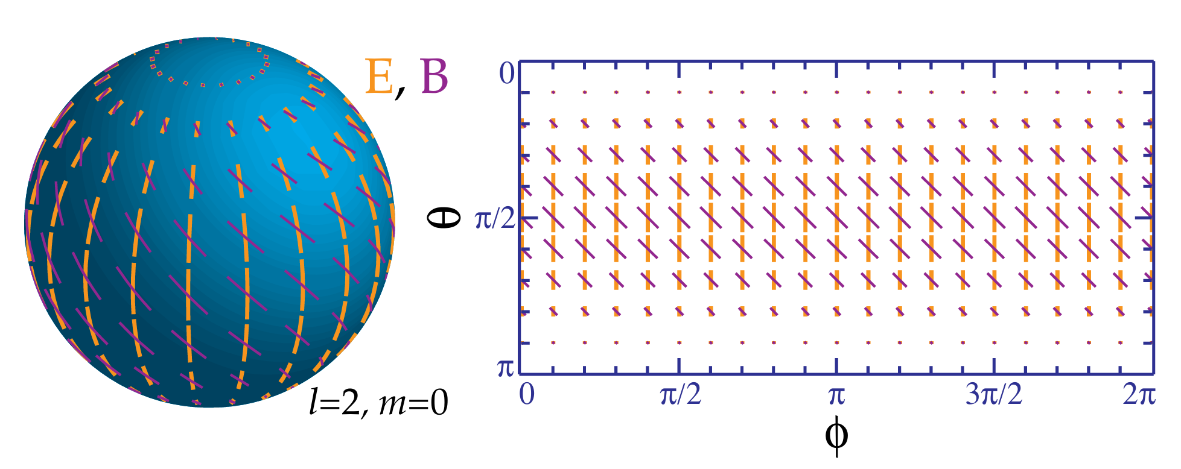
What about polarization?
3 sources of polarization
5/20

Slide 15
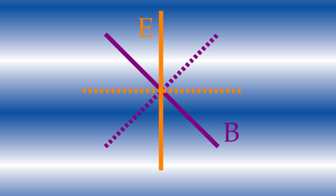
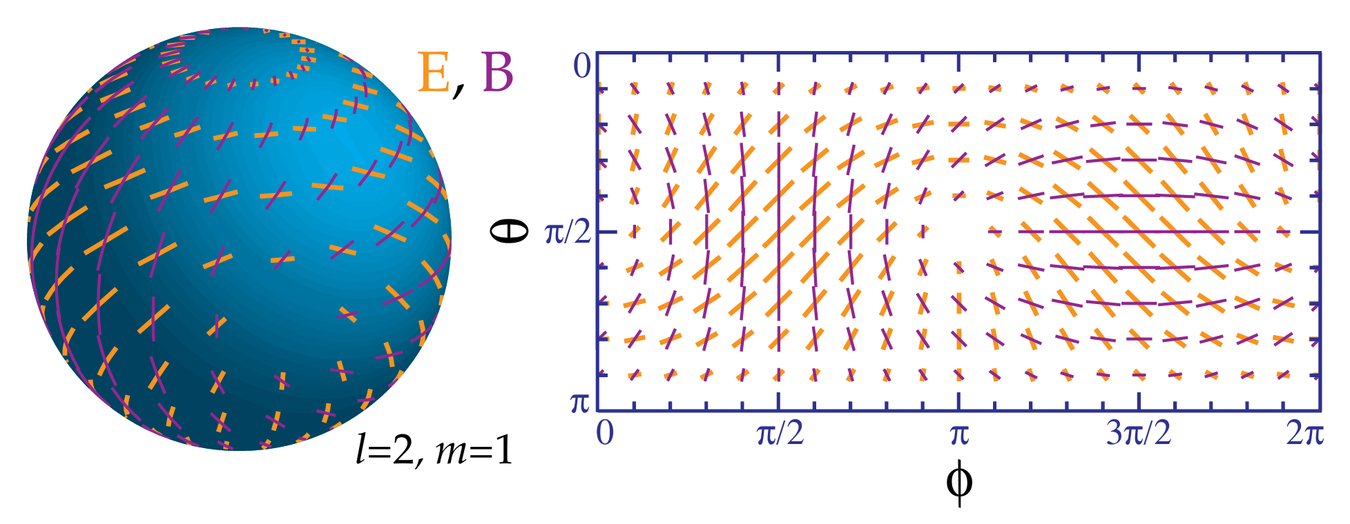
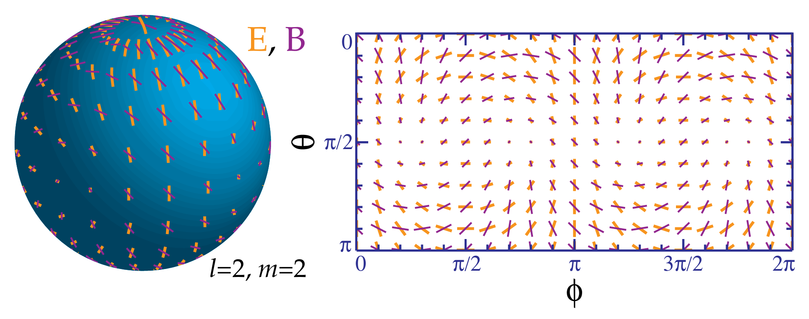
What about polarization?
Is it an E or a B mode?
3 sources of polarization
3 distinct patterns
5/20

Slide 16
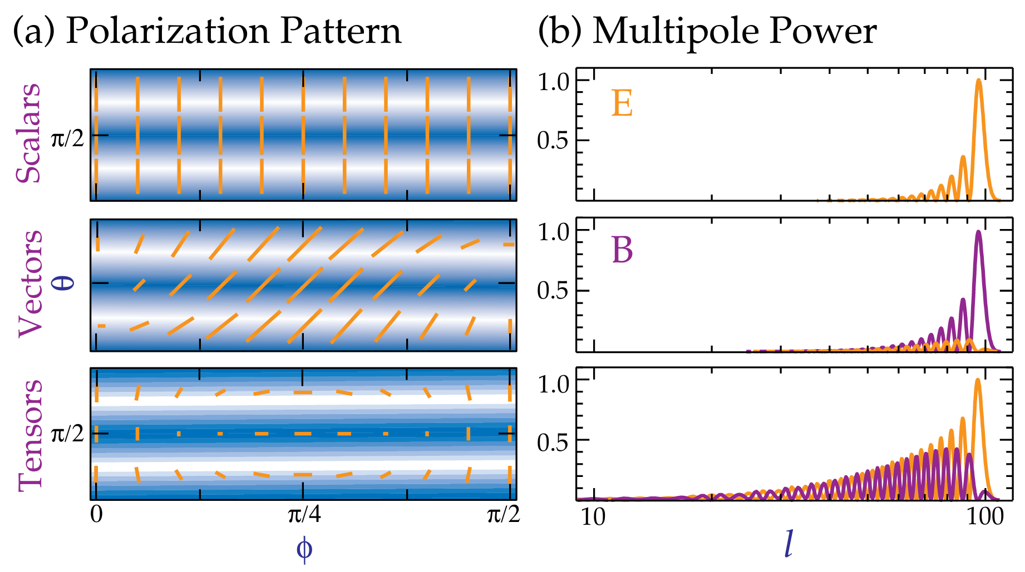


Tensor to scalar ratio ($r$)
$$r=\frac{T}{S}$$
Ratio of power in the gravitational wave (tensor, T) versus density (scalar, S) modes.
6/20

Slide 17
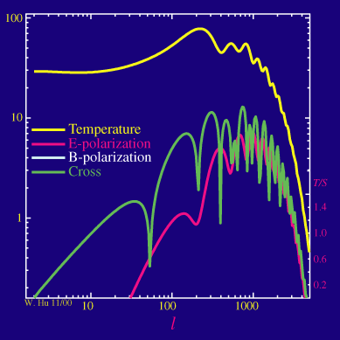
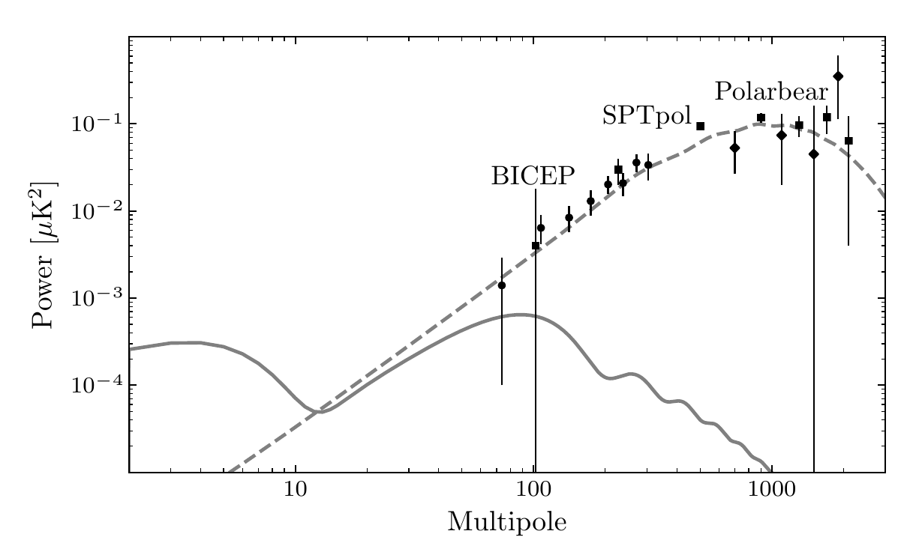
Tensor to scalar ratio ($r$)
The current upper limit on the primordial B-mode signal corresponds to r < 0.032.
Lensing B modes
Primordial B modes
In practice, things are more complicated:
presence of lensing B modes, amplitude much weaker, polarized foreground.
7/20

Slide 18
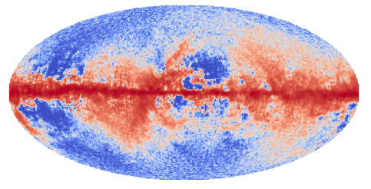
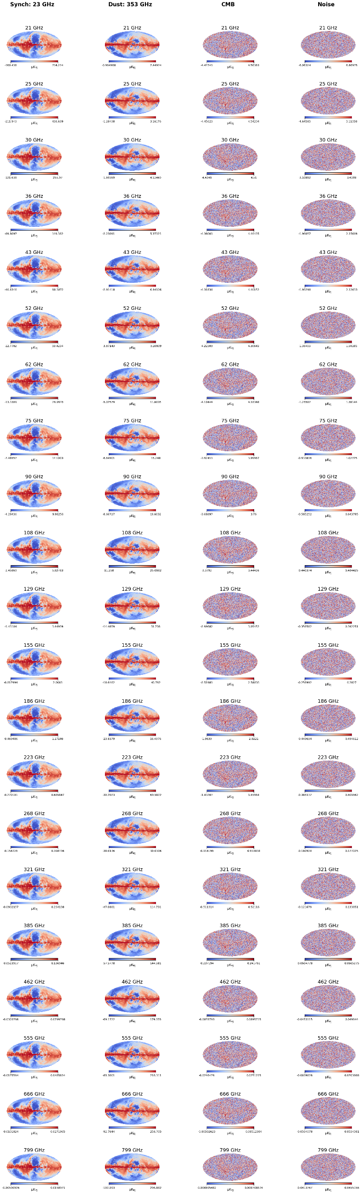
My project
General objective: to use a pixel-based Neural Network (NN) method to perform CMB component separation in polarization.
Total signal
Components
129 GHz
129 GHz
8/20

Slide 19
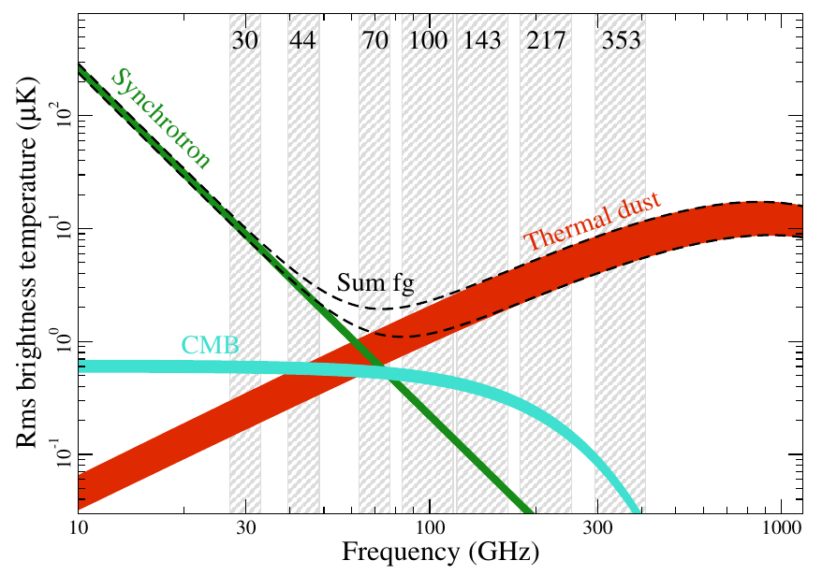
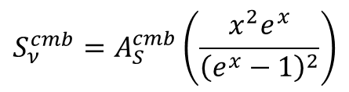




My project
There are different strategies for component separation, but here we use a parametric approach in which the components to be considered are: synchrotron ($s$), thermal dust ($d$), the CMB, and instrumental noise.
Components
$$S_{ν }^{T} = S_{ν}^{s}+S_{ν}^{d}+S_{ν}^{cmb}+S_{ν}^{n}$$
Total signal ($E/B$)
$$S_{ν}^{s}=A_{S}^{s}{\left(\frac{ν}{ν_{s}}\right)}^{β},$$
$$S_{ν}^{d}=A_{S}^{d}{\left(\frac{ν}{ν_{d}}\right)}^{α+1}\left(\frac{e^{hν_{d}/{(k}_{B}T_{d})} − 1}{e^{hν/{(k}_{B}T_{d})} − 1}\right),$$
$$S_{ν}^{cmb}=A_{S}^{cmb}\left(\frac{x^{2}e^{x}}{{\left(e^{x}−1\right)}^{2}}\right)$$
Eqs 1.
Overall, the approach contains 9 free parameters: $A_{E}^{s}, { A}_{E}^{d}, { A}_{E}^{cmb}, β, { T}_{d}, α, { A}_{B}^{s}, { A}_{B}^{d}, { A}_{B}^{cmb}$.
9/20

Slide 20
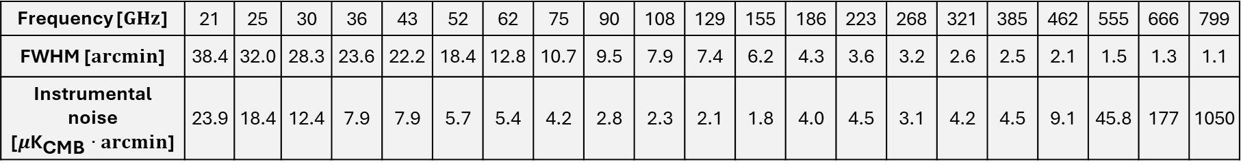
My project
The data simulated for training and validating the NN are based on the PICO satellite, a study funded by NASA featuring a highly sensitive imaging polarimeter designed to scan the sky for 5 years in 21 frequency bands. The key specifications used in this work are summarized in the next table.
Frequency [$GHz$] | 21 | 25 | 30 | 36 | 43 | 52 | 62 | 75 | 90 | 108 | 129 | 155 | 186 | 223 | 268 | 321 | 385 | 462 | 555 | 666 | 799
FWHM [$arcmin$] | 38.4 | 32.0 | 28.3 | 23.6 | 22.2 | 18.4 | 12.8 | 10.7 | 9.5 | 7.9 | 7.4 | 6.2 | 4.3 | 3.6 | 3.2 | 2.6 | 2.5 | 2.1 | 1.5 | 1.3 | 1.1
Instrumental noise [$μ{\text{K}}_{\text{CMB}}∙arcmin$] | 23.9 | 18.4 | 12.4 | 7.9 | 7.9 | 5.7 | 5.4 | 4.2 | 2.8 | 2.3 | 2.1 | 1.8 | 4.0 | 4.5 | 3.1 | 4.2 | 4.5 | 9.1 | 45.8 | 177 | 1050
10/20

Slide 21
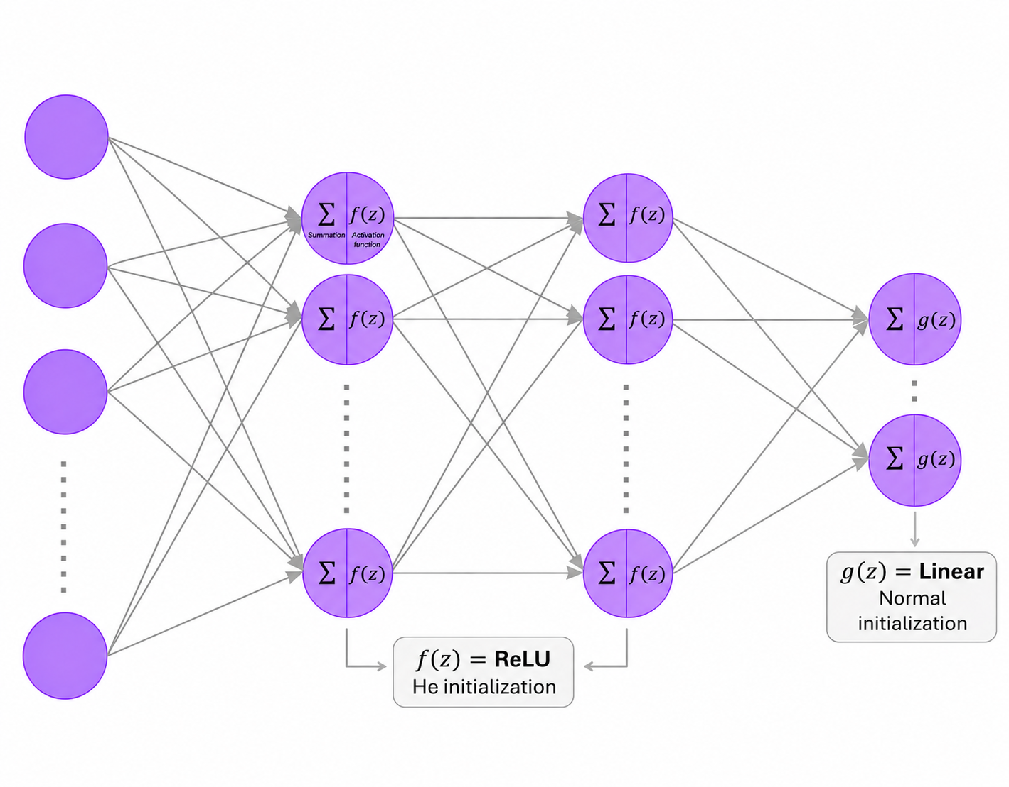








Basic architecture of the NN
Epochs = 500, Batch size = 100,
Optimizer: Adam
$$x_{n}$$
$$h_{j}$$
$$h_{k}$$
$${\hat{y}}_{l}$$
Input Layer
$$n=21$$
Hidden Layer 1
$$j=20$$
Hidden Layer 2
$$k=20$$
Output Layer
$$l=9$$
11/20

Slide 22
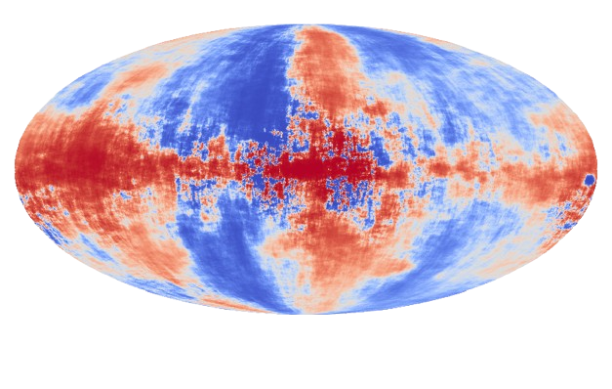
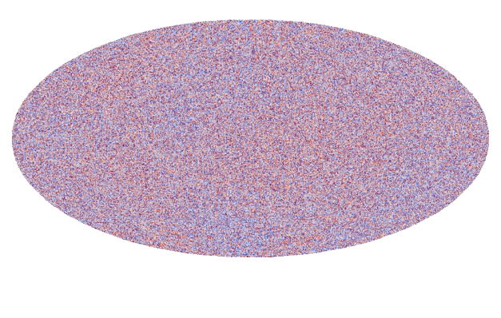
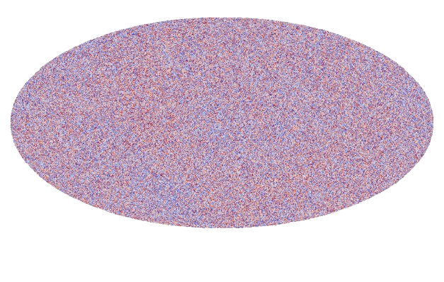
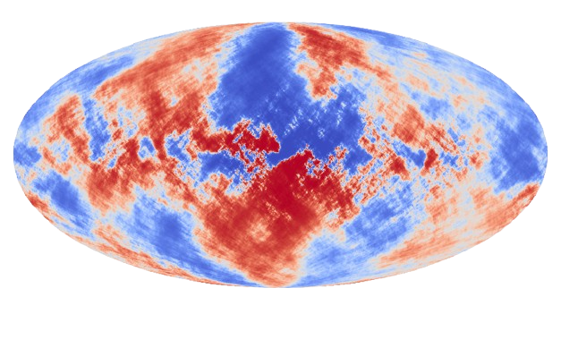
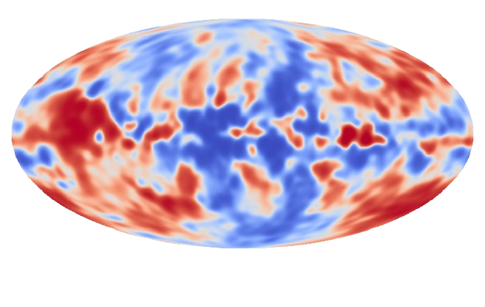
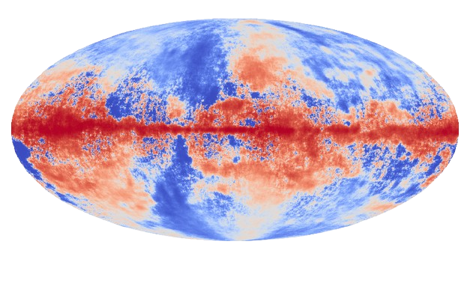
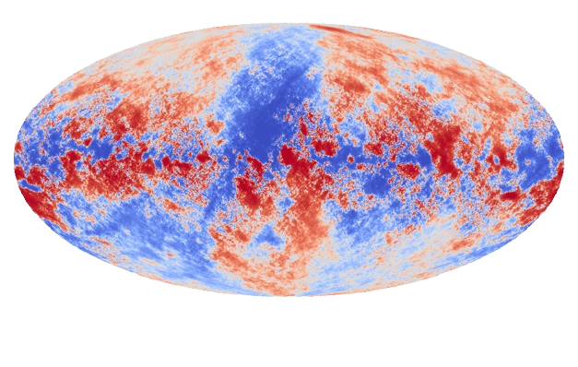
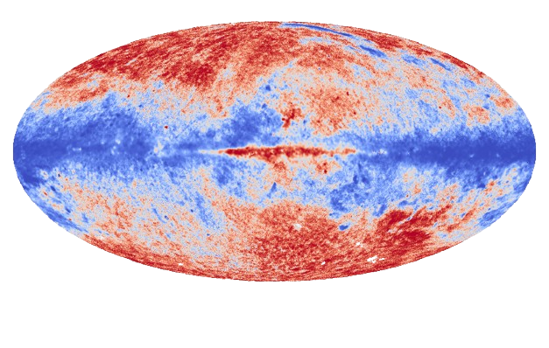
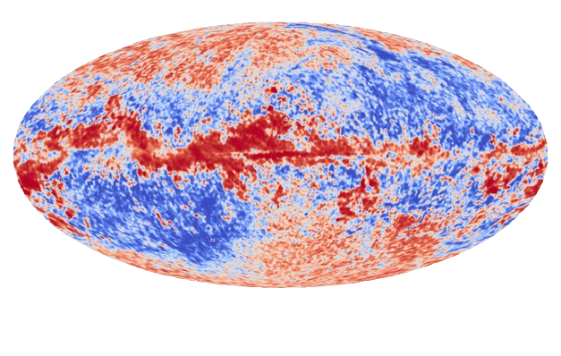
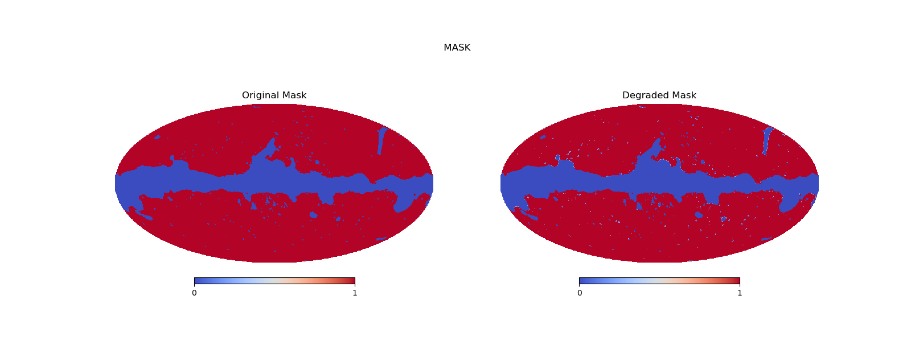



Generation of the NN labels
1.
PySM
(Model ‘s1’ to 23 GHz)
PySM
(Model ‘d1’ to 353 GHz)
CAMB + Synfast, Healpy
(r = 0)
$$A_{Q}^{s},A_{U}^{s}, β$$
$$A_{Q}^{d},A_{U}^{d}, T_{d}, α$$
$$A_{Q }^{cmb},A_{U}^{cmb}$$
Region 2
2.
Smoothing of the amplitudes
by 38.4 arcmin
(Worst PICO resolution)
+
Transformation to E and B modes
+
Dividing the problem by regions:
Region 1
12/20

Slide 23
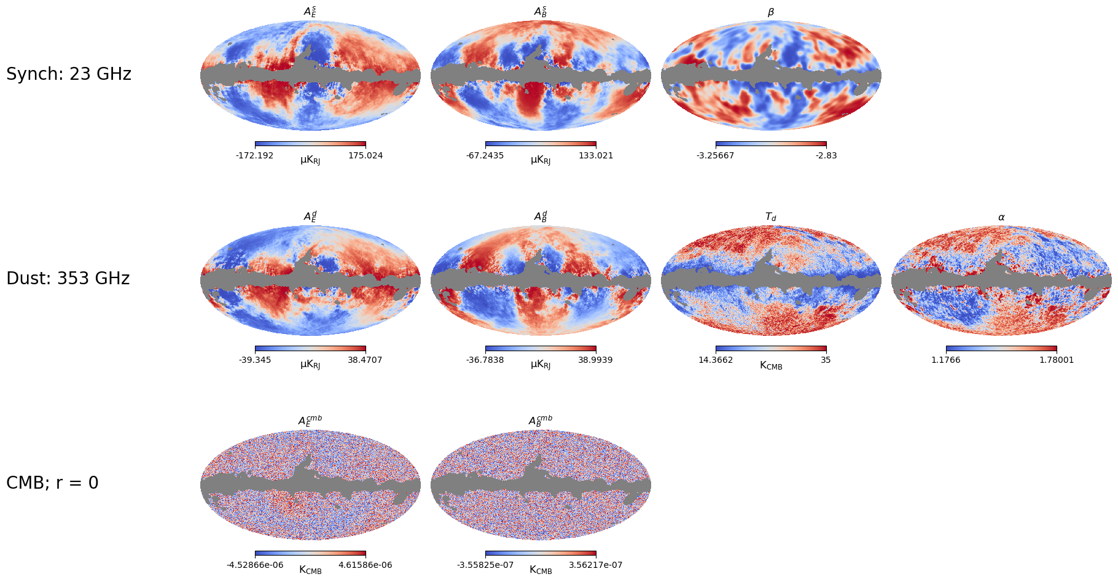
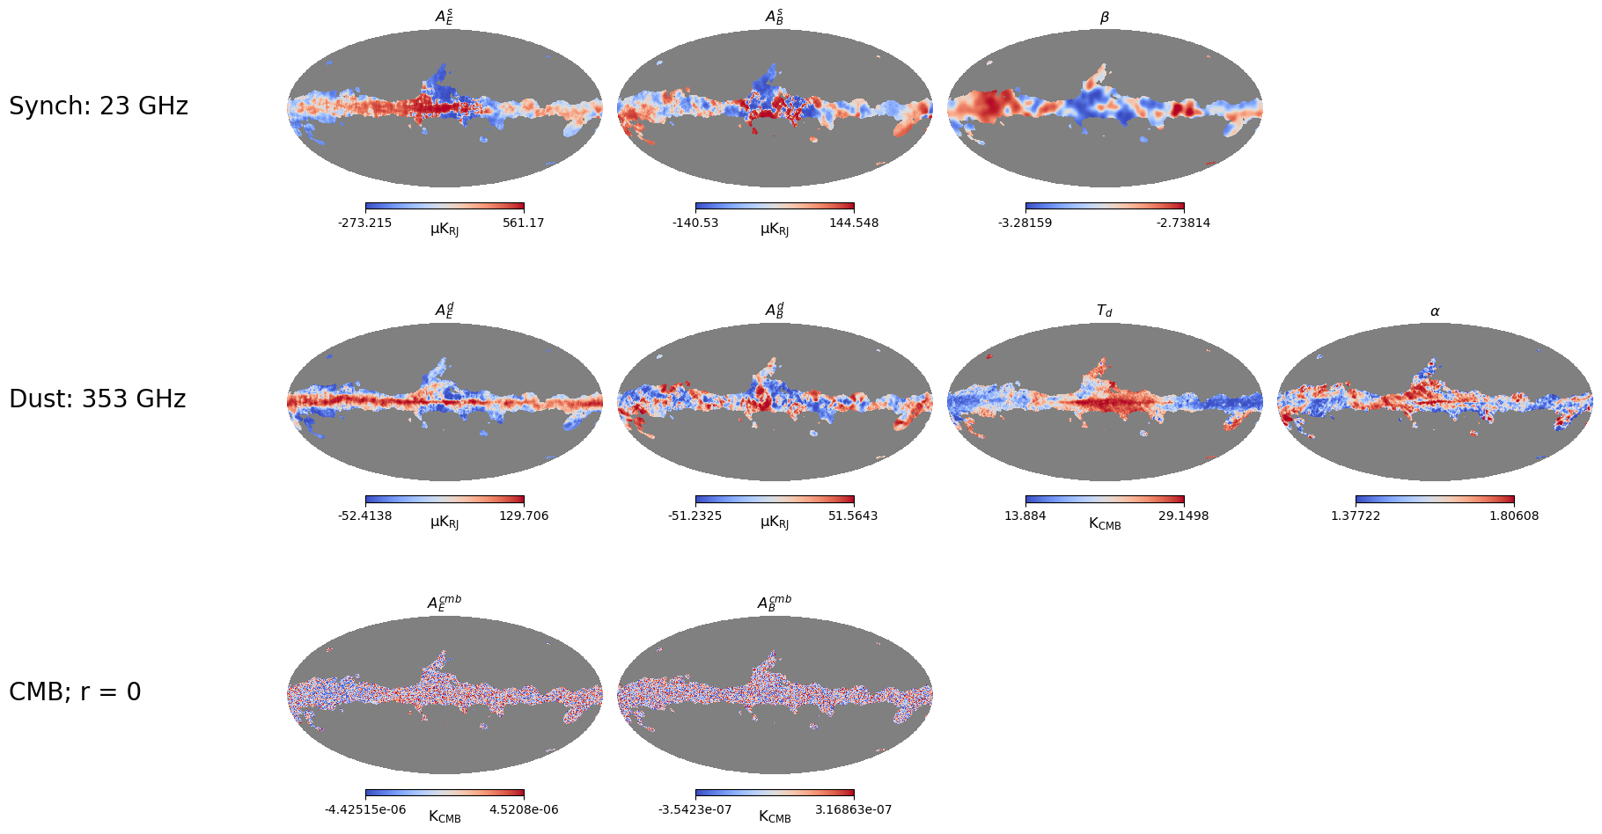
Generation of the NN labels
3.
Region 1
Region 2
E mode
E mode
B mode
B mode
13/20

Slide 24
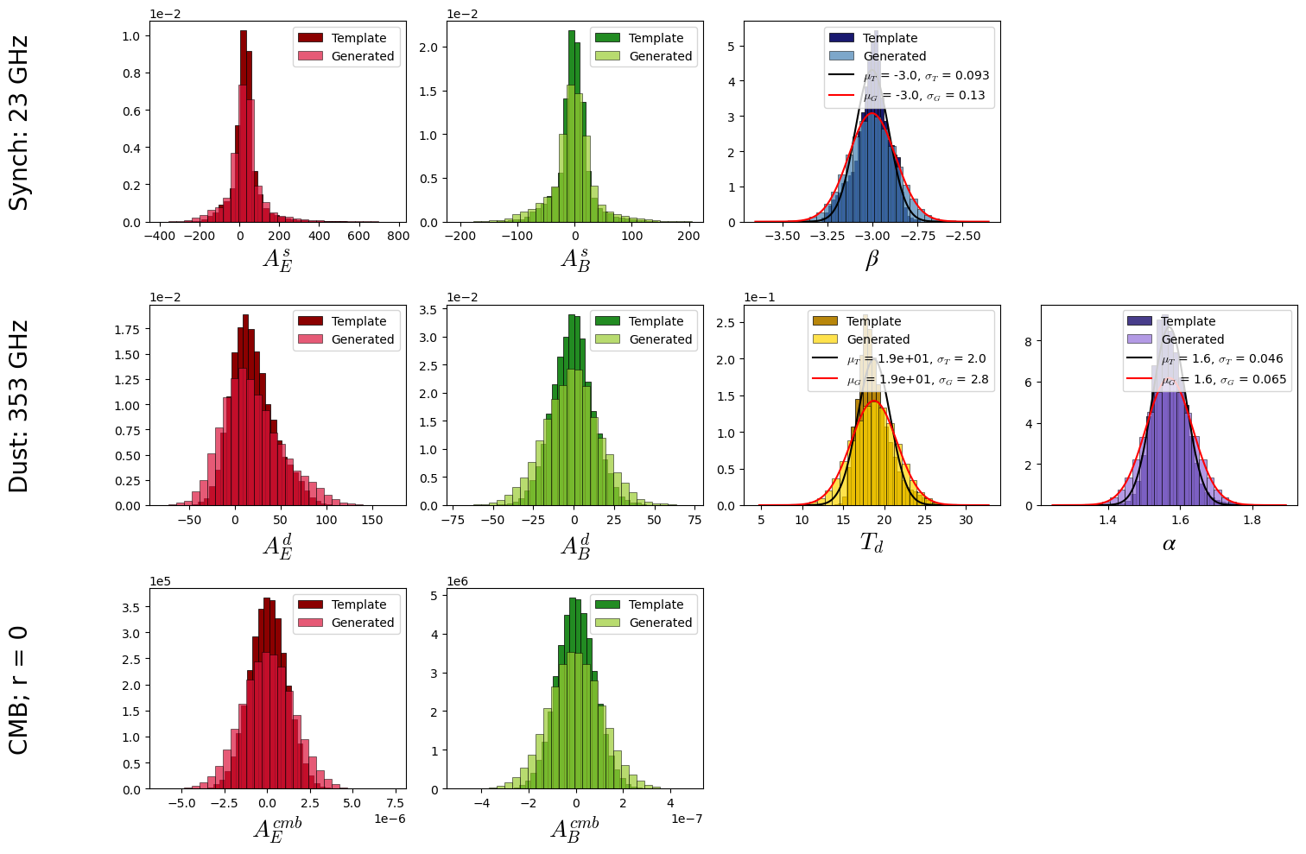
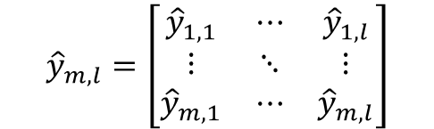
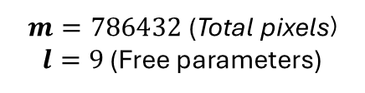
Generation of the NN labels
4.
786432 (NSIDE = 256) pixels/examples for each free parameter
The ranges were increased by 40% in relation to the smoothed templates.
This procedure is applied to the 2 regions shown.
Final Label
$${\hat{y}}_{m,l}=\left[\begin{matrix}{\hat{y}}_{1,1} & ⋯ & {\hat{y}}_{1,l} \\ ⋮ & ⋱ & ⋮ \\ {\hat{y}}_{m,1} & ⋯ & {\hat{y}}_{m,l}\end{matrix}\right]$$
$$m=786432\text{ (}\text{Total} \text{pixels}\text{)}$$
$l=9$ (Free parameters)
Generated using numpy random.choice method
Generated using numpy random.normal method
14/20

Slide 25
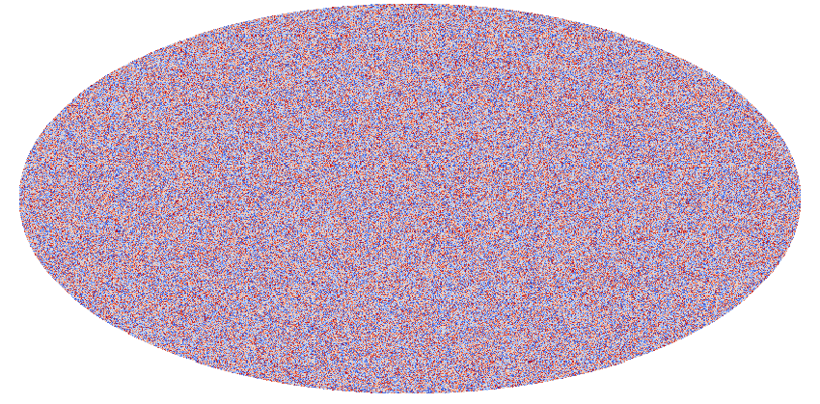




Generation of the NN training set
Eqs [1] + Labels
$m$ examples
$$\left[\begin{matrix}S_{1,1}^{T} & ⋯ & S_{1,m}^{T} \\ ⋮ & ⋱ & ⋮ \\ S_{n,1}^{T} & ⋯ & S_{n,m}^{T}\end{matrix}\right]$$
$$S_{pixel, ν }^{T}=S_{pixel,ν}^{s}+S_{pixel,ν}^{d}+S_{pixel,ν}^{cmb}+S_{pixel,ν}^{n}=$$
$n$ features
Gaussian noise of the instrument
$$m=786432\text{ (}\text{Total} \text{pixels}\text{)}$$
$n=21$ (PICO frequencies in E/B)
Final Training set
* This is done for each mode (E/B) and each region (1/2), so at the end, we train four models.
15/20

Slide 26




Preliminary results …
To evaluate the performance of the NN, we use as input the matrix $S_{pixel, ν }^{T}$, constructed from the smoothed original templates for each mode (E/B) and each región (1/2).
Region 1
Region 2
E mode
E mode
16/20

Slide 27




Preliminary results …
Region 1
Region 2
B mode
B mode
17/20

Slide 28


Preliminary results …
Recovered merged maps with the NN.
E mode
B mode
18/20

Slide 29






Preliminary results …
Recovered power spectra and estimated $r$ values.
No mask
Mask
$$r_{E}$$ | $$r_{B}$$
-0.0568 ± 0.0179 | 3.57E-05 ± 4.21E-05
$$r_{E}$$ | $$r_{B}$$
-0.1698 ± 0.0402 | 1.82E-04 ± 1.77E-04
19/20

Slide 30

20/20

Slide 31


Slide 32


