Slide 1
FPGA-ACCELERATED EDGE AI
SUNRISE: Edge AI for Real-Time Solar Energy Nowcasting
A Deep Learning-Based Approach for Real-Time Solar Energy Estimation
using Computer Vision and AMD Kria KV260 FPGA Acceleration
Edge AI
Computer Vision
Deep Learning
FPGA
Vitis AI
AMD/Xilinx
M. Daniel González · Research Project · SUNRISE
Universidad de Oviedo

Slide 2
AGENDA
Presentation Outline
1
Motivation & Problem Statement
7
DDUNet Adaptation
Cloud impact on solar energy and limitations of current approaches
Model modifications required for FPGA and DPU compatibility
2
Why Edge AI?
8
Quantization Strategies
CPU vs GPU vs FPGA comparison for deep learning inference
Post-Training Quantization vs Quantization-Aware Training
3
Kria KV260 Platform
9
Compilation & Results
Heterogeneous architecture: Processing System and Programmable Logic
Performance evaluation: accuracy, speed, and power consumption
4
Deep Learning Processing Unit
10
Future Work
DPU architecture and hardware-accelerated neural network execution
Roadmap toward full solar irradiance prediction system
5
Vitis AI Workflow
11
Conclusions
End-to-end deployment pipeline: training to runtime inference
Key achievements and impact of this research
6
Platform Preparation
Engineering challenges during KV260 development environment setup
Total duration: ~12 minutes · Q&A session after presentation

Slide 3
MOTIVATION & PROBLEM STATEMENT
Why Accurate Solar Energy Prediction Matters
The Challenge
Impact of Clouds on Solar Generation
☁️
Cloud coverage is the primary factor affecting photovoltaic generation
Clear sky
⚡
Light clouds
Solar power can drop within seconds under heavy cloud cover
Heavy clouds
Grid instability requires accurate short-term production forecasts
Overcast
Meteorological sensors are expensive and require regular maintenance
Key Insight
Real-time cloud assessment enables
accurate solar energy forecasting
without expensive hardware
Local microclimates make general weather models unreliable
Our Solution:
A low-cost camera + FPGA-accelerated AI to estimate irradiance
from sky images in real time — no meteorological sensors required.
<number>

Slide 4
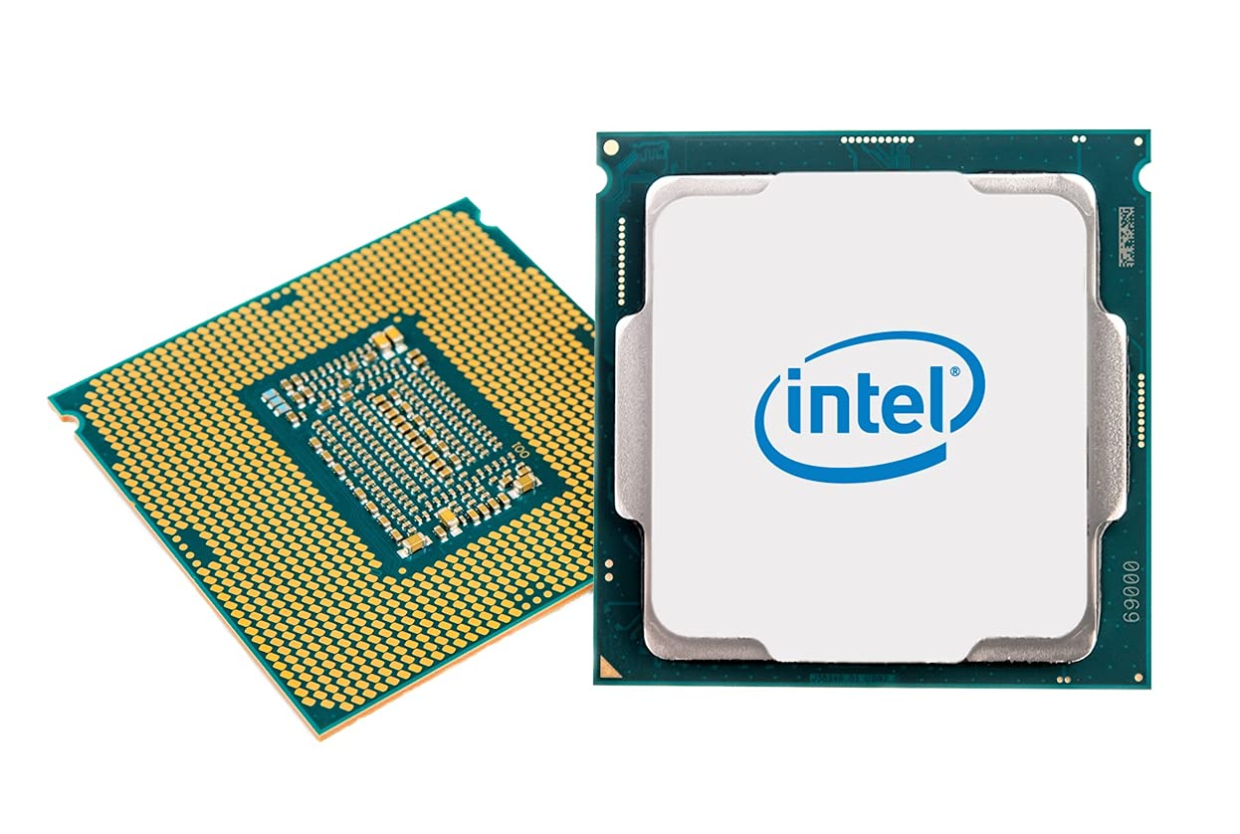
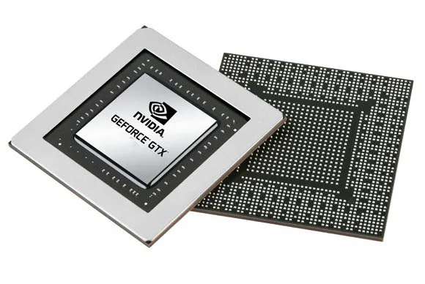
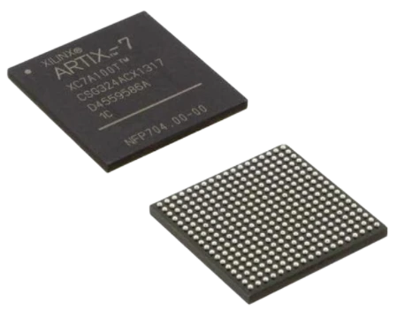
WHY EDGE AI?
Deploying Deep Learning on the Edge
CPU
GPU
FPGA
General-Purpose
Processor
Graphics
Processing Unit
Field-Programmable
Gate Array
Sequential execution
Massive parallelism
Reconfigurable hardware
Limited parallelism
High throughput
Custom data paths
High latency for CNNs
High power consumption
Low latency, deterministic
Not designed for DL inference
Bulkier form factor
Low power consumption
Power: ~15-65W
Power: ~150-400W
Power: ~5-20W
Ideal for: control logic
Ideal for: training clusters
Ideal for: Edge AI inference
FPGAs offer the best balance of performance, power efficiency, and flexibility for real-time Edge AI inference
<number>

Slide 5
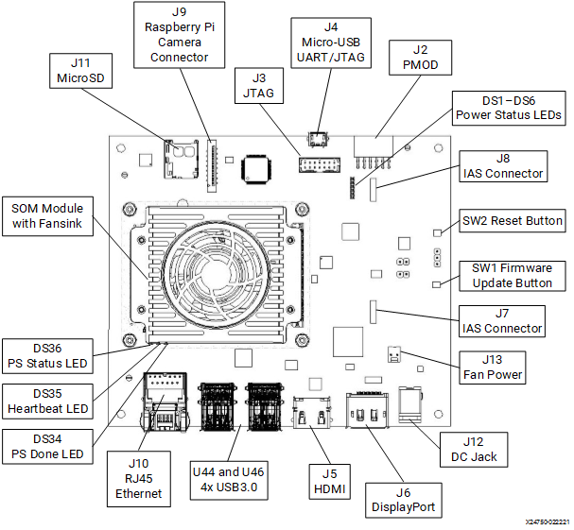
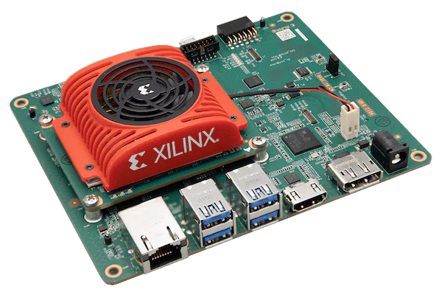
HARDWARE PLATFORM
AMD Kria KV260 Vision AI Starter Kit
<number>

Slide 6

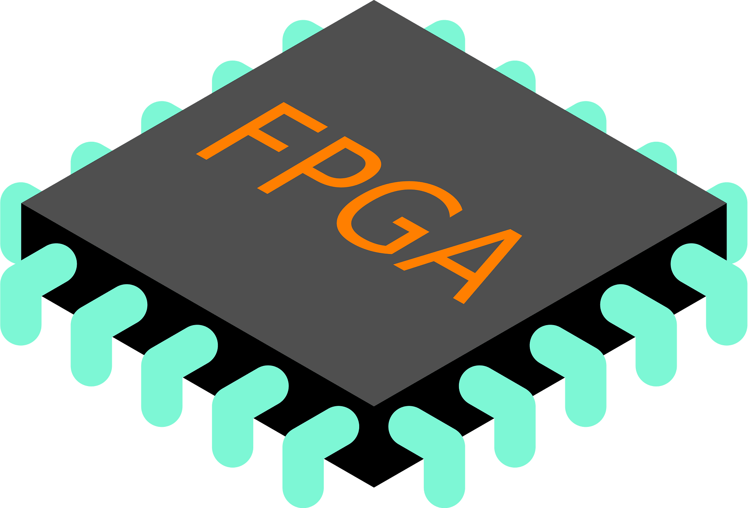

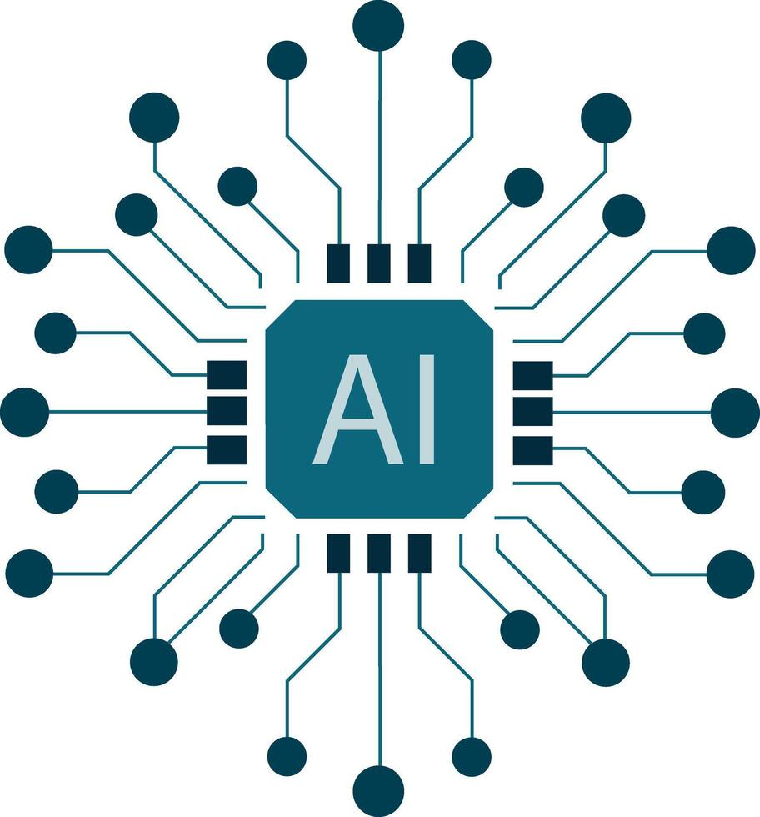

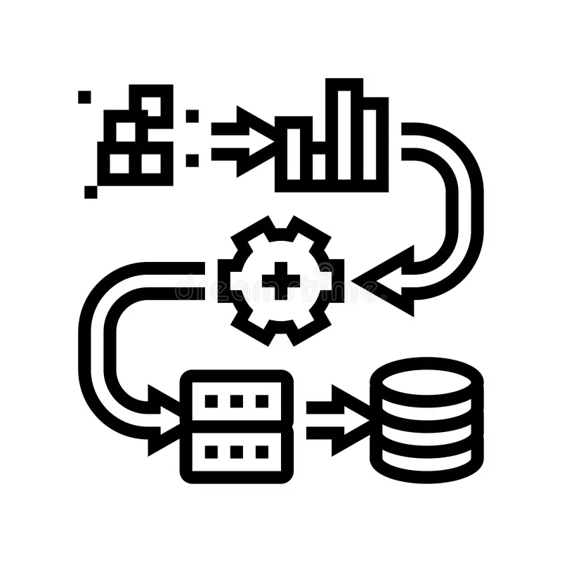
HARDWARE PLATFORM
AMD Kria KV260 Vision AI Starter Kit
Processing System (PS)
Programmable Logic (PL)
ARM Cortex-A53
FPGA Fabric
Quad-core, 1.5 GHz
Custom hardware logic
DDR4 Memory
DPU IP Core
4 GB, 64-bit
Deep Learning Processing Unit
Peripherals
AXI Bus
Video Pipeline
USB, Ethernet, DisplayPort
MIPI, ISP, HDMI
⏱️
Real-Time Unit
⚡
Custom Accelerators
RPU for control tasks
User-defined RTL/IP
💡
The KV260 is designed for Smart Vision and AI applications. The PS handles control and data movement while the PL provides purpose-built hardware acceleration.
<number>

Slide 7
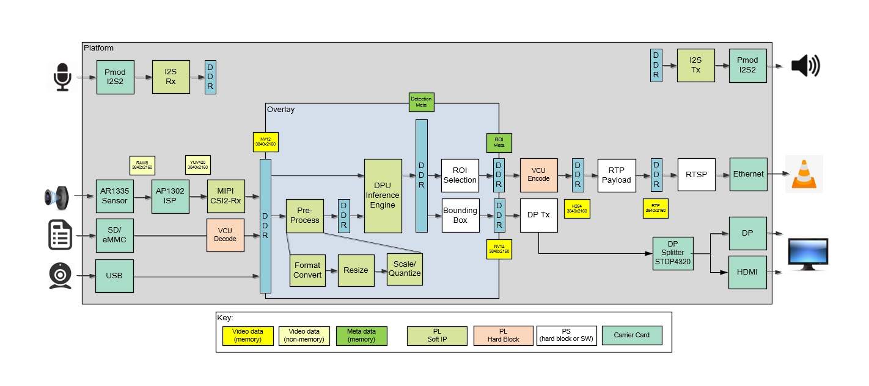
DEEP LEARNING PROCESSING UNIT
Understanding the DPU Architecture
What is a DPU?
Key characteristics:
▪ Convolution engine with pipelining
▪ Parallel MAC operations
▪ Layer-by-layer processing
▪ Fixed-point integer arithmetic
▪ Configurable architecture size
CPU vs DPU Execution
The DPU is a specialized IP core
implemented in the FPGA logic
designed specifically for neural
network inference acceleration.
🖥️ CPU Execution
1. Load instruction from memory
2. Decode instruction
3. Fetch data from memory
DPU Inside the FPGA
4. Execute ALU operation
5. Write result back
→ Sequential, one at a time
🧠 DPU Execution
1. Load input feature map
2. Stream through hardware pipeline
3. Parallel operations
4. Accumulate in dedicated registers
5. Activate & store output
→ 10-100× faster than CPU
<number>
Implemented as a soft IP core inside the FPGA fabric via Vitis AI

Slide 8
PLATFORM PREPARATION
Engineering the KV260 Development Environment
1
2
3
4
5
Initial Setup
Firmware Update
Ubuntu Migration
USB Detection
Power Issues
Board initialization and
firmware verification
Out-of-box experience
Latest AMD firmware
flashing and bootloader
configuration
Decision: Ubuntu 22.04
Stock Ubuntu vs Canonical
LTS support assessment
Driver configuration
Peripheral enumeration
Power distribution fix
Current budget analysis
External power source
Stability testing
Engineering Perspective
Platform setup proved non-trivial: documentation gaps, peripheral detection issues, and power delivery constraints required systematic debugging. These challenges are typical when working with cutting-edge embedded AI platforms and provided valuable hands-on experience.
<number>

Slide 9
VITIS AI DEPLOYMENT WORKFLOW
From PyTorch Model to FPGA Inference
1
2
3
4
5
Model Training
Quantization
Compilation
Deployment
Runtime Inference
PyTorch / TensorFlow
Train DDUNet for
cloud segmentation
PTQ or QAT
Reduce precision to
INT8 for efficiency
Vitis AI Compiler
Generate .xmodel
for DPU target
Load .xmodel
onto KV260
Initialize DPU
Capture images
Run inference
Get predictions
Key Output: .xmodel file
Floating-Point
Model (.pth)
Calibration
Dataset
Quantized
Model (INT8)
DPU Compiler
(vai_c_xir)
.xmodel
File
<number>

Slide 10
MODEL ADAPTATION
DDUNet Architecture for Cloud Segmentation for FPGA Deployment
Original DDUNet Architecture
FPGA-Optimized Version
•
Double U-Net with skip connections
✅
Layer compatibility analysis
✅
Standard convolution layers
❌
Replaced unsupported operations
✅
ReLU activations
⚠️
Adjusted padding for DPU constraints
✅
Batch normalization
✅
Verified DPU op list compliance
Adapt
✅
Max-pooling + upsampling
✅
Channel dimension optimization
❌
Operations not in DPU op list
✅
Stride handling configuration
❌
Custom/Variable padding
⚠️
Reduced model depth where possible
⚠️
Excessive depth channels
✅
Validated with Vitis AI analyzer
💡
The DDUNet architecture required significant adaptation — not all layers are supported by the DPU. Unsupported operations were replaced or refactored to ensure compatibility.
<number>

Slide 11
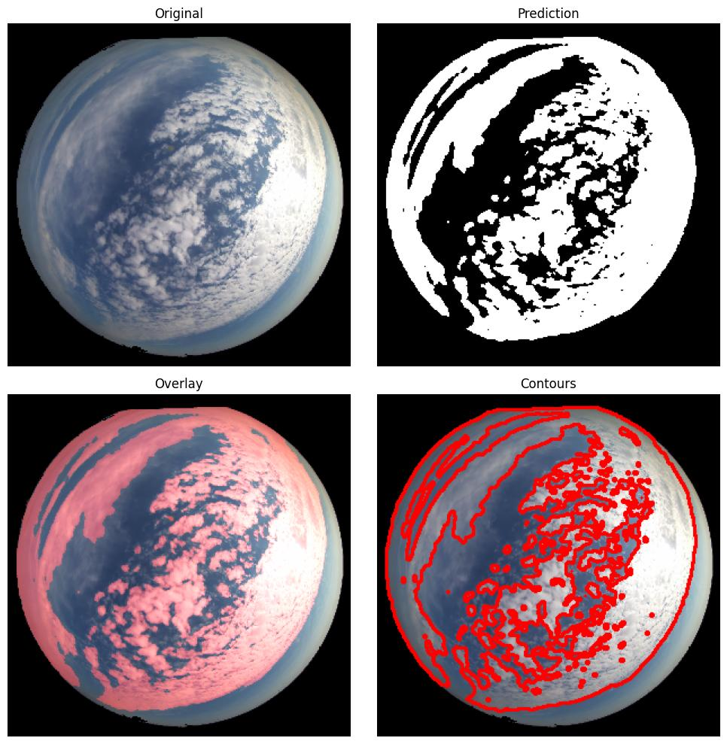
MODEL ADAPTATION
DDUNet Architecture for Cloud Segmentation for FPGA Deployment
FPGA-Optimized Version
✅
Layer compatibility analysis
❌
Replaced unsupported operations
⚠️
Adjusted padding for DPU constraints
✅
Verified DPU op list compliance
Result
✅
Channel dimension optimization
✅
Stride handling configuration
⚠️
Reduced model depth where possible
✅
Validated with Vitis AI analyzer
💡
The DDUNet architecture required significant adaptation — not all layers are supported by the DPU. Unsupported operations were replaced or refactored to ensure compatibility.
<number>

Slide 12
QUANTIZATION STRATEGIES
Post-Training Quantization vs Quantization-Aware Training
Post-Training Quantization (PTQ)
Quantization-Aware Training (QAT)
Concept
Convert FP32 weights to INT8
after training is complete
Concept
Simulate quantization effects
during training to recover accuracy
Process
1. Load trained FP32 model
2. Run calibration with sample data
3. Quantize weights & activations
Process
1. Start from trained FP32 model
2. Insert fake quantization nodes
3. Fine-tune with quantization simulation
Advantages
✅ Fast — no retraining required
✅ Simple workflow
✅ Good starting point
Advantages
✅ Higher accuracy retention
✅ Better handling of outliers
✅ Robust to calibration data
Trade-offs
⚠️ Potential accuracy loss (2-5%)
⚠️ Sensitive to distribution shifts
Trade-offs
⚠️ Requires retraining (longer)
⚠️ More complex pipeline
⚠️ Needs original training setup
When to use
When accuracy loss is acceptable
or as a baseline comparison
When to use
When accuracy is critical
or PTQ results are unsatisfactory
☑
Both strategies are evaluated to determine the optimal balance between inference speed, FPGA resource utilization, and prediction accuracy for the cloud segmentation task.
<number>

Slide 13
MODEL COMPILATION & RESULTS
From .xmodel Generation to Performance Evaluation
Compilation Pipeline
Quantized
Model
XIR Graph
Representation
DPU Compiler
vai_c_xir
.xmodel
File
KV260
Runtime
Performance Results
Metric
FP32 (Baseline)
PTQ (INT8)
QAT (INT8)
Key Observations
Accuracy (IoU)
93.2%
90.2%
91.8%
▸ QAT recovers ~1.5% IoU over PTQ
Relative error coverage
-
~ 6.83%
~ 1.09%
▸ 4× model size reduction via INT8
Model Size
24.7 MB
6.4 MB
6.4 MB
▸ 3× faster inference on DPU vs CPU
Inference Time*
127 ms (CPU)
42 ms (DPU)
42 ms (DPU)
Speedup vs CPU
1×
3×
3×
▸ FPGA power consumption < 10W
Power Estimate
~15W (CPU)
~8W (KV260)
~8W (KV260)
▸ Real-time inference achievable
* Inference time measured on AMD Kria KV260 with DPU (B512 architecture)
<number>

Slide 14
FUTURE WORK
Roadmap Toward Solar Irradiance Prediction
●
●
●
●
Q1: Camera Integration
Q2: Irradiance Model
Q3: End-to-End System
Q4: Optimization
MIPI camera interface on KV260
Correlation: cloud coverage → irradiance
Full pipeline: camera → DPU → prediction
Model pruning & further quantization
Real-time image acquisition driver
Train regression model on sky images
Dashboard for real-time visualization
Multi-location validation
Frame buffer optimization
Validate against pyranometer ground truth
Power generation estimation module
Performance benchmarking & publication
Ultimate Goal →
A complete FPGA-accelerated edge AI system that estimates solar irradiance and predicts photovoltaic energy generation using only a camera as input.
<number>

Slide 15
CONCLUSIONS
What We Achieved
01
02
03
04
Cloud Segmentation
on FPGA
Vitis AI Ecosystem
Mastery
PTQ vs QAT
Evaluation
Platform
Foundation
Successfully deployed a DDUNet
model for cloud segmentation
on the AMD Kria KV260 platform
Full workflow understanding:
Training → Quantization →
Compilation → Deployment
Systematic comparison of
quantization strategies with
quantified accuracy impact
Established the hardware
and software infrastructure
for future irradiance prediction
This project lays the technological foundation for an FPGA-accelerated Edge AI system
capable of estimating solar irradiance and photovoltaic energy production using only visual information.
<number>

