Slide 1

Triggering on Muon Showers at the CMS Experiment
Daniel Estrada, Santiago Folgueras, Javier del Riego, Javier Prado
III ICTEA Research Days
2 June 2026

Slide 2




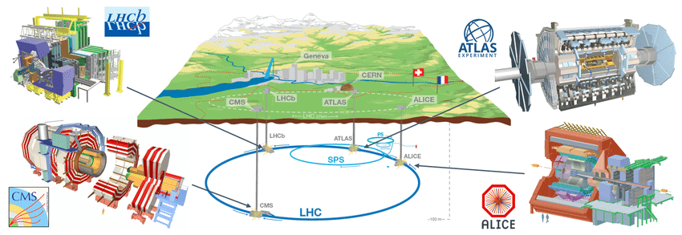
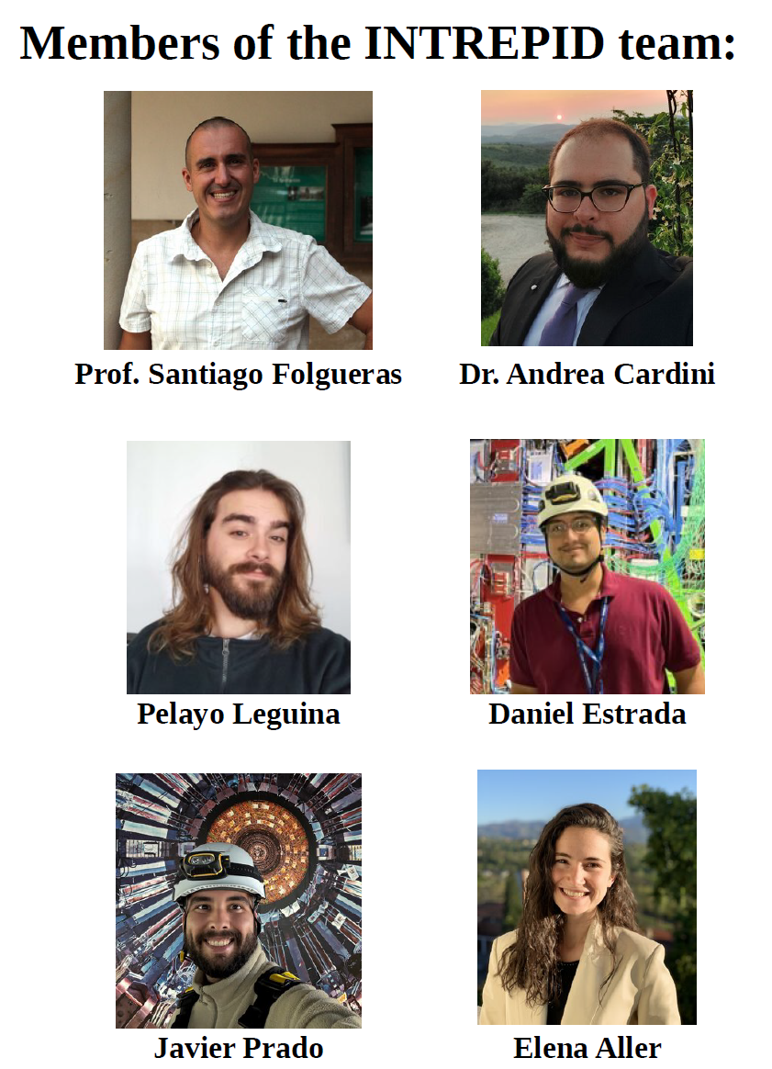

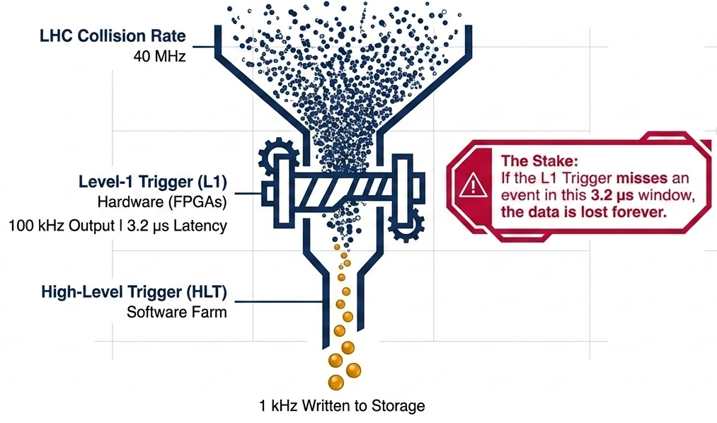



Introduction
INnovative TRiggEr techniques for beyond the
standard model PhysIcs Discovery at the LHC
Details in Santiago’s talk and Florencia’s talk
12.5 $μ$s
750 kHz
12.5 $μ$s Latency
offline-style algorithms can now be deployed
7.5 kHz
Deploy complex algorithms in the CMS Level-1 Trigger for Phase-2.
III ICTEA Research Days
Trigger on Muon Showers | Daniel Estrada
1/6

Slide 3
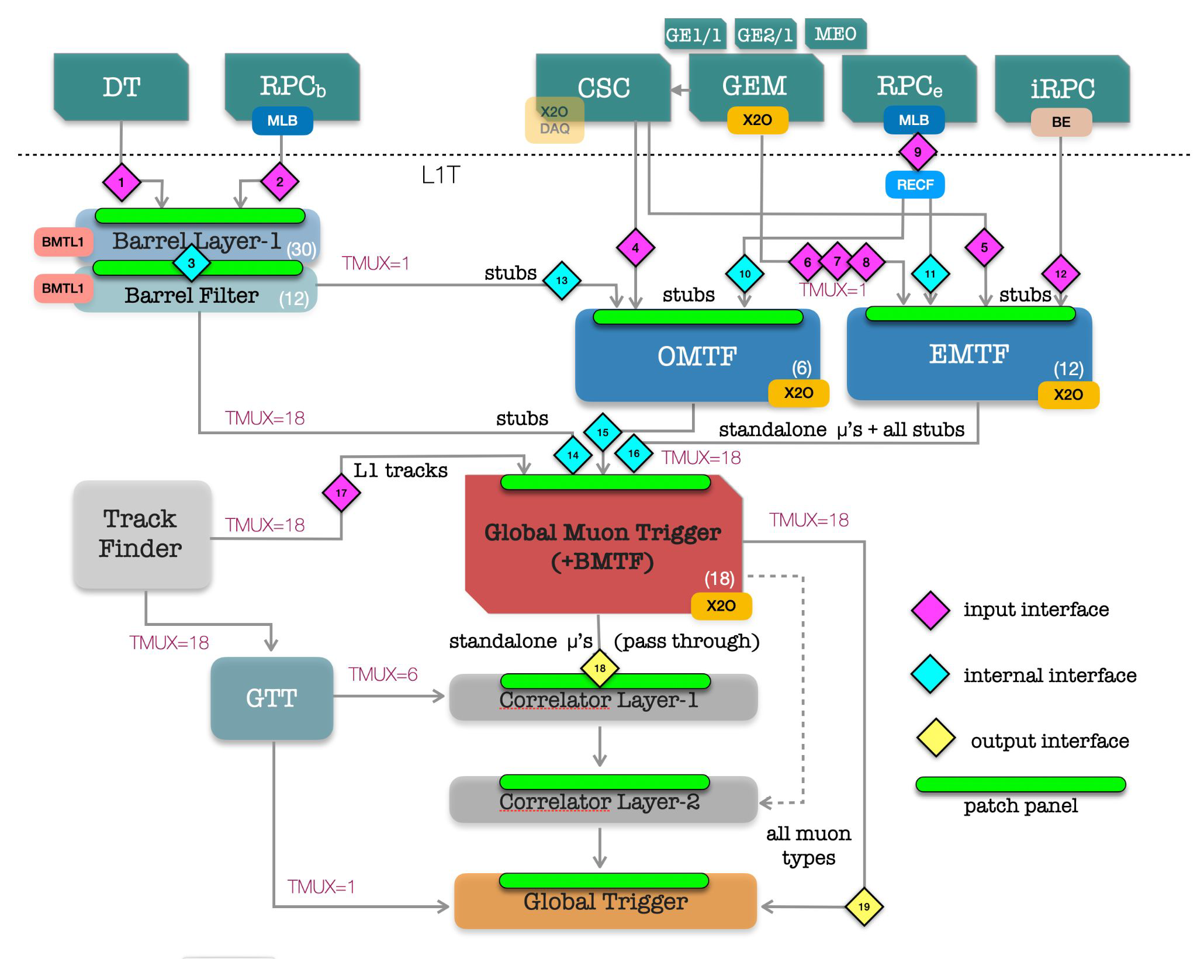
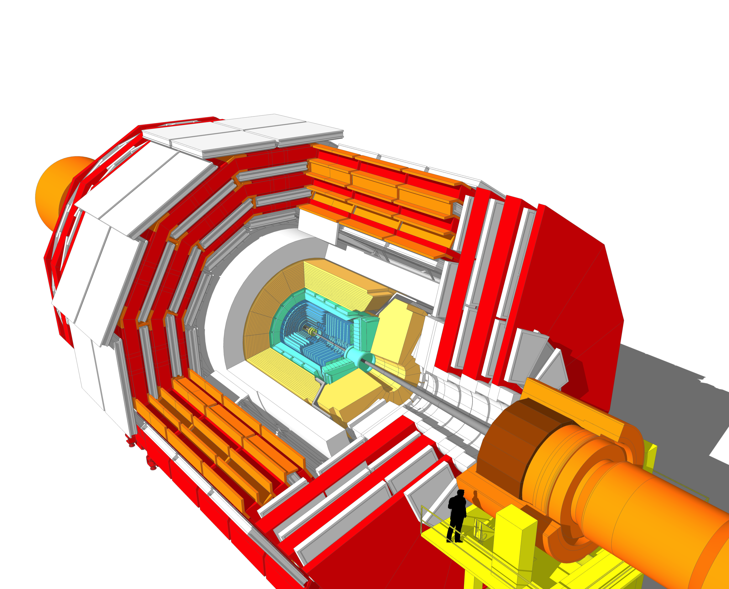


Introduction
CMS L1 Trigger
III ICTEA Research Days
Trigger on Muon Showers | Daniel Estrada
1/6

Slide 4
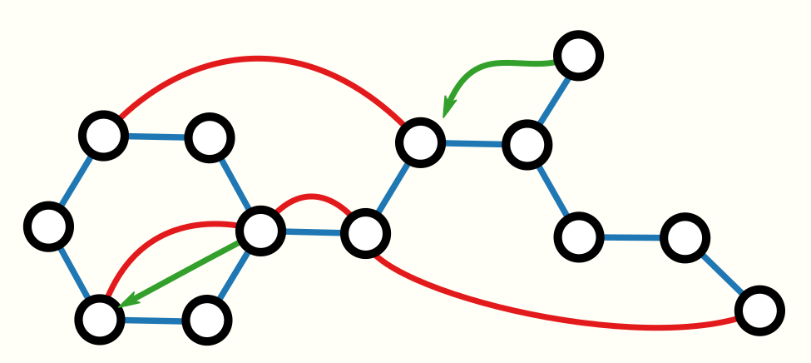
Introduction
Raw hits
GNN
BMTL1
Analytical method
Shower algorithm
DT primitives
Shower
primitives
See Elena’s talk
BMTL1
Pre-filter NN
Machine-Learnig approach
High pt matcher
LLPs matcher
Others...
$$⋮$$
Pattern-recognition approach
Detect muon-showers signatures in the Barrel region of the muon Level-1 Trigger
CMS L1 Trigger
III ICTEA Research Days
Trigger on Muon Showers | Daniel Estrada
2/6

Slide 5
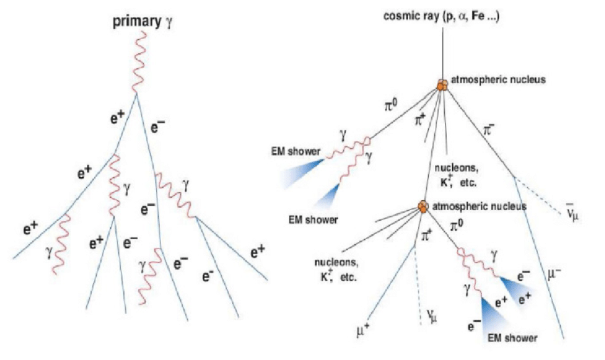
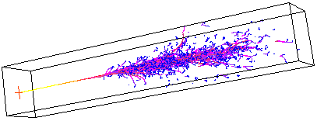
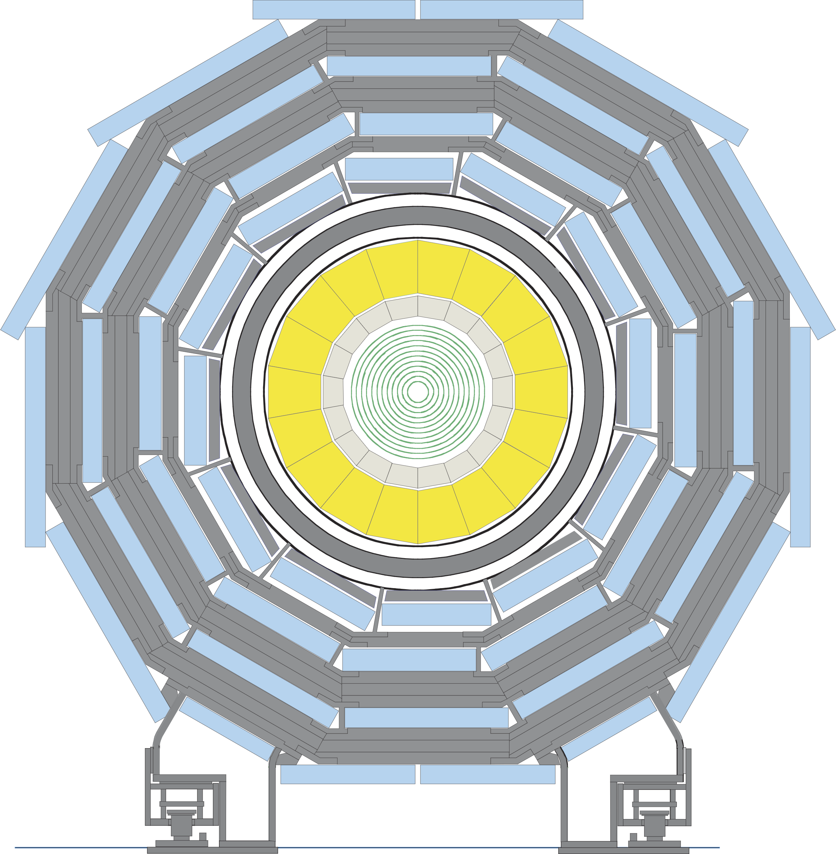



What is an Electromagnetic showers ?
It forms when a sufficiently energetic particle interacts with materials, producing secondary photons and e⁺/e⁻ pairs.
In CMS context, energy deposits are expected in the ECAL and HCAL; but shower-like signatures can also appear in the muon system.
$$μ$$
$$μ$$
High-energy muons radiate via bremsstrahlung
Long-lived particles (LLPs) can decay beyond the HCAL
High-energetic cosmic muons
$$μ$$
III ICTEA Research Days
Trigger on Muon Showers | Daniel Estrada
3/6

Slide 6
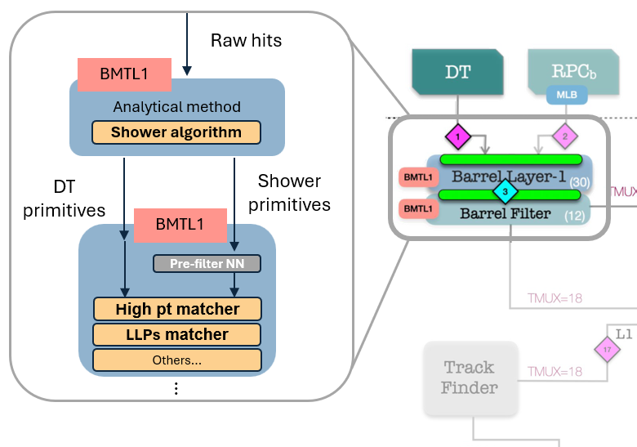
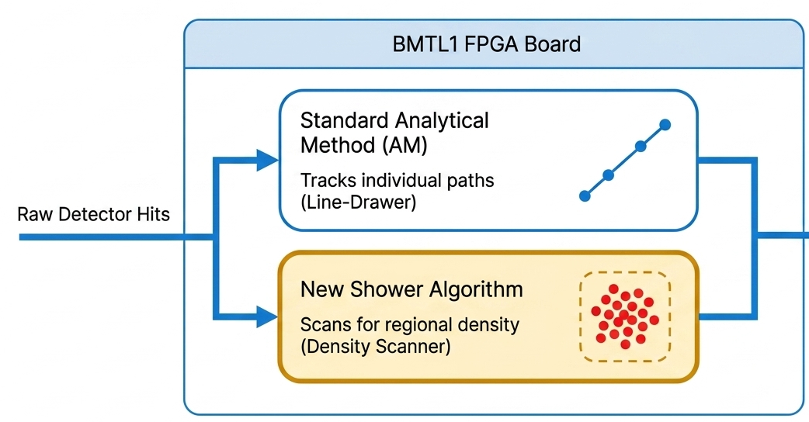
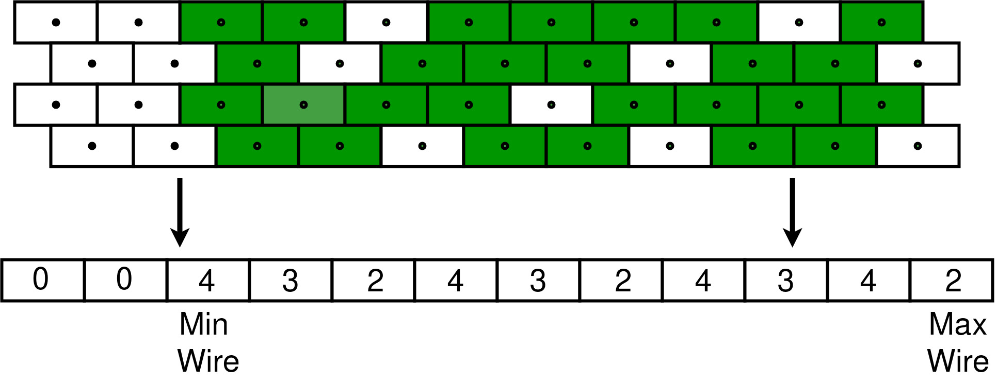
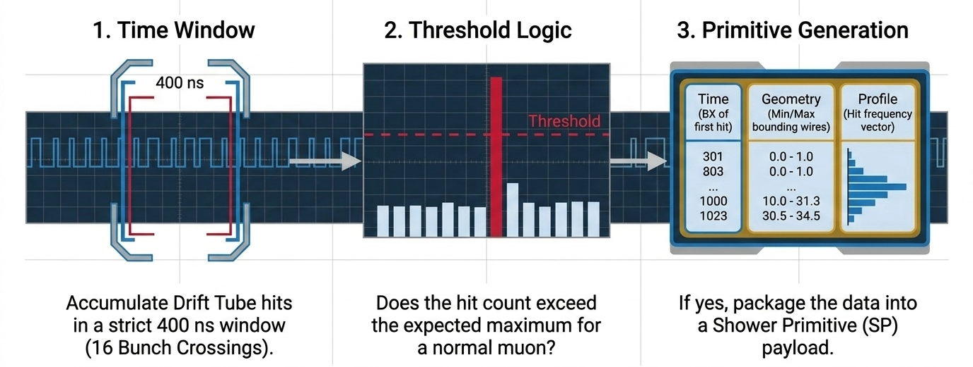
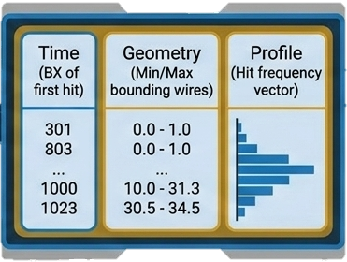
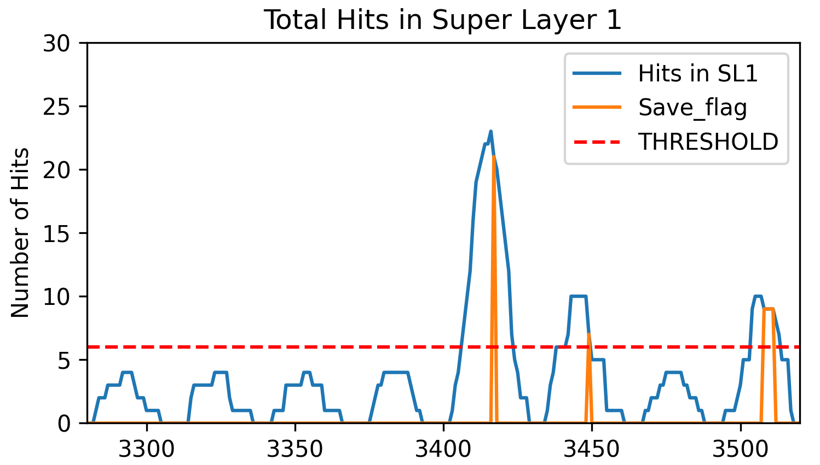
Step 1: construct shower primitives
Collect high-hit multiplicity information and reconstruct the presence and features of a muon shower
Analytical Method (AM)
AM trigger primitives (TPs)
Scan for high hit multiplicity
Shower Primitives (SP)
5 – 10
45-59
...
12-23
30-34
III ICTEA Research Days
Trigger on Muon Showers | Daniel Estrada
4/6

Slide 7
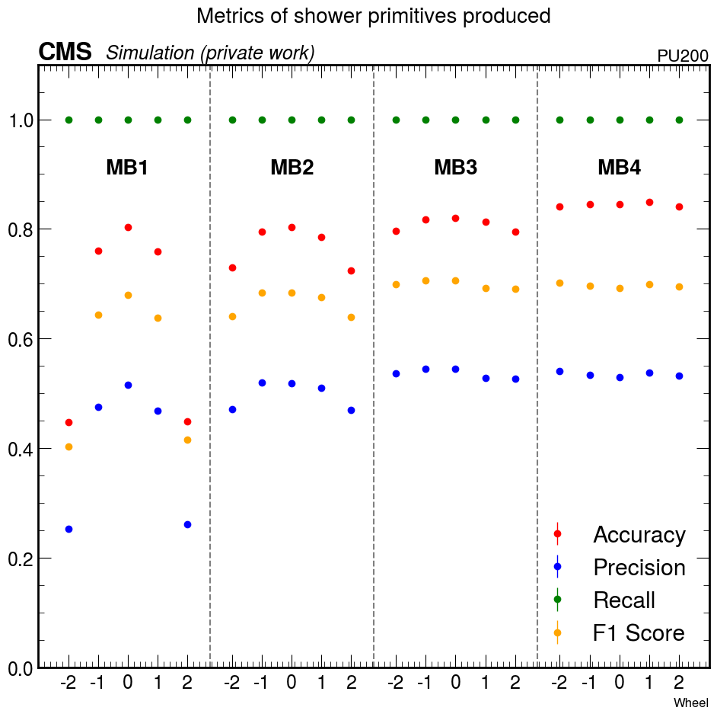
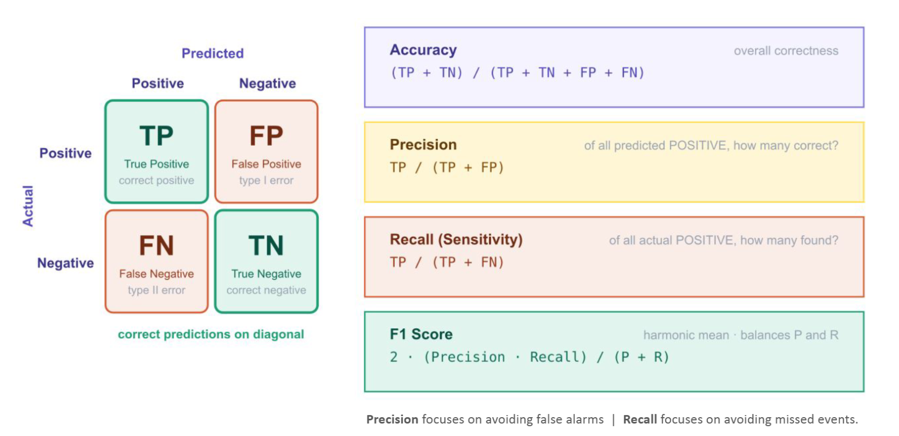
Step 1: construct shower primitives
Collect high-hit multiplicity information and reconstruct the presence and features of a muon shower
Analytical Method (AM)
AM trigger primitives (TPs)
Scan for high hit multiplicity
Shower Primitives (SP)
Simulation studies evaluated whether this simple approach can identify the shower.
Fake cases remain frequent; threshold tuning and further refinements are required.
Current optimization prioritizes avoiding missed events.
III ICTEA Research Days
Trigger on Muon Showers | Daniel Estrada
4/6

Slide 8
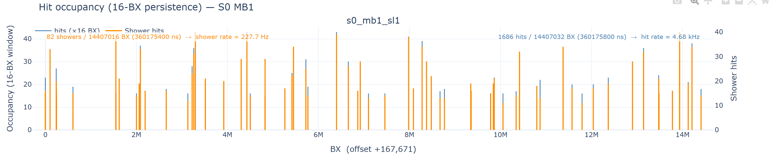
Step 1: construct shower primitives
Collect high-hit multiplicity information and reconstruct the presence and features of a muon shower
Analytical Method (AM)
AM trigger primitives (TPs)
Scan for high hit multiplicity
Shower Primitives (SP)
A first version of this algorithm (firmware) has been deployed to record CMS data during slide test... (couple of weeks ago)
Next step: Analyze these data and verify whether observed behavior matches expectations
III ICTEA Research Days
Trigger on Muon Showers | Daniel Estrada
4/6

Slide 9
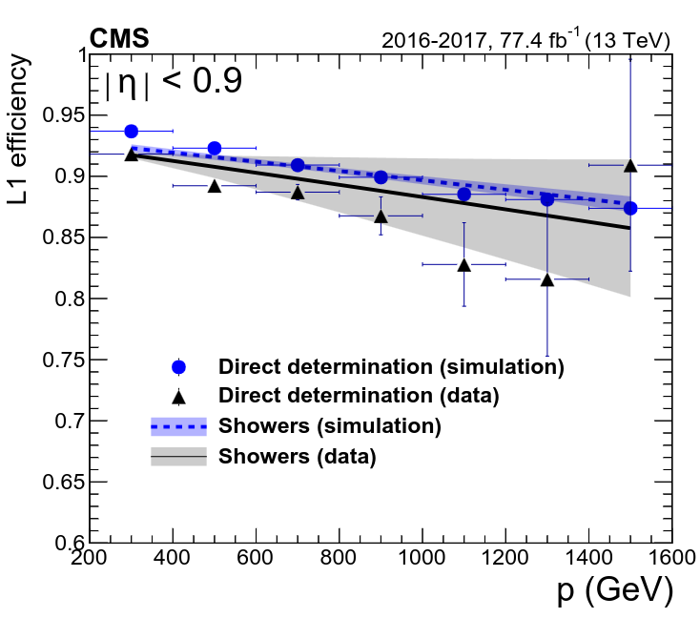
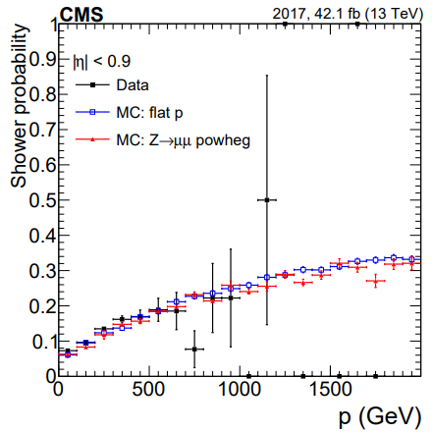
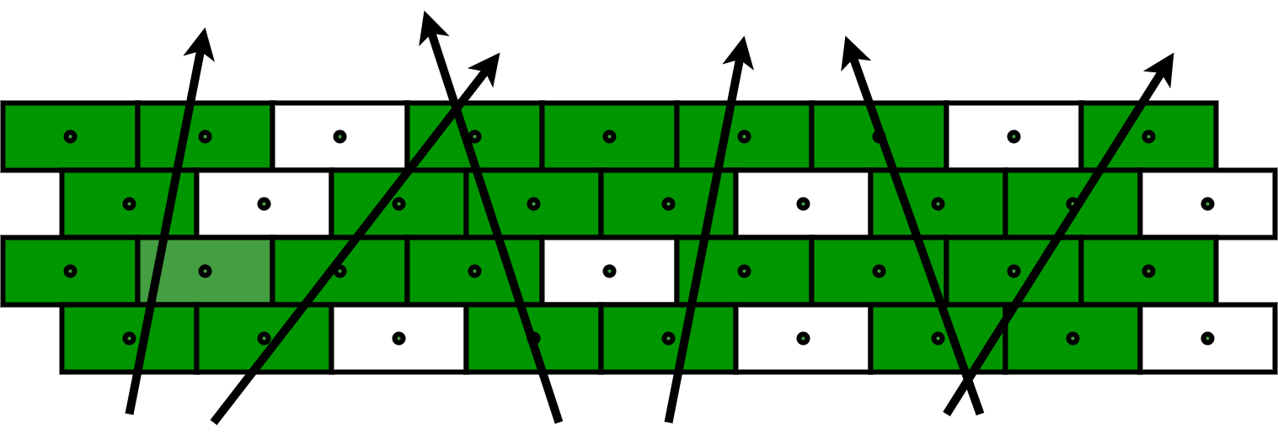
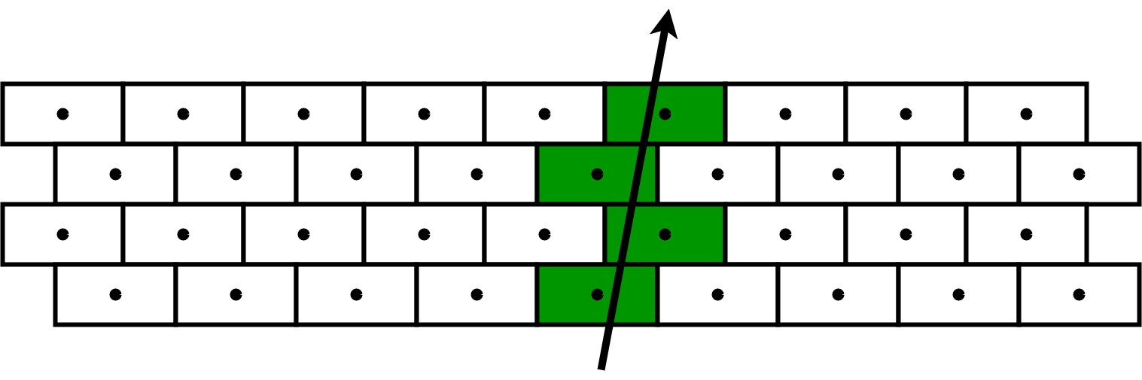

Step 2: use shower primitives
Use shower information to resolve interesting signatures...
Trigger efficiency is reduce by wrong reconstructed muons
$$μ$$
L1 Efficiency in barrel region as a function of P [1].
Probability to tag at least one shower in any of the four stations, as a function of the muon momentum for DTs [1].
III ICTEA Research Days
Trigger on Muon Showers | Daniel Estrada
5/6

Slide 10
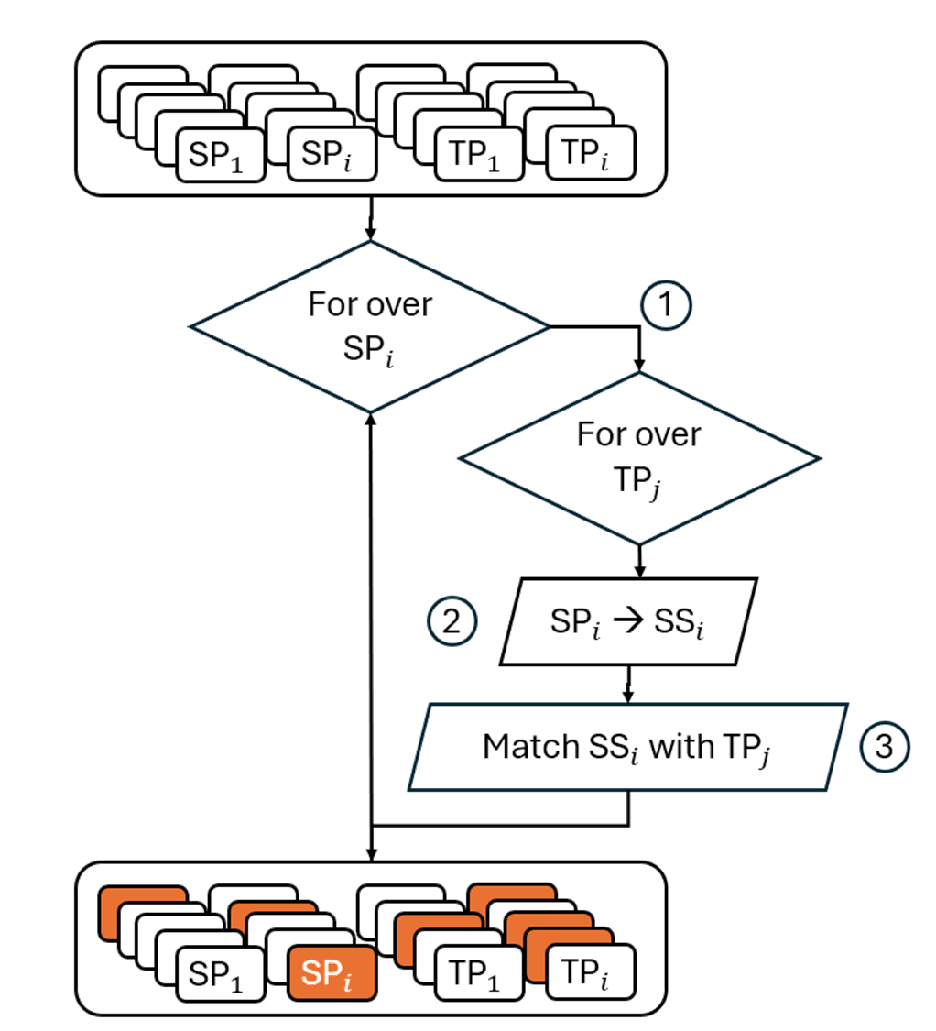
Step 2: use shower primitives
Use shower information to resolve interesting signatures...
For each shower, scan all TPs in adjacent sectors within a single wheel.
Represent the shower as a segment (SS) based on the Min and Max wire
Tag TPs that point to a SS
Goal: make tracking-trigger algorithms aware of showers in a muon path, so affected measurements can be excluded or treated cautiously.
III ICTEA Research Days
Trigger on Muon Showers | Daniel Estrada
5/6

Slide 11
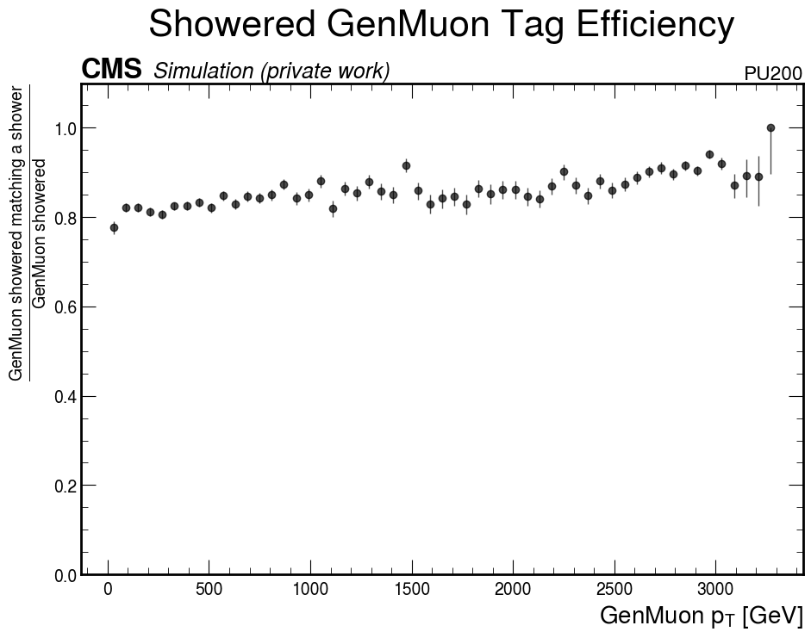
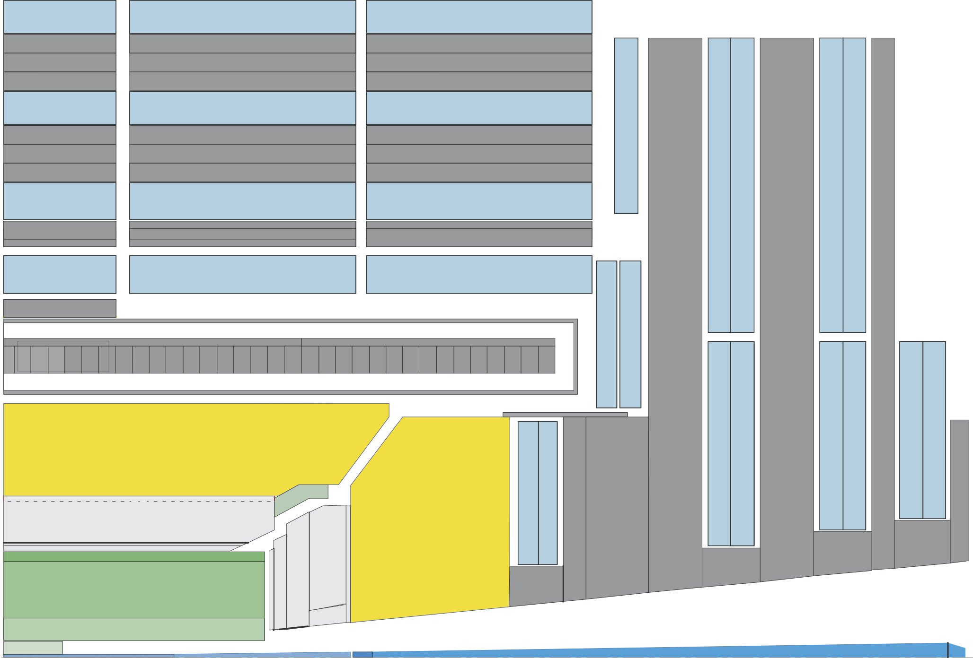
Step 2: use shower primitives
Use shower information to resolve interesting signatures...
Simulation identifies muons that radiate with more than 80% efficiency.
Hardware implementation is now under development.
The logic will also be extended to the longitudinal view of the experiment.
III ICTEA Research Days
Trigger on Muon Showers | Daniel Estrada
5/6

Slide 12
Step 2: use shower primitives
Use shower information to resolve interesting signatures...
Next studies will evaluate how SPs can identify displaced vertices, a potential signature of LLPs.
III ICTEA Research Days
Trigger on Muon Showers | Daniel Estrada
6/6

Slide 13
Thank you
Questions?
III ICTEA Research Days
Trigger on Muon Showers | Daniel Estrada

