Slide 1
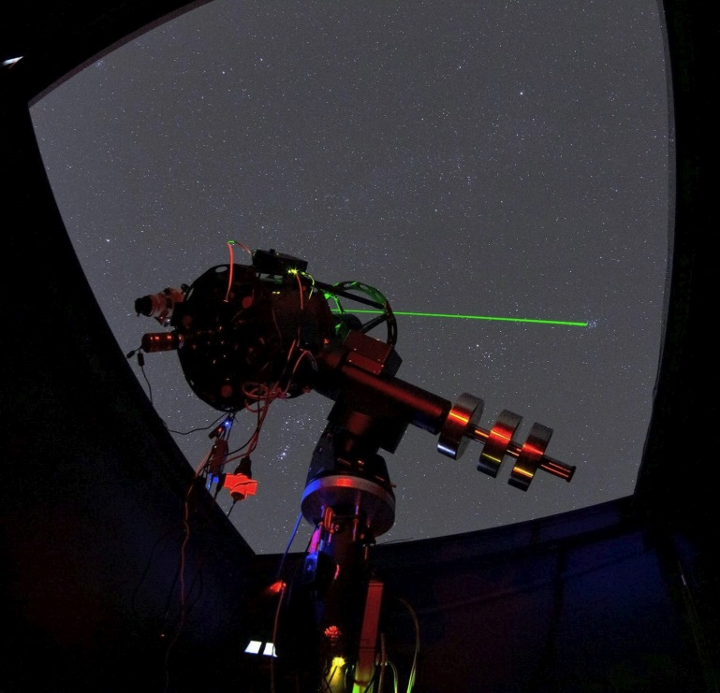
AUTOMATION OF DETECTION, LOCALIZATION AND CLASIFICATION OF ARTIFICIAL OBJECTS IN EARTH ORBIT USING SMALL TELESCOPES.
PROGRAMA DE DOCTORADO DE CIENCIAS Y TECNOLOGIAS DEL ESPACIO Y LA MATERIA
June 2026
Ramón Hevia Díaz.
Santiago Iglesias Álvarez.
Enrique Díez Alonso.

Slide 2
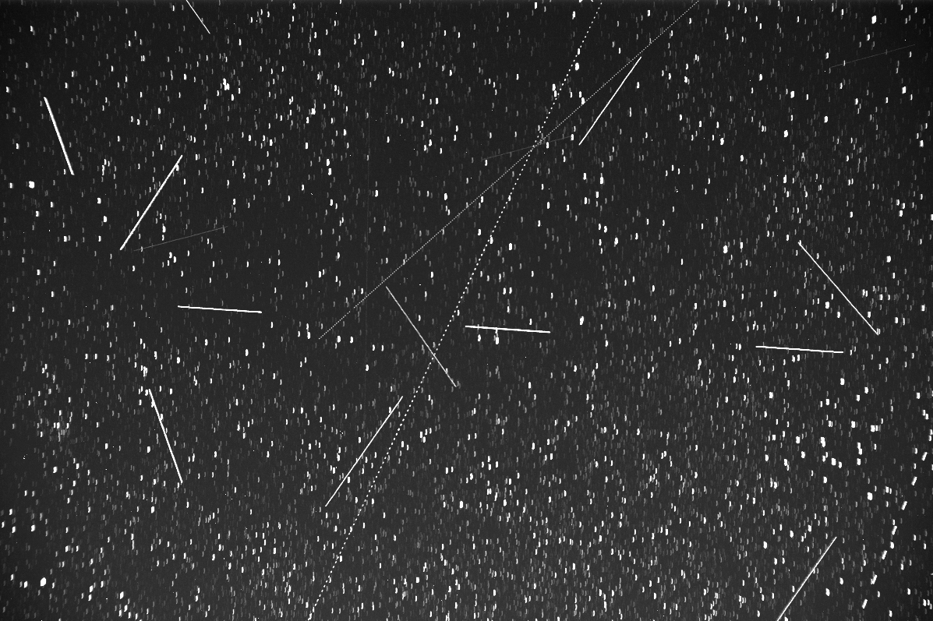
ABSTRACT
Since the launch of Sputnik in 1957, the number of satellites in orbit has increased exponentially. The recent deployment of satellites constellations, like Starlink, has intensified the impact on astronomical observations and on the space travels, due to the increase in space debris and its uncontrolled re-entry into the atmosphere.
The objective of this project is the development of a self-detection system for Near-Earth Objects within the framework of SST/SSA (Space Surveillance and Tracking / Space Situational Awareness) programs, focusing on artificial satellites/space debris and Near-Earth Asteroids (NEOs), using optical instrumentation and machine learning techniques.
The automation and application of Artificial Intelligence techniques will provide an easily replicable and network-coordinate system, with real-time data adquisition, wich offers and early-warning advantage in certain risk situations.

Slide 3
METHODOLOGY
REAL
SIMULATION

Slide 4
METHODOLOGY
La metodología de trabajo se plantea desde dos vias principales:
La adquisición real de imágenes y la generación artifical de las mismas.
En la adquisición real obtenemos dos tipos de imágenes, unas en las que aleatoriamente buscamos trazas de objetos y otra en la que hacemos seguimiento de objetos conocidos para capturar sus curvas de luz.
En las simulaciones realizamos el mismo procedimiento, generamos trazas sobre campos simulados, y por otro lado, simulamos curvas de luz de diversos objetos como etapas de cohetes, satélites artificiales (operativos o no).
TRAILS DETECTION
REAL
LIGHT CURVE
TRAILS DETECTION
SIMULATION
LIGHT CURVE

Slide 5
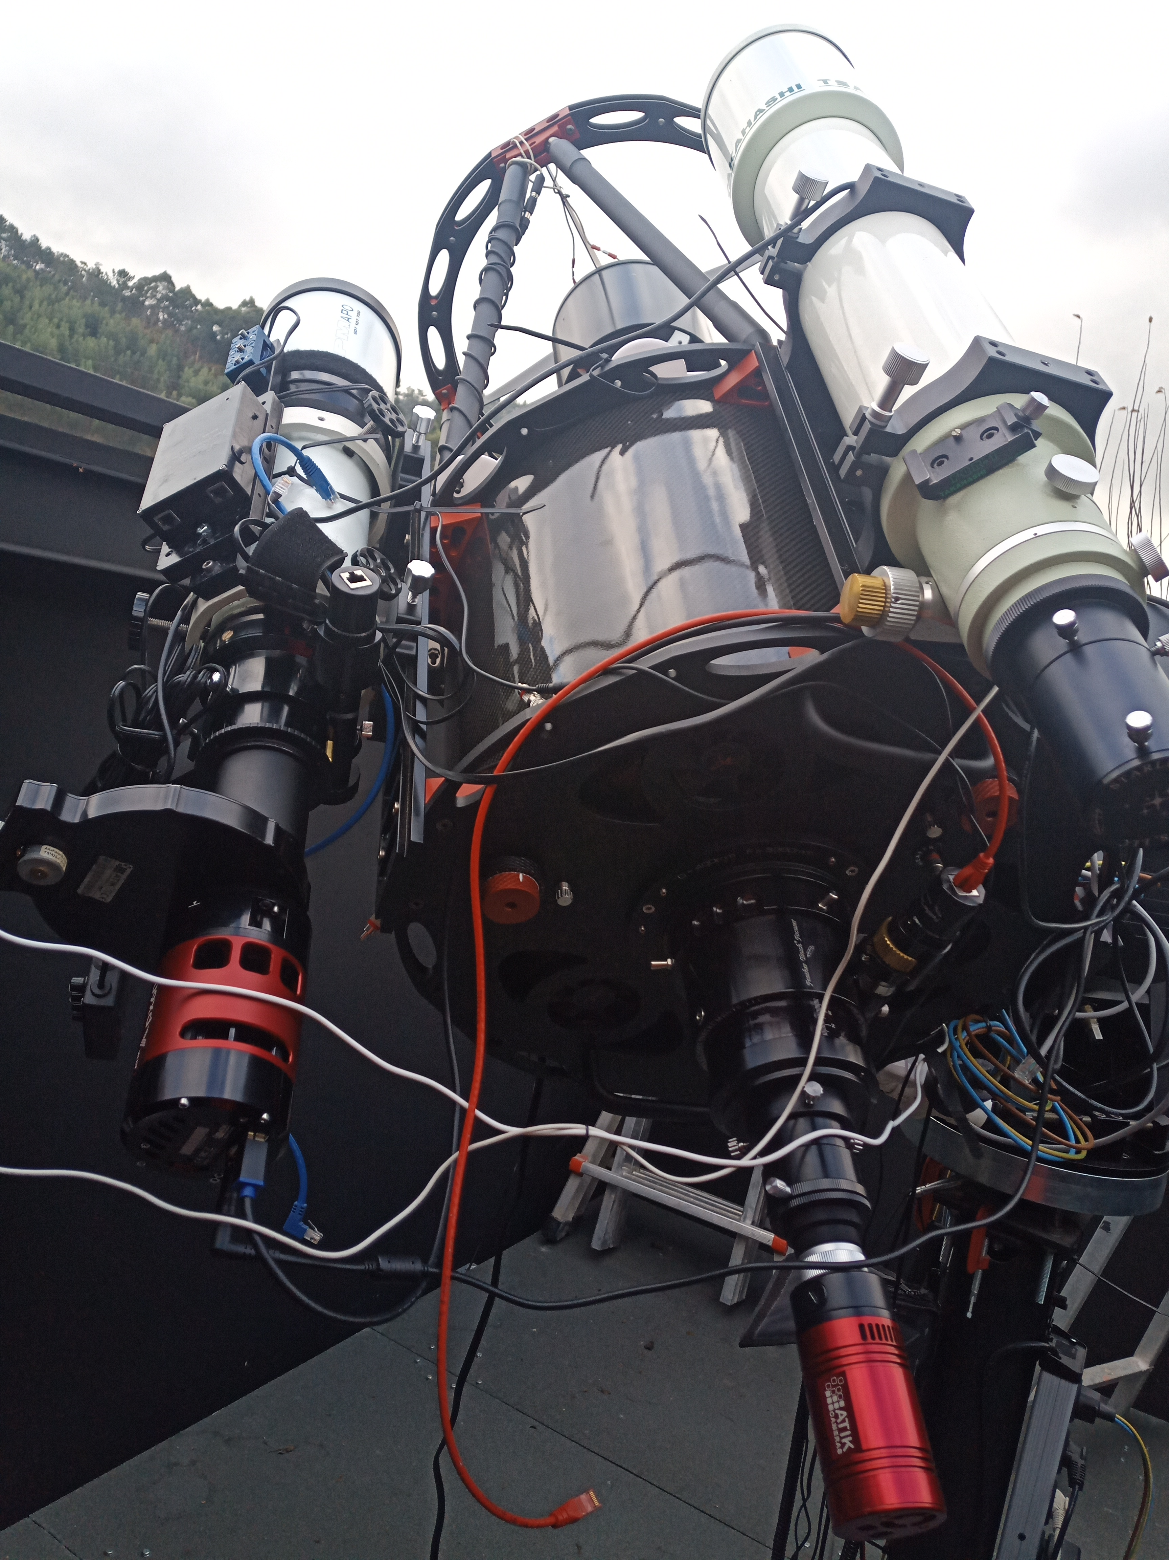
EQUIPMENT
Pillarno Observatory (Avilés, Asturias) 43° 31´N, 005° 59´W
-400 mm Ritchey-Chrétien telescope, focal length 3200mm (FOV: 0,64°x0,43°).
-Starlink<1s, GPS =77s.
-107 refractor, focal length 524 mm. (FOV: 4,0°x2,68°).
-Starlink= 5s, GPS= 300s.
-10 Micron 3000HPS II mount, (Tracking speed: 10°/s and satellite database configuration).
-Low Earth Orbit (LEO) satellites (300-700km altitude), typical angular velocity 1°/s.
-Medium Earth Orbit (MEO) satellites (2000-35000km altitude), typical angular velocity 30 arcsec/s.
-APX60 CMOS camera, quatum efficiency of 80% at 600 nm,
-low read noise: 1,2 e⁻.
-SLOAN photometric filters: Sloan r’ filter (560-700nm) = Block atmospheric oxygen emission line at 557,7nm.

Slide 6
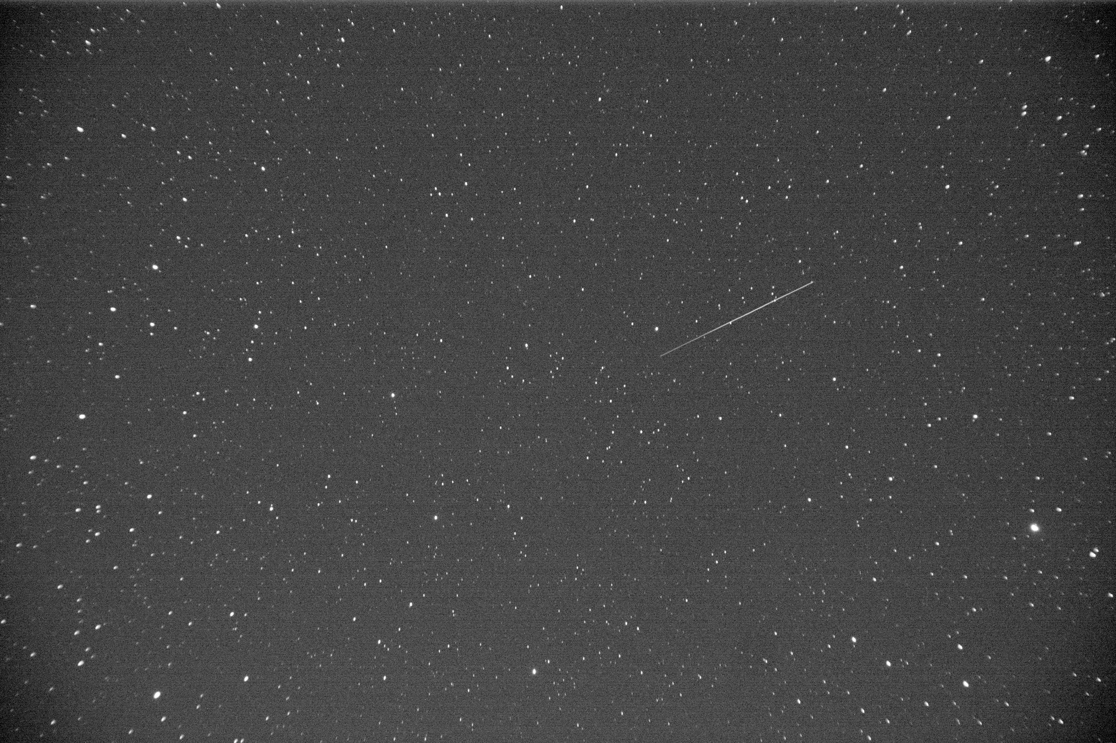
TRAILS DETECTION
200.000 images.
Random pointing without stellar tracking.
Allows have random star fields for AI training.
With the 512mm focal length configuration (FOV 4,0°x2,68°) the exposure time must be around 2-second keep the stars as point soucers.
Each observed track is 2-second transit duration.

Slide 7
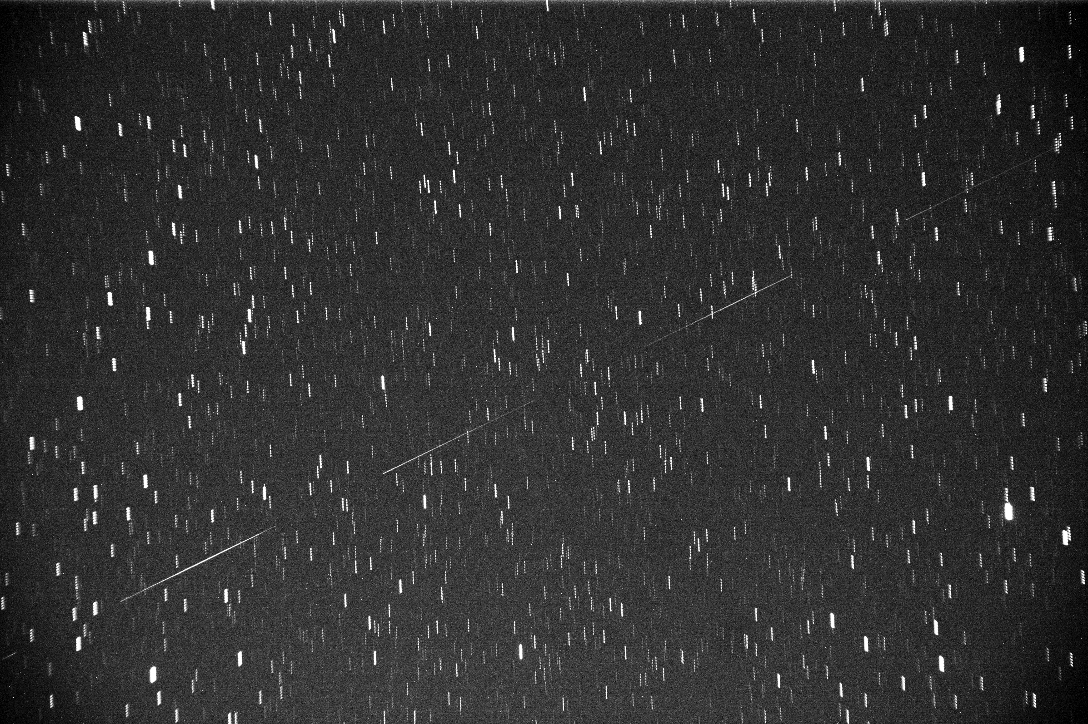

Slide 8
METHODOLOGY
TRAILS DETECTION
NO
YES
ARIANE 5 RB 28499
YES
DATA BASE
REAL
ROCKET
NO
LIGHT CURVE
YES
SATELLITE
STATUS
LIGHT CURVE
NO
SIMULATION

Slide 9
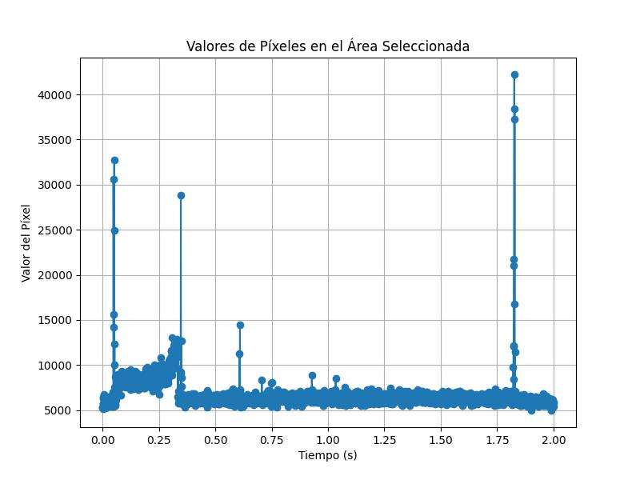
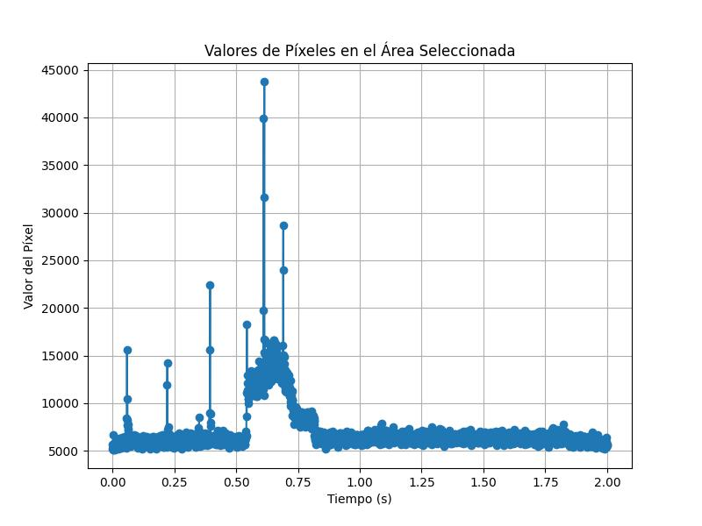
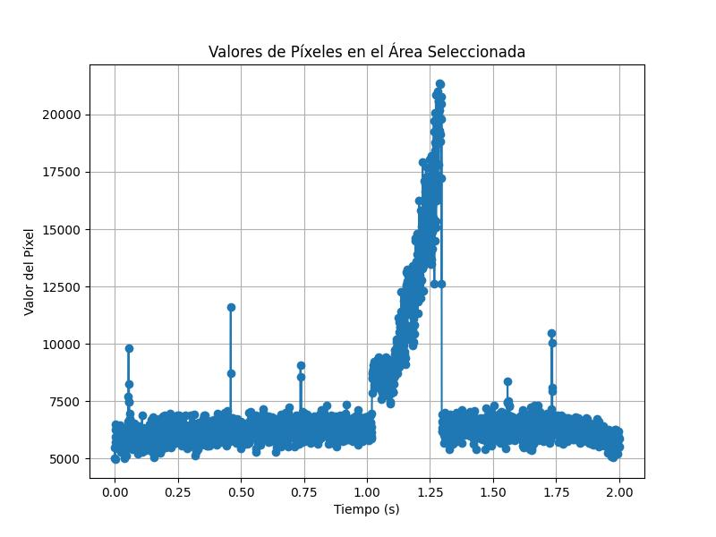
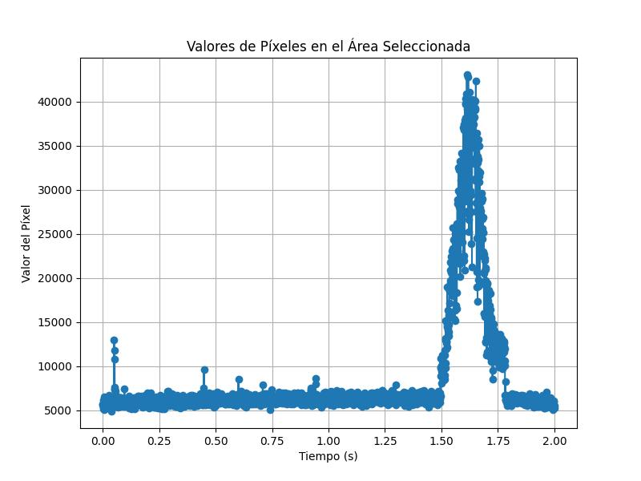
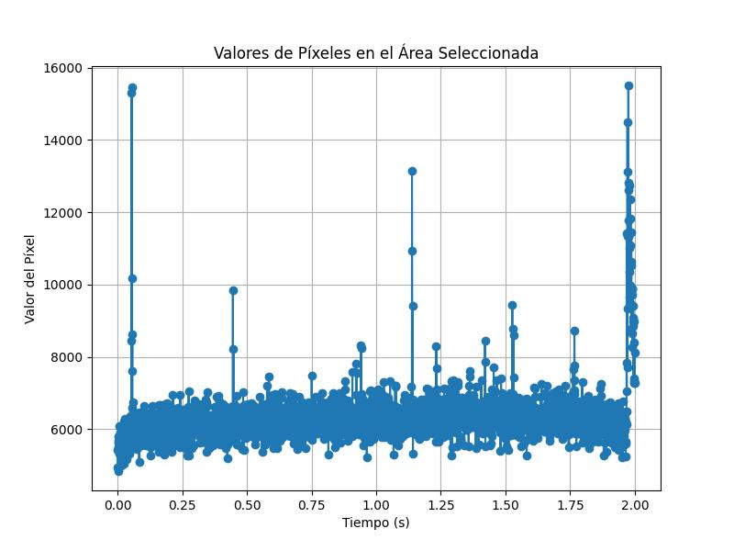

Slide 10
METHODOLOGY
TRAILS DETECTION
NO
YES
ARIANE 5 RB 28499
YES
DATA BASE
REAL
ROCKET
NO
LIGHT CURVE
YES
ROCKET
SATELLITE
STATUS
LIGHT CURVE
YES
NO
SATELLITE
STATUS
NO
SIMULATION

Slide 11
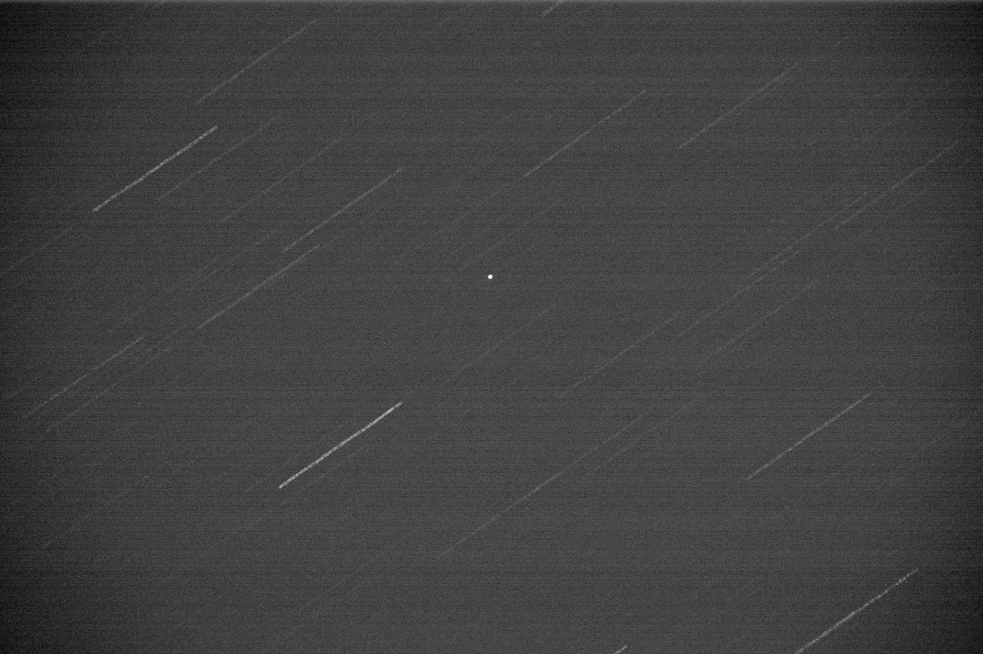
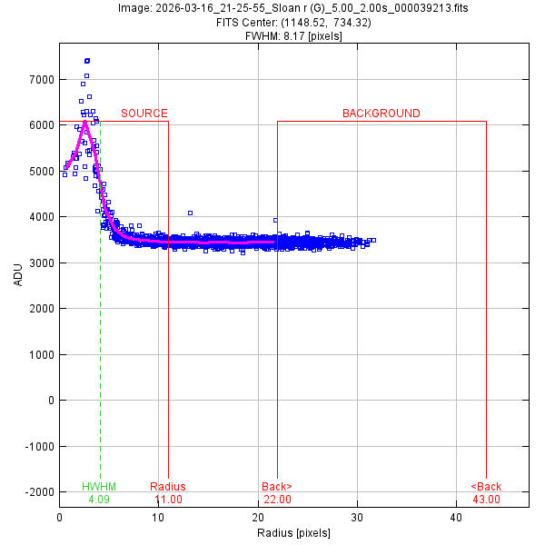
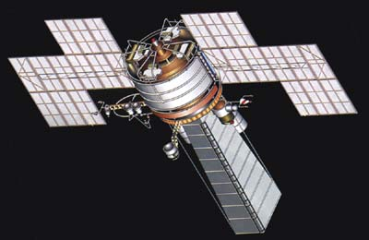
LIGHT CURVE
COSMOS 2084 20663
NORAD ID: 20663
Int'l Code: 1990-055A
Perigee: 551.4 km
Apogee: 559.6 km
Inclination: 62.8 °
Period: 95.6 minutes
Semi major axis: 6926 km
RCS: 8.1009 m² (large)
Launch date: June 21, 1990
Source: USSR
Launch site: PLESETSK MISSILE COMPLEX
Satellite database (TLEs) used for mount tracking, and during the transit, 2-second exposure images are adquired for light curve extraction and analisys.

Slide 12
METHODOLOGY
La metodología de trabajo se plantea desde dos vias principales:
La adquisición real de imágenes y la generación artifical de las mismas.
En la adquisición real obtenemos dos tipos de imágenes, unas en las que aleatoriamente buscamos trazas de objetos y otra en la que hacemos seguimiento de objetos conocidos para capturar sus curvas de luz.
En las simulaciones realizamos el mismo procedimiento, generamos trazas sobre campos simulados, y por otro lado, simulamos curvas de luz de diversos objetos como etapas de cohetes, satélites artificiales (operativos o no).
TRAILS DETECTION
NO
YES
ARIANE 5 RB 28499
YES
DATA BASE
REAL
ROCKET
NO
LIGHT CURVE
YES
ROCKET
SATELLITE
STATUS
LIGHT CURVE
YES
NO
SATELLITE
STATUS
NO
TRAILS DETECTION
SIMULATION
LIGHT CURVE

Slide 13
METHODOLOGY
La metodología de trabajo se plantea desde dos vias principales:
La adquisición real de imágenes y la generación artifical de las mismas.
En la adquisición real obtenemos dos tipos de imágenes, unas en las que aleatoriamente buscamos trazas de objetos y otra en la que hacemos seguimiento de objetos conocidos para capturar sus curvas de luz.
En las simulaciones realizamos el mismo procedimiento, generamos trazas sobre campos simulados, y por otro lado, simulamos curvas de luz de diversos objetos como etapas de cohetes, satélites artificiales (operativos o no).
TRAILS DETECTION
NO
YES
ARIANE 5 RB 28499
YES
DATA BASE
REAL
ROCKET
NO
LIGHT CURVE
YES
ROCKET
SATELLITE
STATUS
LIGHT CURVE
YES
NO
SATELLITE
STATUS
NO
NO
TRAILS DETECTION
YES
LIGHT CURVE
SIMULATION
LIGHT CURVE

Slide 14
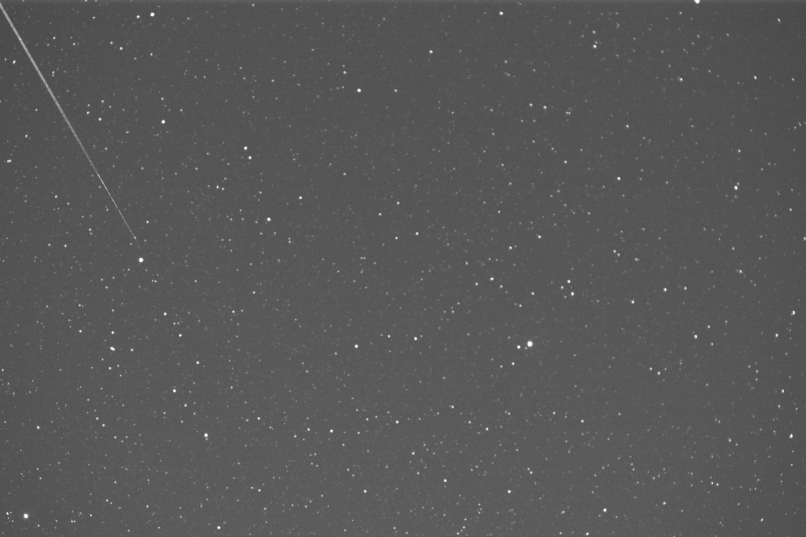
TRAILS DETECTION
-Machine Learning to detect trails in astronomical images.
-Based on a wavelet-transform encoder that feeds a Random Forest binary classifier.
-Using both real and simulated data.
-Injection of synthetic stars circular Gaussian PSFs.
-Synthetic trail generation. Position, orientation, lenght and intensity are all random.
-Preservation de real noise and sky background structure.

Slide 15
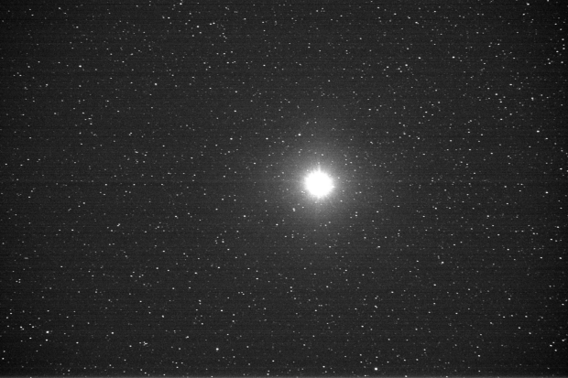
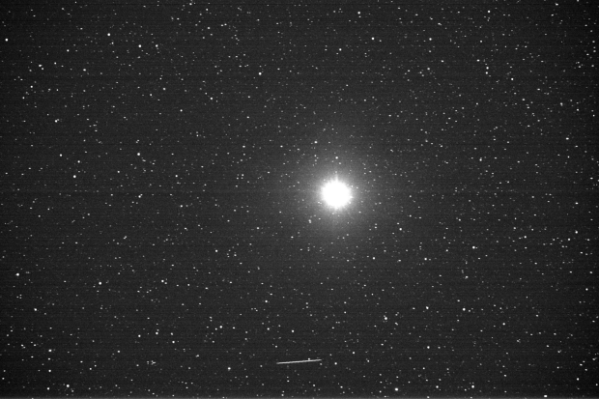
-Real dataset: 5097 images, 792 with trails and 4305 do not.
NOTE: Images used to generate the simulated samples – not included in training process (overfitting).
Additional set of 1366 real images from a separated observing used for simulations.
Random Forest Model:
-Accuracy of 0.9716
-False positive rate 0.0093

Slide 16
METHODOLOGY
TRAILS DETECTION
NO
YES
ARIANE 5 RB 28499
YES
DATA BASE
REAL
ROCKET
NO
LIGHT CURVE
YES
ROCKET
SATELLITE
STATUS
LIGHT CURVE
YES
NO
SATELLITE
STATUS
NO
NO
TRAILS DETECTION
YES
LIGHT CURVE
SIMULATION
LIGHT CURVE
ROCKET
YES
SATELLITE
STATUS
NO

Slide 17
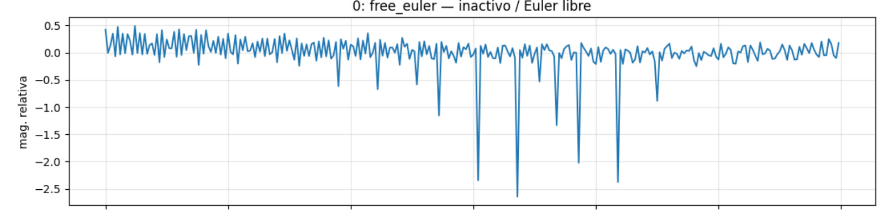
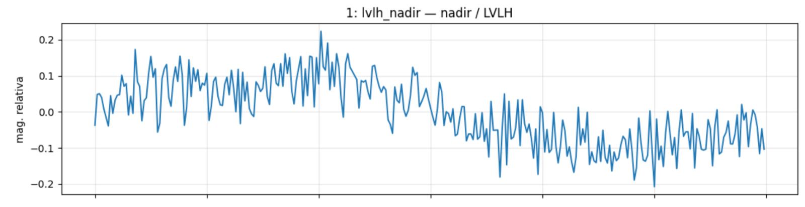
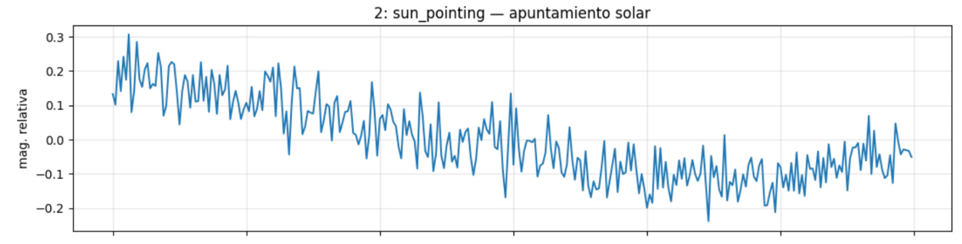
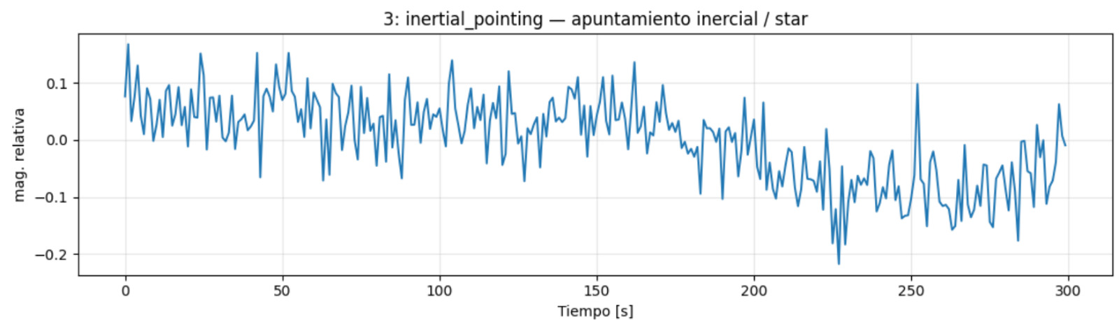
CUBESAT Tumbling (non-operational)
CUBESAT Nadir (Earth pointing)
CUBESAT Sun pointing
CUBESAT stars pointing

Slide 18
