Slide 1
Activities on spacecraft power systems within the University of Oviedo
Pablo F. Miaja, Jose Antonio Fernández, Miguel Fernández, Abraham López, Theyllor Hentschke, Manuel Arias

Slide 2
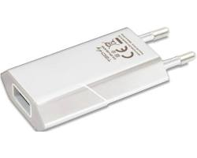
What the hell is power electronics?
Notes:
One of the most important activities you may never Heard of. It is a Good thing you never Heard of it becaus that meas that is not giving any problem
Is the discipline in which electronic devices are used to transform electrical energy
Is everywhere, is a commodity, It Powers everything, vehicles, medical equiplement Inside chips, Powering processors and AI systems, Powering datachenters, spacecraft all sort of equipment.
Goal: Efficiency, size
Example Cell charge 220 V in the mains to 5 V now 100s of Watts in a very small size GaN comparison to few years ago
Origin in Space applications IEEE Transactions on Aerospace
Broad discipline: Power electronic devices, Analog and digital control, magnetic element design, EMI/EMC, Thermal
Las to fund first to blame

Slide 3
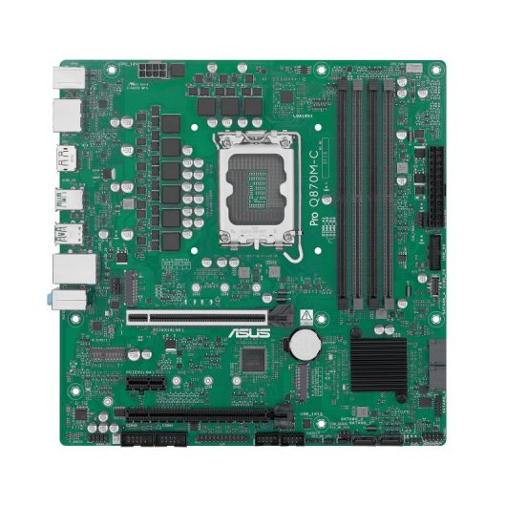
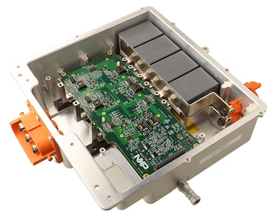
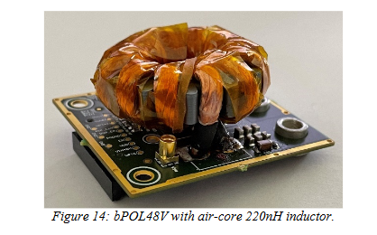
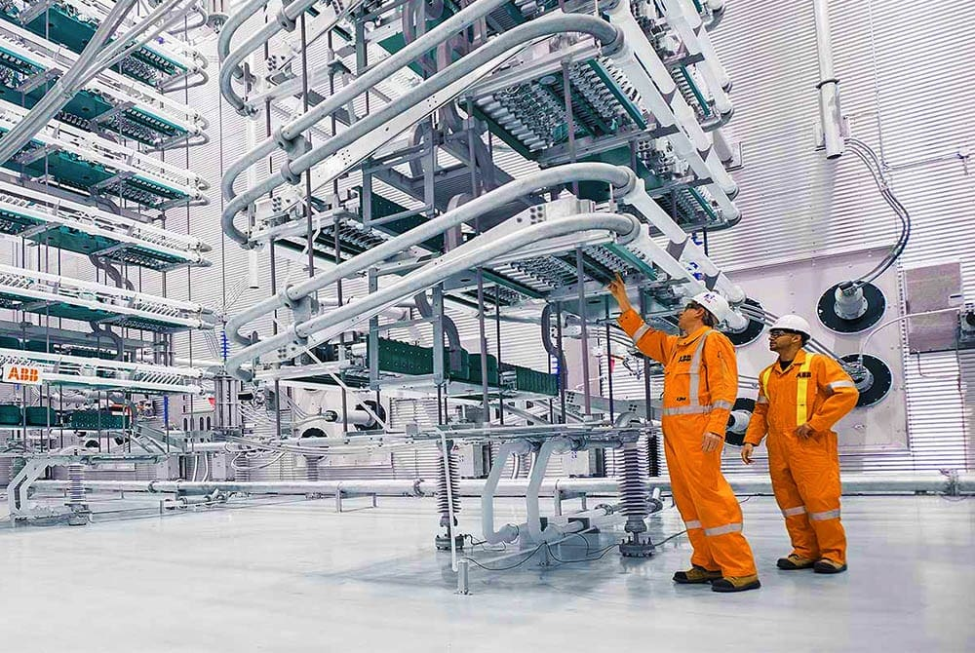
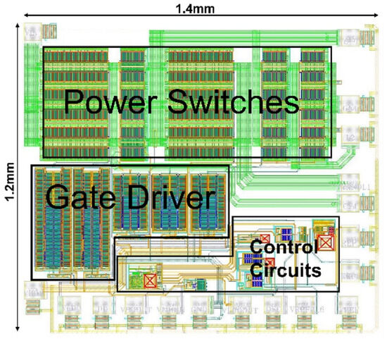
What the hell is power electronics?
Notes:
One of the most important activities you may never Heard of. It is a Good thing you never Heard of it becaus that meas that is not giving any problem
Is the discipline in which electronic devices are used to transform electrical energy
Is everywhere, is a commodity, It Powers everything, vehicles, medical equiplement Inside chips, Powering processors and AI systems, Powering datachenters, spacecraft all sort of equipment.
Goal: Efficiency, size
Example Cell charge 220 V in the mains to 5 V now 100s of Watts in a very small size GaN comparison to few years ago
Origin in Space applications IEEE Transactions on Aerospace
Broad discipline: Power electronic devices, Analog and digital control, magnetic element design, EMI/EMC, Thermal
Las to fund first to blame

Slide 4
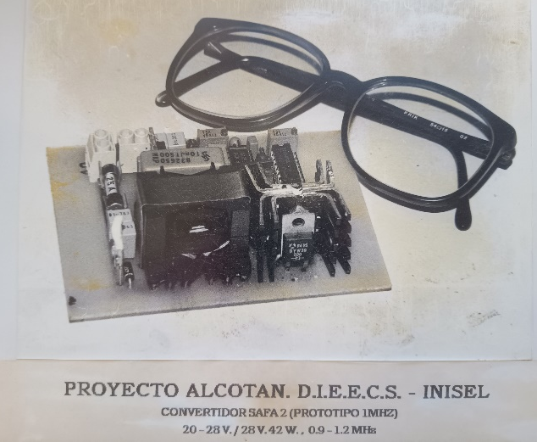
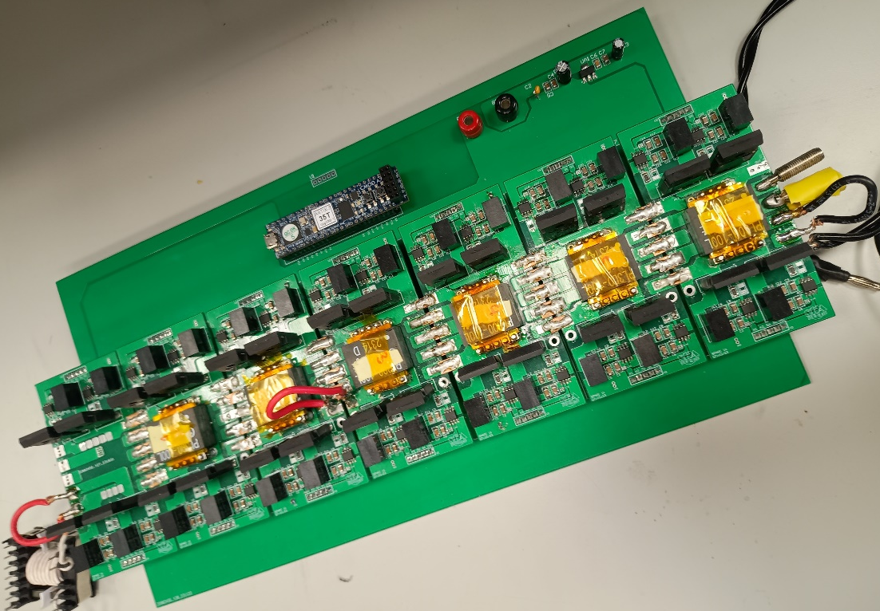
Experience
Over 40 years of combined experience in Power Supplies
Notes:
Powe supply systems group can be traced back to 40 years ago, Based on Gijon
First example Analog control, Mhz switching
2 nd example Digital control, several convertesr working in coordination

Slide 5
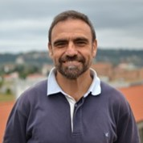
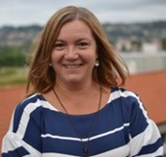
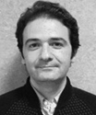
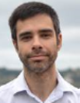
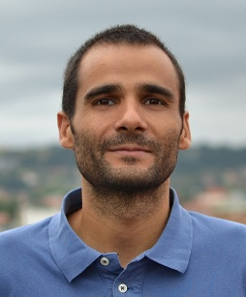
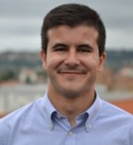



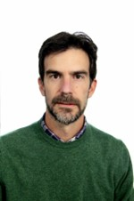
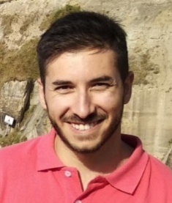
Manpower
Javier Sebastian
Full Professor
Marta M. Hernando Full Professor
Diego G. Lamar
Full Professor
Manuel Arias
Full Professor
Alberto Rodriguez
Full Professor
Aitor Vazquez Associate Professor
Pablo F. Miaja Assistant Professor
Juan Rodríguez . Assistant Professor
Notes:
8 permament professors

Slide 6
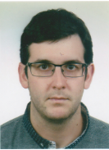
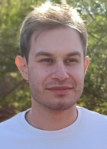
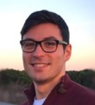
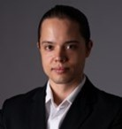
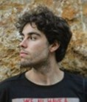
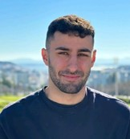
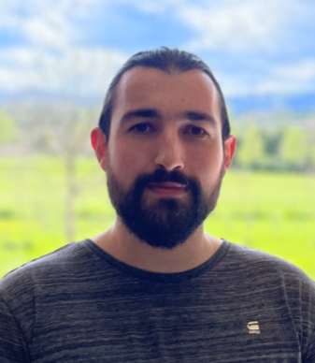
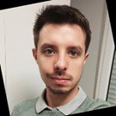
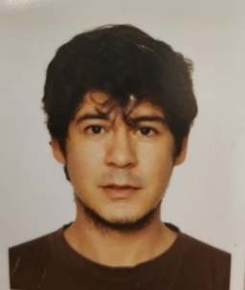
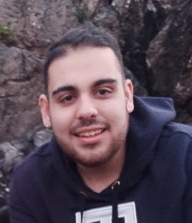
Manpower
Abraham Lopez
Alexis Gomez
Miguel F. Costales
Theyllor H. De Oliveira
Juan Ramon García
Pablo Mateos
Jose Antonio Alvarez
Gabriel D. Colvero
Alberto Jose Cárcamo
Jairo Tuñon
Notes:
10 researchers pot-doc and pre-doc

Slide 7

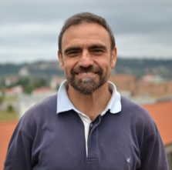


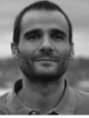
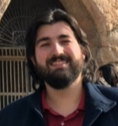
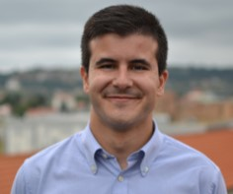
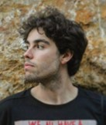
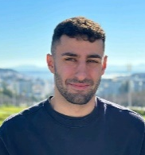
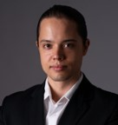
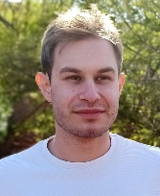
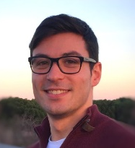
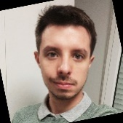
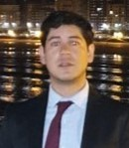
What do we work on now:
Space Applications
Electric transportation
High performance DC/DC converters
Notes:
Topologies and means of increasing the performance of DC/DC converters . Auxiliary supplies for trains

Slide 8
Space activities
Component
Subsystem
System

Slide 9
Spacecraft power system
CC/CC #1
Batería
Bus
control interno
CC/CC #2
control interno
CC/CC #3
control interno
Notes:
Electrical energy is distributerd throudh a DC bus. Distribution analogous to the protection switches we have at home. Loads have also convererters. SAR adapts sun energy to the bus. Battery is managed by BDR and BCR. Each of the blocks have converters. MEA guaranttes taht the bus voltage is fixed to a value. Very high qualitye DC distribution. Solar Array is the main source of energy

Slide 10
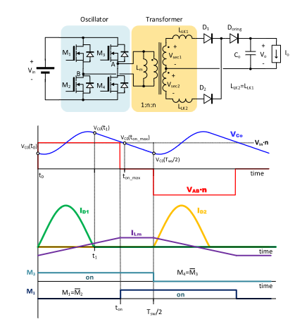
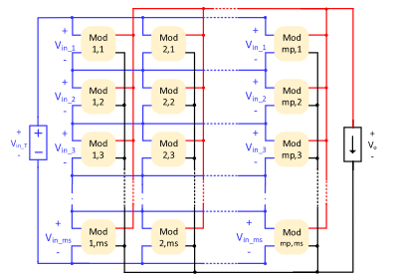

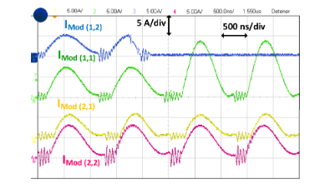
Modular DCX blocks
Objectives:
Fixed transfer ratio. No regulation possible.
Modular design. Automatic power sharing. Failure tolerant.
Several applications: Primary and secondary power systems, Direct Drive architectures
Notes:
Teh converters in each of the diffferent blocks are designed ad-hoc.
Long process. I have an experience of having a full design and qualification process to change one transistor and 1 transformer so a power supply working at 50 V cpudl work at 100 V.
Desigh DCX blocks. Combien them to achieve wider voltaje conversión, increase the power handling and introduce fault tolerance. Compact and with decentralized control

Slide 11
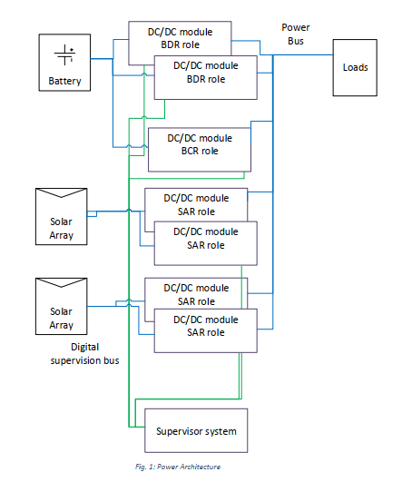
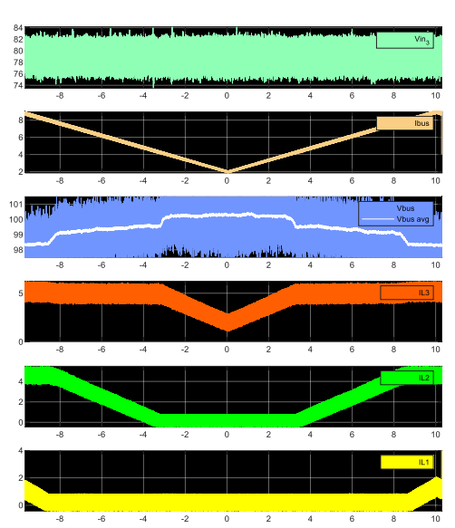
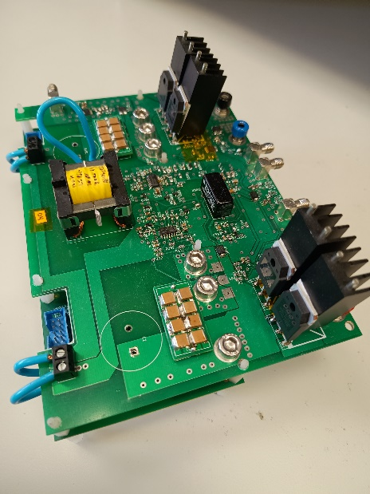

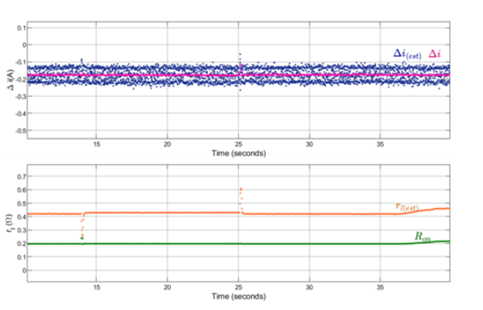
Power system building blocks
Objectives:
Study and development of different decentralized controls for having multiple converters working in the different roles of satellite power system.
Increase the redundancy and introduce health estimation processes to evaluate the status the converters.
Notes:
Have the same hardware for BCR, BDR and SAR. Change the role by different FPGA programming.
Achieve bus regulation without centraliced controller better reliability
Estimate the degradation of the converters. Introduce preventive maintenace.

Slide 12
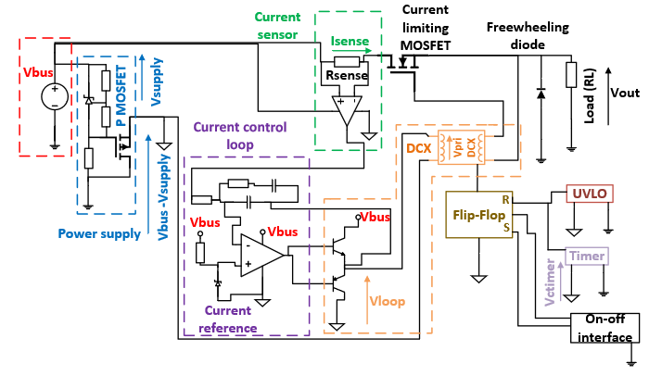
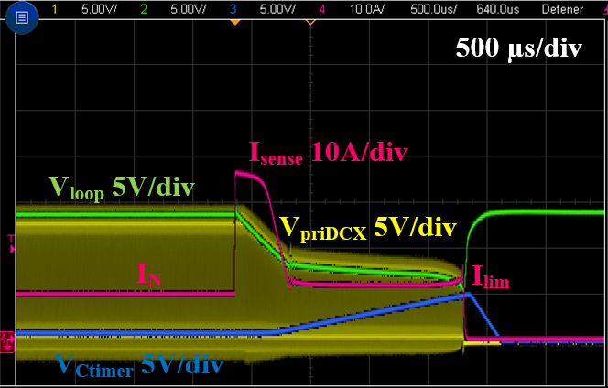
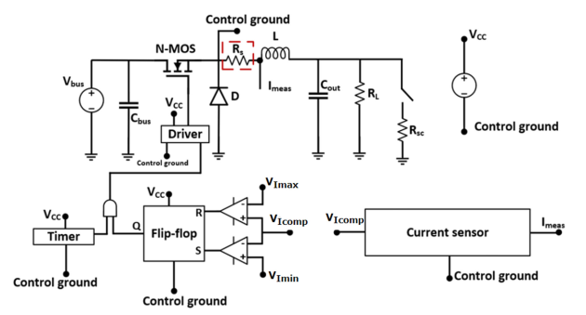
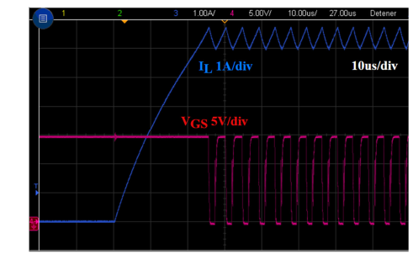
Research on LCLs
Objectives:
Introduce the use of SiC devices in Latching Current Limiters.
Redesign LCLs to use N-Channel SiC MOSFETs.
Design switching class LCLs.
Notes:
LCLs are the protección devices. Microsecond response. Limit the current.
Normally based on dissipating power, very fast but limited. 100 V 10 A dissipates 1 kW. Thermal problems
Use other semiconductors SiC very useful in power application such EV.
Go to switching mode ones.

Slide 13
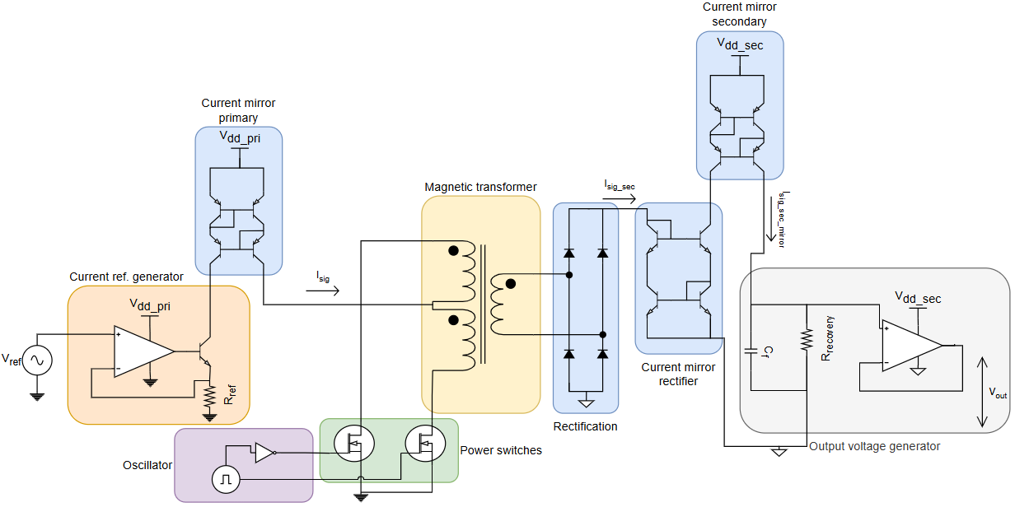
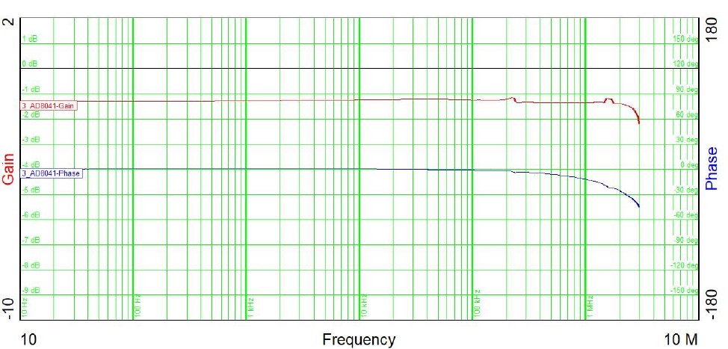


Replacing optocuplers
Objectives:
Design magnetic isolator circuit to transfer the feedback control loop of DC/DC converters
Based on discrete, European components.
Wide bandwidth (almost 1 MHz).
Notes:
Isolated power supplies need to overcome electrical isolation.
In terrestrial applications optocouplers are used. Problems in radiation. Magnetic based designs.

Slide 14





Integrating RTGs and Solar Arrays in Power Systems
Objectives:
Power system sizing
Management of Radiosotope Thermal Generators into a power system.
Notes:
Thermoelectric radiosotope generators. Leicester is the only european source.
Simulation models. Power system architectures
MPPT determination. Thermal issues, thermal determined response

Slide 15



Full system studies: Robocrane
Ingeniería de los Procesos de Fabricación
Objectives:
Deploy and provide communications and power for a group of robots exploring Lunar lava tubes
Notes:
Interdisciplinar study. Funded by ESA. Origin of several Research contracts. Challenges to explore lava tubes. Our goal is to deploy an dprovide communications and power to exploring robots inside the tuve. No Solar light no communicatiosn toe earth.

Slide 16

Full system studies: Robocrane
Ingeniería de los Procesos de Fabricación
Objectives:
https://www.youtube.com/watch?v=Cuc6AEKS-uw

Slide 17
Activities on spacecraft power systems within the University of Oviedo
Thank you very much for your attention

